Slide 1
Software Testing
Name: Sandeep Kalla

Slide 2
Agenda
What is Software Testing
Types of Testing
Methods Of Testing

Slide 3
Software Testing
Software testing is a technique to check whether the actual result matches the expected result and to ensure that the software has not any defect or bug.
The purpose of software testing is to identify errors, gaps or missing requirements in contrast to actual requirements.
Notes:
Software testing is defined as the execution of a program to find its faults. While more time typically is spent on testing than in any other phase of software development, there is considerable confusion about its purpose. Many software professionals, for example, believe that tests are run to show that the program works rather than to learn about its faults.
Myers has provided some useful testing definitions:
Testing
The process of executing a program (or part of a program) with the intention of finding errors.
Verification
An attempt to find errors by executing a program in a test or simulated environment (it is now preferable to view verification as the process of proving the program’s correctness)
Validation
An attempt to find errors by executing a program in a real environment.
Debugging
Diagnosing the precise nature of a known error and then correcting it (debugging is a correction and not a testing activity)
Verification and validation are sometimes confused. They are, in fact, different activities. The difference between them is succinctly summarized by Boehm:
‘Validation: Are we building the right product?’
‘Verification: Are we building the product right?’

Slide 4
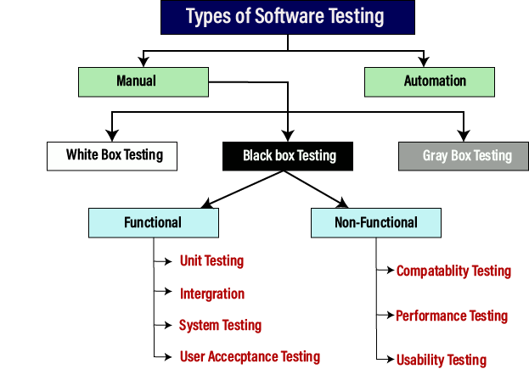

Slide 5
What is Manual And Automation Testing
Manual testing
The process of checking the functionality of an application as per the customer needs without taking any help of automation tools is known as manual testing.
Automation testing
Automation testing is a process of converting any manual test cases into the test scripts with the help of automation tools, or any programming language is known as automation testing.

Slide 6
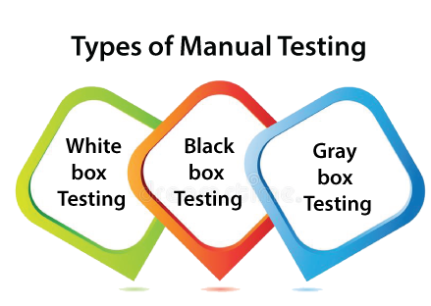

Slide 7
Functional Testing
Unit Testing (White Box)
Integration Testing
Function Testing (Black Box)
Regression Testing
System Test

Slide 8
Unit Testing (White Box)
It is the first level of functional testing.
Individual components are tested.
It is a path test.
To focus on a relatively small segment of code and aim to exercise a high percentage of the internal path
Disadvantage: the tester may be biased by previous experience. And the test value may not cover all possible values.
Notes:
When unit tests are done on a white box basis, they are essentially path test. The idea is to focus on a relatively small segment of code and aim to exercise a high percentage of the internal paths. The simplest approach is to ensure that every statement is exercised at least once. A more stringent criterion is to require coverage of every path within a program.
One disadvantage of white box testing is that the tester may be biased by previous experience. The tests are often designed by the programmers who produced the code since they may be the only ones who understand it. Unfortunately, those who created the programs’ faults are least likely to recognize them. Even though all the paths and variable of the program have gone through by the testing program, it could not guarantee all possible values of the variables have been tested.
While its disadvantages are significant, white box testing generally has the highest error yield of all testing techniques.

Slide 9
Integration Testing
It is the second level of the software testing process comes after unit testing.
units or individual components of the software are tested in a group.
To expose defects at the time of interaction between integrated components or units.
Unit Testing uses modules for testing purpose, and these modules are combined and tested in integration testing.
Notes:
This phase involves testing of modules which have been integrated in sub-system. A module is a collection of dependent components such as object class, and abstract data type of some looser collection of procedures and functions.
On very large system it is often wise to do integration testing in several steps. Such systems generally have several relatively large components that can be built and integrated separately before combination into a full system.
Integration Testing is divided into Top-down Integration Test and Bottom-up Integration Test.

Slide 10
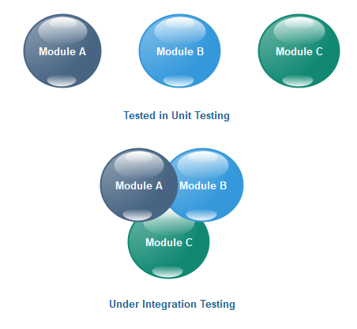
Once all the components or modules are working independently, then we need to check the data flow between the dependent modules is known as integration testing.
Example of a banking application:
First, we will login as a user P to amount transfer and send Rs200 amount, the confirmation message should be displayed on the screen as amount transfer successfully. Now logout as P and login as user Q and go to amount balance page and check for a balance in that account = Present balance + Received Balance. Therefore, the integration test is successful.
Also, we check if the amount of balance has reduced by Rs200 in P user account.
Notes:
Top-down Integration Test starts with the most abstract components and works downwards.
It tests the high levels of a system before testing its detailed components. The program is represented as a single abstract component with sub-components represented by stubs.
Top-down Integration Test is essentially a prototyping philosophy. The initial tests establish a basic system skeleton from the top and each new module adds capability. The problem is that functions of the lower-level modules that are not initially present must by simulated by program stubs. While producing such stubs may at first seem easy, it would be more difficult as more stub add on it. It may be difficult or impossible to test certain logical conditions such as error handling.

Slide 11
Function Testing (Black Box)
Used to verify the functionality of the software application Testers not biased by knowledge of the program’s design.
It also called as black-box testing.
Each function tested by giving the value, determining the output, and verifying the actual output with the expected value.
Notes:
Since exhaustive black box testing is generally impossible, these test should be viewed as statistical sampling; when errors are found, a closer examination is required. Functional testing stars by examining the functions the program is to perform and devising a sequence of inputs to test them.

Slide 12
Regression Testing
Test the effects of the newly introduced changes on all the previously integrated code.
Test cases are re-executed to check the previous functionality of the application is working fine, and the new changes have not produced any bugs.
It can be performed on a new build when there is a significant change in the original functionality.
Regression means Re-test those parts of the application, which are unchanged.
Notes:
The progressive phase introduces and tests new functions, uncovering problems in the newly added or modified modules and in their interfaces with the previously integrated modules. The regressive phase concerns the effect of the newly introduced changes on all the previously integrated code. Problems arise when errors made in incorporating new functions affect previously tested functions.
The basic regression testing approach is to incorporate selected test cases into a regression test bucket that is run periodically in an attempt to detect regression problems. Usually the full bucket is run only occasionally, but the subset is run against every spin. The spin subset should include all the test cases for any recently integrated functions and a selected sample from the full regression bucket.

Slide 13
A Comparison of Testing Methods
Black-Box Testing
White-Box Testing
The internal workings of an application need not be known.
Also known as closed-box testing, data-driven testing, or functional testing
Performed by end-users and also by testers and developers.
Testing is based on external expectations - Internal behavior of the application is unknown.
It is exhaustive and the least time-consuming.
This can only be done by trial-and-error method.
Tester has full knowledge of the internal workings of the application.
Also known as clear-box testing, structural testing, or code-based testing.
Normally done by testers and developers.
Internal workings are fully known and the tester can design test data accordingly.
The most exhaustive and time-consuming type of testing.
Data domains and internal boundaries can be better tested.

Slide 14
References
www.google.com
www.wikipedia.com
www.javatpoint.com
www.guru99.com

Slide 15
THANKS

