Slide 1
Deep Learning Project Presentation
Karl-Johan Djervbrant

Slide 2
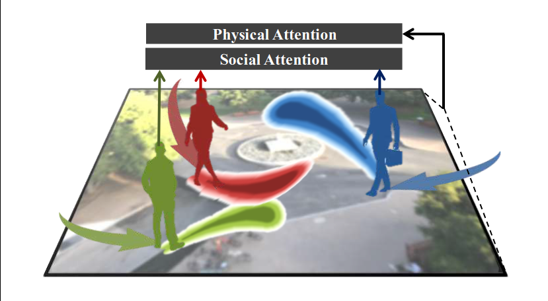
Review
"SoPhie: An Attentive GAN for Predicting Paths Compliant to Social and Physical Constraints" by Sadeghian et al.
A model for trajectory estimation of multiple agents
Deal with physical and social constraints
Image adopted from Sadeghain et al.

Slide 3
Review
Combines LSTM and GAN with two attention modules
A physical- and social attention module
The model can be divided in to three modules
Feature extraction
CNN for image data
Other agent information with a novel method using LSTM
Attention modules with pre-initialized weights
LSTM-GAN to generate trajectories

Slide 4
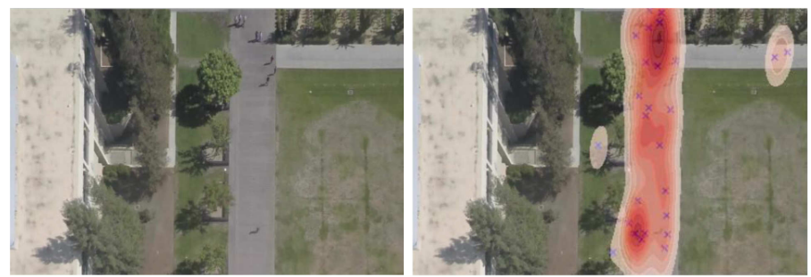
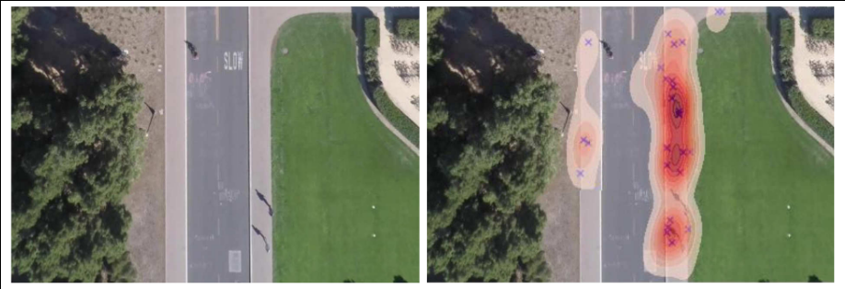
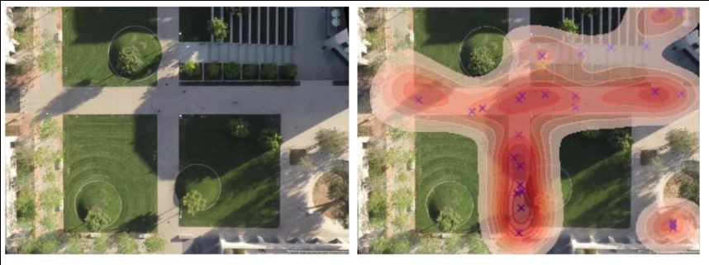
Review
State-of-the-art performance on five of six datasets
(Against 5 other models)
Traversable paths from sample points
Image adopted from Sadeghain et al.

Slide 5
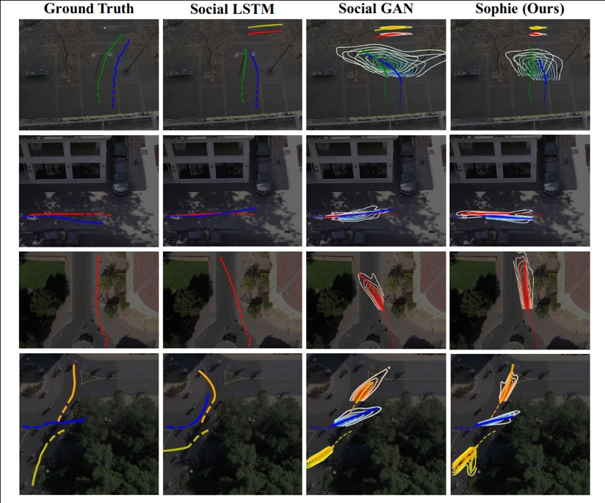
Review
Trajectory prediction with multiple agents
Image adopted from Sadeghain et al.

Slide 6
Review
Short commings
No images of output from other models on traversable paths from sample points
Socaial collision distance is set to 0.1m
Datasets used were not developed for social and physical constraints
They combat this by using simple metrics

Slide 7
GAN Project

Slide 8
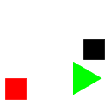
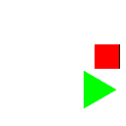
Last frame prediction - GAN

Slide 9
Methodology
Inspect the provided model
How is it structured?
How does it perform?
Setup the environment
Store the metrics
Visualize the data
Store the model
Do research on other models
Pix2pix
Wasserstein GAN
Least Squared GAN

Slide 10
LSGAN
Introduced by Xudong Mao et al. In “Least Squares Generative Adversarial Networks”, 2016.
Addresses vanishing gradients by punishing generated images which are far from the decision boundary
Easy to implement!
Can be implemented with
L2 (MSE) loss
Linear activation function as output in the discriminator
1 = real, 0 = false

Slide 11
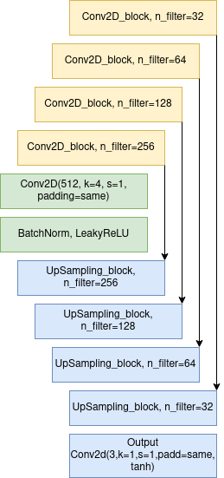
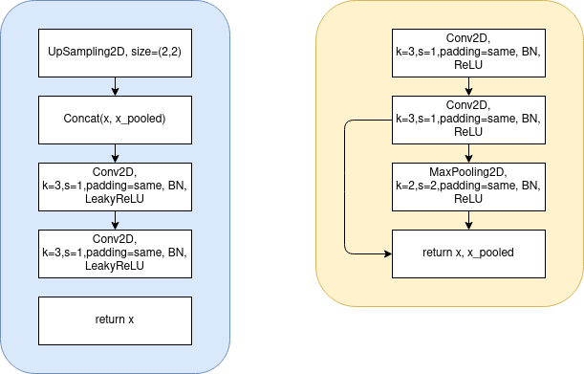
Generator

Slide 12
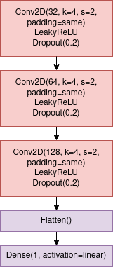
Discriminator

Slide 13
Parameters
MSE as loss
Adam optimizer, beta=0.5
Generator LR=0.0002
Discriminator LR=0.0002
LeakyReLU alpha=0.2
Data Augmentation
Vertiacal flip
Horizontal flip

Slide 14
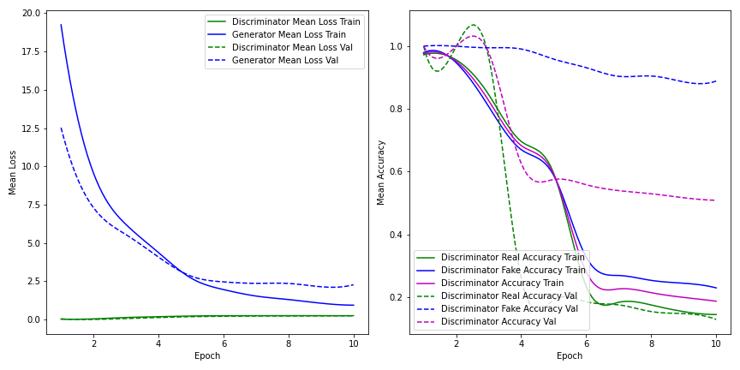
Results - Provided model

Slide 15
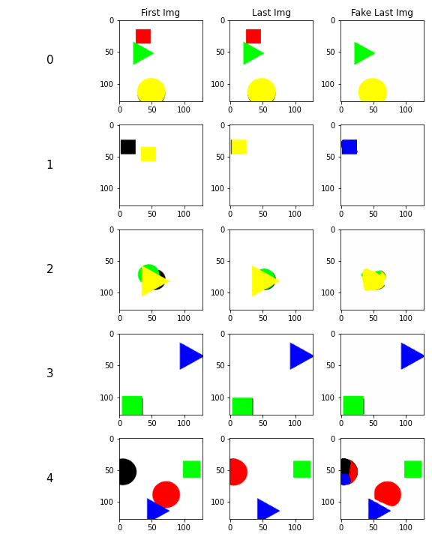
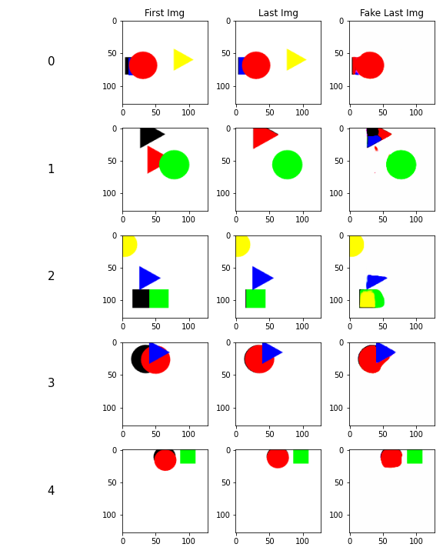
Results - Provided model

Slide 16
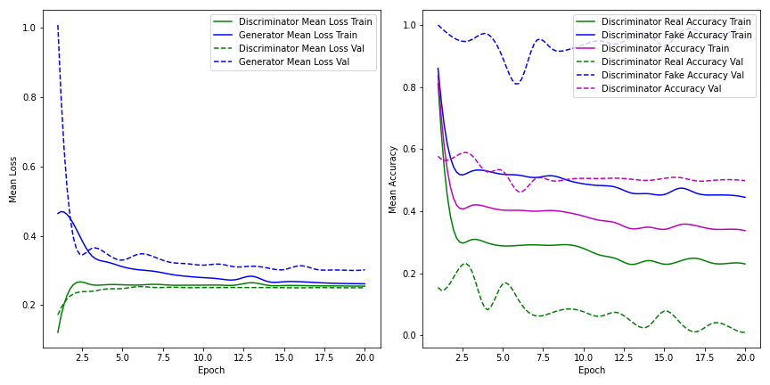
My model

Slide 17
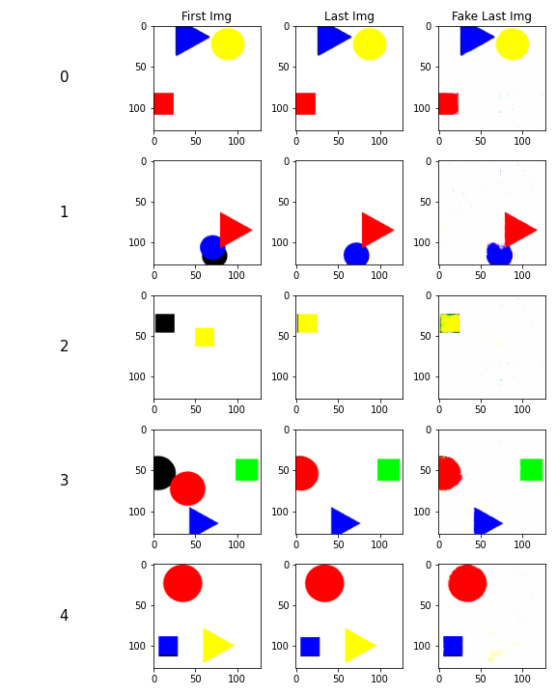
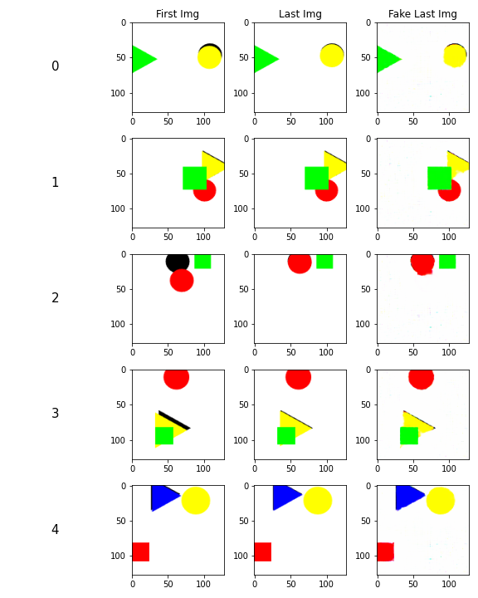
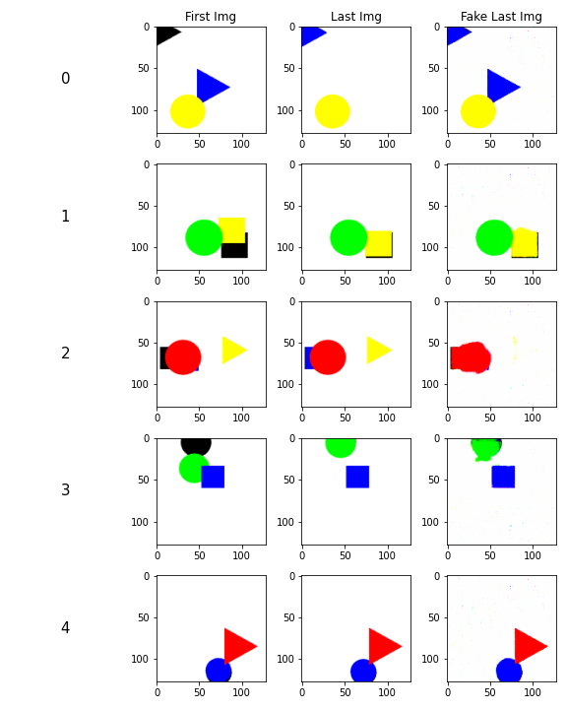
My model

Slide 18
Conclusion
Ok performance
A more complex D gave worse results
Colors were correct but it didn't move the objects
The use of Wasserstein loss might generate better gradients
More label information might help
Each image has text e.g., "red_square", "blue_circle"
Explore other architectures for both D and G
Implement Frechét Inception Distance as metric

Slide 19
Thanks!

