Slide 1

Introduction to eBPF (A Hands-on Tutorial)
Ranjitha K (PhD),
K Shiv Kumar (PhD),
Dept. of CSE,
IIT Hyderabad
https://www.netxiith.in/
Credits : Based on slides/talks from Priyanka Naik (IBM IRL), Thomas Graf (Isovalent) and Internet sources, ebpf.io

Slide 2

Data Centre !
Thousands of racks with millions of servers
Bare-metal servers
Run some flavor of Linux
Require observability, monitoring and tracing tools
Israel pushes ahead with tender for massive cloud-based data center | The Times of Israel

Slide 3
Linux Kernel Architecture
User
Space
process
Admin
process
write()
read()
sendmsg()
recvmsg()
Syscall
Configuration
(netlink,procfs,sysfs )
Syscall
Linux
Kernel
File descriptor
sockets
VFS
TCP/IP
Block Device
Network Device
HW
Storage Hardware
Network Hardware
Notes:
3 pieces
User space, kernel and hardware
User space run process or tasks
Hw layer contain the hardware. Kernel abstract the hardware. It understand all the devices.
System call is used to communicate with the linux kernel
This api does not change, gurantee from kernel
Human being operate this for configuration eg, mount a new file system, firewall configuration etc.
With applications running and distributed across in the data centre, there is a huge demand for extending the capabilities of the kernel.

Slide 4
Extending kernel capabilities
Option1 – Native Support
Option2 – Kernel Support
Change kernel source code
Expose configuration API
Wait for 5 years for users to upgrade
Write kernel module – harder to write/test/debug
Every kernel release will break it
Cons
Ship different module for different kernel version
Crash the kernel
Cons
Time !!!
Hard to extend kernel capabilities
Notes:
What do we do if want to change or add any new feature to the kernel for any specific requirement or usecase.
Change any aspect of it, what if it does not provide a feature that I want.
2 options – native implementation or write a kernel module.
Native impl – changing kernel source code
Convince the community
Exposing API so that the same can be done..
Nice once it is done as whole world can use this.
Kernel module
Loadable plugin at runtime that extend the functionality
Kernel does not have stable API inside, only the user space facing API are stable.
So after every kernel release, one may need to work on the written module.
May need to ship different version of the module for different kernel version.
Any bug in the module can crash,,
These two are not great options…
What if the linux kernel become programmable.

Slide 5

eBPF makes the Linux kernel programmable !
Notes:
BPF evolved to what we call “extended BPF” or “eBPF” starting in kernel version 3.18 in 2014.

Slide 6
eBPF
Regular system call
process
execve( )
syscall
Linux
Kernel
scheduler
Notes:
Execve system call is used to launch a new process. Bash runs execev.
It allows us to take that sys call and run a program that take over on behalf of the system call

Slide 7
eBPF
System call with eBPF
process
execve( )
syscall
Linux
Kernel
scheduler
Notes:
It allows us to take that sys call and run a program that take over on behalf of the system call

Slide 8
eBPF
process
execve( )
syscall
Linux
Kernel
scheduler
int syscall__ret_execve( struct pt_regs *ctx)
{
…..
……
}

Slide 9
What is eBPF ?
- Sandboxed programs (VM) in a privileged context inside kernel
- Provides various hook points in the kernel
- Attach byte code to hook points at runtime
User space
C/C++, Go, Python, …
App
syscalls
Kernel space
Restricted ‘C’
eBPF program

Slide 10
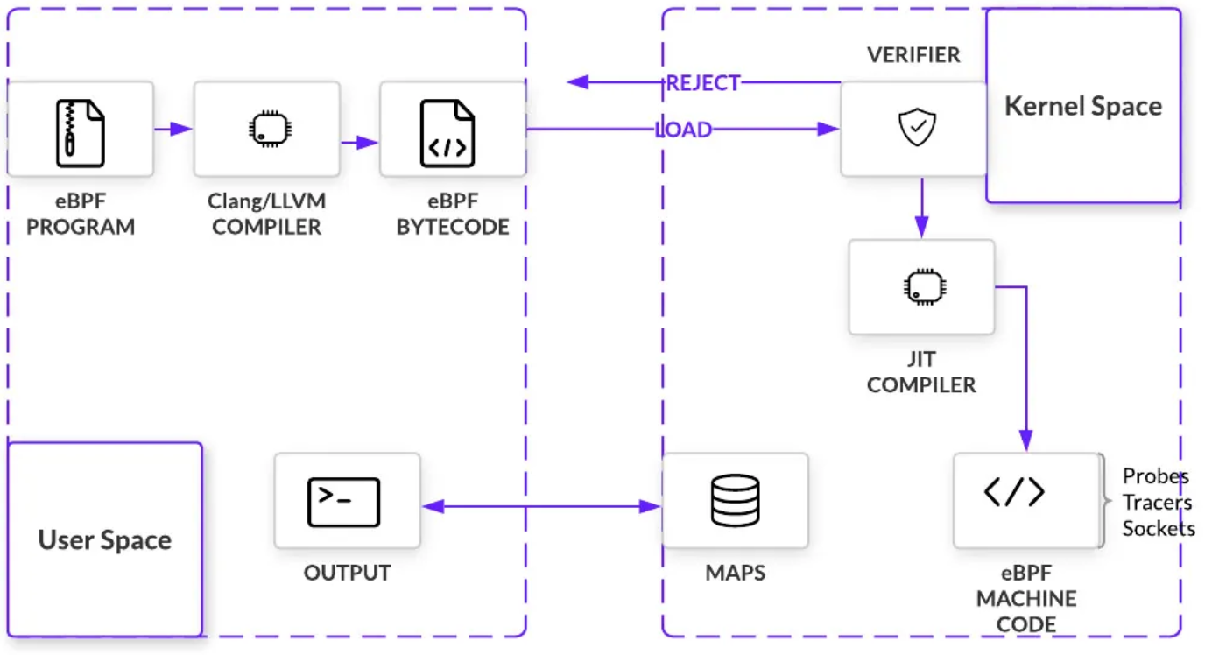
Executing an eBPF program
Notes:
Overview: Lets see how the eBPF programs are compiled, loaded and executed in the kernel.
The eBPF programs are written, and compiled into something called eBPF bytecode:
1) Then the verifier analyzes the eBPF bytecode to make sure the safety of the kernel
2) The JIT compiler will translate the verified eBPF bytecode into native machine instructions
3) Maps will help in transfer the data between user space and kernel space
- Let’s visit the key components one by one

Slide 11
eBPF program
Restricted C lang.
Bounded loops
Limited kernel functions
No floating point

Slide 12


eBPF program
Restricted C Language:
Only bounded loops allowed
for (int i=0; i < N; i++) {
bpf_printk("Looping %d", i);
}
for (int i=0; i < 10; i++) {
bpf_printk("Looping %d", i);
}
Some helper Functions are:
bpf_map_lookup_elem
bpf_map_update_elem
bpf_trace_printk
Limited function calls
Floating point operations
Notes:
eBPF programs can only have bounded loops. By bounded loops we mean the loop conditions should be specified as a constant value.
An eBPF programs can only call a set of kernel functions to interact with kernel components such as maps. These are called helper functions.
Floating points are not allowed in the eBPF programs.
eBPF program:
These restrictions are designed to ensure that eBPF programs are safe to run in the kernel.
Some key restrictions are:
Limitations on loop:
Starting from Linux Kernel version 5.17 loops are allowed with the help of a helper function bpf_loop()
From Linux kernel version 5.3 bounded loops are allowed
No floating point:
eBPF programs do not support floating-point arithmetic, (as they can introduce non-deterministic behaviour)
Limited function calls:
eBPF programs can only called limited set of predefined functions called “helper functions”

Slide 13
eBPF compiler toolchain
Bcc,
ebpf-go, libbpf
bcc: https://github.com/iovisor/bcc, Go: https://github.com/cilium/ebpf, C/C++: https://github.com/libbpf/libbpf
Notes:
Compiler toolchain:
Clang is an LLVM based compiler, which is commonly used to compile an eBPF program into an eBPF bytecode
There are two parts of an eBPF application:
The kernel program that has to be loaded into the kernel.
User space program that interacts with eBPF kernel program to extract the information.
To build eBPF tools there are multiple libraries available:
BCC provides support for python and lua for writing user space part of the eBPF tool.
Similarly, ebpf-go is a Go library that provides utilities for loading, compiling, and debugging eBPF programs and also in creating eBPF tools in Go language.
Basically, it allows eBPF programs written in C within Go code.
libbpf is C based library that provides user space APIs to do the heavy lifting of loading, verifying, and attaching BPF programs to various kernel hooks.
For the tutorial, we will mainly be focusing on libbpf based examples.
Explain everything -> As a user we have to use toolchains
However, we will be using C/C++ toolchain

Slide 14
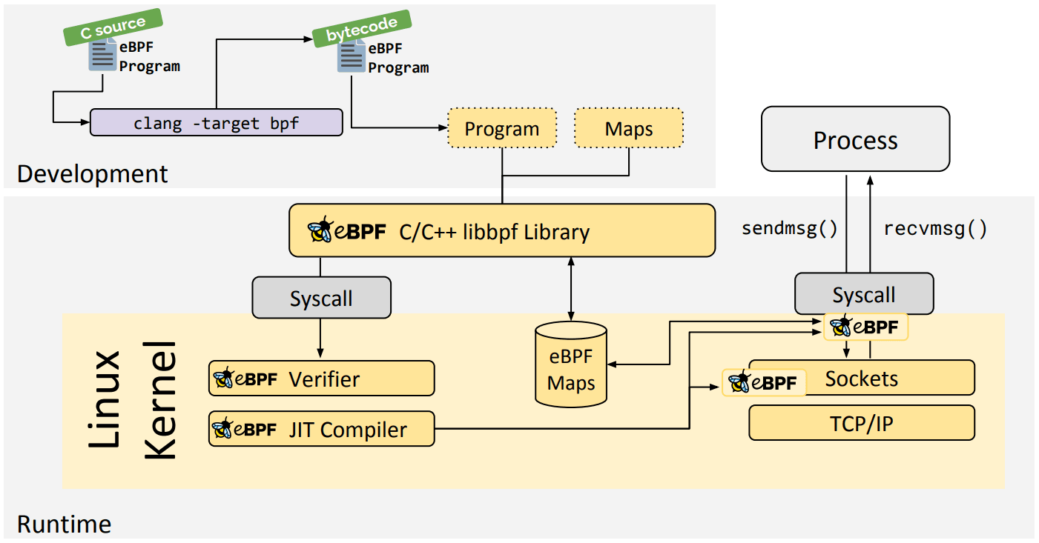
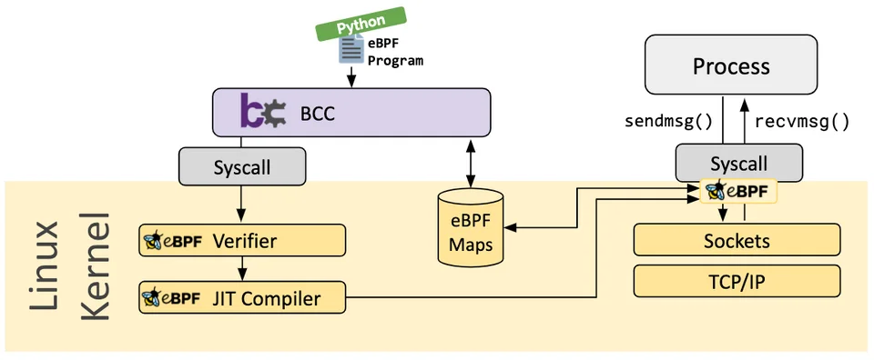
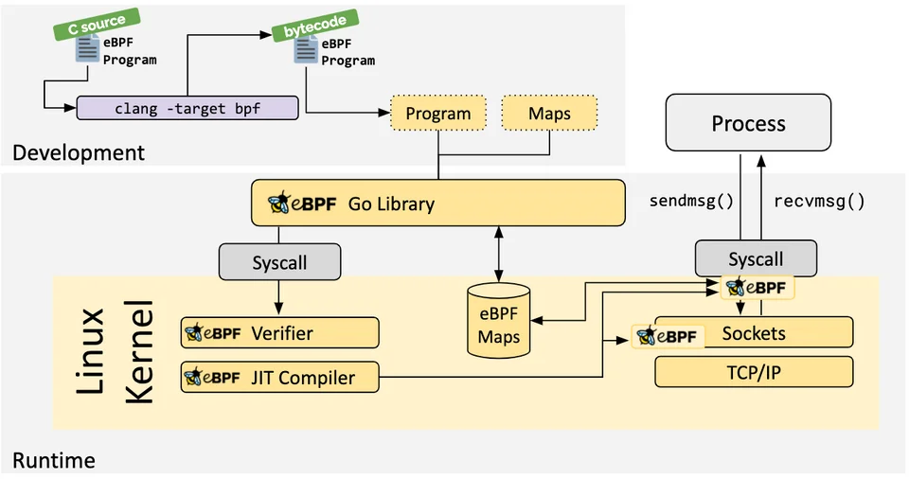
eBPF compiler toolchain (Contd…)
Our Focus
eBPF programs embedded
Toolchain with ‘python’ library support
Toolchain with C/C++ library support
Toolchain with ‘Go’ library support
Notes:
There are toolchains available to help programmers in developing eBPF tools.
Few of them are BCC, Go Library, C/C++ libbpf library
We will be focusing on libbpf. Libbpf is C based library that provides set of user space APIs to interact with eBPF programs.
Compiler:
Clang is an LLVM based compiler, which is commonly used to compile an eBPF program into an eBPF bytecode
There are two parts of an eBPF tool:
The kernel program that has to be loaded into the kernel.
User space program that interacts with eBPF kernel program to extract the information.
To build eBPF tools there are multiple libraries available:
BCC provides support for python for writing user space part of the eBPF tool. Basically, the eBPF programs are embedded inside them.
Similarly, ebpf-go is a Go library that provides utilities for loading, compiling, and debugging eBPF programs and also in creating eBPF tools in Go language.
Basically, it allows eBPF programs written in C within Go code.
libbpf is C based library that provides user space APIs to do the heavy lifting of loading, verifying, and attaching BPF programs to various kernel hooks.
For the tutorial, we will mainly be focusing on libbpf based examples.

Slide 15
eBPF Bytecode
Bytecode specs:
64 bits instr.,
11 registers R0-R10
Notes:
eBPF bytecode:
eBPF bytecode has 64 bit instructions which involves instructions for arithmetic and jump operations.
It has 10 general purpose registers R0 to R9
And a read-only frame pointer register (R10).
We will see how bytecode looks in upcoming slides
Explain everything -> As a user we have to use toolchains
However, we will be using C/C++ toolchain

Slide 16
eBPF bytecode (Contd…)
eBPF is a RISC register machine with
11 registers of size 64-bit each
R0: return value from function calls, and exit value for eBPF programs
R1 - R5: arguments for function calls
R6 - R9: callee saved registers that function calls will preserve
R10: read-only frame pointer to access stack
8 instruction classes (BPF_LD, BPF_ST, BPF_ALU, BPF_JMP, etc.)

Slide 17
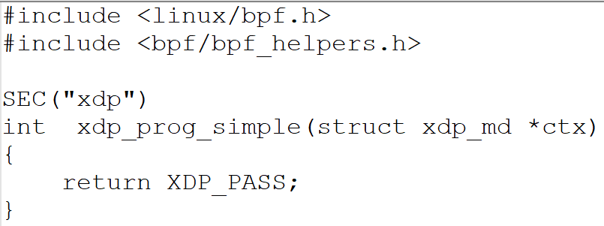
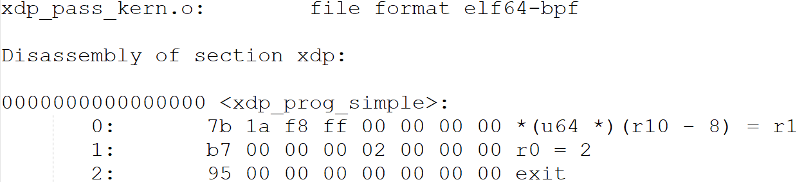
eBPF bytecode (Contd…)
How the bytecode looks like.?
Just PASS the packet to the network stack for further processing
0: Store Reg. to memory
1: Move const. value ‘2’ to R0
2: return R0
Notes:
Lets’ take this example eBPF program written for XDP hook-point
This program just pass the incoming packet to the Network stack for further processing.
The bytecode of this program looks like this.
This is not intuitive, and one must know the bytecode specifications to understand this.

Slide 18
eBPF Verifier
eBPF Verifier
Analyses the bytecode
Ensures kernel safety
Notes:
eBPF Verifier:
eBPF verifier is a part of Linux kernel
It is a complex code(10000+ lines of code) that is responsible of safety of the Linux kernel by:
Analyzing the ebpf bytecode to ensures the safety of the linux kernel.
Few of the checks the verifier performs are:
Checks if the eBPF program runs to completion
Detects unbounded loops and unreachable instructions
Checks if the program is accessing out of bound memory
Explain everything -> As a user we have to use toolchains
However, we will be using C/C++ toolchain

Slide 19
eBPF Verifier (Contd…)
eBPF verifier is a part of Linux kernel
A complex code(10000+ LOC) that is responsible of safety of the Linux kernel
Few of the checks the verifier performs of the bytecode are:
Checks if the eBPF program runs to completion
Detects unbounded loops and unreachable instructions
Checks if the program is accessing out of bound memory

Slide 20
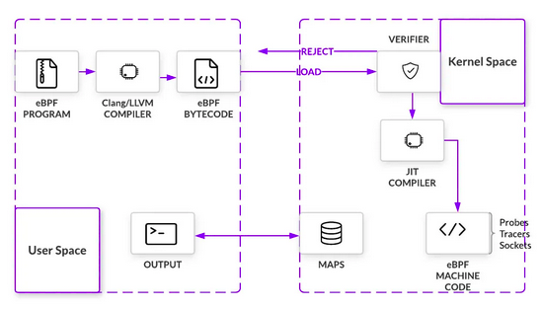
JIT Compiler
JIT compiler:
- Translates eBPF bytecode to native instructions
Notes:
JIT compiler:
It is responsible of translating the bytecode to native instructions for the direct execution of an eBPF program in the kernel.
Explain everything -> As a user we have to use toolchains
However, we will be using C/C++ toolchain

Slide 21
eBPF maps
Key-value store
Kernel ←→ User space
Notes:
eBPF maps:
eBPF maps are part of kernel
To interact with these maps, the userspace programs have to use bpf-helper functions.
It allows data to be passed back and forth within the kernel or between the kernel and user space.
Explain everything -> As a user we have to use toolchains
However, we will be using C/C++ toolchain

Slide 22
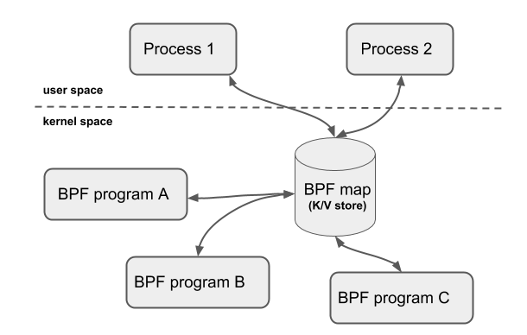
eBPF Maps
Allows sharing data between kernel space and user space programs.
Generic data structure for storing different types of data
Collection of key-value pairs
Program returns file descriptor to the map.

Slide 23
Types of maps
BPF_MAP_TYPE_HASH
BPF_MAP_TYPE_ARRAY
BPF_MAP_TYPE_PERCPU_HASH
BPF_MAP_TYPE_PERCPU_ARRAY
BPF_MAP_TYPE_PROG_ARRAY
BPF_MAP_TYPE_PERF_EVNT_ARRAY
BPF_MAP_TYPE_LRU_HASH
and many more....

Slide 24
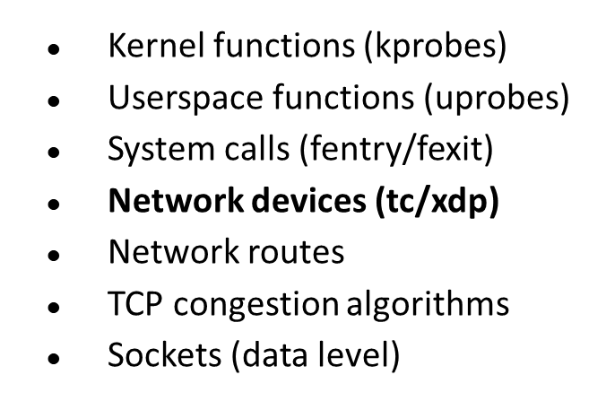
eBPF Hooks
process
process
write()
read()
sendmsg()
recvmsg()
Syscall
Syscall
Linux
Kernel
File descriptor
sockets
VFS
TCP/IP
Block Device
Network Device
Storage Hardware
Network Hardware
Paved way for various use cases such as network observability, tracing , security and many more

Slide 25
eBPF XDP and TC hook
Application
User space
Network stack
Linux kernel
AF_INET
AF_RAW
TCP/IP
AF_XDP
eBPF maps
Queuing and
forwarding
TC eBPF
drop
Device driver
XDP
Build sk_buff
Network Hardware

Slide 26
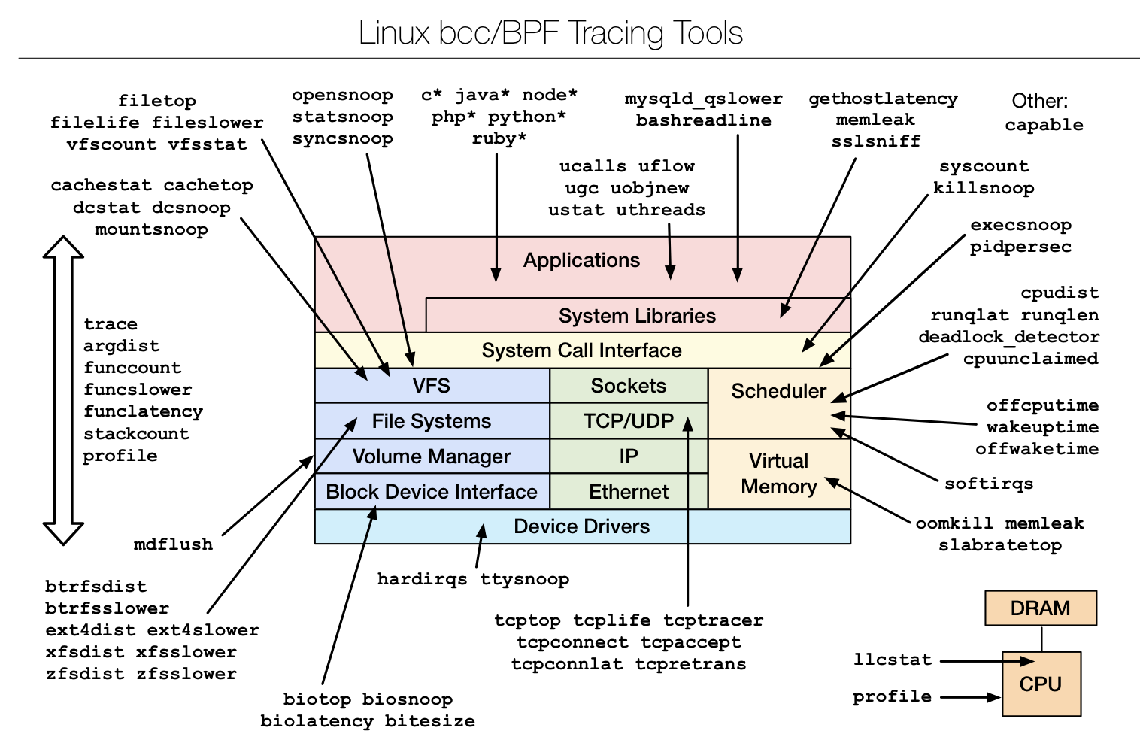
eBPF Hooks
Ref: https://www.brendangregg.com/ebpf.html
Notes:
- One can understand the depth of capabilities we can have with eBPF

Slide 27
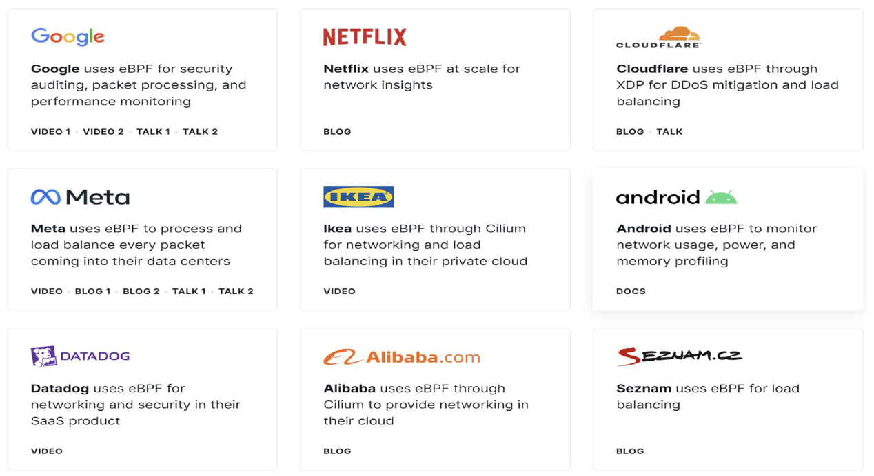
eBPF use cases

Slide 28
eBPF bcc monitoring/tracing
eBPF Toolkit for tracing and program manipulation
requires Linux 4.1 and above
C wrapper around LLVM
Front-ends in Python and lua
https://github.com/iovisor/bcc

Slide 29
References
https://ebpf.io/get-started/
https://github.com/lizrice/ebpf-beginners
https://www.youtube.com/watch?v=lrSExTfS-iQ
https://lwn.net/Articles/794934/
https://medium.com/@megawan/writing-compiling-and-loading-ebpf-program-7b0efa014142
https://www.infoq.com/articles/gentle-linux-ebpf-introduction/
https://github.com/xdp-project/xdp-tutorial
https://www.datadoghq.com/blog/xdp-intro/#xdp_runnergo
https://github.com/gojue/ebpf-slide
https://manpages.ubuntu.com/manpages/focal/en/man7/bpf-helpers.7.html
https://github.com/zoidbergwill/awesome-ebpf
https://www.kernel.org/doc/html/v6.2/bpf/

Slide 30
Thank you
Our Contacts:
Ranjitha K (cs21resch01002@iith.ac.in)
K Shiv Kumar (cs21resch11003@iith.ac.in)

Slide 31
BPF_MAP_TYPE_ARRAY
struct bpf_map_elf SEC("maps") my_map = { .type = BPF_MAP_TYPE_ARRAY, .key_size = sizeof(u32), .value_size = sizeof(xxx), .max_entries = 256, };
Maps are accessed via bpf helper functions
bpf_map_lookup_elem() , bpf_map_update_elem() etc.

