Slide 1
EEIT10714
2
M
I
D
T
E
R
M

Slide 2
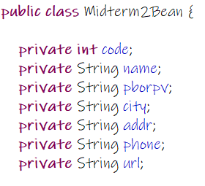
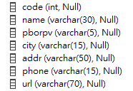
DataBase
BEAN

Slide 3
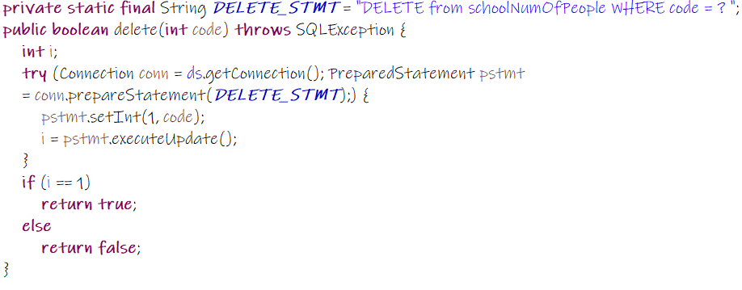
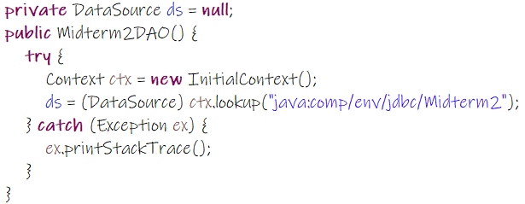
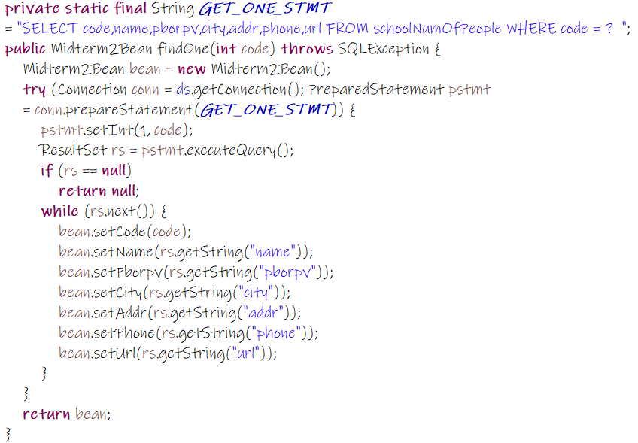
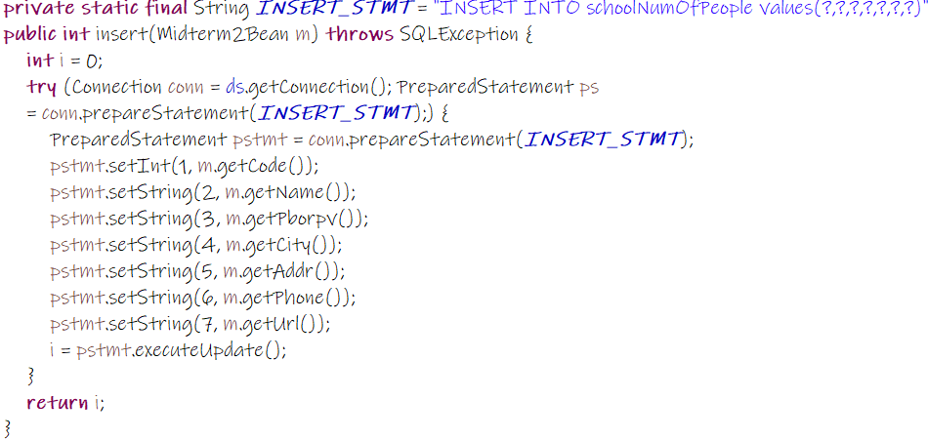
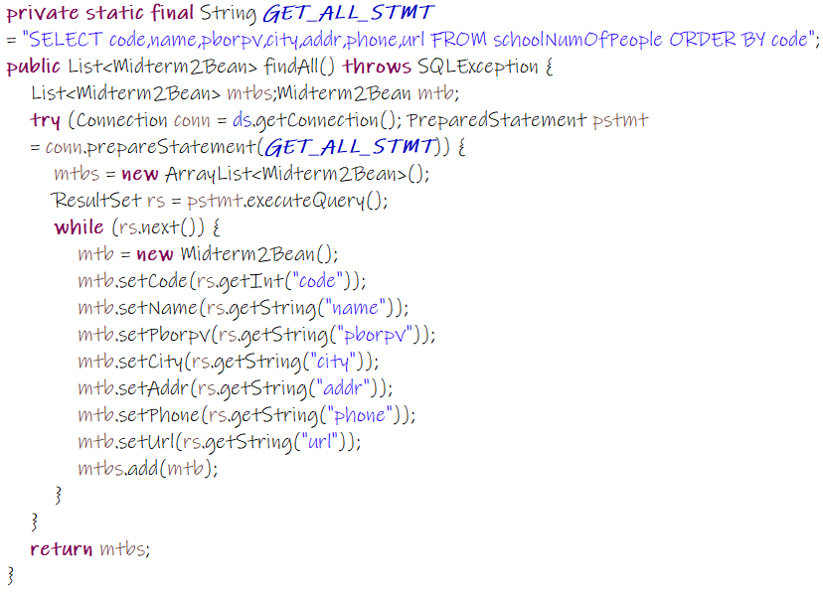
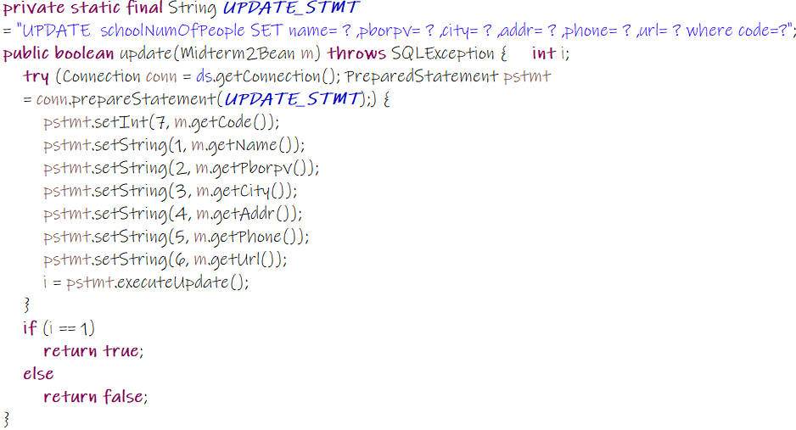
D
A
O

Slide 4
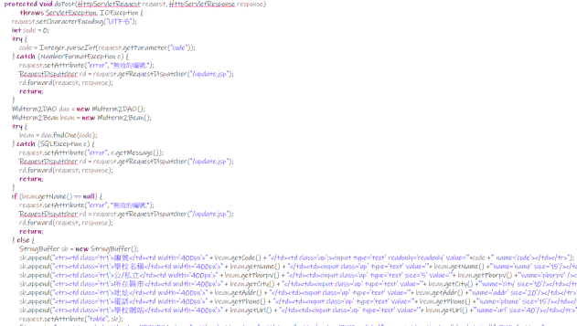
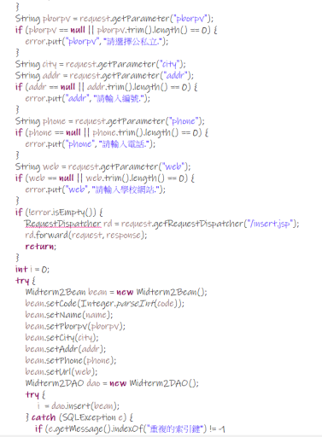
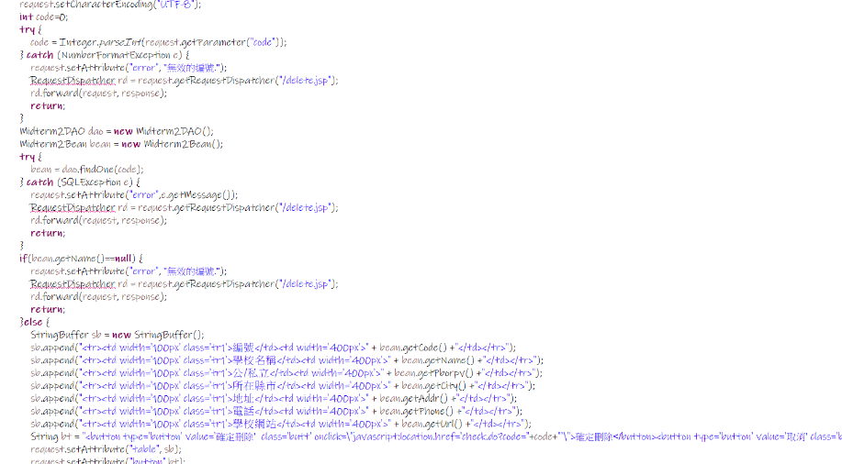
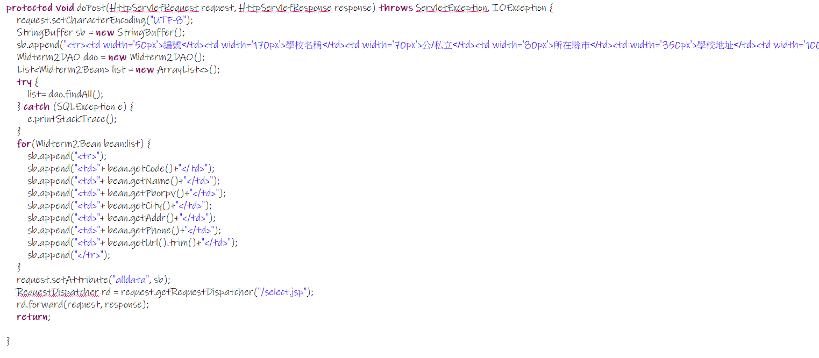
Controller

Slide 5
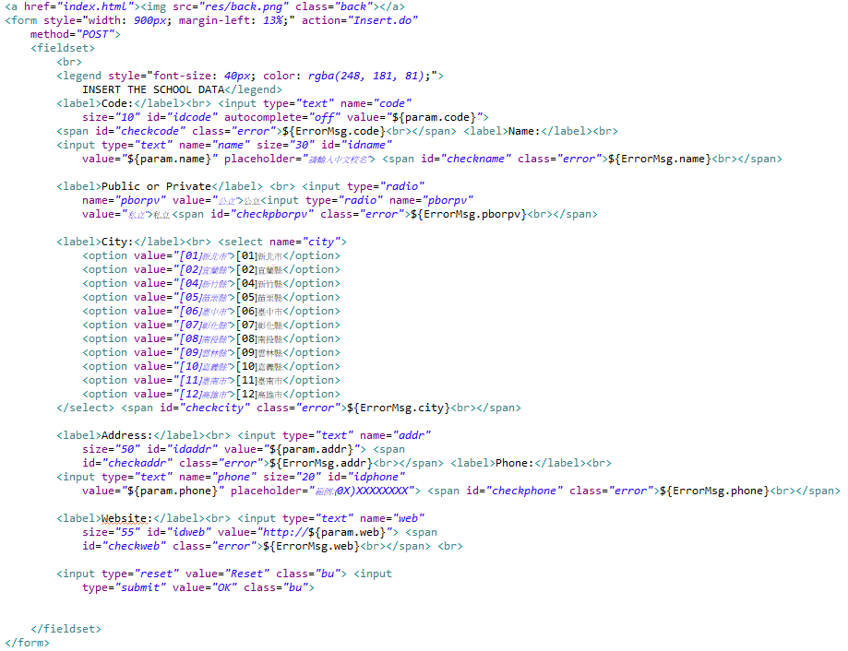
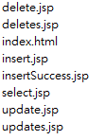
VIEW

Slide 6
<?xml version='1.0' encoding='utf-8'?>
<Context displayName="JSP Exercise" docBase="jspExercise" path="/jspExercise" reloadable="true">
<!-- SQLServer -->
<Resource name="jdbc/Midterm2" type="javax.sql.DataSource"
username="sa" password="passw0rd"
driverClassName="com.microsoft.sqlserver.jdbc.SQLServerDriver"
url="jdbc:sqlserver://localhost:1433;DatabaseName=jdbc"
maxTotal="8"
maxIdle="4"
maxWaitMillis="5000"
/>
</Context>
DATASOURCE
Context ctx = new InitialContext();
ds = (DataSource) ctx.lookup("java:comp/env/jdbc/Midterm2");

Slide 7
document.addEventListener("DOMContentLoaded",function(){
document.getElementById("idcode").addEventListener("blur",checkcode);
document.getElementById("idname").addEventListener("blur",checkname);
document.getElementById("idaddr").addEventListener("blur",checkaddr);
document.getElementById("idphone").addEventListener("blur",checkphone);
document.getElementById("idweb").addEventListener("blur",checkurl);
})
function checkcode(){
var code = document.getElementById("idcode").value;
var re= /^[0-9]{1,}$/;
if(code=="" || code.length==0){alert("請輸入編號.");}
if(code.length>0 && !(re.test(code))){
alert("編號格式錯誤，請輸入數字.");}}
function checkphone(){
var phone = document.getElementById("idphone").value;
var re= /^\([0-9]{2}\)[0-9]{7,8}$/;
if(phone=="" || phone.length==0){
alert("請輸入學校電話.");}
if(phone.length>0 && !(re.test(phone))){
alert("學校電話格式錯誤.");}}
JAVASCRIPT

Slide 8
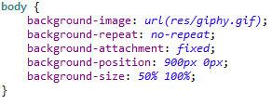
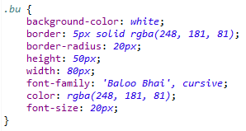


CSS

Slide 9

THANKS.

Slide 10
BACK

Slide 11
BACK

Slide 12
BACK

Slide 13
BACK

