Slide 1

DocBot
Διαλογικά Συστήματα και Φωνητικοί Βοηθοί (Μ913)
Κακαμούκα Καλλιόπη
4^{η} Εργασία
10/03/2024

Slide 2



Introduction
In today’s society, the implementation of AI is considered crucial. Artificial Intelligence is part of our lives in many different aspects and fields and health is one of them. Considering that booking an appointment can take minutes waiting in line and communicating with other individuals can be stressful for some of us, DocBot has been created to help you book doctor’s appointments with ease.

Slide 3
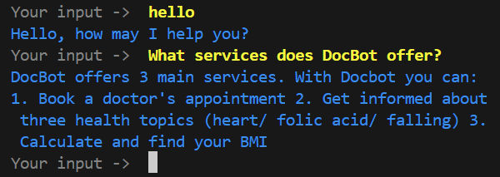
General information about docbot
DocBot offers three main services:
Book a doctor’s appointment
Give information about three health topics
Calculate your BMI

Slide 4
1. Book a doctor’s appointment
DocBot offers 3 different medical specialties (ophthalmologist, gynaecologist and dermatologist). For each medical specialty, the user can choose between a couple of available doctors by clicking on the one they prefer visiting.
At first the user types in their preferred date and time
Then they are asked to type in their SSN (Social Security Number), which is unique for everyone
After validating the SSN input, the appointment is set

Slide 5
2. Give information about three health topics
Users can ask DocBot about health information
DocBot is connected to a health blog’s API address (https://health.gov/our-work/national-health-initiatives/health-literacy/consumer-health-content/myhealthfinder)
Even though there are many different health topics, I chose three for implementation
The topics regard the following subjects:
Heart
Folic Acid
Falling

Slide 6
3. Calculate your bmi
DocBot is connected to another API address: (https://www.calculateconvert.com/calculators/health/bmi.php?kgs=%7Bweight_num%7D&cm=%7Bheight_num%7D)
Users can calculate their BMI using DocBot
The input should include two parameters:
Height
Weight

Slide 7
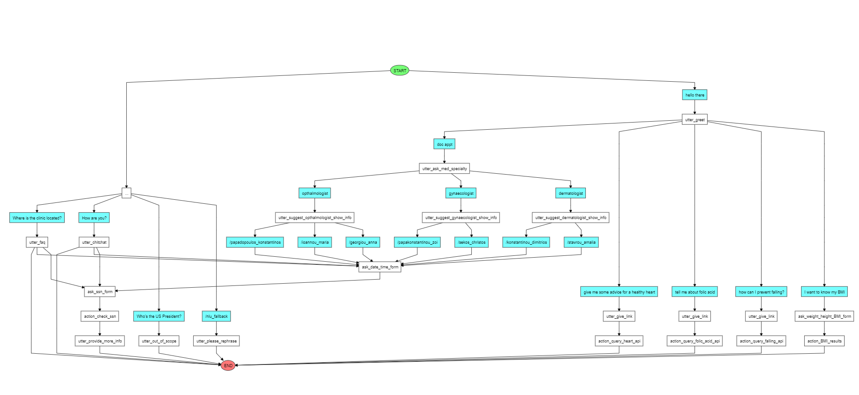
Conversational flow – overview

Slide 8
Conversational flow – overview

Slide 9
Conversational flow – overview – book an appointment
1
2
3

Slide 10
Conversational flow – overview

Slide 11
Conversational flow – overview – API INTEGRATION
1
1. API implementation
2. API implementation
2

Slide 12
Conversational flow – overview

Slide 13
Conversational flow – overview – FAQ/CHITCHAT/OUT-OF-SCOPE/FALLBACK
ask_date_time_form and
ask_ssn_form are designed to handle faq/chitchat/out-of-scope questions without failing the conversation
FAQ
Chitchat
Out-of-scope
Fallback

Slide 14
Conversational flow – happy path
Here’s how the conversation ideally flows:
👱🏻‍♀️ --> user greets 🤖 --> bot greets back and asks the user how it can help them 👱🏻‍♀️ --> user wants to book an appointment 🤖 --> bot suggests 3 medical specialties 👱🏻‍♀️ --> the user chooses between these options: dermatologist, opthalmologist, gynaecologist 🤖 --> bot suggest available doctors based on the chosen medical field 👱🏻‍♀️ --> user chooses a doctor 🤖 --> bot tells the user to choose a date and a time (use of forms) 👱🏻‍♀️ --> user types their preferred date and time 🤖 --> bot asks for the user's Social Security Number (ssn) (use of form) 👱🏻‍♀️ --> user types their SSN 🤖 --> bot checks the existence of the given input in the database (Excel). If the number exists the appointment is set, if not, the user is asked to call a telephone number.

Slide 15
architecture
As mentioned earlier, one of DocBot’s capabilities is to book appointments with various doctors. Considering that there are many different medical specialties, I limited the options to three (ophthalmologist, gynaecologist, dermatologist) just to show how the chatbot works. I would like to point out a few features, which in my opinion make DocBot stand out:
The use of buttons
The custom dummy database

Slide 16
The use of buttons
After requesting to book an appointment, users are asked to make two main choices. At first, they have to choose the type of medical specialty they wish to visit. After they click on the option they prefer, they choose the doctor they would like to book an appointment with, based on the chosen specialty. The reason why I proceeded with the use of buttons regards the following:
Limiting the options. If the user doesn’t know which and how many medical specialties there are, they can see their options straightforward
Robustness.

Slide 17
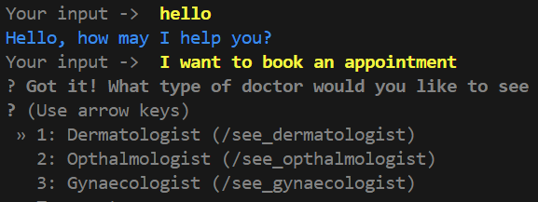
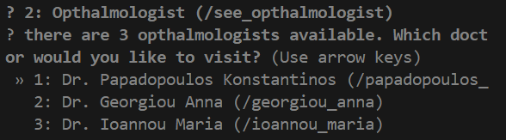
The use of buttons
Fig. 2: Choosing a medical specialty
Fig. 3: Choosing a doctor

Slide 18
The CUSTOM DUMMY DATABASE
It is well known that clinics need a database, which consists of every patient’s information. For that reason, I created my own dummy database, which contains the information of a few fake patients. I proceeded with this implementation, because I wanted to take the experience further and create a realistic booking process.
Instead of the typical name-surname-number-email request, I proceeded to create an Excel file, which is considered to be the "clinic's database", consisting of various information about its patients. The columns I created include information about the following topics: SSN number (it's unique for every patient), Name, Surname, Email and Appointment. Here's how it works: When the user gives their SSN number, the bot runs a custom action called 'action_check_ssn'. At first, this custom action checks the existence of the given ssn number in the Excel file. If the number exists, the bot implements two different activities

Slide 19
The CUSTOM DUMMY DATABASE
1. It makes use of the {date} and {time} slots given by the user previously in the conversation and adds the chosen appointment date and time in the column "Appointment". The bot manages to locate the row that the SSN is set in the Excel file and adds the date and time to the corresponding cell.
2. After adding the chosen date and time, the bot 'sees' whom this SSN number belongs to in the list and replies kindly with the following message: "Thank you, {name}!, your appointment on {date} at {time} is confirmed", making the approach even friendlier. If the user gives an SSN number, which is not part of the Excel file or an SSN number which is invalid, they are asked to call the clinic for further assistance.

Slide 20
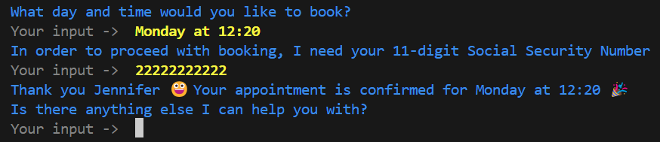
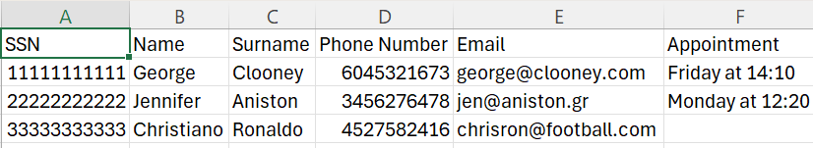
The CUSTOM DUMMY DATABASE

Slide 21
The CUSTOM DUMMY DATABASE

Slide 22
The CUSTOM DUMMY DATABASE

Slide 23
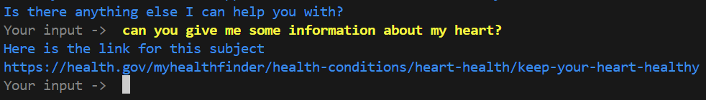
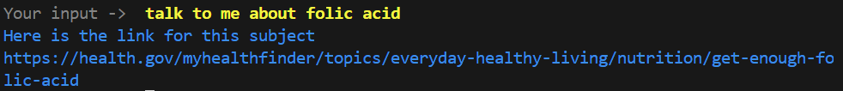
1. API INTEGRATION
keywords

Slide 24
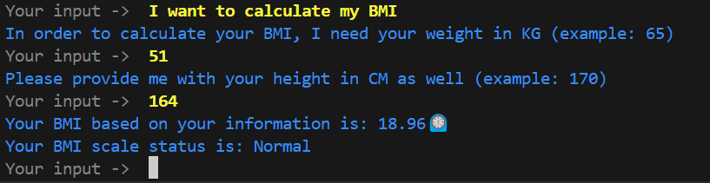
2. Api integration
As mentioned earlier, DocBot is connected to a website’s API, which can calculate a person’s BMI and conclude the state they are in. The user is asked to give their height in cm and weight in kg for the calculations. Here’s the conversational flow:

Slide 25
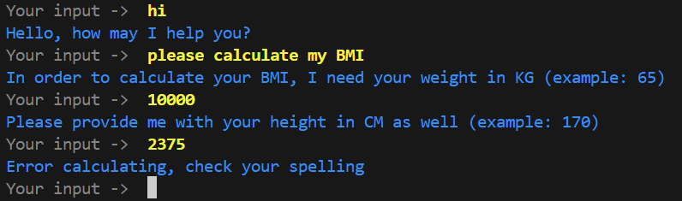
2. Api integration
It’s important to note, that the action used for this function is able to handle invalid inputs as well without crashing:

Slide 26
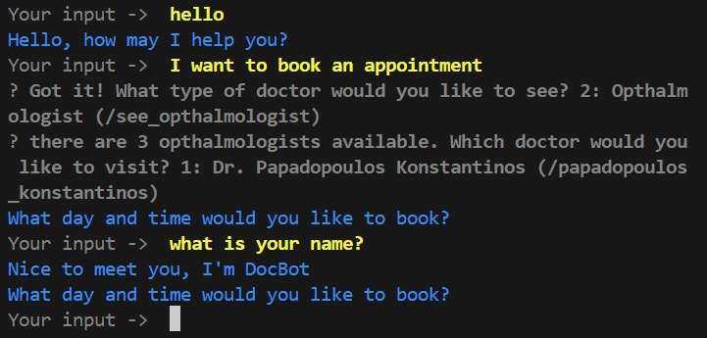
Handling faq/chitchat
Users’ inputs can be unpredictable sometimes. That means, that the conversational flow might not go as planned. Chatbots should be able to handle such cases gracefully without crashing. DocBot is able to do so:

Slide 27
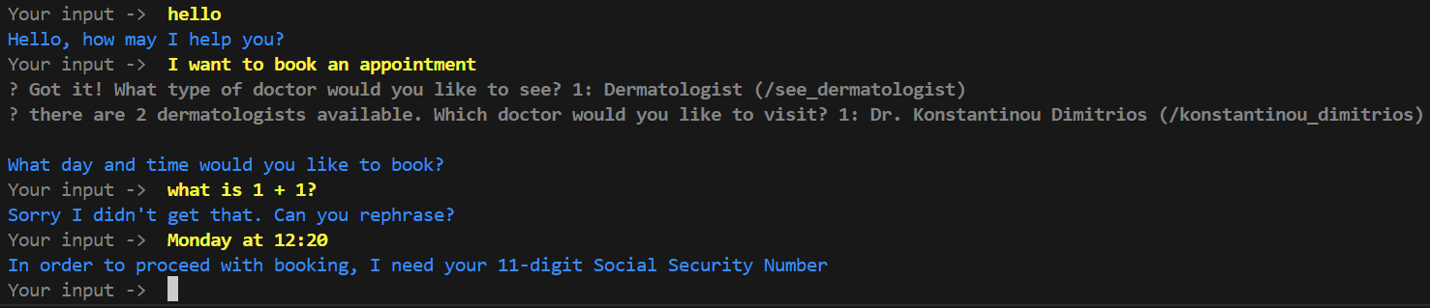
Handling out-of-scope cases
DocBot can also handle out-of-scope scenarios! Simply by asking the user to rephrase, the conversation doesn’t fail, and the user can give their answer without restarting the conversation.

Slide 28
How docbot can become better
DocBot can be implemented in clinics and personal doctors’ offices, making it suitable for patients who struggle with communicating (e.g people who are deaf), or people who don’t want to waste time waiting for the receptionist to pick up the phone.
However, it is important to note, that DocBot could become even better. Here are some features, that I would want to upgrade:
Connect DocBot with an actual calendar
Connect DocBot to more API addresses, and thus offer more services
Add more medical specialties

