Slide 1



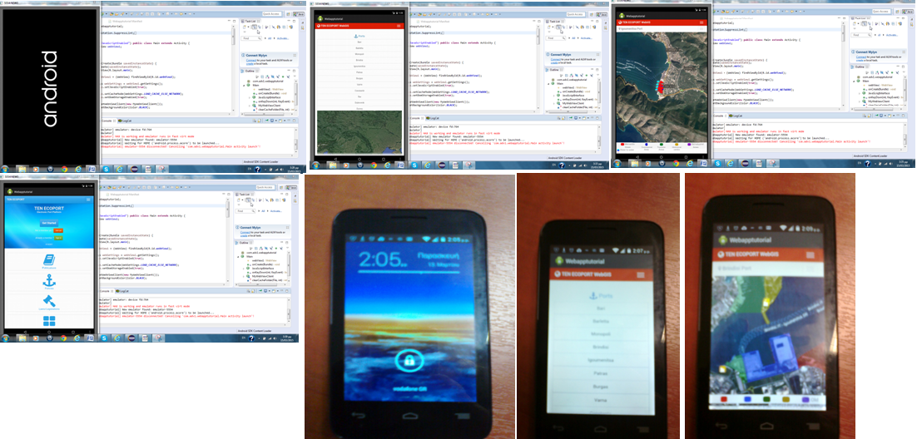
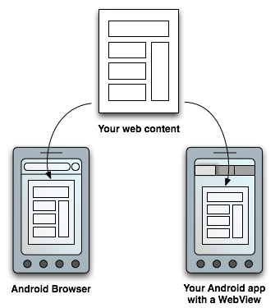
WebGIS APPLICATION FOR ANDROID SOFTWARE DEVICES
Kalliopi Salla¹, Stavros Kolios¹, Chrysostomos Stylios¹
¹ Laboratory of Knowledge and Intelligent Computing,
Dept. of Computer Engineering, T.E.I of Epirus, Arta, Greece
INTRODUCTION
The WebGIS arises as the combination of web technology and Geographic Information Systems (GIS) [1][2]. It comprises a GIS application with the use of internet technology to share and manipulate spatiotemporal data, maps and analyses to the wide public. It is known that spatial data analyses through a GIS are focused to capture, store, manipulate, analyze, manage, and present different types of spatial or geographical data. All these capabilities are also offered in a WebGIS application. In its simplest version, a WebGIS needs at least one client and one server, to operate. Here the client is an application running on a mobile device which communicates with the server, which runs as web server application.
Here, a WebGis application for mobile telephones with Android operational system is presented [3]. Within the Android operational system a developer can create an activity containing a WebView application, which is able to display any document or similar file being hosted online [4]. The mobile application is based on the information and the design philosophy of an operative WebGIS system about port environmental conditions in the southeast Europe [1].
WebGIS Application
The development of mobile application could be based on various programing languages such as Flex, Action Script, PHP, JavaScript and Ajax. Java is usually used in the Geoserver software. Standard RIA (Rich Internet Application), Flex and Action Script are usually used for GIS web interfaces. It is required to include components capable of overlaying layers such as WMA and WCS (Web Coverage Service) format usually provided by software such as Geoserver, which turns the navigator maps in GIS hybrid representation, capable of presenting data the server. Mobile web applications have some advantages in comparison with native applications, concerning accessibility, cost-effectiveness and compatibility.
The Ten Ecoport WebGIS for android has developed and it can be downloaded from TorrApk and lived on the mobile device. It is available at the app store so it is increasing its visibility and downloading. Although, it requires internet connection to download then the webGIS application can work offline. It uses common install process and access to operating system features.
On the other hand, Ten Ecoport WebGIS could be accessed through mobile browser without requiring any more action than constant internet access but also it provides limited or no access to operating system features.
An application for Android: The case of Ten Ecoport WebGIS
This study aims to present the transformation of the “TEN_Ecoport WebGIS” system into Android environment. There was used one of the most popular and powerful tools to develop android applications: the WebView. The WebView provides access to device functionality via javaScript, which means hardware buttons, persistent storage, contacts, SMS, location identification etc. But the file system and database accesses to system’s resources need special privileges that must be assigned to Android application when it is installed. Also it allows development of more streamlined capable applications.
The WebView library allows easy development of WebGIS applications using the following:
1) HTML, JavaScript, CSS,
2) Targeted at inexperienced developers,
3) Third party framework (Apache / Cordova) requiring no code at all
4) Updates based on the change of web content
Figure 2. Screen shot of the developed WebGIS App-Eclipse for Android device.
Results and Conclusions
It has created a WebGIS application for mobile devices with Android operation system based on Web 2.0 where the web services are using open owner map and database server. It was used the three main components for this application: User Interface, Application Server and Database. The mobile application was developed using WebView tool.
The aim of this work was to examine functionality and operational characteristics of the developing a WebGIS application for android mobile devices. WebView was used to transform and display of the ‘Ten Ecoport WebGIS’ system into an android mobile device. WebView designed to enable closer interaction between Android applications and websites. Android applications, using WebView, can embed a browser in them, allowing them to display web contents, as well as launch HTTP requests.
There has been compared the advantage to develop a mobile application or just use the mobile browser. Both have their own advantages and disadvantages and so the selection is based on the user’s priorities.
Acknowledgement
Figure 1. Publish web content in two ways: through a traditional web browser or an Android application including a WebView in the layout.
This work is supported by the SOUTH EAST EUROPE Transnational Cooperation Programme, Project Code SEE/D/0189/2.2/X, Acronym: TEN ECOPORT
MAIN REFERENCES
[1]Kolios, S., Stylios C. and Petunin A. (2015). A WebGIS platform to monitor environmental conditions in ports and their surroundings in South Eastern Europe. Journal of Environmental Monitoring and Assessment, accepted for publication.
[2]Akinyede, J.O. and Adeboju K. A. (2014). GIS Technology: Past, Present and Future Trends” Africa Geospatial Forum, Victoria Island, Lagos, Nigeria.
[3]Hellman, E. (2013). Android Programming: Pushing the Limits. Wiley
[4]Dongwan, S., Huiping, Y. and Rosi U. (2013). Supporting visual security cues for WebView-based Android apps. Proceedings of SAC’13, Coimbra, Portugal, pp. 1867-1874.

