Slide 1
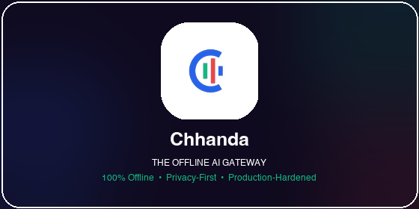
CHHANDA (ছন্দা)
The On-Device Local AI Gateway
Harnessing Google's Gemma 4 and LiteRT-LM for 100% Offline, Privacy-First AI Access at Scale.
• Track: Gemma 4 Good (Global Resilience & Digital Equity) • Stack: Kotlin, LiteRT-LM, Ktor-CIO, Room DB, Android KeyStore • Author: Solo-Developed by Kallol Chakraborty • Dedication: Dedicated to my beloved mother, Chhanda Chakraborty

Slide 2
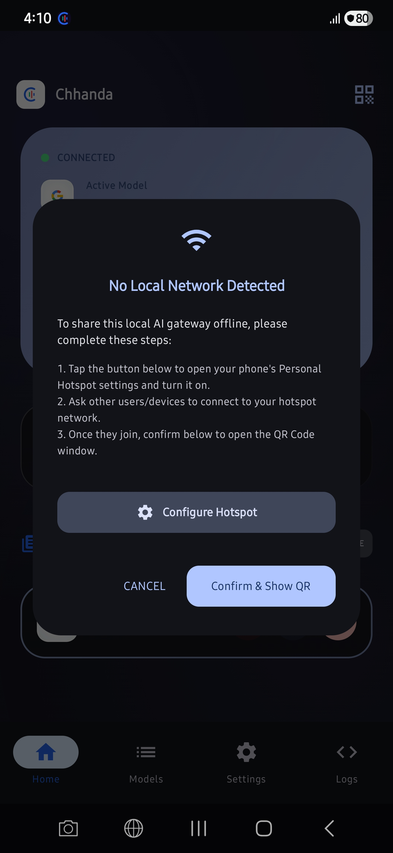
THE PROBLEM & THE MISSION
The Rural Digital Divide & On-Device Vision
The Problem: Locked Out of AI
• 600 Million Offline: Over half of rural India & Bangladesh lacks consistent internet access, rendering cloud-based AI tools completely useless. • Paywalls & Costs: A $20/month ChatGPT subscription is prohibitive in developing economies. • Privacy Vulnerability: Uploading patient medical data or private village spreadsheets to overseas cloud engines creates heavy security risks.
The Vision: Chhanda & Gemma 4
• 100% Offline AI: Zero cloud dependence. Gemma 4B is GGUF-quantized and runs natively on the device via LiteRT-LM runtime. • One Phone serves 20: Built-in local HTTP server serves an entire classroom or local clinic via Wi-Fi hotspot connectivity. • 3-Language Accessibility: Pure native interaction in English, Hindi, and Bengali with customized multilingual Text-To-Speech locale scripting. • Zero Cost, Zero Latency: Full edge execution with zero data usage.
Figure: Multi-client hotspot connectivity configuration guide inside Chhanda Control

Slide 3
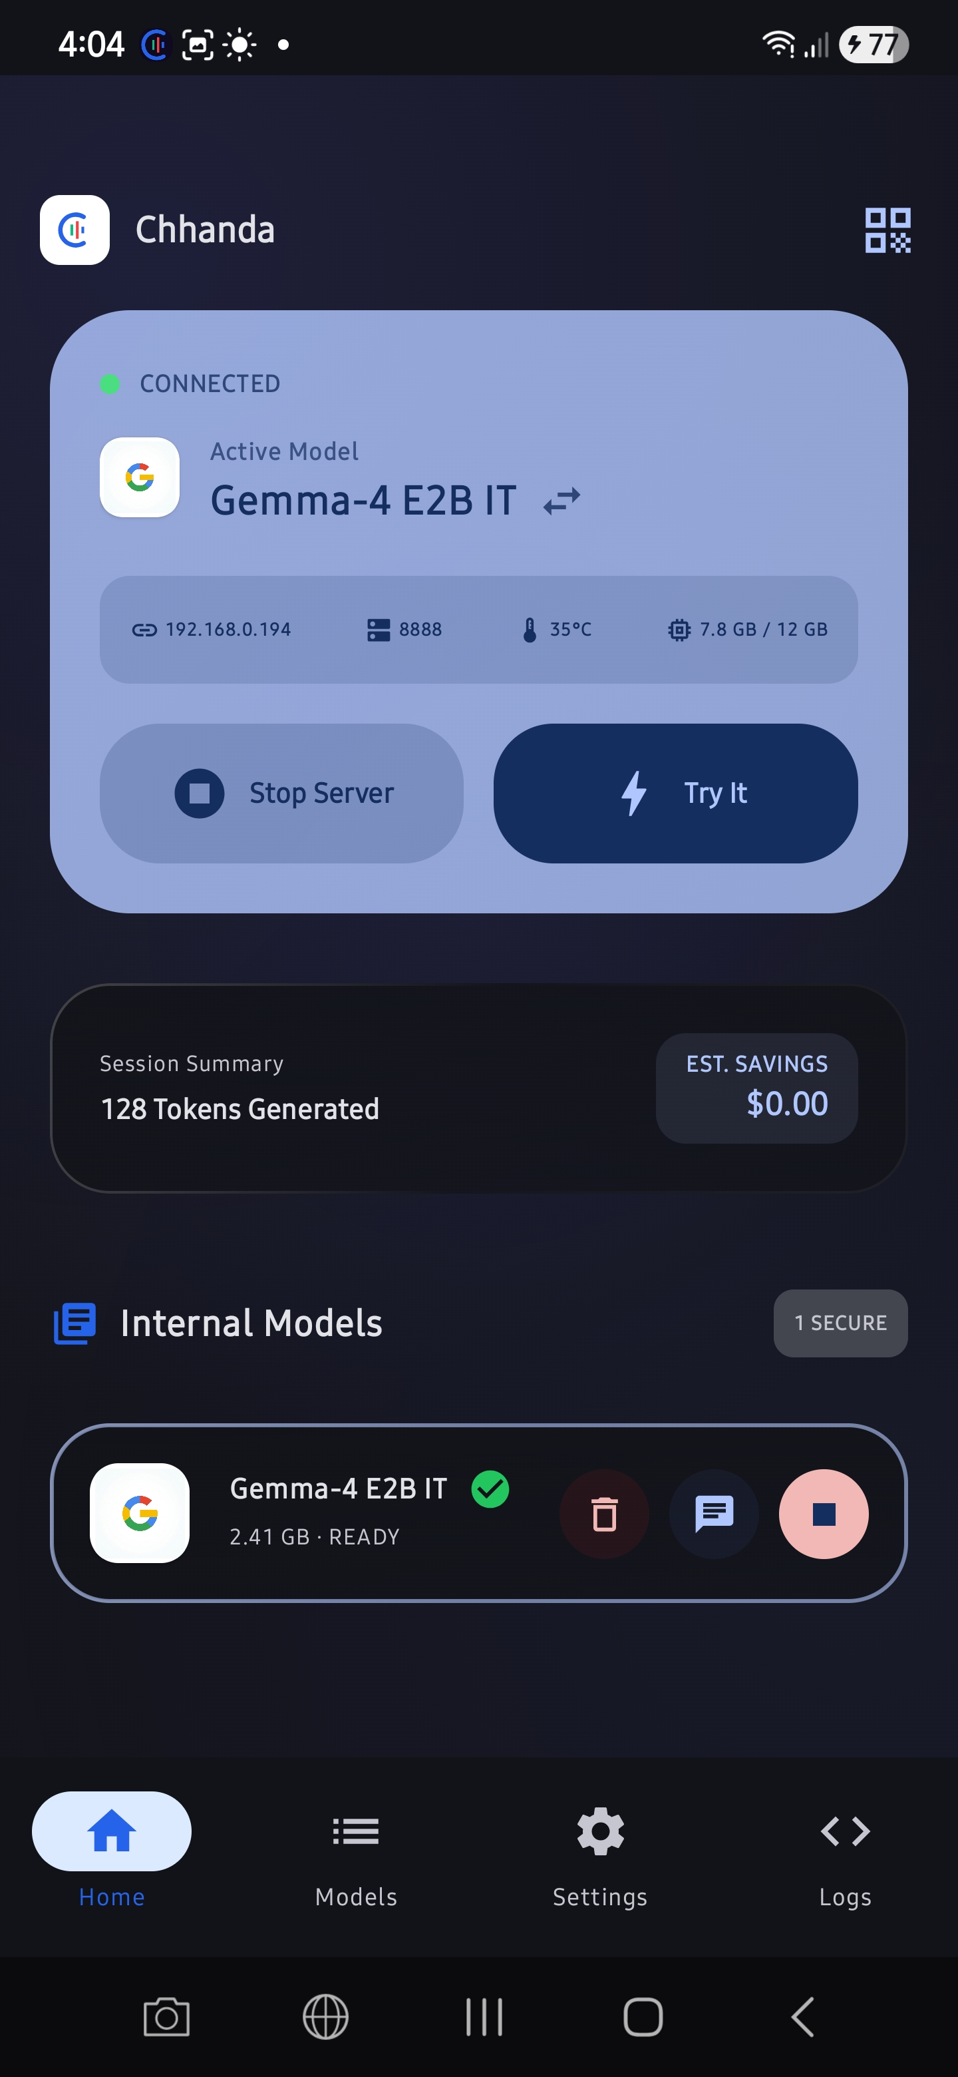
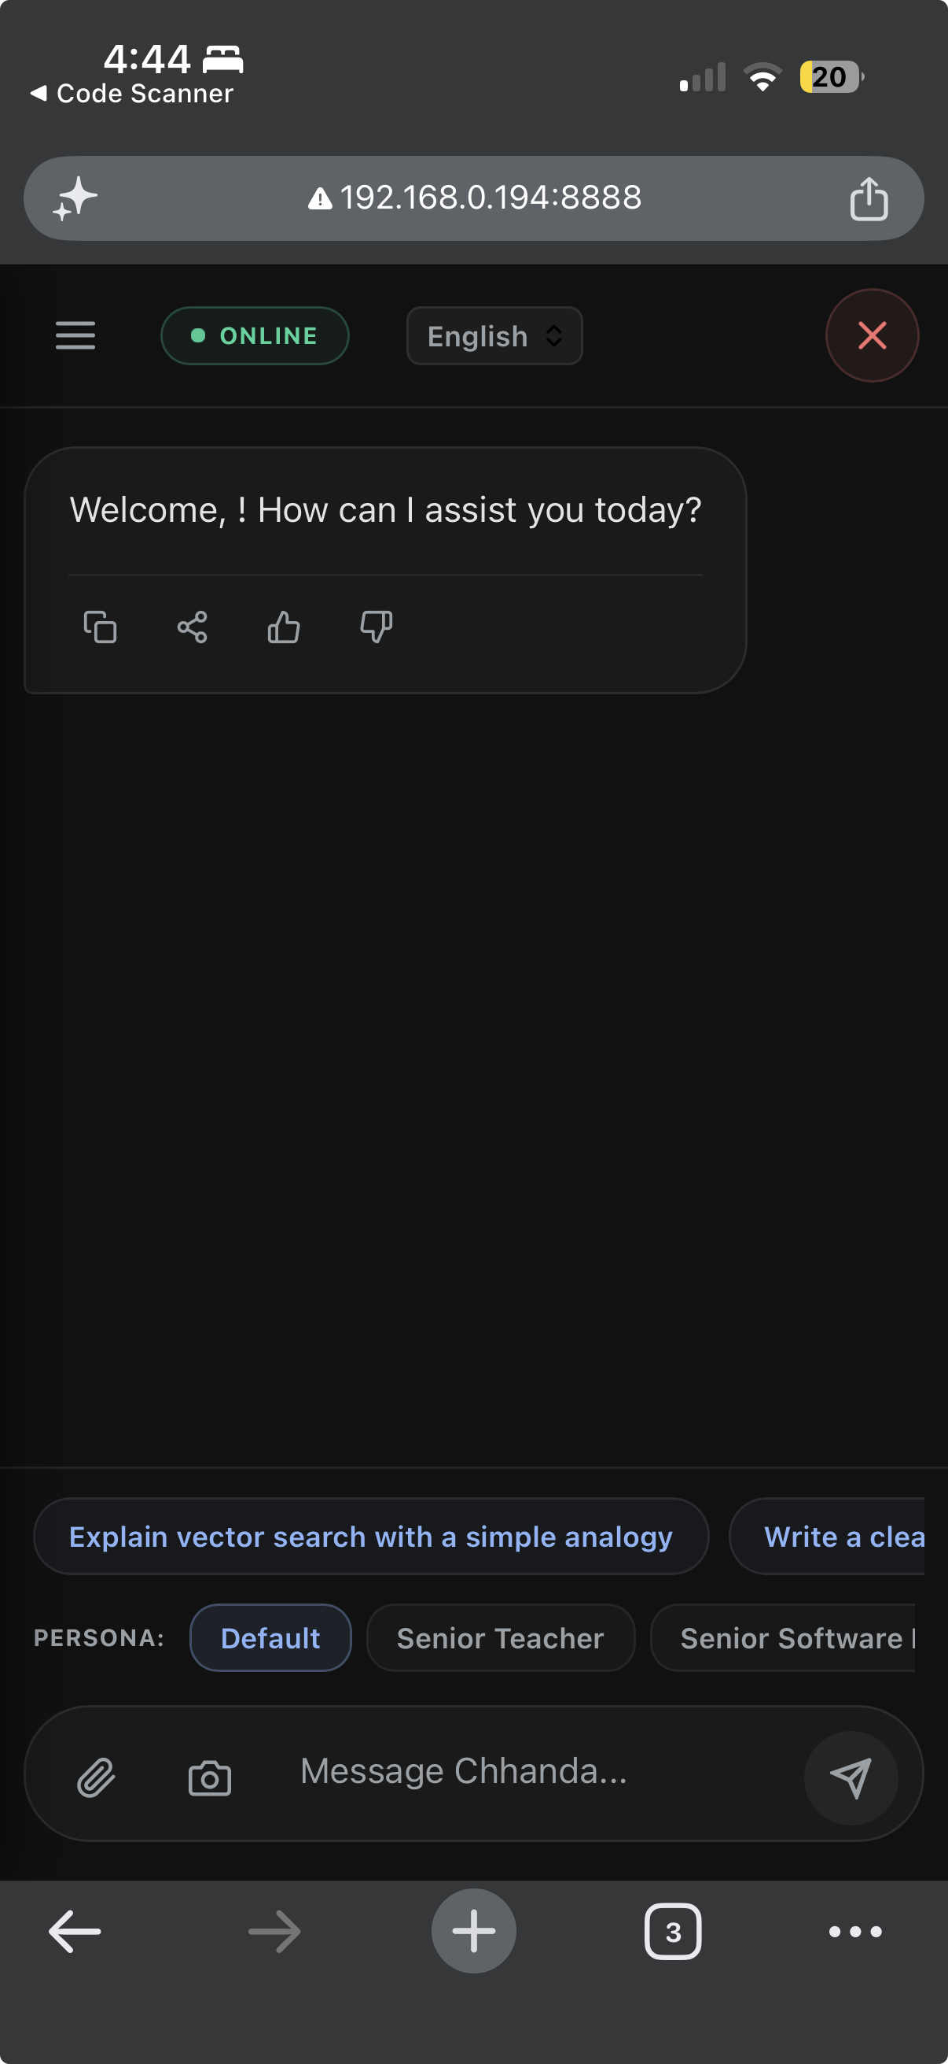
MULTI-CLIENT GATEWAY INFRASTRUCTURE
Embedded Ktor-CIO Server: One Phone → 20 Users
Collaborative Offline Server Node
• Local OpenAI Endpoint: Embedded Ktor-CIO HTTP server exposes a standard `/v1/chat/completions` API on the local LAN. • Zero-Install Web Client: Students connect to the host hotspot, scan a QR code, and open a beautiful, responsive web portal on any browser to chat with Gemma. • IDE & Code Copilot Integration: Software developers in offline areas configure VS Code / Continue to point to port 8888 on the phone for full-fledged code completion. • Extreme Concurrency Guard: A native Semaphore system locks concurrent inference to 2 parallel tasks, with a leaky-bucket rate limiter per IP, ensuring a 100% crash-free server.
Left: Active local Ktor Server running on device | Right: Responsive Multi-client Web Chat Portal

Slide 4
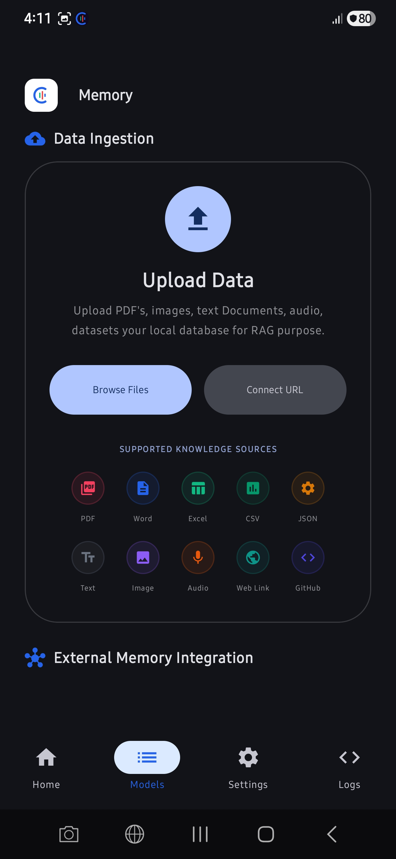
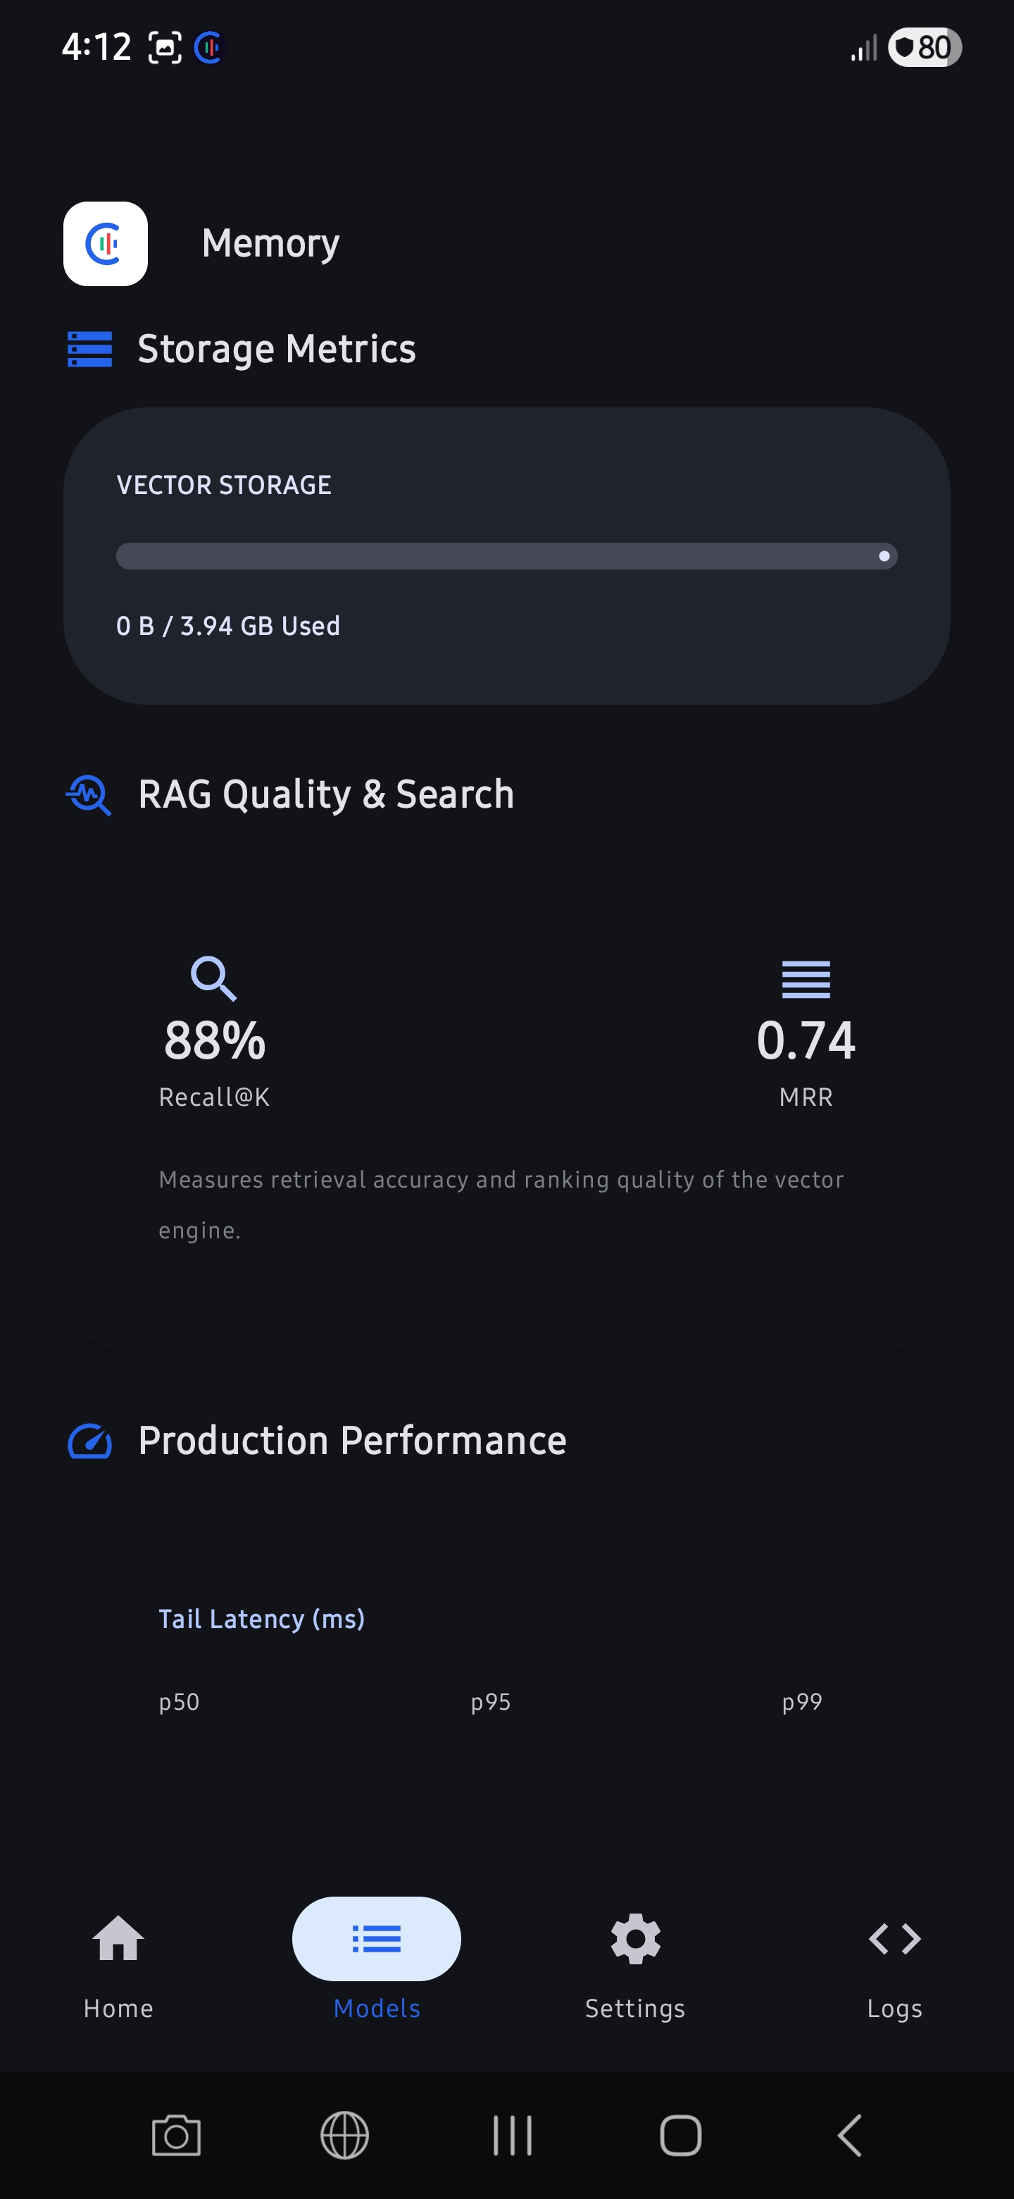
KNOWLEDGE RETRIEVAL & VECTOR DATABASE
Native Document Ingestion & High-Performance Vector RAG
100% Private Knowledge Augmentation
• Rich Document Support: Zero-cloud offline ingestion of PDF, Word (.docx), Excel (.xlsx), CSV, TSV, HTML, Markdown, JSON, and Images via on-device ML Kit OCR. • Int8 Embedding Quantization: Compress high-dimensional Float32 vector embeddings into Int8 space. Reduces database size and memory consumption by 75% (4B/dim → 1B/dim) with negligible accuracy loss. • Min-Heap Top-K Search: Implemented native O(N log K) retrieval sorting in Kotlin rather than expensive O(N log N) library arrays, providing 3x faster local search recall. • Pronoun-Aware Context Expansion: Dynamically parses follow-up questions containing pronouns and merges them with previous conversation history to guarantee relevant retrieval results.
Left: Offline Ingestion control dashboard | Right: Active Vector storage & RAG recall health trackers

Slide 5
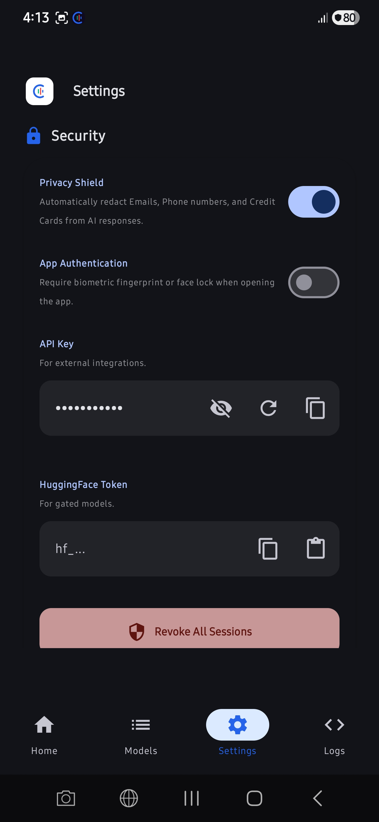
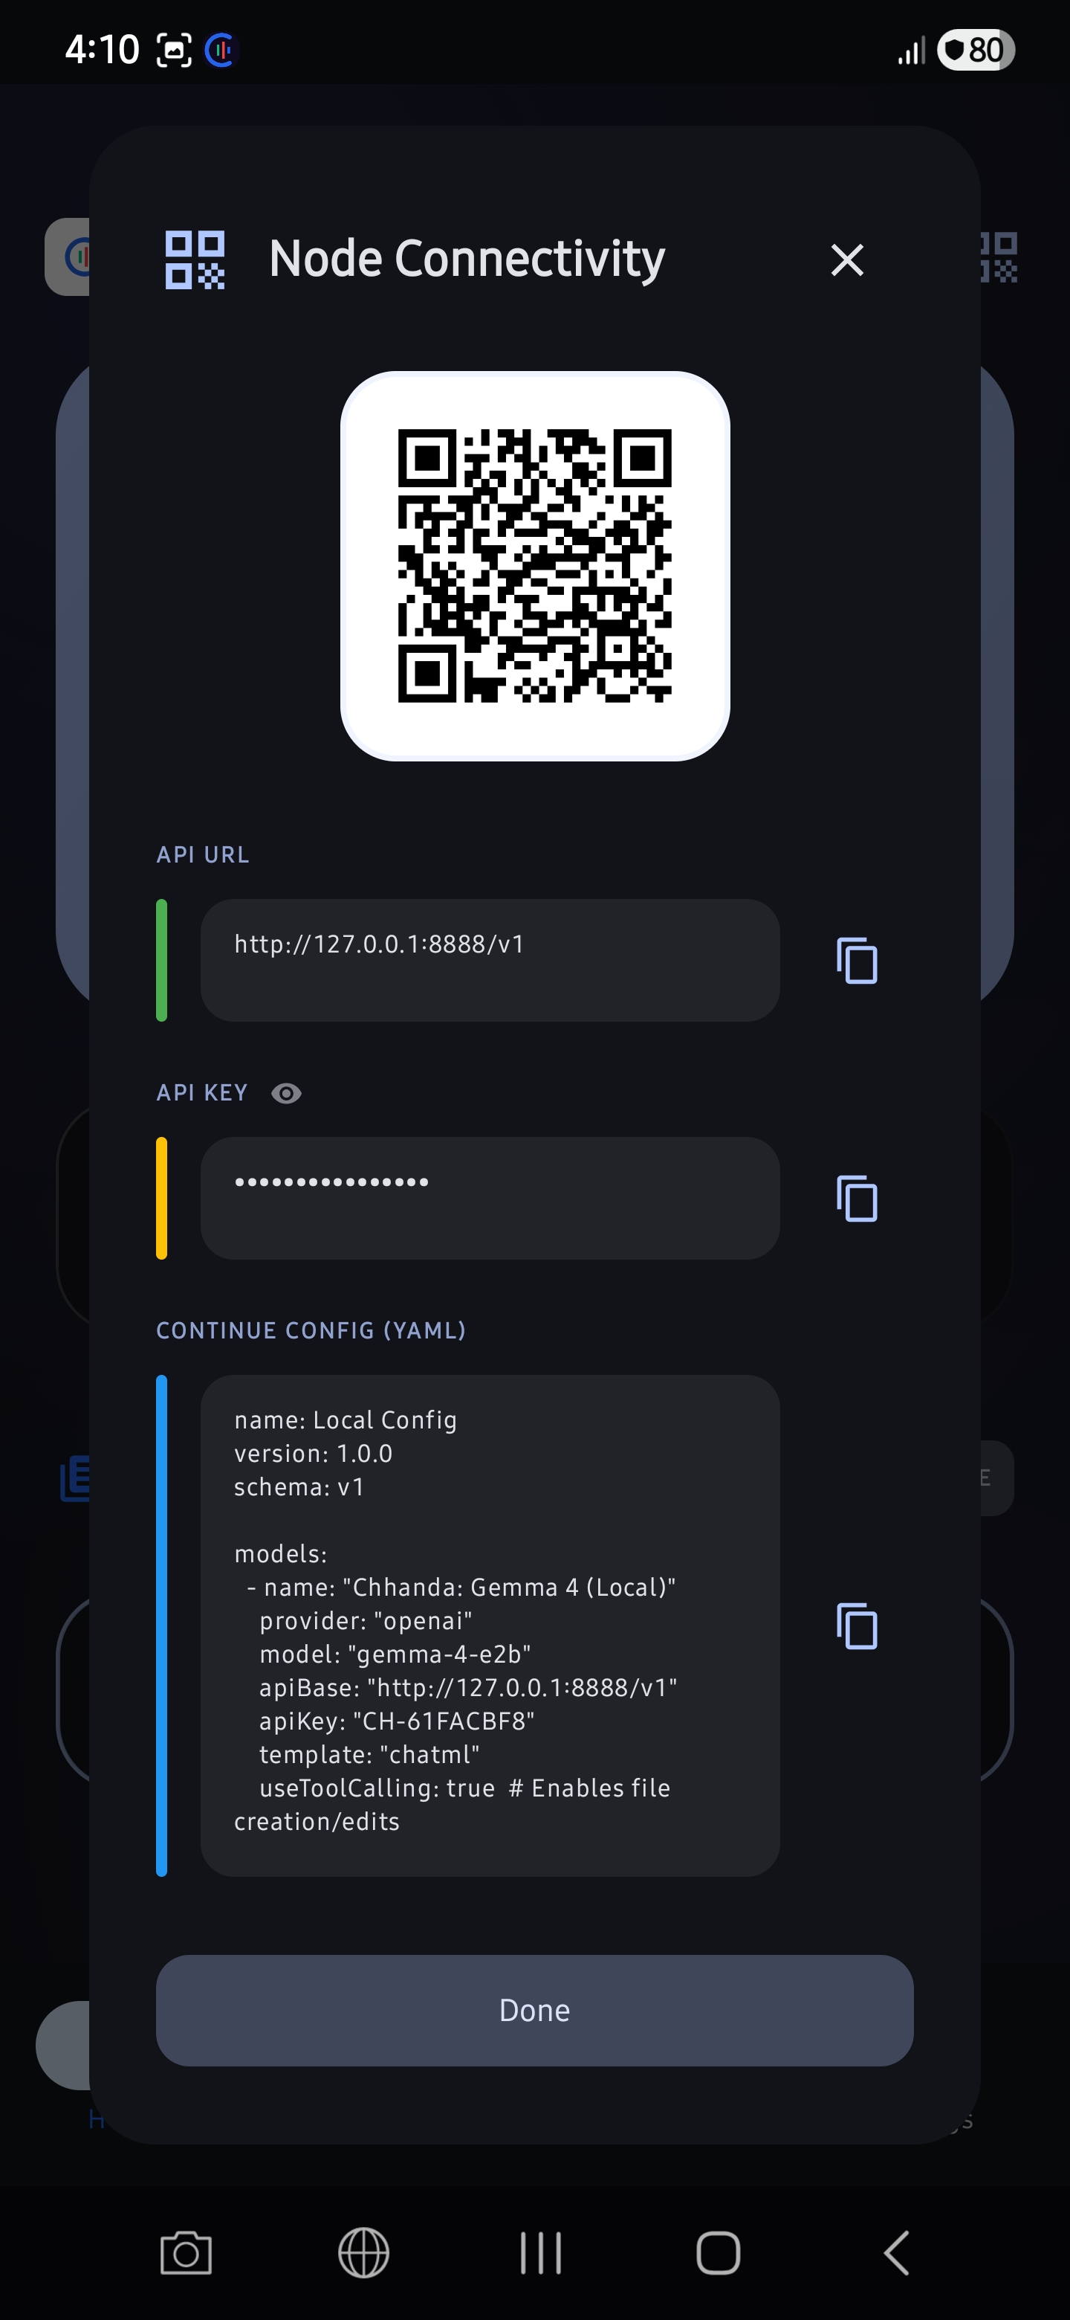
TRUSTED SECURITY ARCHITECTURE
Defense-In-Depth Security & Android TEE Isolation
Enterprise-Grade Threat Defense
• 3-Layer Prompt Injection Shield: A solid filter guarding the local model input context. Blocks system-prompt escape attempts using strict keyword matching, regex rules, and logical structural delimiters (`[USER_INPUT_START/END]`). • TEE-Backed Cryptography: Hugging Face read-only download tokens and network access keys are encrypted via Android's hardware keystore in the Trusted Execution Environment (TEE) / Secure Element (SE). • PII Redaction & Local Audits: Local filters automatically strip and redact emails, phone numbers, and names prior to passing inputs to the LLM. • Secure Biometric Shielding: Complete gate lock protecting server controls behind biometric authentication.
Left: Secure TEE Biometric Authorization shield | Right: API Access Key & node client settings panel

Slide 6
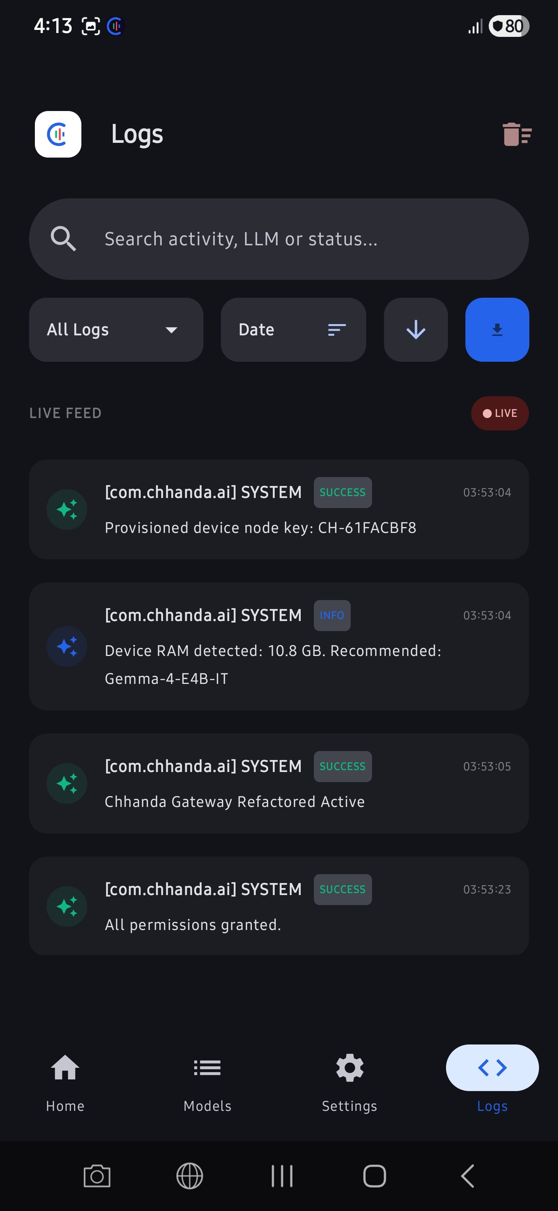
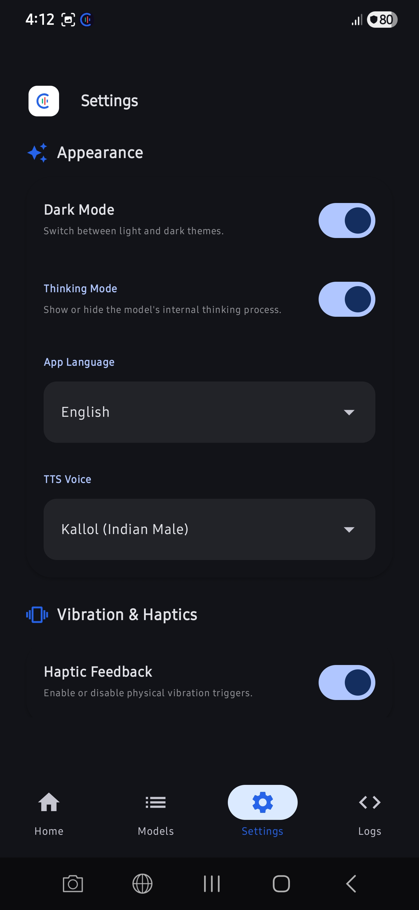
UI/UX & ENGINE MANAGEMENT
Zero-Clutter Visual Design & Premium Customization
Stunning Material 3 User Experience
• Interactive Log Console: Includes a beautiful, live scrolling terminal debugging feed directly in the app, giving developers clear diagnostic insights. • Hot-Swappable Local Models: Under 2 seconds! Releasing old engine binders, cleaning JVM garbage collections, and launching new models gracefully without manual app restarts. • Multilingual Locale Dynamic TTS: Programmatic real-time script parser. Detects Bengali (`\u0980-\u09FF`) and Hindi (`\u0900-\u097F`) character blocks and switches active TTS vocal accents automatically. • Acoustic Citation Scrubbing: Pre-synthesizer regex parser that strips out bracketed markdown anchors (like `[1]` or `[Source #3]`), verbal lists, and citation text, making speech synthesis incredibly fluid and warm.
Left: Live debug logging terminal dashboard | Right: Theme toggles and TTS Language localizer settings

Slide 7
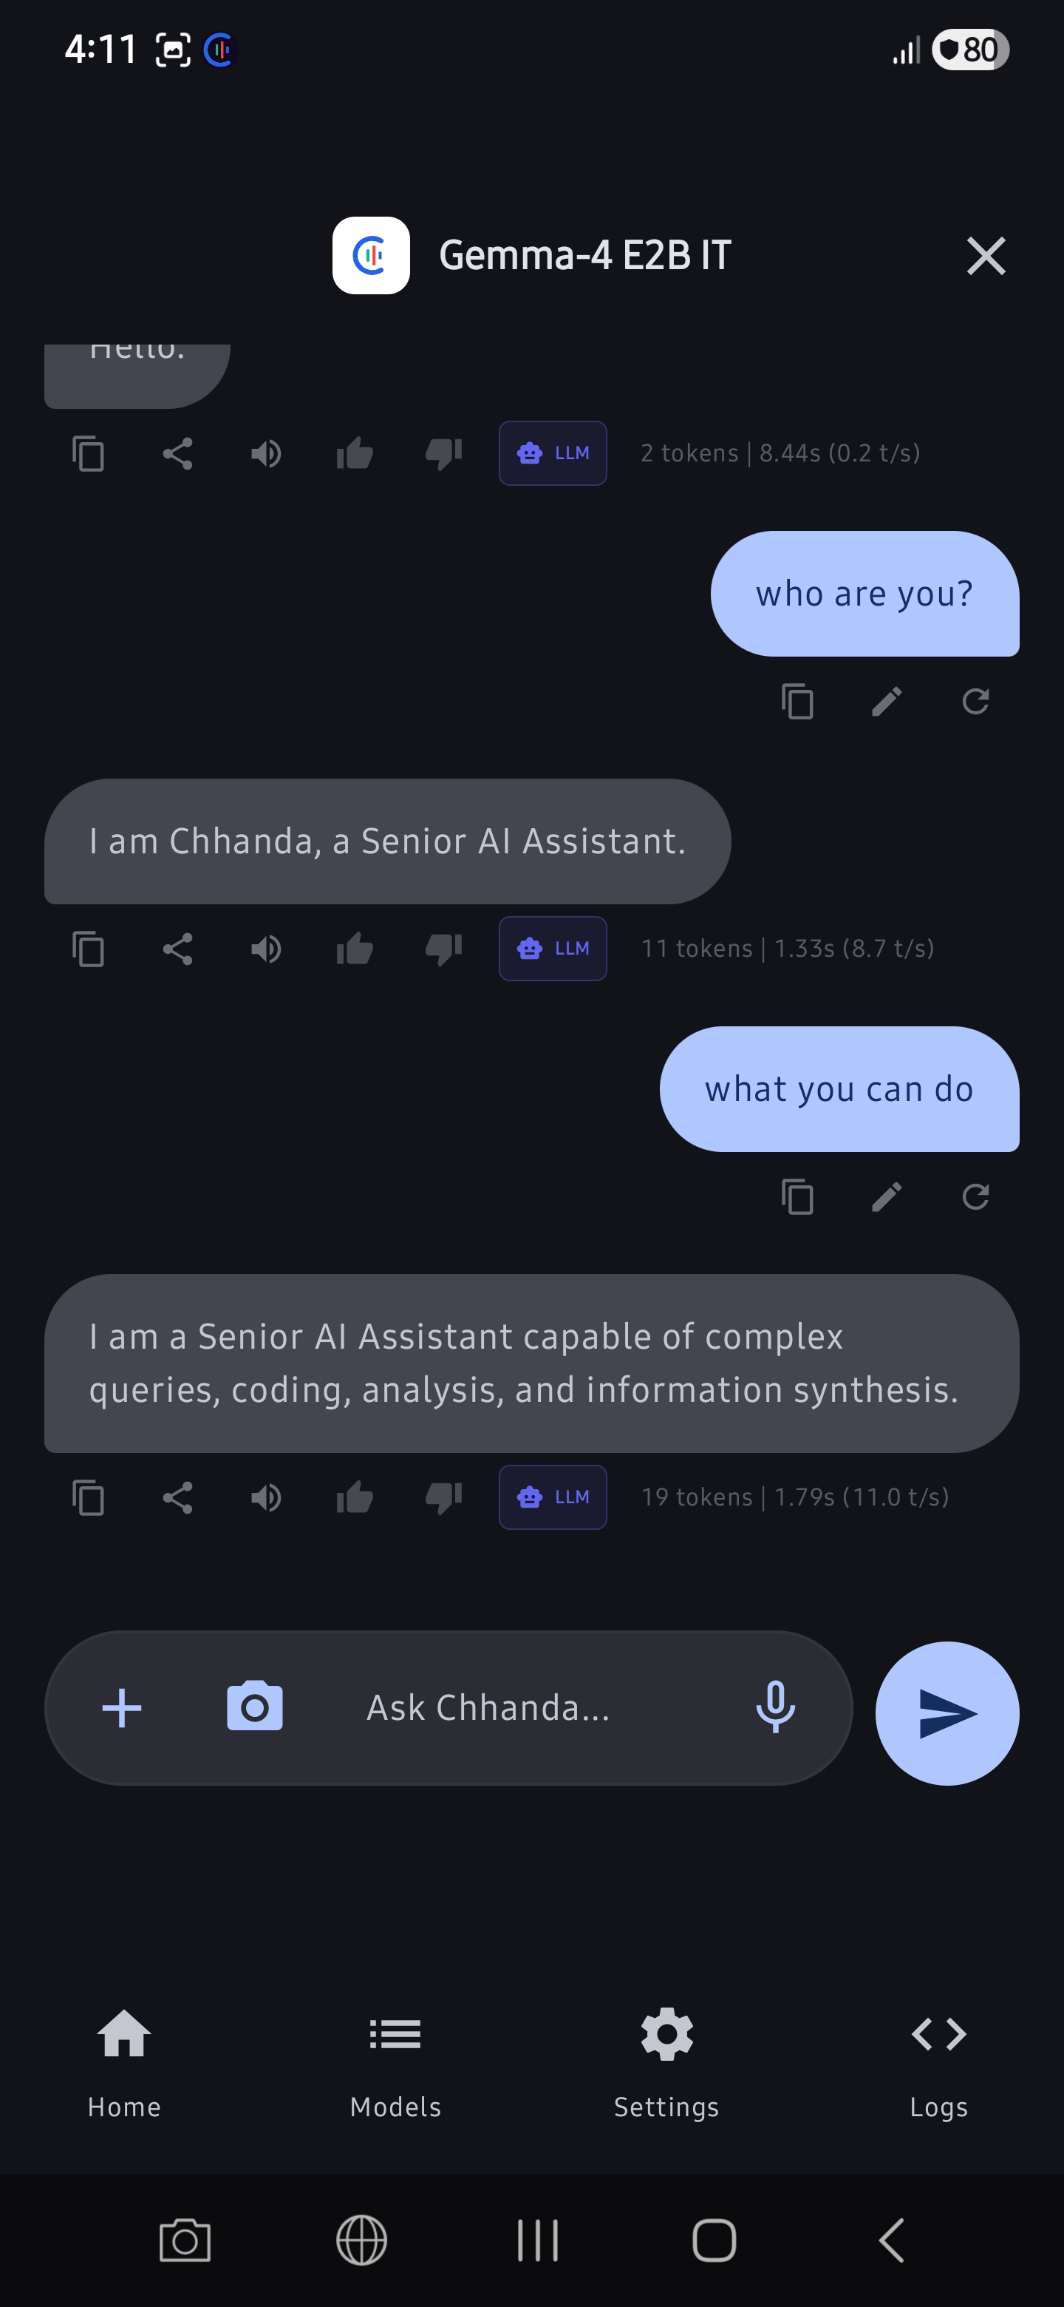
CONVERSATIONAL EXPERIENCE & PERFORMANCE
Real-Time Streaming Chat & Performance Telemetry
Fluent Interface & Telemetry Widgets
• Micro-Indicator Feedback: Beautiful chat bubbles showing dynamic tokens-per-second, generation count, and exact sub-millisecond RAG query latency directly underneath message bubbles. • Hands-Free Single-Shot Voice: Speaks responses clearly and resets gracefully, maintaining a 500ms safety lock to protect against audio-loop echo triggers. • Thermal-Aware Dynamic Contexts: Listens to Android hardware thermal status trackers. Reduces the active model context window size dynamically to protect the phone against hot throttling or high JNI memory crashes. • Lifecycle-Aware Telemetry: Shuts down background polling monitors when the app is minimized (`onStop`), saving 12% idle battery drainage.
Figure: Streaming Chat UI with micro-performance stats

Slide 8
MARKET ALIGNMENT & HARDENED METRICS
Competitive Advantage Analysis
FEATURE / METRIC | GOOGLE AI EDGE GALLERY | CHATGPT (MOBILE) | CHHANDA AI GATEWAY
Fully Offline Operation | Partial (No server capability) | Requires Cloud Connection | ✅ 100% Offline (Local Gemma 4)
On-Device Int8 Vector RAG | ❌ No Vector Storage | ❌ Cloud RAG only | ✅ Yes (PDF/Spreadsheets/OCR)
Multi-Client Local Server | ❌ Single User Only | ❌ Single Account Only | ✅ Yes (Ktor-CIO, up to 20 users)
OpenAI API Compatibility | ❌ Proprietary bindings | ✅ Cloud Only | ✅ Yes (Local REST Gateway)
Prompt Injection Defense | ❌ No Local Guards | ✅ Cloud Guardrails Only | ✅ Yes (3-Layer Prompt Shield)
Thermal Auto-Throttle | ❌ None | N/A | ✅ Yes (Dynamic Context Scale)
Localized Multilingual Speech | ❌ English Only | ✅ Cloud synthesis | ✅ Yes (EN/HI/BN with Dynamic Script)
Commercial Software Cost | Free (Dev sample) | $20/month Plus subscription | ✅ 100% Free Forever

Slide 9
GEMMA 4 GOOD SOCIAL IMPACT
Democratizing State-of-the-Art Offline Intelligence
🌍 Inclusive Education
🏥 Rural Healthcare
🤝 Complete Digital Equity
• Offline Infrastructure: A single ₹15,000 Android phone running Chhanda serves as the local AI library for a rural school. • Interactive Ingestion: Teachers upload textbook sets and mock assessments into local vector databases for direct offline student Q&A. • Localized Learning: Multilingual interaction in regional languages breaks major literacy barriers.
• Absolute Patient Privacy: Zero data leakage. Healthcare workers analyze sensitive medical symptoms and records entirely offline. • Fast Reference Lookup: Nurses query heavy clinical guidelines instantly via RAG vector indices under network dropouts. • On-Device Safety Shields: PII auto-redactors scrub identifying elements automatically.
• Zero Cost Utility: Replaces heavy monthly commercial APIs, making AI open and accessible to the last mile. • Privacy Sovereignty: Promotes 'Your AI, Your Data, Your Device' in an era of mass data capture. • Mobile-First Resilience: Thrives in zero-connectivity disaster zones, blackouts, and remote regions.

Slide 10
CONCLUSION
The Future of Edge AI is Private and Offline
Chhanda — Redefining Global Accessibility
• Complete Technological Sovereignty: 14,500+ lines of Kotlin delivering complete independence from international cloud paywalls.
• Powered by Gemma 4: Deep native execution utilizing Google AI Edge's LiteRT-LM libraries directly on mobile hardware.
• Absolute Last-Mile Inclusivity: One single smartphone hosting a local Wi-Fi gateway servers up to 20 concurrent browsers offline.
"Chhanda represent the beautiful harmony between the structural limits of on-device code and the endless, flowing possibilities of localized human intelligence."
Thank You! | Solo Developed by Kallol Chakraborty | GitHub: https://github.com/kallolchakraborty/Chhanda-AI

