Slide 1
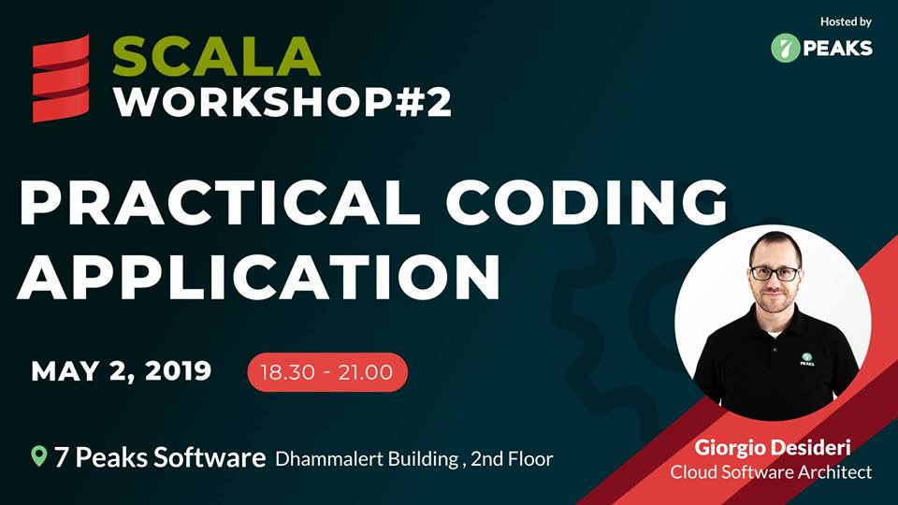

Slide 2


HOUR 1
Refreshing concepts to code the application
Domain analysis and design
Functional and object design
Coding application

Slide 3

REFRESH
Define application domain ( entity, DTO, DAO, etc … )
All types are objects
“Functional programming is …. as the evaluation of mathematical functions and avoids state and mutable data”
DSL := ( function + stateless + immutable types )

Slide 4
Monoids
Exist class A
SomeFunction( A1, A2 ) := A3
(binary associative operation that takes two values of type A and combines them into one)
SomeFunction( A1, NULL) := A1
(A value of type A that is an identity for that operation)

Slide 5
Monads
Monads are structures that represent sequential computations. A Monad is not a class or a trait; it is a concept.
A Monad is an object that wraps another object in Scala. Use for-comprehension instead of flatMap(s)

Slide 6

Options
Option[A] → is the abstract class to represents the implementations
Some → options with value.
E.g. Option[Int] = Some(10)
None → Option without value, aka null

Slide 7
APPLICATION
Test case of one E-COMMERCE application, where
    Registered user can access by email & password
    Registered user can create new product to sell
    Registered user can update or remove own products
    Unregistered user can navigate throught the website to search the products

Slide 8
Use Cases
Authentication
Products
Login
Add / Create
Logout
Update
Search

Slide 9
Use Cases
Authorization
    Registered & Unregistered user
Audit
    Log actions on registered user to support
    Log actions on unregistered user to statistics
Not delete → archive for accounting

Slide 10
Coding
Download application template
https://github.com/kallsu/scala-workshop
Choose directory
      workshop02/scala-template-app/
Wifi SID: “7 Peaks Software”
Password: 7p3akss0ftware

Slide 11
Coding
Domain ( object and action )
Routing
Database
    Entity
    DAO
1st operation
    TDD
Validation

Slide 12
End of HOUR 1

Slide 13
HOUR 2
Finish to code the application
“Scala”-ing the application
Testing and improvement discussion

Slide 14
Coding
Testing and acceptance criteria
    Does it “work” ?
    Why?
Database ;-) ?!?!??!!??!

Slide 15
Discussion
Multiple instances and multiple region distribution
    Database changes ?
    Logging and Audi changes ?
    User management changes ?

Slide 16
End of HOUR 2

Slide 17
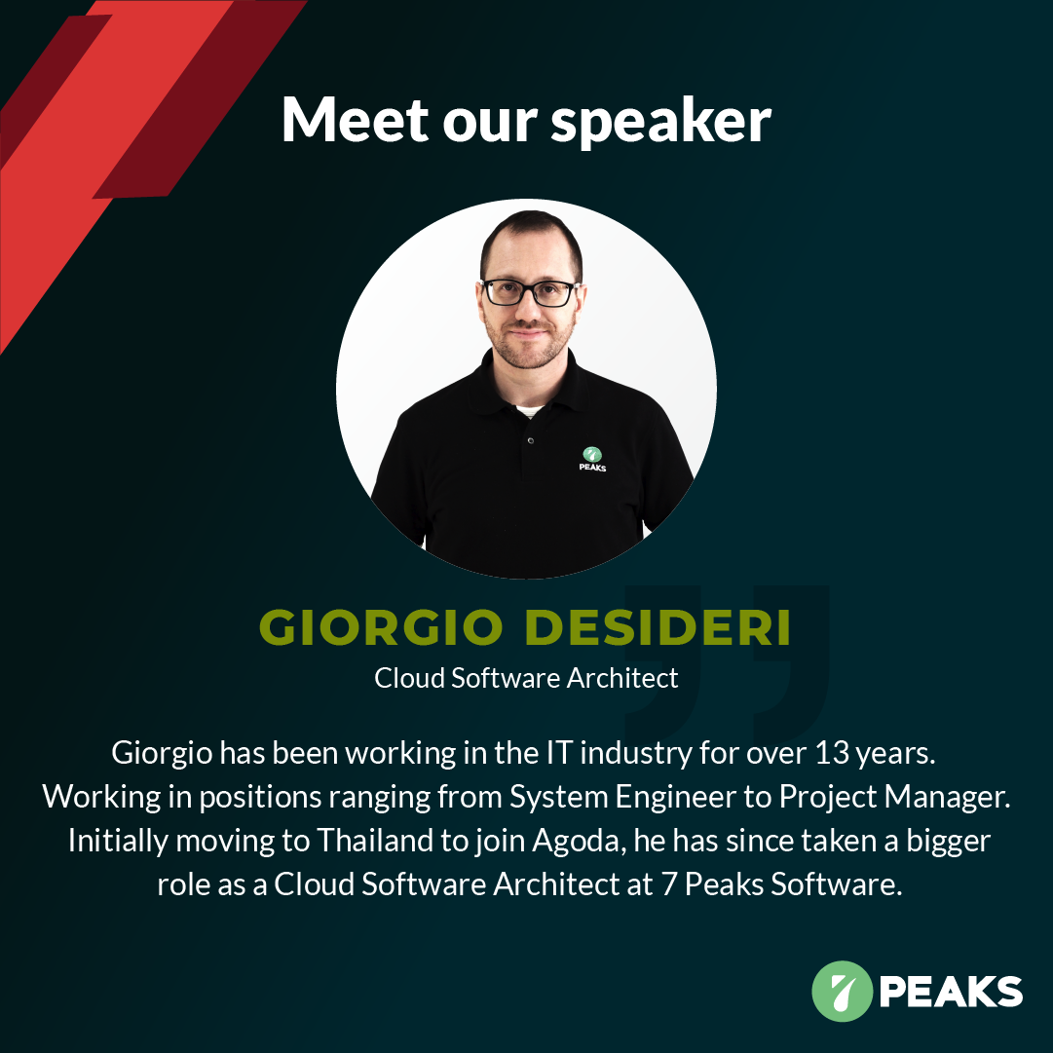
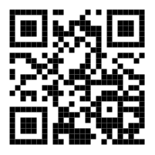
Who we are

Slide 18
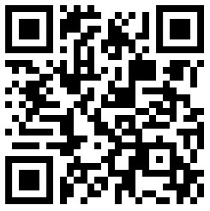
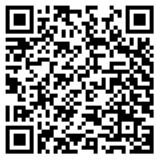
Links
Materials
Event Feedbacks

