Slide 1
PRESENTATION ON SMART AGRICULTURE

Slide 2
WELCOME
Welcome to smart agriculture presentation
Transforming traditional farming with technology
Building tomorrow’s agriculture solutions today
Empowering farmers through digital innovation

Slide 3
WORKSHOP OBJECTIVES
Learning objectives
Understand the role of AI/ML in modern agriculture
Learn image processing techniques for crop disease detection
Master MATLAB and Simulink for agricultural applications
Develop practical skills in cotton leaf disease identification
Build real-time disease classification systems

Slide 4
WORKSHOP AGENDA
Today’s schedule
09:40 - 10:30 : Welcome & Objectives
10:31 – 11:00 : Introduction to Image Processing & ML in Agriculture
11:00 – 12:00 : MATLAB & Simulink Basics
12:00 – 01:00 : Preprocessing Cotton Leaf Images
14:00 – 15:30 : Feature Extraction & ML Model Training
15:30 – 16:30 : Simulink Integration & Real – Time Simulation

Slide 5
THE AGRICULTURE CHALLENGES
CURRENT PROBLEMS IN AGRICULTURE
Manual disease detection is time-consuming and subjective
Late detection leads to significant crop losses (20-40% yield reduction)
Lack of expertise in remote areas
Need for precision agriculture solutions
Economic impact : $220 billion annual crop issues globally
Human visual inspection limitations : lighting, fatigue, experience variance

Slide 6
COTTON CROP IMPORTANCE
Why focus on cotton?
Major cash crop in India
Susceptible to various leaf diseases
High economic value and export potential
Visual symptoms appear on leaves first
Idea candidate for image based detection

Slide 7
COTTON CROP LEAF DISEASES
Major cotton leaf diseases
Bacterial blight
angular, water-soaked lesions
Brown to black spots with yellow halos
Cotton leaf curl virus (CLCuV)
Upward curling of leaves
Yellowing and stunted growth
Fusarium wilt
Yellowing and wilting of leaves
Vascular discoloration

Slide 8
TRADITIONAL VS SMART DETECTION
Comparison : Traditional vs Ai-based Detection
Traditional method | AI-based Method
Visual inspection by experts | Automated image analysis
Subjective and time consuming | Consistent and objective
Limited scalability | Scalable to large areas
Human error pronea | 24/7 availability

Slide 9
IMAGE PROCESSING IN AGRICULTURE
Role of image processing
Image acquisition
Cameras , drones , smartphones
Preprocessing
Noise removal , enhancement
Segmentation
Isolating regions of interest
Feature extraction
Color, texture, shape analysis
Classification
Healthy vs diseased identification

Slide 10
MACHINE LEARNING APPLICATIONS
ML in Precision Agriculture
Supervised learning: training with labeled data
Classification algorithms: SVM, Decision Trees, Neural Networks
Pattern recognition: identifying disease signatures
Predictive analytics: early warning systems
Automated decision making: treatment recommendations

Slide 11
REAL WORLD IMPACT
Success stories and benefits
Early detection: 95% accuracy in disease identification
Cost reduction: 40% decrease in pesticide usage
Yield improvement: 25% increase in crop productivity
Farmer empowerment: mobile app based solutions
Scalability: drone-based monitoring of large fields

Slide 12
WHY MATLAB IN AGRICULTURE?
Matlab Advantages
Comprehensive image processing toolbox
Built-in machine learning algorithms
Easy prototyping and visualization
Integration with hardware systems
Simulink for system modeling

Slide 13
MATLAB ENVIRONMENT
Matlab interface overview
Command Window: Execute commands
Workspace: Variable management
Current Folder: File navigation
Editor: Script and function development
Figure Windows: Data visualization

Slide 14
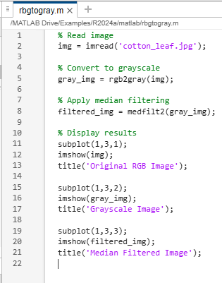
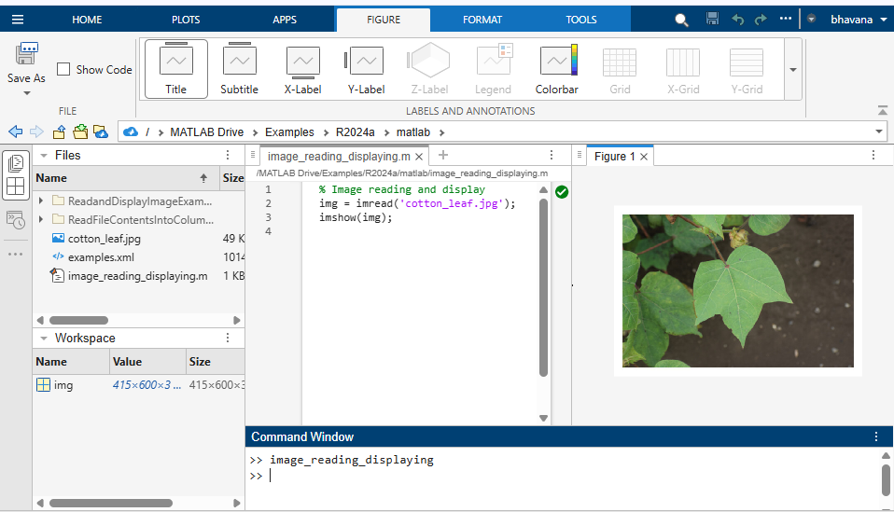
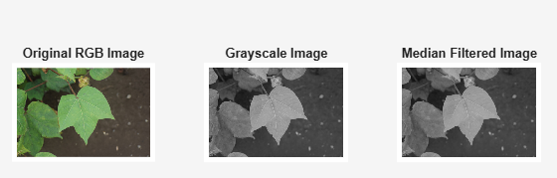
IMAGE PROCESSING TOOLBOX
Image reading, image displaying, converting rgb to grayscale

Slide 15
SIMULINK OVERVIEW – VISUAL MODELING ENVIRONMENT
Block based modeling
Graphical drag-and-drop interface
Library of prebuilt blocks for image processing, control and ML
Easy to connect MATLAB functions with visual blocks
System simulation
Test and debug algorithms before real-world deployment
Model complex agricultural systems
Simulate environmental changes and processing delays
Real – time capabilities
Hardware-in-the-loop (HIL) testing
Integration with cameras, sensors and embedded boards
Model verification
Validate algorithm performance against real datasets
Automated checks for model accuracy and timing
Performance profiling for hardware constraints

Slide 16
IMAGE ACQUISITION METHODS
Data collection strategies
Smartphone Photography
Low-cost and widely accessible
Ideal for close-up leaf inspections
Works best with consistent lighting and stable focus
Drone-based Imaging
Monitors large agricultural fields efficiently
Supports multi-spectral and thermal imaging
Captures GPS-tagged images for precise mapping
Dataset Preparation
Use public datasets (e.g., PlantVillage)
Collect custom field images to match local crop varieties
Apply data augmentation (rotation, scaling, flipping) to improve ML model robustness.
Fixed camera installations
Cameras mounted in greenhouses or fields for continuous monitoring
Time-lapse image capture for tracking disease progression
Can be integrated with IoT sensors for environmental data
Satellite imaging
Very large-scale crop monitoring
Useful for detecting stress patterns across regions
Typically lower resolution, but supports multi-spectral and hyperspectral analysis
Hyperspectral / multispectral cameras
Capture data beyond visible light (NIR, SWIR)
Detects plant stress before symptoms appear visually
Often used in research setups or on drones
Microscope / Lab imaging
Used for detailed pathogen – level analysis
High – resolution cellular and tissue images
Not practical for field deployment bus useful for ground – truth data

Slide 17
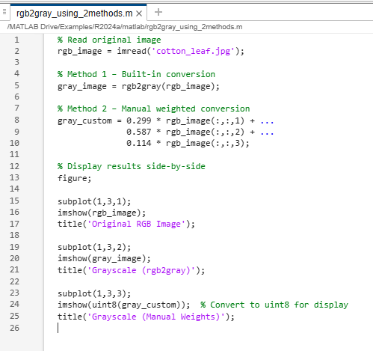
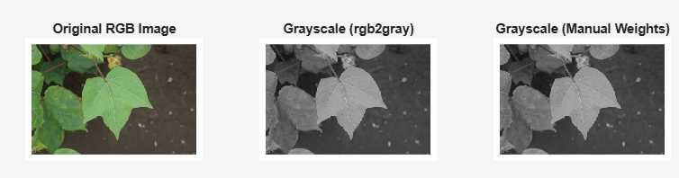
COLOR SPACE CONVERSION

Slide 18
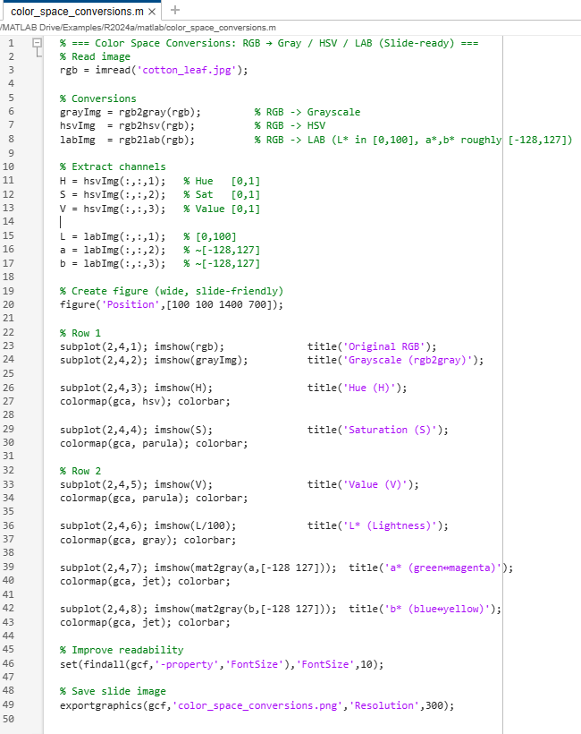
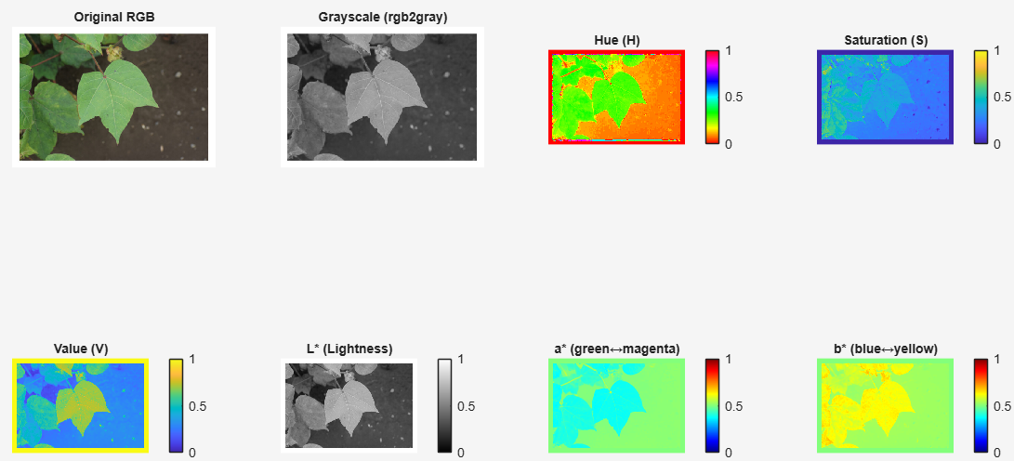
COLOR SPACE CONVERSION

Slide 19
NOISE REMOVAL TECHNIQUES – FILTERING METHODS
Purpose: removes unwanted variations in pixel values caused by senor imperfections, environmental conditions or transmission errors. Improves image quality for further processing.
Common methods:
Median filtering
Replaces each pixel with the median of its neighborhood
Excellent for salt-and-pepper noise removal
Preserves edges better than mean filtering
Gaussian filtering
Uses a Gaussian kernel for weighted averaging
Smooths images and reduces Gaussian noise
Tends to blur edges slightly

Slide 20
IMAGE SEGMENTATION – SEGMENTATION TECHNIQUES
Purpose: partition the image into meaningful regions for analysis, such as separating the leaf from the background or isolating diseased areas
Common methods:
Thresholding
Converts grayscale image to binary using intensity cutoff
Otsu’s method automatically finds optimal threshold
Works well when foreground and background have distinct brightness levels
Edge detection
Finds boundaries where pixel intensity changes sharply
Canny is widely used for its accuracy and noise resistance
Useful for outlining shapes like leaf edges or disease spots.

Slide 21
MORPHOLOGICAL OPERATIONS – SHAPE PROCESSING
Purpose: modify binary images to enhance or remove specific structures, especially useful after segmentation
Basic operations:
Dilation (imdilate): expands white regions, bridges gaps in edges
Erosion(imerode): shrinks white regions, removes small noise
Opening(imopen): erosion followed by dialation, removes small noise particles while keeping main shapes
Closing(imclose):dialation followed by erosion, fills small holes in objects

Slide 22
FEATURE EXTRACTION & ML MODEL TRAINING
1. Color Features - Mathematical Foundation
RGB Color Space: Additive color model representing Red, Green, Blue intensities
Range: [0, 255] for 8-bit images
Linear relationship with light intensity
Suitable for device-dependent color representation
HSV Color Space: Hue, Saturation, Value
Hue: Color information (0°-360°)
Saturation: Color purity (0-100%)
Value: Brightness (0-100%)
More intuitive for human perception
Statistical Color Descriptors:
Mean (μ): Average intensity μ = (1/N)Σpᵢ
Variance (σ²): σ² = (1/N)Σ(pᵢ - μ)²
Skewness: Measures asymmetry = E[(X-μ)³]/σ³
Kurtosis: Measures tail heaviness = E[(X-μ)⁴]/σ⁴
2. Texture Features - Signal Processing Approach
Gray Level Co-occurrence Matrix (GLCM):
2D histogram of pixel pair occurrences
Captures spatial relationships between pixels
Direction-dependent (0°, 45°, 90°, 135°)
Distance parameter controls neighborhood size
Local Binary Patterns (LBP):
Binary encoding of local neighborhoods
Rotation and illumination invariant variants
Histogram of pattern occurrences as feature vector
Computational complexity: O(n) per pixel
Gabor Filters:
Frequency and orientation selective filters
Gaussian envelope modulated by sinusoid
Parameters: wavelength (λ), orientation (θ), aspect ratio (γ)
3. Shape Features - Geometric Descriptors
Basic Geometric Properties:
Area: Number of pixels in region
Perimeter: Boundary length in pixels
Circularity: 4π×Area/Perimeter²
Aspect Ratio: Major axis / Minor axis
Advanced Shape Descriptors:
Hu Moments: 7 translation, rotation, scale invariant moments
Fourier Descriptors: Frequency domain shape representation
Solidity: Area/ConvexHullArea (measure of convexity)
EXTRACTING FEATURES: COLOR, TEXTURE, SHAPE

Slide 23
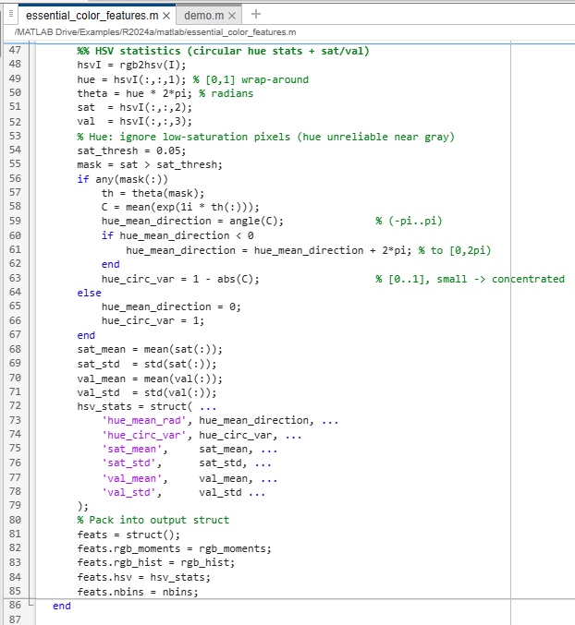
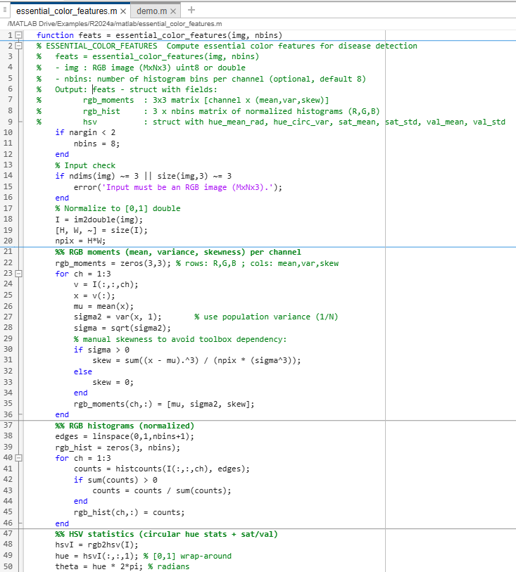
COLOR FEATURE EXTRACTION - IMPLEMENTATION DETAILS
The code extracts color-based features from agriculture image. These features are crucial for detecting diseases because diseased leaves show distinct color deviations

Slide 24
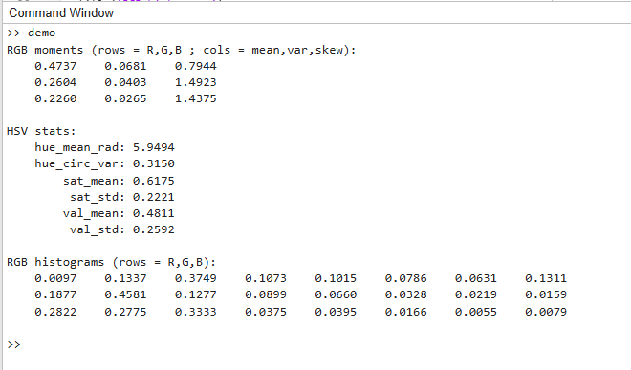
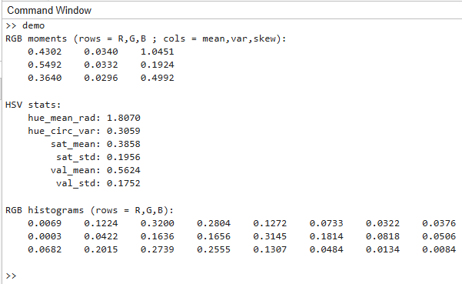
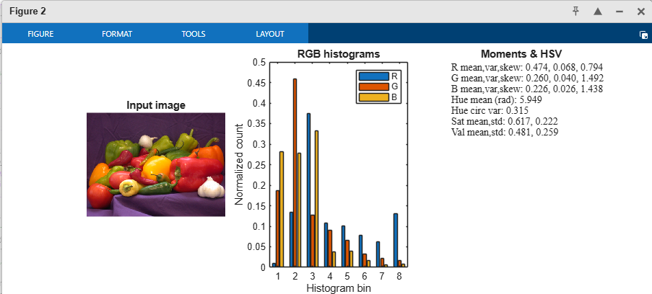
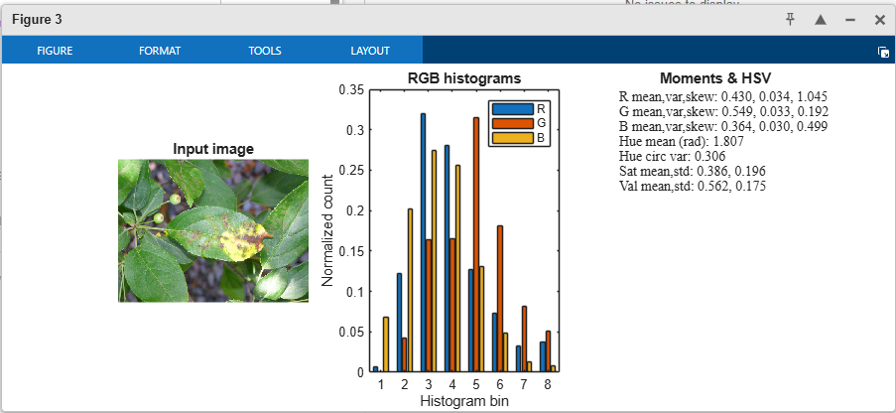
COLOR FEATURE EXTRACTION - IMPLEMENTATION DETAILS

Slide 25
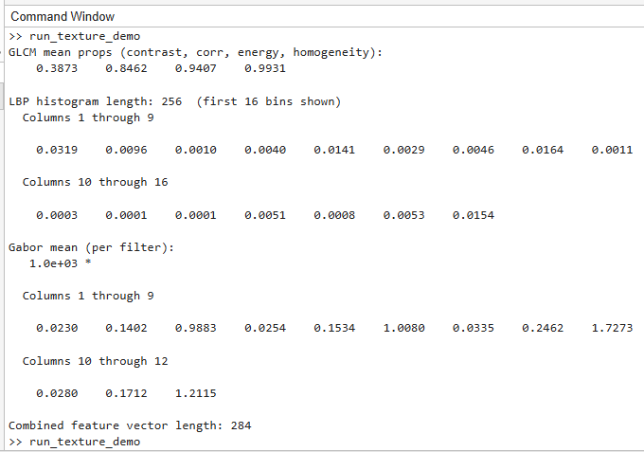
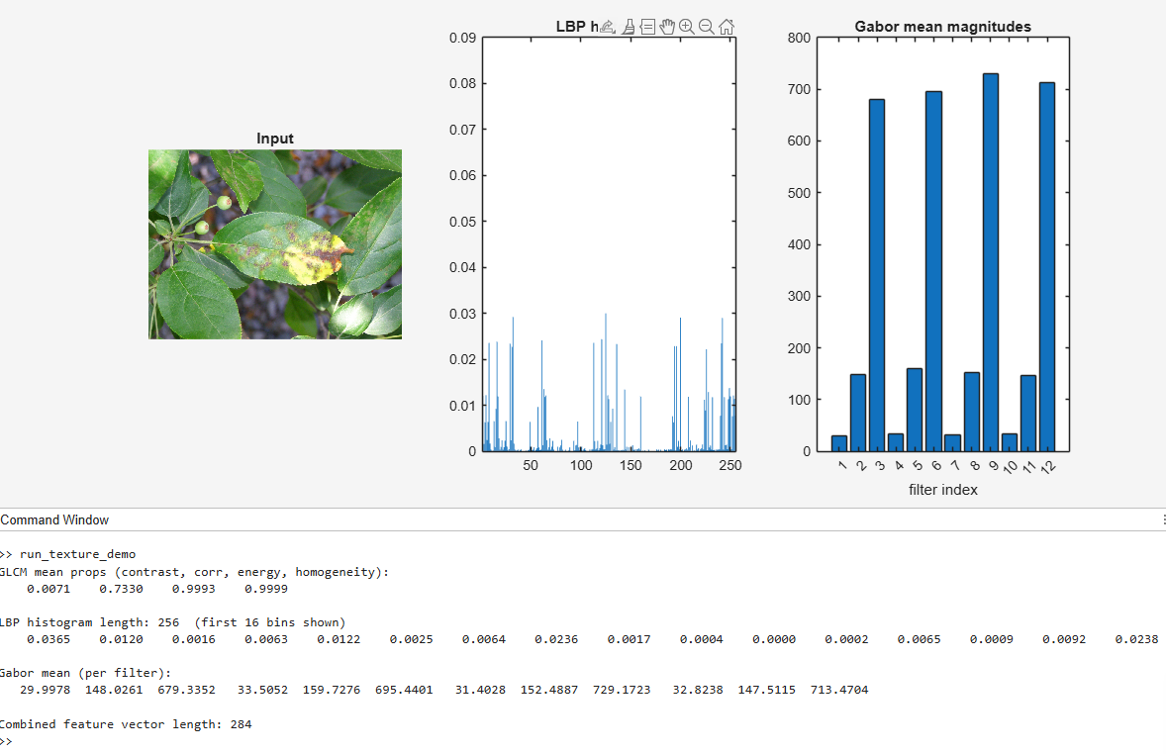
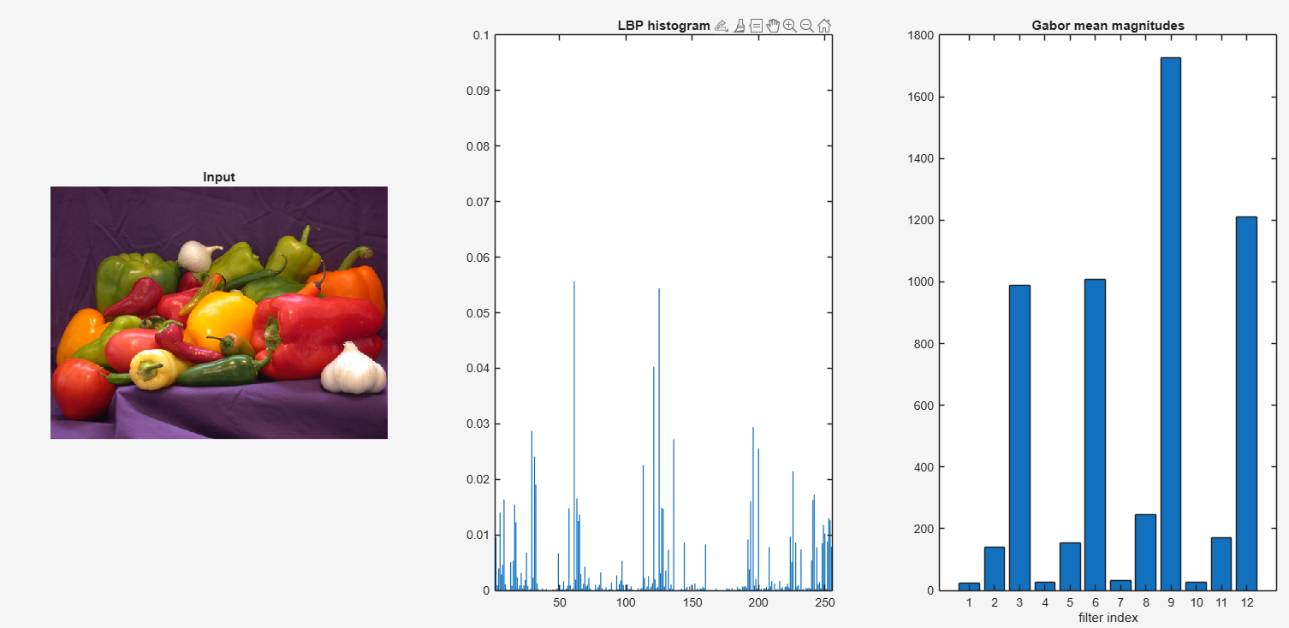
TEXTURE FEATURES – IMPLEMENTATION DETAILS

Slide 26
DATASET PREPARATION & SPLITTING
Dataset structure
Images are stored in two folders:
Healthy → healthy leaf images
Diseased → diseased leaf images
Features extraction & labels
Loaddataset() converts images → numerical feature matrix (features)
Labels(labels) indicate whether a sample is healthy or diseased.
Splitting into training & testing
70% training data → used to train the model
30% testing data → used to test model performance
Cvpartition ensures stratified sampling (equal distribution of healthy & diseased samples)

Slide 27
ML ALGORITHMS: SVM, DECISION TREES, KNN
SUPPORT VECTOR MACHINE
Supervised learning algorithm for classification/regression
Works well for high-dimensional feature spaces (color, texture, shape)
DECISION TREE
Tree like structure for decision making
May overfit, but useful for quick decisions
K-NEAREST NEIGHBORS (KNN)
Instance based, non-parametric algorithm
Classifies based on similarity to nearby samples
Finds the optimal boundary (hyperplane) that best separates classes (i.e separates healthy vs diseased leaves)
Kernel trick allows handling non-linear problems
Splits data based on features (eg. Leaf color, vein patterns)
Easy to visualize and interpret for disease diagnosis
Effective for small datasets
Computationally expensive for large datasets
Sensitive to noise & requires proper choice of K

Slide 28
TRAINING & VALIDATION USING MATLAB CLASSIFICATION LEARNER APP
PURPOSE
To train machine learning models on labeled data and evaluate their performance
Ensures that the model generalizes well to unseen data avoiding overfitting
TRAINING & VALIDATION
The process where the algorithm learns patterns from the training dataset
Adjusts model parameters to minimize prediction error on known data
MATLAB CLASSIFICATION LEARNER APP BENEFITS
User-friendly GUI
Code generation
Uses a separate validation dataset to test model accuracy during training
Helps in hyperparameter tuning, selecting the best model and preventing overfitting
Supports multiple algorithms
Automatic model comparison
Visualization tools

Slide 29
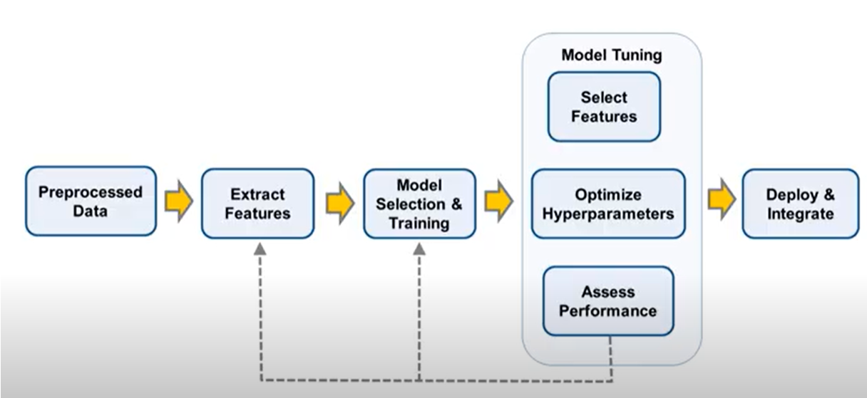
BUILD MODELS WITHOUT CODING USING MATLAB CLASSIFICATION LEARNER APP
The MATLAB Classification Learner App is a tool within the statistics and machine learning toolbox that facilities the training, evaluation, and comparison of classification models using supervised machine learning. It allows users to perform classification tasks without writing extensive code

Slide 30
PERFORMANCE METRICS: ACCURACY, PRECISION, RECALL
A confusion matrix is a table that summarizes how well a classification model makes predictions compared to the actual (true) outcomes
Definitions of terms:
True Positive (TP): → model correctly predicts diseased when it is truly diseased
True Negative (TN) → model correctly predicts healthy when it is truly healthy
False positive (FP) → model incorrectly predicts diseased when it is actually healthy (false alarm)
False Negative (FN) → model incorrectly predicts healthy when it actually diseased (missed detection)
It is especially useful in binary classification problems (eg. Healthy vs diseased crop), but also extends to multi-class problems.
A confusion matrix provides a detailed breakdown of model performance, not just accuracy
Helps identify types of errors ( false alarms vs missed detections)
Used to calculate key performance metrics : accuracy , precision , recall, F1-score
 | Predicted: healthy | Predicted: diseased
Actual: Healthy | True Negative (TN) | False Positive (FP)
Actual: Diseased | False Negative (FN) | True Positive (TP)

Slide 31
PERFORMANCE METRICS: ACCURACY, PRECISION, RECALL
ACCURACY
Proportion of all predictions that are correct
Accuracy = $\frac{TP+TN}{TP+TN+FP+FN}$
Accuracy = (𝑇𝑃+𝑇𝑁)/(𝑇𝑃+𝑇𝑁+𝐹𝑃+𝐹𝑁)
PRECISION
Of the plants predicted disease. How many are truly diseased
precision = $\frac{TP}{TP+FP}$
precision = 𝑇𝑃/(𝑇𝑃+𝐹𝑃)
RECALL(SENSITIVITY)
Recall = $\frac{TP}{TP+FN}$
Recall = 𝑇𝑃/(𝑇𝑃+𝐹𝑁)
Accuracy is overall reliability
Precision is how much we can trust a “diseased” prediction.
Recall is ability to catch diseased cases early
F1-score – balance between precision and recall
F1-score – harmonic mean of precision & recall
F1 = $\frac{2x(precisionxrecall)}{precision+recall}$
F1 = (2𝑥(𝑝𝑟𝑒𝑐𝑖𝑠𝑖𝑜𝑛𝑥𝑟𝑒𝑐𝑎𝑙𝑙))/(𝑝𝑟𝑒𝑐𝑖𝑠𝑖𝑜𝑛+𝑟𝑒𝑐𝑎𝑙𝑙)

Slide 32
WHAT SIMULINK IS, WHY WE USE IT, HOW TO BUILD A SIMPLE MODEL
WHAT IS SIMULINK?
Definition: A MATLAB-based graphical programming environment for modeling, simulating and analyzing dynamic systems
Features :
WHY USE SIMULINK
Intuitive visual modeling instead of coding only
Allows system-level design & testing before hardware implementation
HOW TO BUILD A SIMULINK MODEL
Open Simulink
Create new model → drag & drop blocks from library browser
Block-diagram modeling (drag & drop)
Integration with MATLAB
Real-time simulation & hardware deployment
Applications :
Control systems
Signals & image processing
ML deployment
Communication systems
Seamless integration with ML models trained in MATLAB
Supports real-time simulation for faster prototyping
Bridges prototype → deployment
Add input block
Processing block (resize, filtering, ML classification)
Output block (display, scope, decision output)
Run simulation → test with real-time input

Slide 33
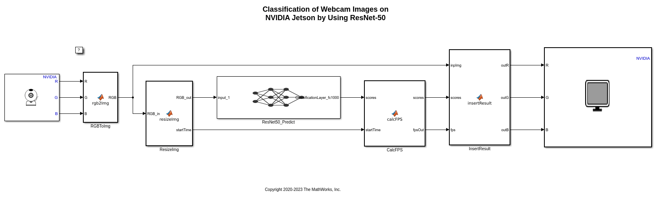
BUILDING A SIMULINK MODEL FOR DISEASE CLASSIFICATION
Camera block captures real time images (e.g. from webcam or field camera)
RGB conversion & resizing – converts raw feed to RGB format and resizes to match model requirements (eg. 224x224 for CNNs)
Predict block – takes processed frames and runs the ML model
Annotation & display – overlay predictions/confidence on image and display in real-time (eg. Using a display or video viewer block)
Live feedback loop – this setup enables immediate predictions and dynamic visualization during simulation

Slide 34
INTEGRATING TRAINED ML MODEL INTO SIMULINK
PURPOSE
Simulink allows deploying ML model in a block based simulation environment
Enables real-time testing with signals/images before deploying to hardware
Bridges the gap between offline training (MATLAB) and real-time deployment (Simulink/FPGA/Embedded target)
WORKFLOW
Export the trained ML model
Train your ML model in MATLAB
Save I as .mat file or use MATLAB coder for generating C code
Import model into Simulink
Write a Matlab function that loads the trained model and calls predict()
Predict block (statistics & machine learning toolbox) – drag the classification learner/predict block into Simulink → directly connect inputs(features) to this block
Connect with preprocessing & input/output blocks
Add image from file/camera block to simulate real inputs
Add preprocessing (resize,grayscale,normalization) using image processing toolbox blocks
Connect processed features/images → ML prediction block
Add display/scope/to workspace block to visualize predictions
Simulate and validate
Run the simulation with test data
Verify classification outputs
Compare accuracy with Matlab offline testing results
Once validated → ready for hardware deployment

Slide 35
Any Questions?

Slide 36
THANK YOU

