Slide 1

Connect-Tel Customer Churn Solutions
Capstone Project presentation
By
Callistus obijiaku

Slide 2

Customer churn is the percentage of customers who stopped using your company's product or service during a certain timeframe. Presentation Outline.
Problem statement - Data overview -key insights outline
model selection/training -model evaluation
CONCLUSION

Slide 3

Problem Statement Connect-Tel Telecom Company faces the pressing need to address customer churn, which poses a significant threat to its business sustainability and growth. We try to overcome this problem by employing advanced analytics and Machine learning techniques. This will enable us:
Perform eda to get key insights.
Prepare the data for ml model training.
Develop a robust customer churn prediction system.

Slide 4
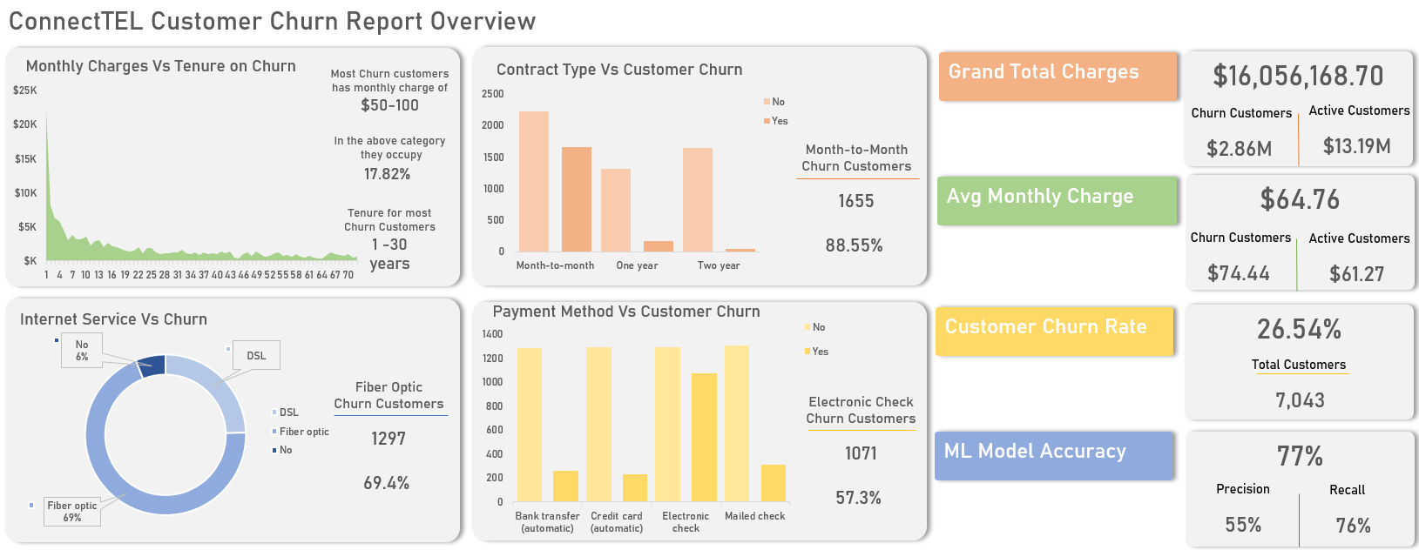
Data Overview

Slide 5
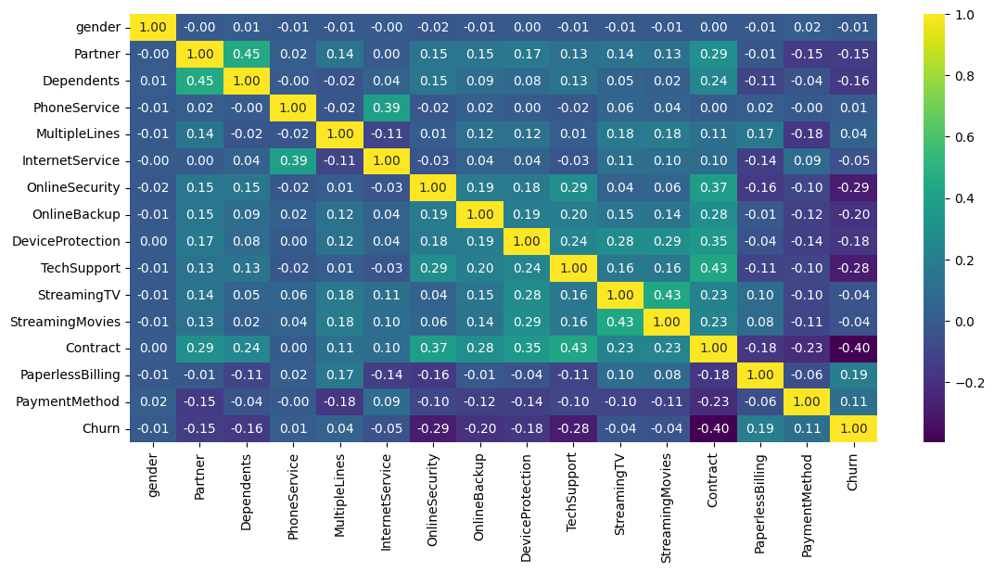
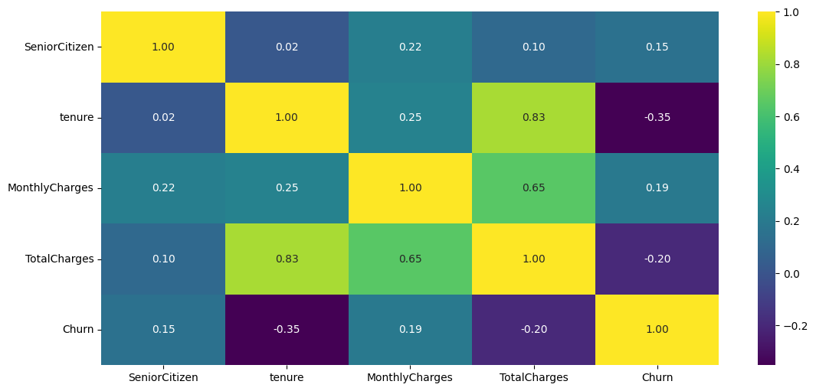
Key Insights Outline (EDA)
Total-charge feature had 11 nan values(median replacements).
Data segments: numerical & categorical.
“No” value for online services recorded high churn.
Gender, partner, dependents doesn’t have strong corr. With churn.

Slide 6
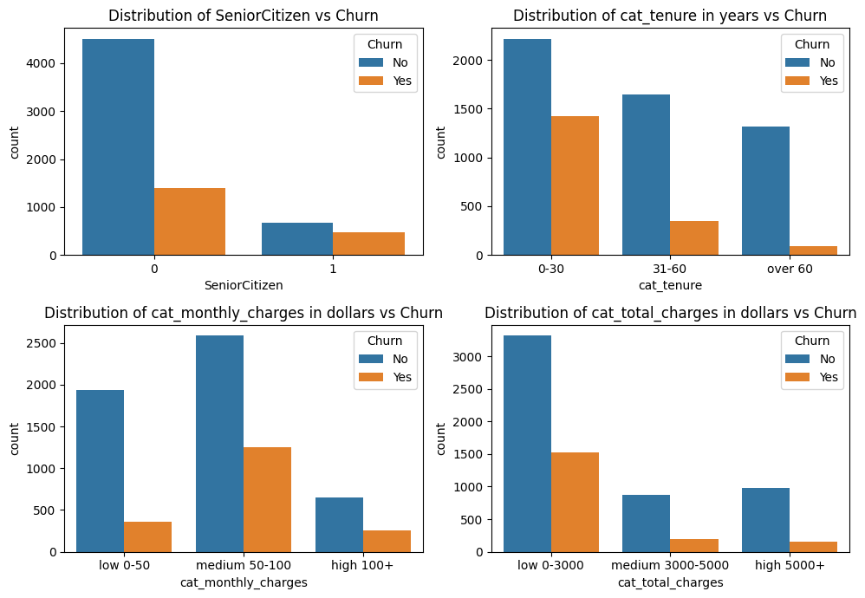
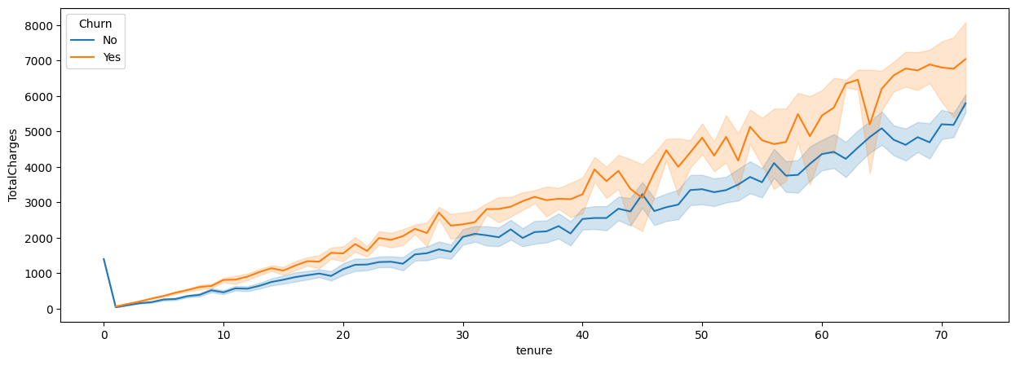
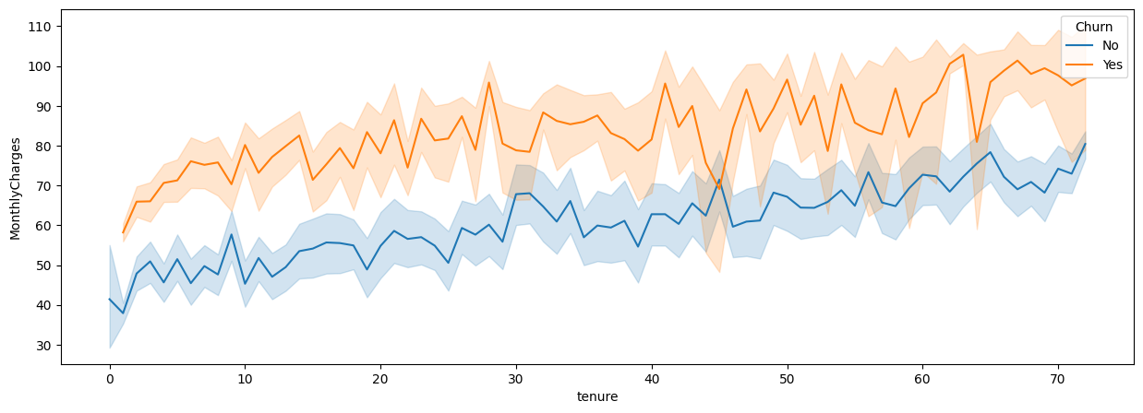
Key Insights Outline (EDA)
proportion for 1-30 years tenure is 20.23%
The percentage of medium $50-100 monthly charges is 17.82%.
Portion for low $0-3000 total charges is 21.57%.
The proportion of non-senior citizens is 19.78%.

Slide 7
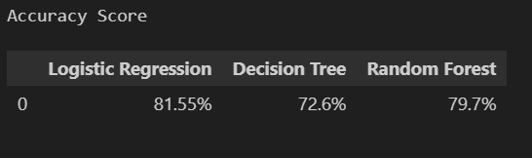
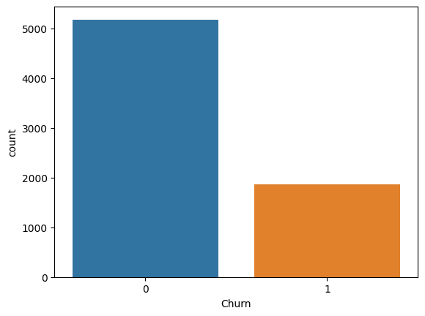
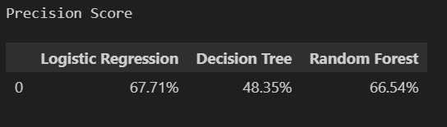
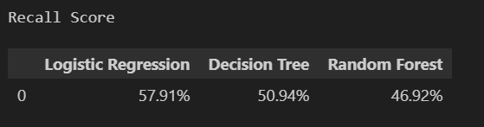
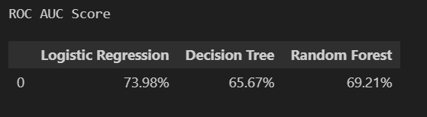
Model Selection/training
Churn Class Imbalance
Feature engineering: -combined online services features.
Feature encoding(label encoder).
Split data into training and test sets (test:20%, random state:42).
Scale the x train and x test sets.
model training: logistic regression, decision tree, and random forest classifiers.
Logistic regression performed best but churn class imbalance was affecting the result.

Slide 8
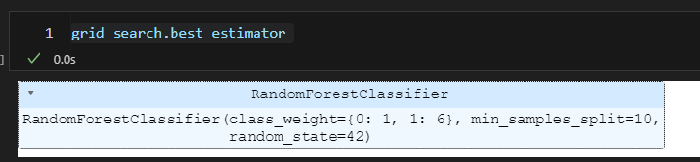
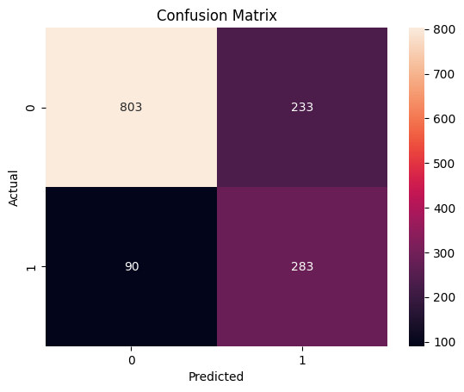
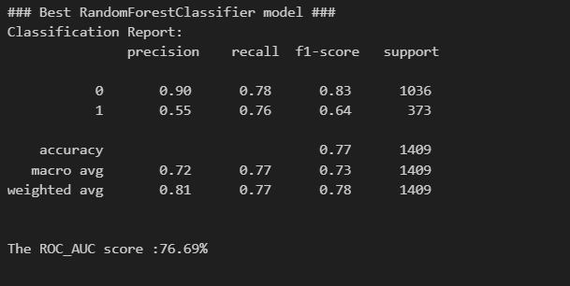
Model Selection/training
Used grid-search-cv ,best parameters(best score :0.73)
Random forest classifier performed best.
Having a tp: 283 , tn: 803, fp: 233 , and fn: 90.
Company should focus on an ml that will increase tp and reduce fn.

Slide 9
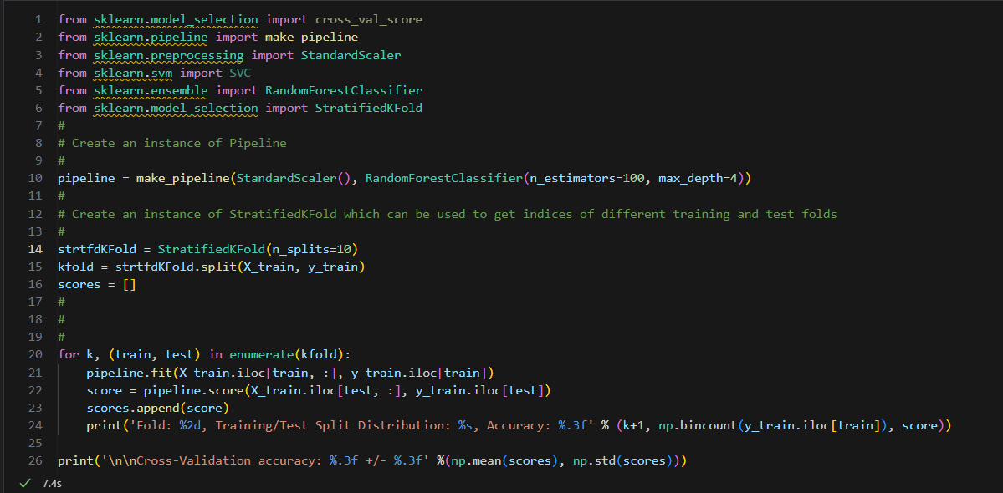
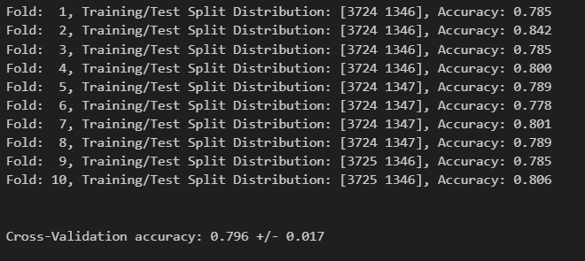
Model Evaluation
10-Fold Cross-validation Results
Implemented k-fold cross validation to evalute the model performance
WITH A CROSS-VALIDATION ACCURACY OF 79.6%.
WE CAN SAY THE MODEL HAS WILL HAVE A GOOD PERFORMANCE EVEN WITH NEW UNSEEN DATA.
Company should focus on an ml MODEL that will increase tp and reduce fn.

Slide 10
Thank you for your time
deployment of the developed model FOR CONNECT-TEL.
WILL HELP ADDRESS THE ISSUE OF CHURN, IDENTIFY POTENTIAL CUSTOMERS EARLY AND IMPLEMENT NECESSARY PRECAUTIONS.

