Slide 1
Basic salesforce
Getting familiar with the system
Csaba Feher

Slide 2
Salesforce is a crm system
Cloud based Customer Relationship Management
Everything is in cloud, even the code compiler
Data
The exact information we store as relationship related data
Metadata
Describe how the data is stored and how the features are designed
XML files
Apex class files
Etc…

Slide 3
Creating an org and login
Go to the developer website and fill the form
https://developer.salesforce.com/signup
Verify and create password by clicking the link in the received email
Login on the page https://login.salesforce.com/
It is possible to create custom domain see: https://developer.salesforce.com/docs/atlas.en-us.externalidentityImplGuide.meta/externalidentityImplGuide/external_identity_set_up_my_domain.htm

Slide 4
Train yourself
Trailhead is a playground where the learning can be started
https://trailhead.salesforce.com/
Login with Salesforce
Go through on the basics with modules and projects.
How trailhead works: https://trailhead.salesforce.com/en/content/learn/modules/trailhead_basics

Slide 5
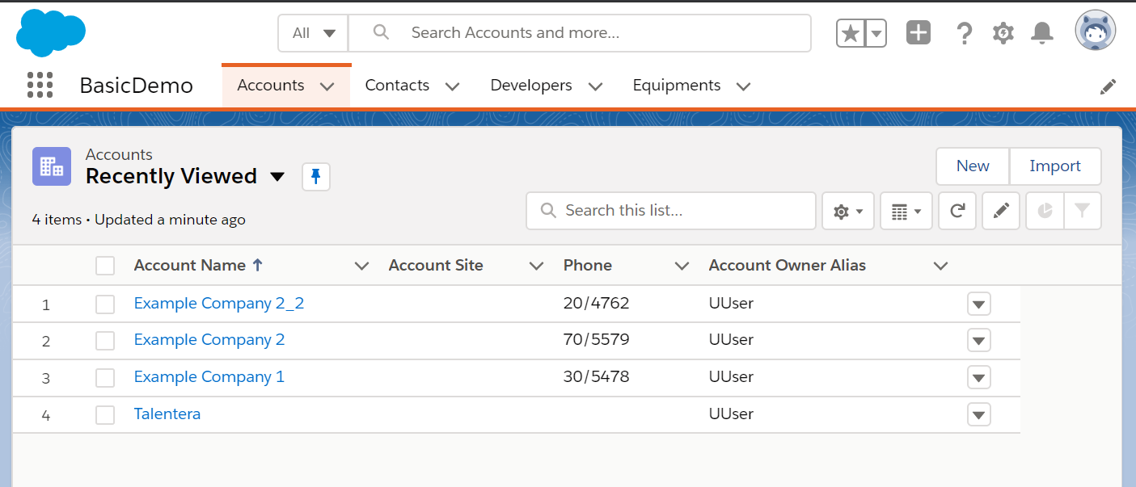
App, tab, object
App
Collection of tabs
Tab
Referenece to object list
Object
Data type (table name)
Fields (table columns)
Records (table rows)

Slide 6
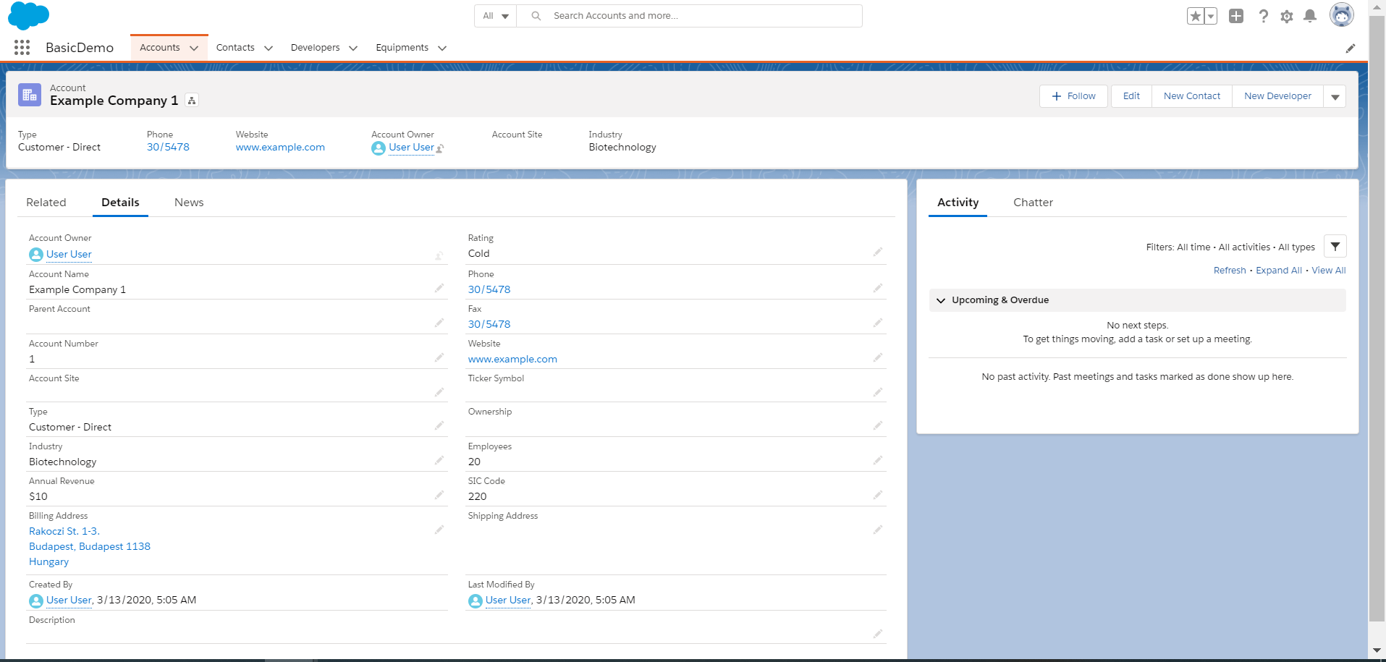
Record page
Fields
Text
Number
Picklist
Formula
Lookup
Many more types
Buttons
Standard
New
Clone
Custom
Related lists

Slide 7
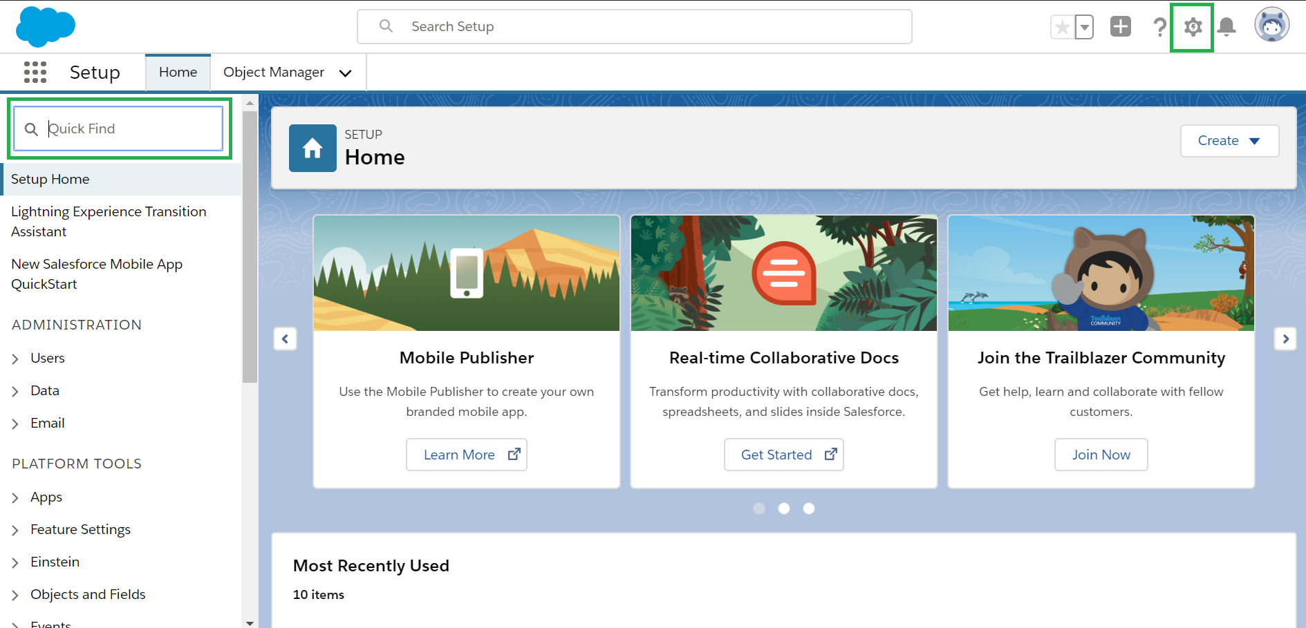
The setup menu
The configuration page for the org
Accesible via the button
Search by name
Notes:
Pull from scratch org (overwriting local files with –f attribute):
sfdx force:source:pull -u meetup-scratch (-f)
Or retrieve from Dev Hub:
sfdx force:source:retrieve -u DevHub -m ApexClass,ApexTrigger
Checking changes:
sfdx force:source:status
Create Unlocked Package:
sfdx force:package:create -n MeetupPkg -d „Demo for Meetup vol 1" -r force-app -t Unlocked -v DevHub
Modify sfdx-project.json
"versionName": "Meetup vol 1.0",
"versionNumber": "1.0.0.NEXT„
Create first package version:
sfdx force:package:version:create -p MeetupPkg -d force-app -k meetupKeyVol1 --wait 10 -v DevHub
Checking package list:
sfdx force:package:list
Package ingredients:
The sfdx.project.json file indicates which folder contains the package components
Install on other Scratch:
sfdx force:package:install --wait 10 --publishwait 10 --package MeetupPkg@1.0.0-1 -k meetupKeyVol1 --noprompt
Install on DevHub:
sfdx force:package:install -u DevHub --wait 10 --package MeetupPkg@1.0.0-1 -k meetupKeyVol1 –noprompt
Package dependencies:
You express dependencies in the packageDirectories section of the sfdx-project.json file.

Slide 8
Profile, Role settings
There are different types of security settings
By object (table level)
Profiles, layouts
By field (column level)
Field level security
By record (row level)
Roles, sharing
Setup -> User
Setup -> Security

Slide 9
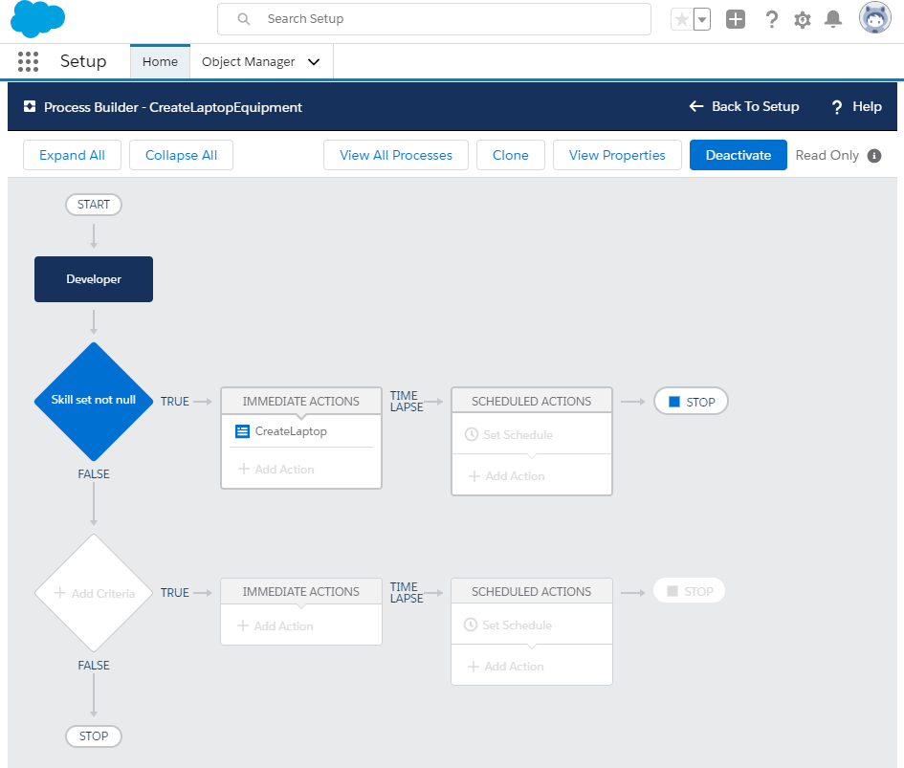
Configuration possibilities
Creating logic without code
Workflow
Process builder
Quick actions
Validation rules
Formula fields

Slide 10
Developer console
Online embedded tool, access similar to Setup
Apex classes can be written
Tests can be run
Instant scripts can be used
Execute Anonymous Window
Records can be queried

Slide 11
Programming languages
Salesforce backend language is Apex
Similar to Java, has some features from C# (such as getter, setter)
It has restrictions compared to Java and C#
Frontend is written in
Html
Javascript
Database is reached via
SOQL (Salesforce Object Query Language)
Mostly used, similar to SQL
SELECT * FROM is not possible, fields must be identified by every occasion
Relationship with fields, no need for join table
SOSL (Salesforce Object Search Language)

Slide 12
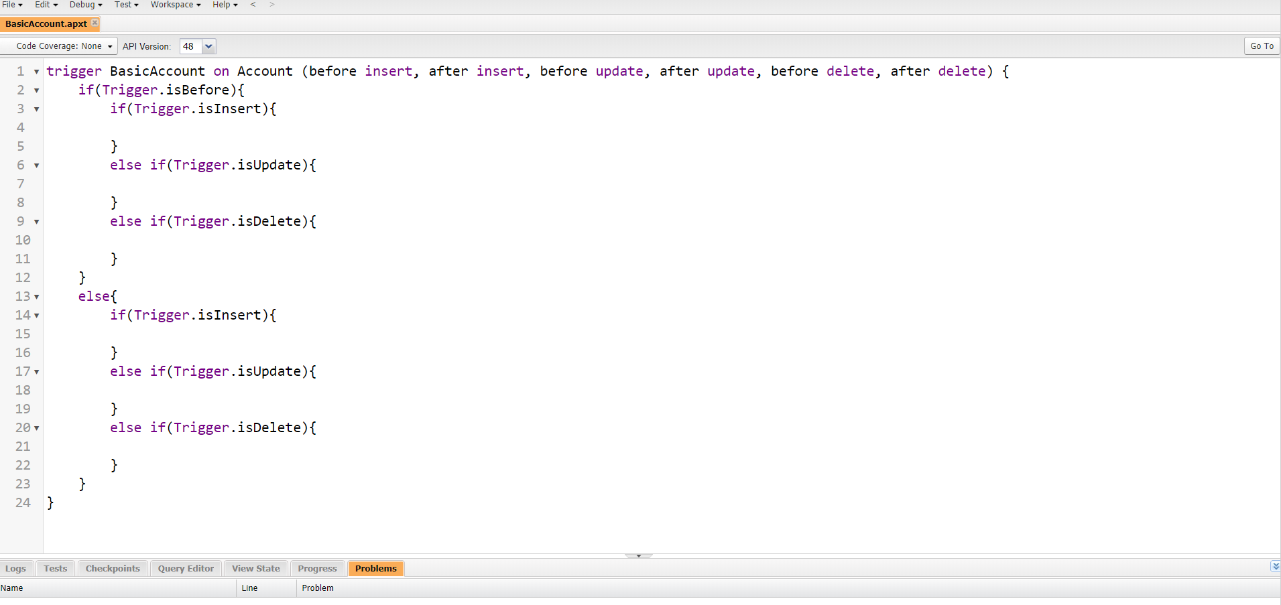
Triggers
Event based, written in apex
Record creation, update, deletion, etc…
Always connects to one object

Slide 13
API integration with Apex
REST
Using HTTP requests with JSON
Apex language supports JSON formatting, decoding
SOAP
XML envelopes, connector:
Apex code generated by WSDL file automatically
Can be written manually with HTTP request, building the XML envelopes in apex

Slide 14
Workbench
https://workbench.developerforce.com/login.php
Separate tool
3rd party, not official, only for testing purposes
Uses standard Salesforce API
It can be used for basic integration processes
REST API functions
Getting object information
SOQL queries
Record insert/update
Deployment
And many more

Slide 15
Useful links
The source code:
https://github.com/kalman2tas/BasicDemo
Documentation:
https://developer.salesforce.com

