Slide 1



“Learning AOSP”
Hardware Abstraction Layer
Nanik Tolaram
@nanikjava
(kernel).ozandroid.info
plus.google.com/+NanikT

Slide 2

Thank You !

Slide 3
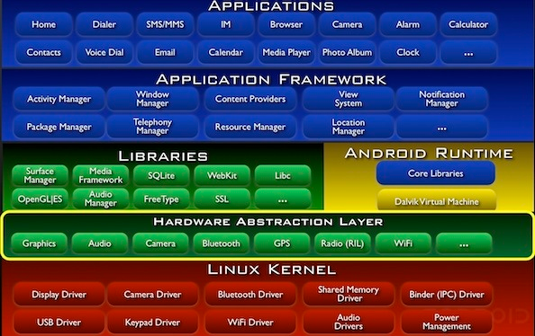
Architecture

Slide 4
Questions !
  What is HAL ?
  Why is it such a big deal ?
  Why do we care ?
  What hardware is part of HAL ?
  What is relationship between Android and HAL ?

Slide 5
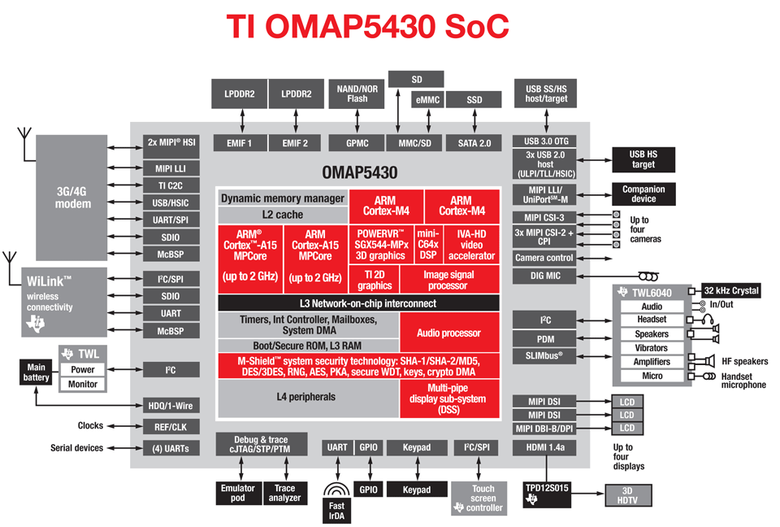
Hardware Layer

Slide 6
What is HAL ?
  Cater for non-GPL vendor code
  Included in Android image as blob (.so)
  Freeing developer to focus on their app (Camera3 multiple camera support - KitKat)
  Software layer that interact with kernel drivers *NOT* to hardware
  /system/lib/hw and /vendor/lib/hw

Slide 7
Hardware
  Nexus 7 (2012) [“grouper” ] : Camera, Sensors, Wi-Fi, Bluetooth, GPS, Touch Panel, Orientation Sensor, Graphics, NFC, DRM
  Nexus 7 (2013) [“razor”] : Camera, Sensors, Wi-Fi, Bluetooth, GPS, Graphics, NFC, DRM, Audio, Sensors, Media, DSP, USB
  Nexus 5 [“hammerhead”] : Camera, Sensors, Wi-Fi, Bluetooth, GPS, Graphics, NFC, Audio, GSM, Camera, Media, DSP, USB

Slide 8
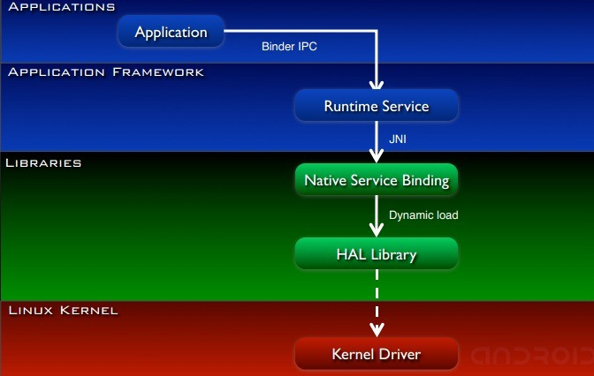
Framework and HAL

Slide 9
HAL Stubs
  Android provides the interface that vendors must implement (/hardware/libhardware/include/hardware)
  HAL process
      Java application call hardware framework service API
      Framework service call internal API
      HAL framework loads hardware library
      Obtain device structure from memory
      Call HAL stub function

Slide 10
Example - Power HAL
DisplayPowerState.java
PowerManagerService.java
com_android_server_power_PowerManagerService.cpp
power.c
/sys/devices/system/cpu/cpufreq/interactive/timer_rate
/sys/devices/system/cpu/cpufreq/interactive/go_hispeed_load
/sys/devices/system/cpu/cpufreq/interactive/input_boost

Slide 11
Example – LCD Backlight
DisplayPowerState.java
LightsService.java
com_android_server_LightsService.cpp
device/asus/grouper/liblights/lights.c
/sys/class/backlight/pwm-backlight/brightness

Slide 12
HAL Structure
(1)
Device specific structure contain hw_module_t which is queried by Android framework from HAL library through hw_get_module function
hw_module_t
hw_device_t
'open' generally called to obtain device implementation structure
(2)
hw_module_methods_t
* open (..)
camera_device
nfc_nci_device
audio_hw_device
different structure implementation for different hardware

Slide 13
Thank You

