Slide 1

Android Meetup
@

Slide 2
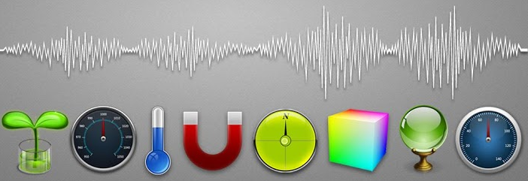

Android Sensors

Slide 3
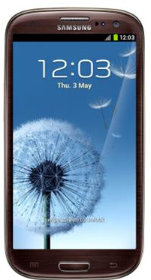
Android Sensors Overview
Android Sensors:
  Accelerometer
  Gravity sensor
  Linear Acceleration sensor
  Magnetic Field sensor
  Orientation sensor
  Gyroscope
  Light sensor
  Proximity sensor
  Temprature sensor
  Pressure sensor
  Other sensor

Slide 4
Accelerometer
Provides the total force applied on the device.
When device is stationary, this gives +1g (gravitational force) reading in one axis and its components on other axes.
Accelerometer values minus the gravity factor gives the induced acceleration.
Generally it is used to determine device orientation.
The measurment unit is SI m/s².

Slide 5
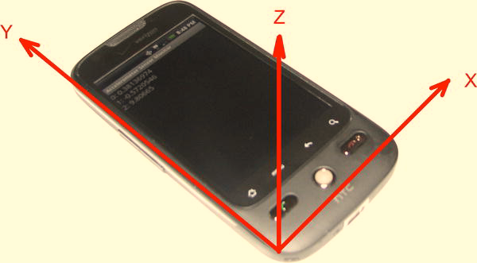
Accelerometer Coordinate System

Slide 6
Accelerometer and Gravity
All forces acting on the device will be detected by the accelerometers.
F= ma
If device is stationary we get the gravity value with zero acceleration, which can be saperated by low pass filter.
Can We calculate distance/speed ?
  D= ut + 1/2 at2
How to seperate Gravity and linear accelereation ?
Used in gaming to make it interactive.
Pattern recognition. pedometer

Slide 7
Gravity Sensor and Linear Acceleration
Gravity sensor is not a saparate hardware but t’s a virtual sensor based on the accelerometers, acceleration is removed from accelerometer data.
Similarly Linear acceleration is not a saparate hardware but it is based on the accelerometer, gravity is removed from accelerometer data.

Slide 8
Magnetic field Sensor
The magnetic field sensor measures the ambient magnetic field in the x, y, and z axes.
The units of the magnetic field sensor are microteslas (uT). This
sensor can detect the Earth’s magnetic field and therefore tell us where north is. This sensor is also referred to as the compass
Magnetic field sensor is used in combination with accelerometer.
The coordinate system

Slide 9
Orientation sensor
Measures degrees of rotation that a device makes around all three physical axes (x, y, z). As of API level 3 you can obtain the inclination matrix and rotation matrix for a device by using the gravity sensor and the geomagnetic field sensor in conjunction with the getRotationMatrix() method.
There is no hardware for orientation sensor but combination of two sensor detrmine the orientation of device.
Form API level 8 is is been deprecated.

Slide 10
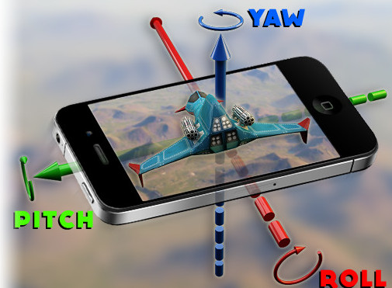
Gyroscope sensor
Gyroscopes measure the rate of rotation around an axis. When the device is not rotating, the sensor values will be zeroes.
It gives us 3 value.
  Pitch (around X
  Roll (around y)
  Azimuth (around z)

Slide 11
Gyroscope Continue...
Unfortunately gyroscope is error prone over time. As time goes gyroscope introduce drift in result, but by sensor fusion(combine accelerometer and gyroscope) results can be corrected and path of movment of device can be obtain correctly.
The measurment unit is SI m/s².

Slide 12
"Angel of rotation using Gyroscope(GyroRaw.java)”
Call backs PerSecond
Observe the readings
  Highly Accurate initially
Gyro drift
Used to build responsive games.

Slide 13
Light Sensor
Located at front of mobile near to front facing camera.
gives a reading of the light level detected by the light sensor of the device. As the light level changes, the sensor readings change.
The units of the data are in SI lux units
Range is from 0 to maximum value for sensor.

Slide 14
Proximity Sensor
The proximity sensor either measures the distance that some object is from the device (in centimeters) or represents a flag to say whether an object is close or far.
Some proximity sensors will give a value ranging from 0.0 to the maximum in increments, while others return either 0.0 or he maximum value only.
Interesting fact about proximity sensors : the proximity sensor is sometimes the same hardware as the light sensor. Android still treats them as logically separate sensors.

Slide 15
Temprature Sensor
The old temperature sensor provided a temperature reading and also returned just a single value in values[0]. This sensor usually read an internal temperature, such as at the battery. Till API level 13
From API level 14 it is replaced by TYPE_AMBIENT_TEMPERATURE.
The new sensor tell us about the room temprature in degree Celsius.

Slide 16
Pressure sensor
This sensor measures barometric pressure, which could detect altitude can be used for weather predictions.
The unit of measurement for a pressure sensor is atmospheric pressure in hPa (millibar).

Slide 17
Other Sensor
Rotation Vector
  The rotation vector represents the orientation of the device as a combination of an angle and an axis, in which the device has rotated through an angle θ around an axis (x, y, or z).
Humidity sensor
  Measures the relative ambient humidity in percent (%).

Slide 18
Sensor fusion
Sensor fusion is a technique to filter the data and obtain the result by combining two or more sensor's data.
Well known algorithem for sensor fusion
  Kalman filter alogrithem
  Complimentary filter algorithem

Slide 19
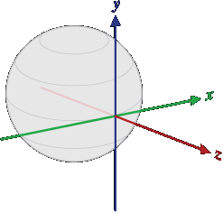
Measures Device's Angle by Accelerometer
Generally Accelerometer use for measure device rotation around axis(x, y, or z).
By Combining of Accelerometer orientation sensor and magnetic field sensor correct device orientation can be obtain.
Android sensor framwork provide methods like getRotationMatrix() and getOrientationMatrix() which tell us the device rotation reltive to ground on all axis.
Earth Coordinate System

Slide 20
Sensor Framework
Android has provided sensor Framework managed by following classes
  Sensor
  SensorManager
  SensorEvent
  SensorEventListener
Framework has provided call back to obtain sensor data.

Slide 21
SensorFramework continue...
SensorEventListener async call back
Call back retrive data at different duration
  Normal 20mS
  Game 20mS
  Fast 0mS
Accuracy of rerieved data can be Low,Medium or High
Your App
SensorManager
Register Callback
Sensor Event
Sensor Event
Sensor Event

Slide 22
Sensor example
public class SensorActivity extends Activity implements SensorEventListener {
private SensorManager mSensorManager;
private Sensor mLight;
@Override
public final void onCreate(Bundle savedInstanceState) {
super.onCreate(savedInstanceState);
setContentView(R.layout.main);
MSensorManager =(SensorManager)
getSystemService(Context.SENSOR_SERVICE);
mLight = mSensorManager.getDefaultSensor(Sensor.TYPE_LIGHT);
}

Slide 23
SensorEventListener call back
@Override
public final void onAccuracyChanged(Sensor sensor, int accuracy) {
// Do something here if sensor accuracy changes.
}
@Override
public final void onSensorChanged(SensorEvent event) {
// The light sensor returns a single value.
// Many sensors return 3 values, one for each axis.
float lux = event.values[0];
}

Slide 24
Good Habits for sensors
@Override
protected void onResume() {
super.onResume();
mSensorManager.registerListener(this, mLight, SensorManager.SENSOR_DELAY_NORMAL);
}
@Override
protected void onPause() {
super.onPause();
mSensorManager.unregisterListener(this);
}
}

