Slide 1
Introduction to RCU in the kernel
Mark Veltzer
veltzer@gnu.org

Slide 2
The efficacy of locking mechanisms
Lock nothing
Atomics
Lock free algorithms
RCU
Readers/Writer lock
Mutex/Spinlock
These are mapped from:
  Harder to do to easier to do
  Less shared data to more shared data
  Less hindrance to concurrency to more hindrance to concurrency

Slide 3
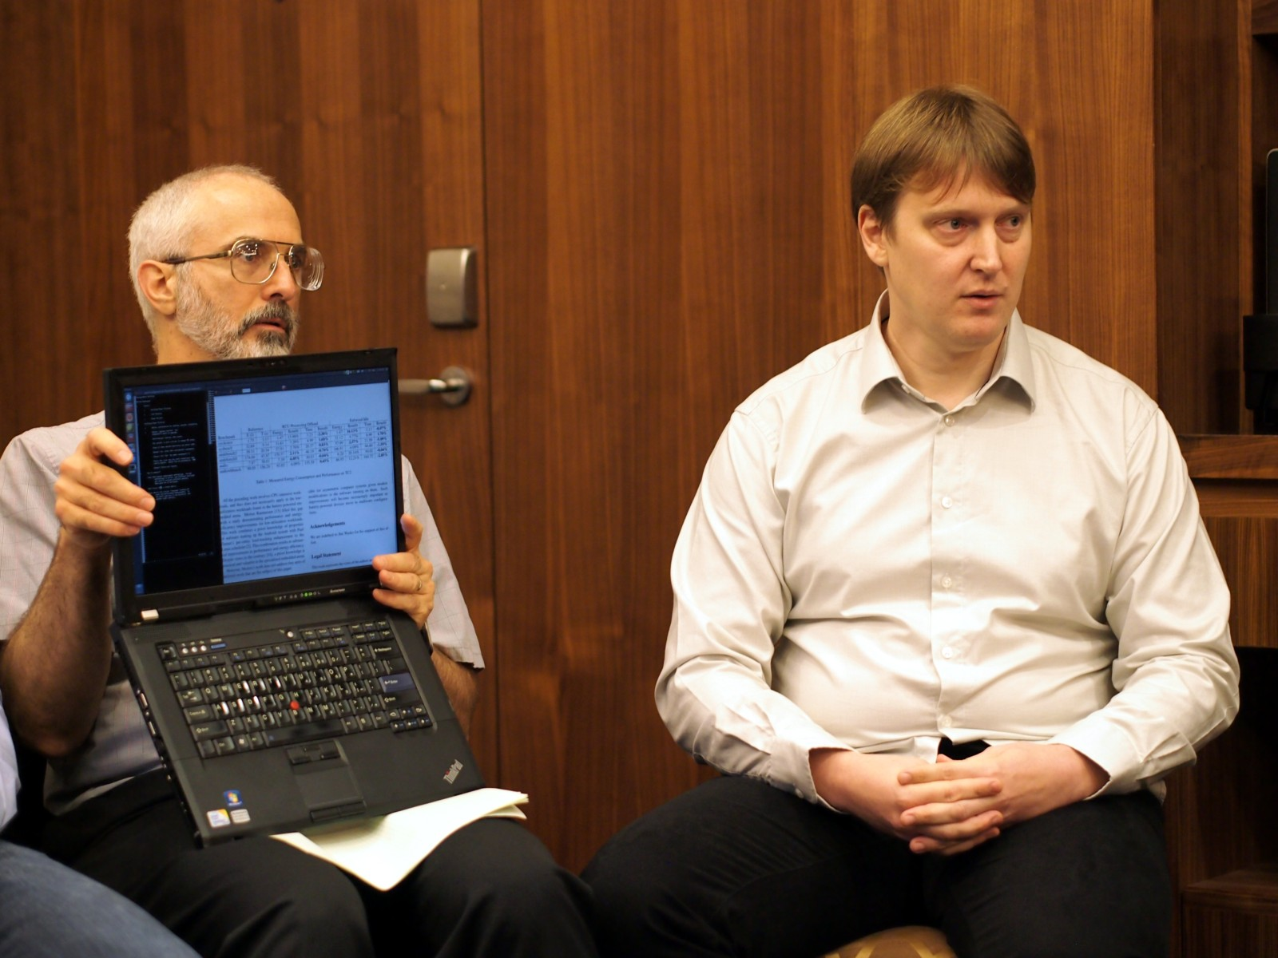
Here are the people to blame… Paul and Ringo, uhmm, Ingo...

Slide 4
Why RCU?
Multi core + data structures which are accessed frequently + locks are a bottleneck.
Readers/Writer lock still requires that writers wait for readers to finish.
RCU blocks no one and allows very frequently large data structures to be accessed without problems (well, almost). Think about process list etc.

Slide 5
History
RCU was added to the kernel in 2002.
Paul has been slowly converting many frequently accessed data structures in the kernel to RCU since then.
Today there are about 10,000 references to RCU within the kernel.
One of the reasons that Linux scales relatively well to large numbers of cores when compared to other operating systems.

Slide 6
What is RCU?
RCU is a method by which to share data in RAM using an algorithm which enables multiple readers and multiple writers to operate on the same data structure concurrently without blocking.
RCU stands for Read-Copy Update.
Read is what readers do.
Copy update is what the writers do.
RCU is a way of thinking more than one specific algorithm.

Slide 7
Real life is harder...
RCU is sometimes implemented in a way that allows just one writer to work concurrently with readers. This makes life easier and is usually good enough for mostly read data structures.
RCU is hard to implement correctly for complex data structures and so it is usually used with simple data structures (like singly linked list which we will concentrate on in this intro).

Slide 8
How RCU works? (Insert)
Lets imagine a linked list.
Readers simply glide from element to element.
Writers create a new node to be inserted in the middle. The node already points to the rest of the list.
The previous pointer is atomically replaced.
No blocking.
Writers should block each other since they can step on each other toes but this scenario is so rare that we care less about it.

Slide 9
How RCU works? (delete)
A reader want to remove an element from a linked list.
He atomically updates the reference that points to the element to reference the element that follows that element.
He does not destroy the element since there may be a reader reading it.
Elements are destroyed when all readers have finished reading. This requires that all readers declare a “critical section” which actually does nothing in non CONFIG_PREEMPT kernels.
Destruction is done lazily once the kernel does scheduling in a special RCU thread in the kernel. Since threads doing RCU do not sleep then the very fact that there is scheduling is evidence for the fact that they are done (in non CONFIG_PREEMPT kernels, ofcourse).
The time span when elements which were deleted remain accessible is called a “grace period”.

Slide 10
How RCU works? (non atomic element update).
A thread wants to change an element in a non atomic manner.
It creates a private copy of the element.
Does the non atomic update on the private copy of the element.
Then we use a CPU atomic operation to swap the pointer to the old element with the pointer to the new.
We do all of this under a write lock and hence the limitation that no more than one writer can work concurrently with readers.
The write lock is to avoid two writers stepping on each others toes during the above operation.

Slide 11
The mental problem of RCU
In RCU the data structure is in two states at once.
Some people find that disturbing. It messes with their notion of being only “one truth”.
The response of RCU people is “get over it and grow up already!”
Another solution is to imagine actually copying the data structure around. The objections fade to a whisper…:)

Slide 12
RCU and memory barriers
A good RCU implementation also takes care of memory barriers.
The interesting bit is that the memory barriers usually are inserted by the RCU author only at the end of a writer thread.
Compiler barriers are also inserted appropriately so the compiler will not assume memory does not change and does not reorder in certain read operations.
As we know, some kernel developers throw memory barriers in their code just to ward off evil spirits…. Luckily Paul knows what he is doing...

Slide 13
Can I do all of this in user space?
Actually you can and sometimes it even makes more sense since you are spending most of your time in user space (at least for regular type applications).
liburcu is a user space library available in Linux distributions that provides user space RCU implementation and implements many data structures (singly linked lists, doubly linked, hashes, stacks, queues and more)..
It is surprising how the hard to implement stuff is being led by the kernel even though kernel development is a lot harder than user space...

Slide 14
Some APIs
Pointer access
rcu_assign_pointer()
rcu_assign_pointer(..., NULL)
rcu_dereference()
Lists
list_add_rcu()
list_add_tail_rcu()
list_replace_rcu()
list_del_rcu()
list_for_each_entry_rcu()

Slide 15
Some code
rcu_read_lock();
/* Note: audit_netlink_sem held by caller. */
list_for_each_entry_rcu(e, &audit_tsklist, list) {
if (audit_filter_rules(tsk, &e->rule, NULL, &state)) {
rcu_read_unlock();
return state;
}
}
rcu_read_unlock();

Slide 16
Problems with RCU
Does not support multiple batched updates (“transactions”) to data structures.
A little heavier on CONFIG_PREEMPT kernels than on non CONFIG_PREEMPT kernels.
Needs special support for real time kernels (already there).
A lot of implementations do not support multiple writers, even if those writers work on different areas of the data structure and could avoid blocking each other. This means that some custom lock free algorithms or better RCU implementation could achieve more concurrency.
It's hard to understand, use and maintain. Lets all hope Paul lives a long and healthy life...

Slide 17
Other ideas
RCU is just the beginning and other ideas are on the horizon.
RLU = Read Log Update allows multiple changes to a data structure to be combined into a “transaction” which is not seen by any reader until complete. This overcomes RCUs deficiency.
Transactional memory allows to speed up locking code in kernel and user space as well and serves to overcome locking but in a completely different approach than RCU.
It remains to be seen whether and which mechanisms will prove themselves superior to RCU in the long run...

Slide 18
References
“What is RCU, Fundamentally?” http://lwn.net/Articles/262464/
$KERNEL_CODE/Documentation/RCU/*.txt
“Is Parallel Programming Hard, And, If So, What Can You Do About It?” free pdf book by Mckenney which caused many a kernel developer to become catatonic. Maintained in a git repository and compiled to PDF.
“What Every Developer Should know About Memory” by Ulrich Drepper of libc fame
RLU paper by Nir Shavit et al.

