Slide 1
Who am I?
Mark Veltzer (mark@veltzer.net).
Technology geek
CTO of Hinbit
Senior instructor on many subjects
Linux kernel developer
Jazz piano player
Political philosopher (check out my book “שלטון ההמון”)
Maintainer of GNU grep

Slide 2
Architecture and Design of Distributed Enterprise Systems

Slide 3
Objectives
Understand the hard points of distributed apps.
Understand major concepts that help you build such apps (application servers, TP monitors, distributed databases, various other middleware, cloud capabilities).
Understand their advantages/disadvantages and make an intelligent choice.

Slide 4
What we will cover...
Defining “distributed”
The Enterprise environment
Distributed systems
Caching
Middle-ware
MOMs
XML
Persistence strategies
Cloud and enterprise computing

Slide 5
Defining “Distributed”...

Slide 6
Defining “Distributed”
Harder than you think
Even multi-core could be thought of as “distributed”
One machine could have many physical hard-drives attached to it. Is it “distributed”?
If one machine runs multiple pieces of software is it “distributed”?

Slide 7
One attempt at definition
Ken Arnold, CORBA designer:
“Failure is the defining difference between distributed and local programming, so you have to design distributed systems with the expectation of failure”
Developers spend more time designing for failure than they do actually working on the problem itself!

Slide 8
Failure on a single machine
We can design for failure even on a single machine.
Even though in practice we are very bad at it.
Hard disk failure (Oracle, git)
Socket disconnect between two apps on the same machine.
Exception handling. The optimistic approach to programming.
Even memory corruption!

Slide 9
What about many machines?
On many machines failure becomes from a rarity to a real, occurring reality.
Examples: network failure, upgrade of machines, application not running.
Handling these errors produce the most buggy parts of our distributed applications!

Slide 10
Can't some framework/tool handle all of these distributed errors for us?
All of them? No.
Some of them? Definitely
The browser will help us with handling errors when connecting to servers.
JEE, .NET handle some errors at the framework level.
Distributed database systems (MongoDB, Cassandra) will handle errors at their level.
Cloud providers (especially PAAS providers) will handle many more for you. More on that later.
Major reason for the success of such tools/frameworks!

Slide 11
The Enterprise environment

Slide 12
Characteristics
Supports a whole organization
Many thousands of users.
Provides a single, timely version of the “truth” across the organization, regardless of the location of that information.

Slide 13
Requirements
Scalable
Flexible
Extensible
Reliable
Available
Secure
In reality: none of the above and a total mess that no one understands.

Slide 14
OLTP vs DSS
Informational
Historical data
Loosely constrained
Complex logic
Minutes and hours
Ad-hoc
Black magic
N-way joins
Executed infrequently
Operational
Current data
Highly constrained
Simple predicates
Sub second
Well understood
Highly optimized
Single table
Exexcuted 1000s times/sec

Slide 15
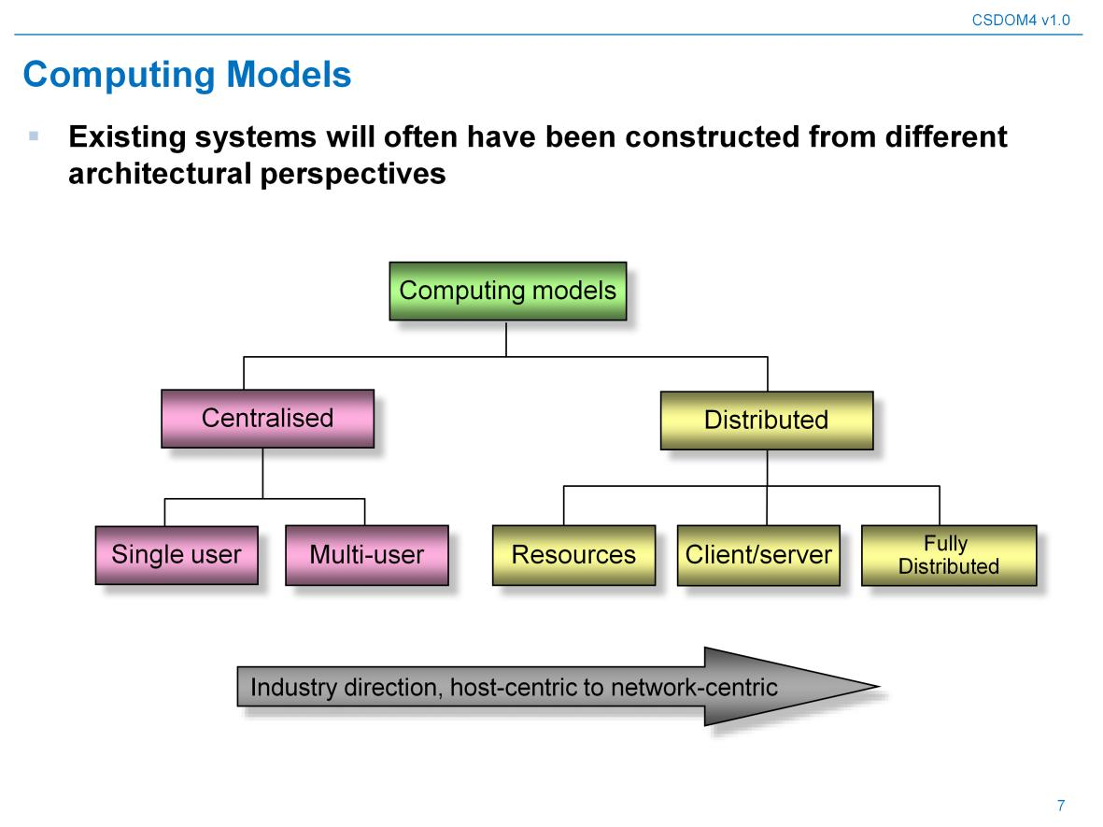
The arrow of history...

Slide 16
Example of distributed app: ERP system
One system replaces dozens of legacy systems
Much more concise
Makes lots of money for it's makes (SAP, Baan, Oracle, …)
Case in point: Microsoft corp.

Slide 17
Enabling technologies
Distributed objects
Components
DBMSs
Data replication
Transactional processing monitors
Application servers
Message Oriented Middleware
XML
Web services
Cloud PAAS
We will explain lots of those...

Slide 18
Distributed systems

Slide 19
Why distribute?
Availability
Performance
Re-usability
Scalability

Slide 20
Evolution of distributed systems
From the nature of large organizations.
  Geographic, legacy apps, mergers, downsizing
From the influence of emerging technologies
  Faster networks, new protocols and APIs, new devices (mobile)
From the influence of other companies
  Need to get and send data to co-operating companies, clients expect more data

Slide 21
The nature of distributed systems
Are written by different vendors
In different languages
On different operating systems
Using different protocols
Using different frameworks and application servers

Slide 22
Middleware
The glue that binds components of a distributed system together.
Examples: RPC standards, message queuing standards, DNS, broadcast and multicast

Slide 23
Early distributed systems: the client/server model
The client/server model is one of the most successful examples of a distributed system.
It can also be seen as an example of the MVC paradigm (more on that later).
The model got a serious boost with the emergence of mobile technologies.

Slide 24
Presentation tier options in clients
NULL client: plain stateless HTML pages
Thin client: some session info on the server side, a little on the client. Most business is on the server. Just a sprinkle of JavaScript.
Rich Client: complete GUI and lots of application logic at the client side. Once: ActiveX, Java applets. Today: JavaScript.
As requirements for better GUI mount and browsers get enhanced the arrow of history points to rich clients...

Slide 25
Evolution: from 2 ties to 3 tiers...
A major step in the evolution of enterprise systems.
Client: handles display and GUI logic.
Middle tier handles: resource sharing and recycling, load balancing, location transparency, off-line work and message queuing, fail-over, security.
Data tier handles: binds business components to persistent representation (RDBMS?), some sanity on the data, handles caching (complicated!).

Slide 26
Abstraction
The 2 tier and 3 tier models could be seen as implementations of the MVC paradigm.
M – model – holds the data and knows it's current state
V – view – handles showing the data.
C – controller – serves to connect the view to the model (the least significant part of the MVC paradigm).

Slide 27
MVC is everywhere!
A database is the M of your enterprise (V).
The database + the middle tier is the M of the client side (V).
The data layer could be the M while the middle tier + client tier could be the V.
Even client side now uses MVC!
And so on...

Slide 28
Caching

Slide 29
Caching
“all computing is an exercise in caching”
Systems that have caches: CPUs, disk drives, operating systems, applications, databases, special cache servers, ORM solutions, ...
Examples of caching servers: Memcached, Redis, Riak, Membase, EHCACHE, ….

Slide 30
The problems of caching
Correct invalidation of the cache
  Too little → stale data
  Too much → performance problem
You don't have infinite room in the cache
  Which elements go out of the cache?
Notifying the user of the cached data that the data is not longer up to data. What would the user of the data do?
  Web client → extra technical problems

Slide 31
Notifying web clients (aside)
The web client could poll the server (performance problem)
The long request trick.
Web sockets in HTML5
Too much notifications are also a problem.
Mitigation techniques are required
Some of these requires special web server technologies...

Slide 32
Middle-ware

Slide 33
Distribution with multiple machines - problems
How do we locate the machine that provides a service?
How do we locate the process in that machine that provides the service?
How do we call the service? How do we pass parameters?
What if the remote process is written in another language?
What happens if the remote process hangs? Do we hang? Indefinitely?

Slide 34
Many technologies aid in helping those exact problems
Good old DNS can help you with hard-coding only names of machine instead of IP addresses.
Names of ports can help too.
But there are more high level tools than these...

Slide 35
RPCs
Implemented on top of the underlying transport
Example: RMI in java.
Can sometimes also propagate errors from the remote server into errors in the local server.
Can handle security.
Can handle object marshalling.

Slide 36
What about more than RPC?
What if I want to call more than one function/method?
Are these calls independent?
What if they are dependent?
What if I want to roll back changes I did?
Conclusion: RPC is good but not great. Higher level solutions are needed. In comes the middleware.

Slide 37
Categories of middle-ware
What is communicating?
  RPC, CORBA, EJB/COM+
Is the communication stateless/stateful?
  Stateless is very appealing but sometimes too simple.
  Stateful is harder to implement.
Who initiates the requests?
  Client, server, both?
How do you use the middle-ware?
  Message based? SQL? Operation call (CORBA/EJB/COM+)?

Slide 38
Client server communication...
Two basic ways to do it:
  “Real time”/Synchronous: client sends request and waits for server to give it results.
  Deferrable/Asynchronous: client sends request which gets put in a queue and disconnect. Server will send (or not!) the result to the client using other means.
Real time examples: RPC, CORBA, EJB, COM+
Deferrable examples: JMS

Slide 39
General guidelines
Usually we will use synchronous communication for end clients (web browsers?!?)
Asynchronous communication is better suited for server to server communication.
And of-course there are exceptions to these rules...

Slide 40
List of middle-ware technologies
TCP/IP, UDP/IP – do it yourself type technology
MOM – message oriented middleware (JMS).
CORBA/.NET remoting/EJB – true distributed object technology.
RMI – Java lower level RPC
RPC – old school remote procedure calls.
SOAP – a facade of a distributed object which helps to solve cross language/platform issues.

Slide 41
Distributed objects vs client/server
Distributed objects provide real benefits over old school client/server.
An object can move from node to node (like in failover) and is therefor independent of an address.
Therefore we need discovery mechanisms.
Scalability is automatically enhanced by this approach since we do not determine in advance which object will reside where.

Slide 42
Distributed object vs client/server (cont)
In distributed object there the concepts of client/server fade away.
Or, you can think of the object as the “server” and the user of the object as the “client”.
Although the IP of the object is not constant. It's “object address” (technology specific) is.
Distributed object usually expose constant (?) interfaces.
Usually implemented using stubs and skeletons (transparent to programmers).

Slide 43
Stateful vs stateless distributed objects
Stateless objects are the best way to expose plain information.
While stateful objects are sometimes needed to let client manipulate in complex ways the state of the system.
Stateful objects must address concurrency and partial failure with respect to changes of state.
Stateless objects can become stateful if the client is willing to hold the state for them...:)

Slide 44
MOM – Message Oriented Middle-ware

Slide 45
Limitations of distributed objects
Peer/Peer model. What if I don't know who my peer is?
Synchronous communication. Client is blocked during the call.
Difficult to implement callbacks.
Close coupling. High dependencies. Limited scalability.

Slide 46
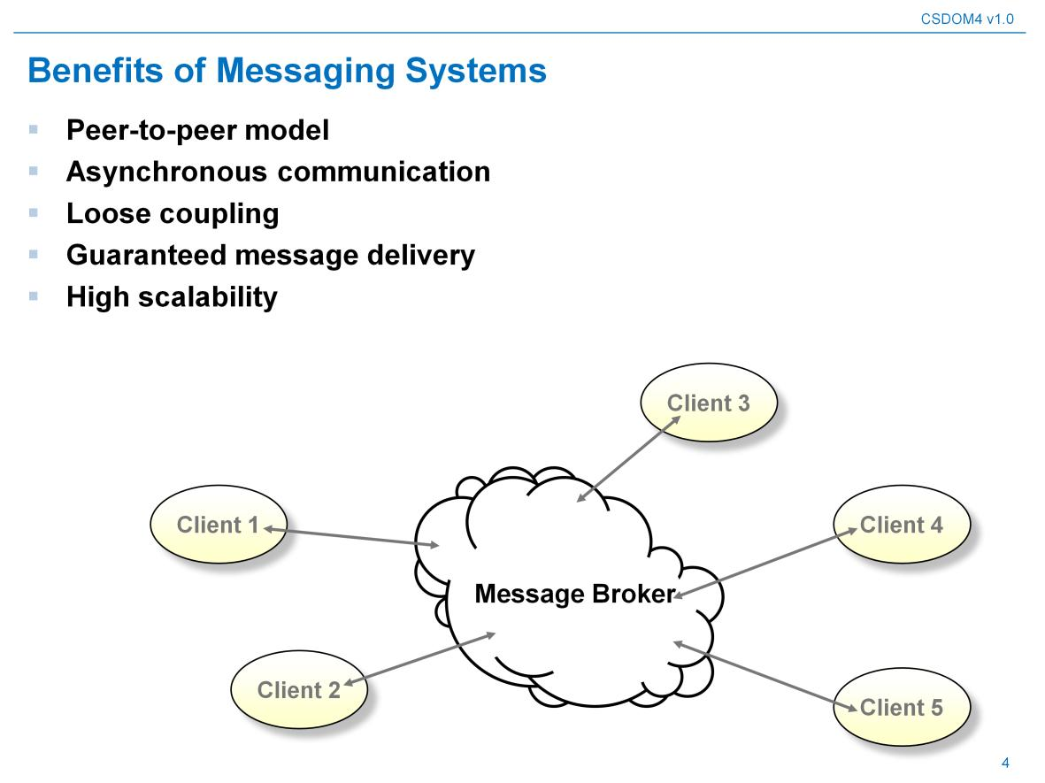
In comes message oriented communication...

Slide 47
Advantages of message systems
Only need to know the broker.
Can still implement peer to peer.
Loose coupling.
Guaranteed message delivery.
High scalability.
Asynchronous.
Time of delivery is not dependant on time of handling of message.
Email is to phone what messaging is to RPC.
No need for the receiver to be available all the time.

Slide 48
Real systems...
IBM's MQSeries
Microsoft's Message Queue
Sonic's SonincMQ
Tibco's Rendezvous
…
(and of-course interoperability problems)

Slide 49
MOM considerations
Durability: is delivery guaranteed? How?
Delivery: is delivery guaranteed at least once? Exactly once? At most once?
Ordering between message: is it guaranteed?
Connection between messages and database transactions.
Is one->many/many->many communication possible? (topics/queues).
Size of messages? Persistence of messages?
Can I do synchronous and asynchronous messaging?
Are there specific constraints on the content of the message?
What about getting notification when errors happen?

Slide 50
MOM in the Java world...
JMS – the primary solution. Part of J2EE. Very flexible.
Message driven EJBs (MDB). Consume and process JMS messages. Supports concurrency and transactions.
JAXM – Java API for XML messaging.

Slide 51
MOM and real time
Can be used together! This is actually common!
One queue for input and one for output.
It all depends on how “real time” is “real time”...
And how flexible your MOM solution is...

Slide 52
XML

Slide 53
XML?!? We already know that...
Just to make sure you know all the advantages of XML.
If you store documents you want to make sure that you'll be able to read them tomorrow
And that you know that if you choose to drop these advantages you will be sorry later.

Slide 54
XML features/advantages
Standard.
Supported by all programming languages and even databases.
Machine and human readable.
The document describes itself.
Document structure is tight and not loose (compare to HTML).
Separates content from data structure.
Open and extensible.
Has name-spaces for complex applications.
Can store binary data inside the document.
An XML document can be very large.
An XML document can contain references to itself within itself.

Slide 55
XML features/advantages (cont)
You have a choice of how to parse the document (DOM/SAX) and these have standards.
Many technologies built on top of XML (XSL, xpath, xlink, xinclude, DTD, schema, xselect, …).
Many editors that specialize in helping you with editing your XML content and keeping it correct.
Many tools for validating XML documents and converting it to/from other formats.
XML documents can include and/or reference other XML documents.
XML is multi-lingual (support UTF and other encodings).

Slide 56
Competition to XML?
There are all kinds of other formats (YAML?)
Stronger competition today is JSON because of JavaScript prevalence.
But JSON does not have MOST of the features mentioned before.
So enterprise document storage should still be in XML.

Slide 57
XML deficiencies
XML document are text and therefore a little heavy.
Tag names appear again and again.
You can solve this by using compression at lower levels (transport, disk storage).

Slide 58
Persistence strategies

Slide 59
Definition
A persistent object is one whose lifetime extends beyond the end of the process which creates it.
Orthogonal to type
Can be implemented in many ways.

Slide 60
Persisting objects
Files
  Need to hand write all code.
  Need to implement your own indexing
  Many pitfalls (too many files in a folder?)
  Not standard.
  No query language.
Key/value lightweight stores (e.g. Berkeley DB).
  Does the indexing for you.
  No higher level ACID guarantees.
  Usually just a library (not a process).
  No query language (only select by key).

Slide 61
Persisting objects (cont)
Lightweight SQL systems (e.g. SQLite)
  Has query language. Has indexing.
  Not very scalable or durable.
  Used a lot in mobile apps.
  ACID guarantee is technology specific.
Real RDBMS (e.g. Oracle)
  Has many features.
  Scalable and durable.
  ACID compliant.
  Not scalable for very high end needs.
  Needs ORM solution for large projects or your own data access layer.

Slide 62
Persisting objects (cont)
ODBMS (e.g. ObjectStore)
  Many features
  Usually tied to specific programming languages.
  Does not need ORM solution.
NoSQL solutions (e.g. MongoDB)
  SQL is gone.
  Scalable and durable (to a much greater degree than RDBMS).
  Select by key.
  Can usually store documents.

Slide 63
Persisting objects (cont)
And there are weirder solutions...
  Using an XML document store.
  Using ODBMS as gateway to RDBMS.
  Use the new language level persistence schemes: Java Data Objects, C# Linq.
  Use version control systems for storage? Git?!?
  Use ODMG (Object Database Management Group)

Slide 64
Choosing a persistence strategy
Is difficult.
Usually very few people have a wide enough view of all the technologies and the needs of the company to choose wisely.
So you choose and then you switch. Or just abuse your existing solution until you rewrite the entire system.

Slide 65
Making sure your data survives
Most RDBMs vendors provide solution, but you need to implement them. Usually replication of some kind and backup utilities.
No-SQL databases usually have it built in.
Other solutions will require more work on your part.

Slide 66
What about making sure your data is correct?
Disk corruption is very common.
Checksums are the standard way to fight this.
Some RDBMs vendors have features that fight disk corruption (how do you check this ?!?)
No-SQL vendors are very good at this.
Some hard drives are better at it than other.
Again, in home made solutions you will have to write code and maintain it...:(

Slide 67
Using your database correctly
Database abuse is very common.
Don't index what you don't need in the fast path.
Don't use RDBMs to store not OLTP data (or do it wisely...).
De-normalize to gain performance.
Shard the data? (lose some ACID features).
Be agile in your database design...

Slide 68
Multiple databases?
That is a dirty word! Or is it?
You lose ACID. You gain performance.
Sometimes you just have to live with multiple databases (complexity of organizational environment, third party companies/products, …).
What if you want transactions vs multiple databases?

Slide 69
Transacting vs multiple databases...
Do op1 on db1 but dont commit.
Do op2 on db2 but dont commit.
Send commit to db1.
Send commit to db2.
If problems happen then rollback or continue from where you left off.
Hard to code right.
Better use something like JTA in J2EE to do it for you...

Slide 70
What about decision support systems?
Create a data warehouse for DSS.
Use middle-ware to populate it.
Use numerous SQL applications/tools/reporting tools to access the data warehouse.
Maybe use big data solutions (HADOOP) if you have too much data?

Slide 71
Introducing the cloud

Slide 72
Where did cloud computing originate?
Converging of many ideas:
  Virtualization
  Grid computing
  Software as a Service (SaaS)
  Web Services (WS)
  Service Oriented Architecture (SOA)
  Web 2.0 / Web Oriented Architecture (WOA)

Slide 73
How disruptive is the cloud?
It depends on who you ask...
Answers range from “A nice tool” to “computing will never be the same again”.
Example: mobile applications developed very efficiently
Always remember that predicting is very hard.

Slide 74
Wikipedia
“Cloud computing refers to the delivery of computational resources from a location other than your current one”
Cloud is a metaphor for the Internet, based on how it is depicted in computing diagrams
A style of computing in which IT capabilities are delivered allowing users to use them without expertise of the underlying platform.

Slide 75
Attributes of cloud computing
Service based
Scalable and elastic
Shared
Metered by use
Uses Internet technologies

Slide 76
Cloud computing examples
Amazon EC2
Salesforce.com
Google Apps (GAE)
PayPal
Gmail

Slide 77
But what do you deliver?
IAAS: deliver the hardware (EC2).
PAAS: deliver the platform (GAE).
SAAS: deliver the software (Gmail).

Slide 78
Infrastructure-As-A-Service (IAAS)
The vendor provides infrastructure for you to deploy your own software solution, OS images, database, etc.
Amazon EC2 and GoGrid are hosted in the provider’s cloud, RightScale is a management platform to use with an IAAS for scaling and resource management.

Slide 79
Platform-As-A-Service (PAAS)
The vendor provides a framework that your solution must fit within.
You code against their APIs, management resources, and other elements of the framework to ensure that your software stack works within their environment.

Slide 80
Software-As-A-Service (SAAS)
The vendor provides a complete solution that you simply purchase access to in the form of some sort of licensing subscription model.
You can even use a private cloud to host it in some cases.

Slide 81
Understanding by analogy
The land line vs mobile phone analogy.
In a land line you are tied to a single provider with a fixed hardware
In a mobile phone you may switch providers and they may switch hardware on you without you knowing

Slide 82
Is cloud a buzz word?
It's wrongly accused of being a buzz word
But there are good reasons for this
Lack of standards is one
On the other hand a company with 2 employees managing a web app used by 30 million people could be hardly considered a buzz

Slide 83
Statistics
69% of US internet use is via some form of cloud service (2008)
50% in survey say their cloud budget will increase in the next 12 months (2009)
Cloud spending increased by 50% in 2010
And there are plenty more...

Slide 84
What can you use the cloud for?
Development infrastructure.
Deployment infrastructure.
Data
Software
Business processes
User interface

Slide 85
Cloud value – what does it give me?

Slide 86
“If you don't like change, you're going to like irrelevance even less”
– Gen. Erik Shineski

Slide 87
Cloud and efficiency
Number of applications is increasing
We really don't know which applications are going to be more successful.
We need the clouds elasticity to be ready for success but not over pay for it.

Slide 88
Cloud and agility
Facebook has been rewritten 3 times
This is not for lack of brain power
Main reason: you really don't know where your problems will be
In comes agile
The cloud allows agility, private IT stifles agility.
Cloud good, IT bad.

Slide 89
Cloud and competitiveness
Cloud allows you to pretend you have very scalable IT.
Even if you are a single developer
You can now use that to beat huge competitors.
Cloud is democracy

Slide 90
Cloud and money
IT costs.
It costs because it's custom.
It costs because it's slow.
It costs because changing IT infrastructure is slow.
Once you buy hardware or software for IT you pay for it whether you use it or not.

Slide 91
Cloud and reliability/maintainability
Sure, you can do that on your own.
No. You don't want to.
Monitory you machines? Replace hard-drive when they start showing signs of aging? Send SMS when your app is failing?
Cloud is outsourcing all of this.

Slide 92
Cloud and scalability
Scale up is obvious.
Scale down is also very important!
Remember that more apps mean a lot more apps that will fail.
And you don't want to pay for IT infra for failed apps.

