Slide 1
expressJs
OpenPaaS technical on-boarding
Notes:
To change the logo in the footer, go to the VIEW menu > Master > Slide Master, and replace the existing logo by your entity's logo.
To edit the confidentiality level, go to the INSERT menu > Header and footer, and fill in the desired level.

Slide 2
CONTENTS
Basics P.03
Routes P.06
Templates P.09
API & MongoDB P.11
Notes:
Page numbers are flushed right using the tab function ("->” key or "TAB" key), and are formatted manually (Century 12 pt., dark blue).
Chapters are numbered automatically.
To edit the footer for the entire document, go to INSERT > Header and footer, and fill in the desired titles and dates.
The vertical line should be adjusted manually.

Slide 3
1
Basics
Notes:
The background color can be changed using the slide’s background color commands (preferably using the color palette). Note that we recommend using either this color or that of the following slide (10th color of the predefined palette).
(right click on the slide + “Format background”). Here, the 4th color of the predefined palette was chosen.

Slide 4
ExpressJS – Basics
ExpressJS is a nodeJS module providing a more “high-level” http server framework than using “http” module
ExpressJS allows you to
Handle routing in an easier way,
Use templates,
Add functionalities to your endpoints via middlewares
ExpressJS is used by many other module (SailsJS, Loopback,
Note: As we’re going to use ExpressJS to create APIs, we need a tool to test those endpoint. Please install postman
https://www.getpostman.com/apps
Notes:
To change bullet colors, select the text in question and go to the HOME menu > Bullets and numbers, choose "Custom bullet" and choose the desired bullet.
To insert the bullets to the PowerPoint bullet library, go to menu > Bullets and numbers, choose “bullets and numbering”, choose “picture”, choose import”, select the bullets’ folder previously saved on the hard drive and validate.

Slide 5
ExpressJS – Basics
Let’s write some code!
Create a new folder and cd into it
Run “npm init” and hit return to use default values EXCEPT for “entry point” => app.js
Run ”npm install express --save”
Copy paste the following code in your “app.js” file
const express = require('express');
const app = express();
app.get('/', (req, res) => res.send('Hello World!'));
app.listen(3000, () => console.log('Example app listening on port 3000!'))
Explanation
Load the express module
Create a new instance of express called « app »
Define a route (bind on « / » and GET method) that will send « Hello World! » as a response
Start our app on port 3000
Notes:
To change bullet colors, select the text in question and go to the HOME menu > Bullets and numbers, choose "Custom bullet" and choose the desired bullet.
To insert the bullets to the PowerPoint bullet library, go to menu > Bullets and numbers, choose “bullets and numbering”, choose “picture”, choose import”, select the bullets’ folder previously saved on the hard drive and validate.

Slide 6
2
Routes
Notes:
The background color can be changed using the slide’s background color commands (preferably using the color palette). Note that we recommend using either this color or that of the following slide (10th color of the predefined palette).
(right click on the slide + “Format background”). Here, the 4th color of the predefined palette was chosen.

Slide 7
ExpressJS – Routes
Let’s check some code!
Clone Github.axa.com/openpaas-asia-training/nodejs-example.git
Git checkout express-start
Npm install
Npm start (to start the server)
Standard routing in expressJS
app.METHOD(PATH, FUNC) where
App is an instance of express
METHOD is an HTTP request method in lowercase
PATH is the path on the server
FUNC is the handler function
Dynamic routing in expressJS
Route with dynamic element (« /user/1 », « /blog/december/24 », …)
Use « :paramName » in the URL (« /user/:id », « /blog/:month/:day », …)
Use the dynamic element in your code with « req.params.paramName »
Static files in expressJS
app.use(express.static(‘public’))
app.use => describe a middleware that will be use for each request
express.static => built-in express function to handle public folder
Notes:
To change bullet colors, select the text in question and go to the HOME menu > Bullets and numbers, choose "Custom bullet" and choose the desired bullet.
To insert the bullets to the PowerPoint bullet library, go to menu > Bullets and numbers, choose “bullets and numbering”, choose “picture”, choose import”, select the bullets’ folder previously saved on the hard drive and validate.

Slide 8
ExpressJS – Routes
Let’s check some code!
Git checkout express-router
Npm install
Npm start (to start the server)
Explanation
Line 3 & policy.js: We create a dedicated router to handle all our routes & specific middleware for « /policy » URLs
Line 9-12: We handle all routes to « /user » with a chained structure for all the HTTP request methods
Line 23: We use our dedicated « policy » router as a middleware for all routes starting with « /policy »
Line 26-29: Error handling middleware (special signature with 4 params)
Notes:
To change bullet colors, select the text in question and go to the HOME menu > Bullets and numbers, choose "Custom bullet" and choose the desired bullet.
To insert the bullets to the PowerPoint bullet library, go to menu > Bullets and numbers, choose “bullets and numbering”, choose “picture”, choose import”, select the bullets’ folder previously saved on the hard drive and validate.

Slide 9
3
Templates
Notes:
The background color can be changed using the slide’s background color commands (preferably using the color palette). Note that we recommend using either this color or that of the following slide (10th color of the predefined palette).
(right click on the slide + “Format background”). Here, the 4th color of the predefined palette was chosen.

Slide 10
ExpressJS – Templates
Let’s check some code!
Git checkout express-template
Npm install
Npm start (to start the server)
Explanation server.js
Overview: a web server using expressJS with a middleware providing access logs, static HTML files, and EJS templates.
Line 5 & 8: We load an external tool (« morgan ») that is loaded as a middleware to provide us logs
Line 11-20: Static files + static HTML pages (using « res.sendFile() »)
Line 23-24: Templates settings giving information to express where are located the template files & what templating engine is used
Explanation policy.js
Line 6-17: using the « res.render() » method, we can render the templates, and even passing data to populate the templates
Check the format in « views/pages » & « views/partials » for more information on how EJS templates works.
Notes:
To change bullet colors, select the text in question and go to the HOME menu > Bullets and numbers, choose "Custom bullet" and choose the desired bullet.
To insert the bullets to the PowerPoint bullet library, go to menu > Bullets and numbers, choose “bullets and numbering”, choose “picture”, choose import”, select the bullets’ folder previously saved on the hard drive and validate.

Slide 11
4
API & MongoDB
Notes:
The background color can be changed using the slide’s background color commands (preferably using the color palette). Note that we recommend using either this color or that of the following slide (10th color of the predefined palette).
(right click on the slide + “Format background”). Here, the 4th color of the predefined palette was chosen.

Slide 12
ExpressJS – API & MongoDB
MongoDB is a document oriented database (NoSQL). It’s a non-relationnal DB for JSON document, which means it’s natively compatible with JS
No joins, no transactions and schemaless DB => you can have different document schema in the same collection.
Vocabulary
Database: a database (“myaxa”)
Collection: a set of documents (“myaxa > policy”)
Document: a set of information in JSON format (“myaxa > policy > policy25816400”)
Mongo shell available using “mongo” client
Javascript based prompt (loop, …)
Running mongodb locally using “mongod”
MongoDB driver available in nodeJS
Npm install mongodb
MongoClient = require(‘mongodb’).MongoClient;
Notes:
To change bullet colors, select the text in question and go to the HOME menu > Bullets and numbers, choose "Custom bullet" and choose the desired bullet.
To insert the bullets to the PowerPoint bullet library, go to menu > Bullets and numbers, choose “bullets and numbering”, choose “picture”, choose import”, select the bullets’ folder previously saved on the hard drive and validate.

Slide 13
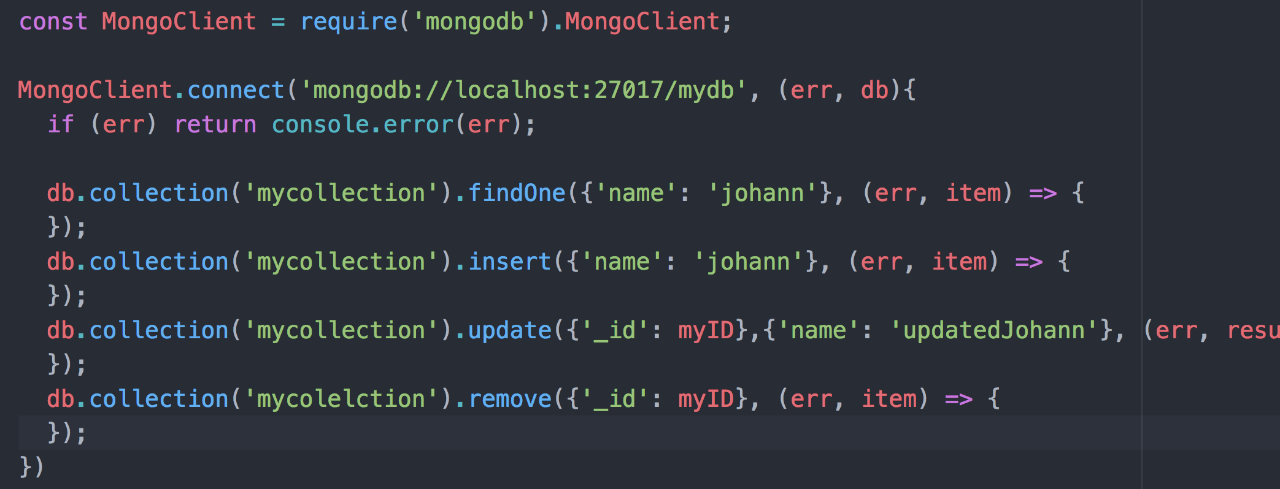
ExpressJS – API & MongoDB
Using MongoClient in nodeJS
Notes:
To change bullet colors, select the text in question and go to the HOME menu > Bullets and numbers, choose "Custom bullet" and choose the desired bullet.
To insert the bullets to the PowerPoint bullet library, go to menu > Bullets and numbers, choose “bullets and numbering”, choose “picture”, choose import”, select the bullets’ folder previously saved on the hard drive and validate.

Slide 14
ExpressJS – API & MongoDB
Let’s write some code!
Exercise:
Create an express application that will expose 4 endpoints:
GET /api/note/:id => retrieve a policy by its ID
POST /api/note => post a new policy
PUT /api/note/:id => update a policy
DELETE /api/note/:id => delete a policy
A note is based on a « title » and a « body »
Tips: use the « body-parser » middleware to retrieve data from « req.body »
Create, read, update & delete operation should interact with a mongoDB database
BONUS: create a endpoint to list all notes
Notes:
To change bullet colors, select the text in question and go to the HOME menu > Bullets and numbers, choose "Custom bullet" and choose the desired bullet.
To insert the bullets to the PowerPoint bullet library, go to menu > Bullets and numbers, choose “bullets and numbering”, choose “picture”, choose import”, select the bullets’ folder previously saved on the hard drive and validate.

Slide 15


Thank you

