Slide 1
Nodejs
OpenPaaS technical on-boarding
Notes:
To change the logo in the footer, go to the VIEW menu > Master > Slide Master, and replace the existing logo by your entity's logo.
To edit the confidentiality level, go to the INSERT menu > Header and footer, and fill in the desired level.

Slide 2
CONTENTS
Basics P.03
Events P.10
Modules P.13
Package.json P.18
Notes:
Page numbers are flushed right using the tab function ("->” key or "TAB" key), and are formatted manually (Century 12 pt., dark blue).
Chapters are numbered automatically.
To edit the footer for the entire document, go to INSERT > Header and footer, and fill in the desired titles and dates.
The vertical line should be adjusted manually.

Slide 3
1
Basics
Notes:
The background color can be changed using the slide’s background color commands (preferably using the color palette). Note that we recommend using either this color or that of the following slide (10th color of the predefined palette).
(right click on the slide + “Format background”). Here, the 4th color of the predefined palette was chosen.

Slide 4
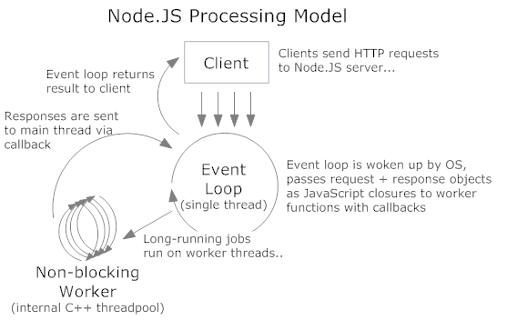
NodeJS – Basics
NodeJS is a JavaScript runtime built on top of Chrome’s V8 JavaScript engine
NodeJS = using javascript on the server side
Event-driven, Non-blocking I/O, asynchronous, single-threaded model
Notes:
To change bullet colors, select the text in question and go to the HOME menu > Bullets and numbers, choose "Custom bullet" and choose the desired bullet.
To insert the bullets to the PowerPoint bullet library, go to menu > Bullets and numbers, choose “bullets and numbering”, choose “picture”, choose import”, select the bullets’ folder previously saved on the hard drive and validate.

Slide 5
NodeJS – Basics
const callback = function (error, response, body) {
console.log("Download complete");
});
request('http://www.site.com/file.zip', callback);
console.log("Doing something else while waiting");
What this function does?
Request “file.zip” > start download
Print “Doing something else while waiting”
When the file has been downloaded, print “Download complete”
Explanation
Request is module to request a web resources (page, api, file, …)
The request module take a callback that will be triggered when the resources is downloaded (asynchronous)
The callback is an anonymous function that will display a msg when download is complete (or an error is emitted)
Note: nodeJS uses « error first » approach, which means that all callback functions will handle an error as the first argument
This code shows the asynchronous / non-blocking way NodeJS works
Notes:
To change bullet colors, select the text in question and go to the HOME menu > Bullets and numbers, choose "Custom bullet" and choose the desired bullet.
To insert the bullets to the PowerPoint bullet library, go to menu > Bullets and numbers, choose “bullets and numbering”, choose “picture”, choose import”, select the bullets’ folder previously saved on the hard drive and validate.

Slide 6
NodeJS – Basics
Let’s check some code!
Clone Github.axa.com/openpaas-asia-training/nodejs-example.git
Git checkout master
Node server.js (to start the server)
Explanation of server.js
Overview: create a http server that will send ‘Hello everyone’ in any cases, for any requests. This server listen on port 8080.
Line 1: require will load a nodeJS library (“http”). This library is a built-in lib of nodeJS. There’s a ton of libraries than can be downloaded using NPM (node package manager)
Line 3-6: with the “http” lib, we will create a small http server. The parameter is a callback function that will handle all our request to the server
The callback function takes 2 parameters: the request (“req”) with all the information coming from the user, and the response (“res”) that we will use to send back information to the user.
res.writeHead(200) sends a 200 status code to the user
res.end will end our response with the text we want to send
Line 7: server is listenning on port 8080
Notes:
To change bullet colors, select the text in question and go to the HOME menu > Bullets and numbers, choose "Custom bullet" and choose the desired bullet.
To insert the bullets to the PowerPoint bullet library, go to menu > Bullets and numbers, choose “bullets and numbering”, choose “picture”, choose import”, select the bullets’ folder previously saved on the hard drive and validate.

Slide 7
NodeJS – Basics
Next step
Git checkout html-response
Node server.js
Explanation of server.js
Overview: create a http server that will send HTML in any cases, for any requests. This server listen on port 8080.
Line 4: we indicates what type of content we’re sending back to the user. In this case, « text/html »
Using res.write() instead of res.end() in order to divide what we want to send to our user, and when it has to end.
You always have to end your request with res.end()!
Of course, this is not a correct way to have a web server sending HTML! If you want to know more about this, google search « templating in nodeJS »
Notes:
To change bullet colors, select the text in question and go to the HOME menu > Bullets and numbers, choose "Custom bullet" and choose the desired bullet.
To insert the bullets to the PowerPoint bullet library, go to menu > Bullets and numbers, choose “bullets and numbering”, choose “picture”, choose import”, select the bullets’ folder previously saved on the hard drive and validate.

Slide 8
NodeJS – Basics
Next step
Git checkout url-parsing
Node server.js
Explanation of server.js
Overview: create a http server that will send Plain Text depending on the url that has been requested. This server listen on port 8080.
Line 2: we are using another built-in library of nodeJS: « url ». This library allows to perform various task on the url element (« req.url »).
Line 5: we use our newly loaded library to retrieve the pathname of the request.
Line 8-16: Depending on the page name, different message will be displayed.
Notes:
To change bullet colors, select the text in question and go to the HOME menu > Bullets and numbers, choose "Custom bullet" and choose the desired bullet.
To insert the bullets to the PowerPoint bullet library, go to menu > Bullets and numbers, choose “bullets and numbering”, choose “picture”, choose import”, select the bullets’ folder previously saved on the hard drive and validate.

Slide 9
NodeJS – Basics
Next step
Git checkout query-parsing
Node server.js
Explanation of server.js
Overview: create a http server that will send personalize Text based on parameters provided by the user. This server listen on port 8080.
Line 3: we are using another built-in library of nodeJS: « querystring ». This library allows to parse a query string and will map the key / value in an array.
Line 6: we use our newly loaded library to retrieve the parameters from the url.
Line 9: If we retrieve the firstname & lastname parameters, we will display a personalized message.
Note: we use a special ES6 notation: the back tick. This allows us to use variable in print message with the syntax ${var}. As our variable is an array, we provide the name of the key to retrieve its value.
Notes:
To change bullet colors, select the text in question and go to the HOME menu > Bullets and numbers, choose "Custom bullet" and choose the desired bullet.
To insert the bullets to the PowerPoint bullet library, go to menu > Bullets and numbers, choose “bullets and numbering”, choose “picture”, choose import”, select the bullets’ folder previously saved on the hard drive and validate.

Slide 10
2
Events
Notes:
The background color can be changed using the slide’s background color commands (preferably using the color palette). Note that we recommend using either this color or that of the following slide (10th color of the predefined palette).
(right click on the slide + “Format background”). Here, the 4th color of the predefined palette was chosen.

Slide 11
NodeJS – Events
NodeJS is event-driven, meaning that functions or actions that will take some time will register a callback triggered on the event « function is done ». This architecture enables non-blocking code & I/O.
In a browser, we attached event Listenners on specific element (DOM element). Those elements will emit event, that will be intercepted by our listenners.
Objects in nodeJS emits & receives events by extending the « EventEmitter » module.
For example, the « http » module emits events (connection, request, close, connect, …)
https://nodejs.org/api/http.html
Notes:
To change bullet colors, select the text in question and go to the HOME menu > Bullets and numbers, choose "Custom bullet" and choose the desired bullet.
To insert the bullets to the PowerPoint bullet library, go to menu > Bullets and numbers, choose “bullets and numbering”, choose “picture”, choose import”, select the bullets’ folder previously saved on the hard drive and validate.

Slide 12
NodeJS – Events
Next step
Git checkout events
Node server.js
Explanation of server.js
Overview: create a http server that will send personalize Text based on parameters provided by the user & listen on port 8080. A custom logger will be set up to display an error message in the console if parameters provided doesn’t match.
Line 4-5: Custom logger created using the EventEmitter sub-module
Line 15: We « emit » an event
Line 20-22: We declare the event receiver and attached a function to it.
Notes:
To change bullet colors, select the text in question and go to the HOME menu > Bullets and numbers, choose "Custom bullet" and choose the desired bullet.
To insert the bullets to the PowerPoint bullet library, go to menu > Bullets and numbers, choose “bullets and numbering”, choose “picture”, choose import”, select the bullets’ folder previously saved on the hard drive and validate.

Slide 13
3
Modules
Notes:
The background color can be changed using the slide’s background color commands (preferably using the color palette). Note that we recommend using either this color or that of the following slide (10th color of the predefined palette).
(right click on the slide + “Format background”). Here, the 4th color of the predefined palette was chosen.

Slide 14
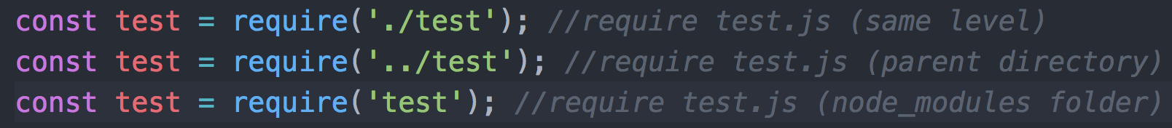
NodeJS – Modules
NodeJS core is very small, but can be extended with modules
Modules can be anything! Redis client, MySQL connector, template systems, Frameworks, utilities functions, … Available on NPM (node package manager)!
If there’s no « node_modules » folder, NodeJS will try to find it in the parent directory recursively
The code in « test.js » is exporting some functions to make them available when « require(‘test’) » is executed.
Note: We’re not using the « .js » extension when we require the modules.
Notes:
To change bullet colors, select the text in question and go to the HOME menu > Bullets and numbers, choose "Custom bullet" and choose the desired bullet.
To insert the bullets to the PowerPoint bullet library, go to menu > Bullets and numbers, choose “bullets and numbering”, choose “picture”, choose import”, select the bullets’ folder previously saved on the hard drive and validate.

Slide 15
NodeJS – Modules
Global modules comes with executable that will be add to the path
In order to install modules from NPM, you can search, and then install
npm search modulename
npm install modulename
When you install a module, you can « save » it in 3 differents way:
npm install modulename --save
Will save the module as a « dependency » (always installed)
npm install modulename --save-dev
Will save the module as a « development dependency » (installed only when NODE_ENV != production)
npm install modulename --global
Will save the module as a « global module » (not project related)
Note that global module are not « requirable » in your code, but provide useful executable available globally on your computer
If you want to update your modules
npm update
Notes:
To change bullet colors, select the text in question and go to the HOME menu > Bullets and numbers, choose "Custom bullet" and choose the desired bullet.
To insert the bullets to the PowerPoint bullet library, go to menu > Bullets and numbers, choose “bullets and numbering”, choose “picture”, choose import”, select the bullets’ folder previously saved on the hard drive and validate.

Slide 16
NodeJS – Modules
Module versionning use SemVer (major, minor, patch)
If you need a specific version of a module
« module » : « 0.1.0 »
If you need a specific version of a module, but you authorize patch update
« module » : « ~0.1.0 »
If you want to authorize minor update
« module » : « ~0.1 »
The modules, and their version, are located (project wised) in a file called package.json
This file keeps track of the project information, its version, the dependencies and devDependencies
Notes:
To change bullet colors, select the text in question and go to the HOME menu > Bullets and numbers, choose "Custom bullet" and choose the desired bullet.
To insert the bullets to the PowerPoint bullet library, go to menu > Bullets and numbers, choose “bullets and numbering”, choose “picture”, choose import”, select the bullets’ folder previously saved on the hard drive and validate.

Slide 17
NodeJS – Modules
Next step
Git checkout modules
Node server.js
Explanation of server.js
Overview: create a http server that will send personalize Text based on parameters provided by the user & listen on port 8080. A custom logger module will be set up to display an error message in the console if parameters provided doesn’t match.
Line 4: Our custom logger module (note the « ./logger » to indicate that the module is in the same directory of our « server.js » file
Line 14: We use our module to submit an error level, and an error message
Explanation of logger.js
Line 1-5: We require EventEmitter then create a new instance of it, and attach a function matching the event « logging »
Line 4: Depending on the level provided, we use the console to display the message passed as arguments
Line 7-9: We export only the function « log » that can be used by other modules. This function will fire an event to our logger with the provided parameters
Notes:
To change bullet colors, select the text in question and go to the HOME menu > Bullets and numbers, choose "Custom bullet" and choose the desired bullet.
To insert the bullets to the PowerPoint bullet library, go to menu > Bullets and numbers, choose “bullets and numbering”, choose “picture”, choose import”, select the bullets’ folder previously saved on the hard drive and validate.

Slide 18
4
Package.json
Notes:
The background color can be changed using the slide’s background color commands (preferably using the color palette). Note that we recommend using either this color or that of the following slide (10th color of the predefined palette).
(right click on the slide + “Format background”). Here, the 4th color of the predefined palette was chosen.

Slide 19
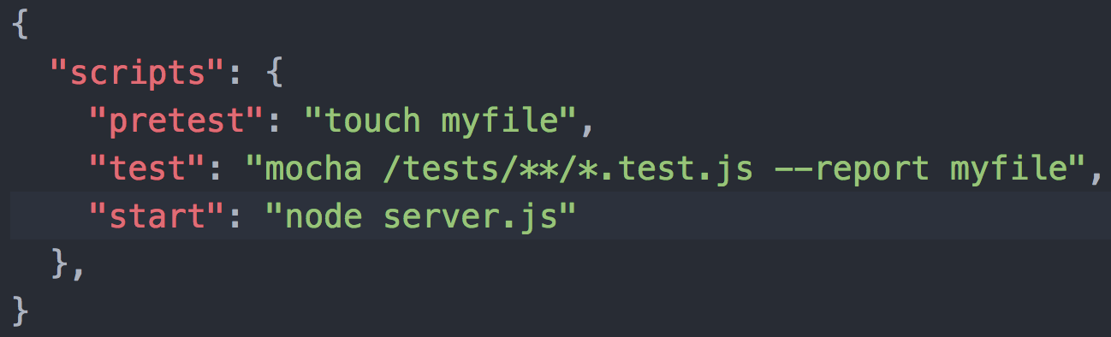
NodeJS – Package.json
The package.json file represents all your NodeJS application’s information
Name (required): Name of your application
Version (required): SemVer version
Scripts: Commands that are run at various time in the lifecycle of your application with key being the lifecycle event, and value being the command to run
In order to run script, you will execute npm run <scriptName>
Lifecycle elements are supported, for example:
Dependencies: your application main dependencies (will be installed everytime when npm install)
DevDependencies: your application developement dependencies (will be installed only if environment != production)
Notes:
To change bullet colors, select the text in question and go to the HOME menu > Bullets and numbers, choose "Custom bullet" and choose the desired bullet.
To insert the bullets to the PowerPoint bullet library, go to menu > Bullets and numbers, choose “bullets and numbering”, choose “picture”, choose import”, select the bullets’ folder previously saved on the hard drive and validate.

Slide 20


Thank you

