Slide 1
Greenhouse Management
design

Slide 2
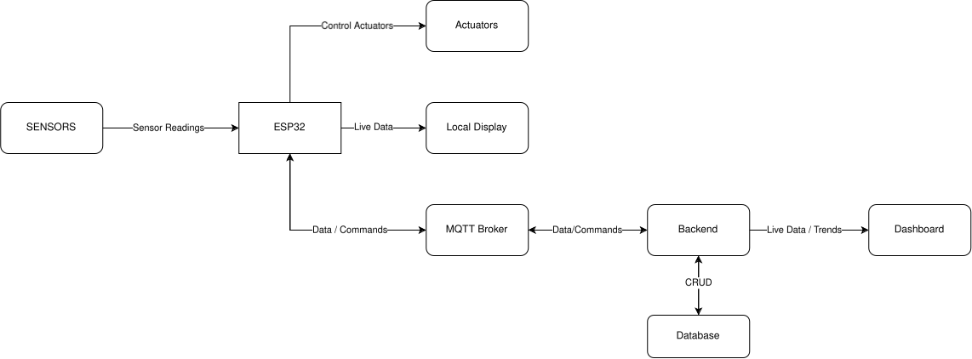
1. System architecture

Slide 3
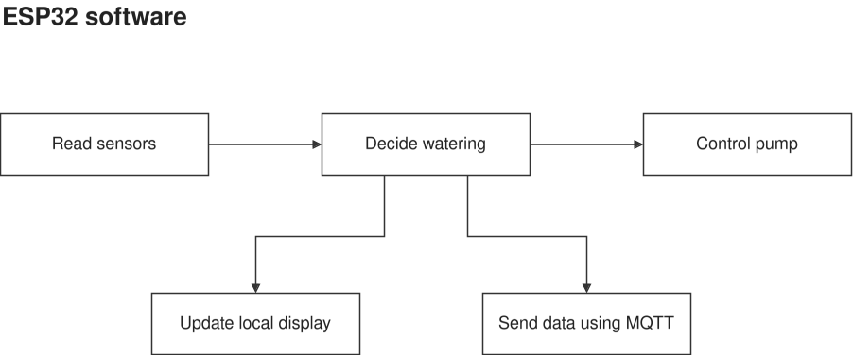
2. Firmware responsibilities

Slide 4
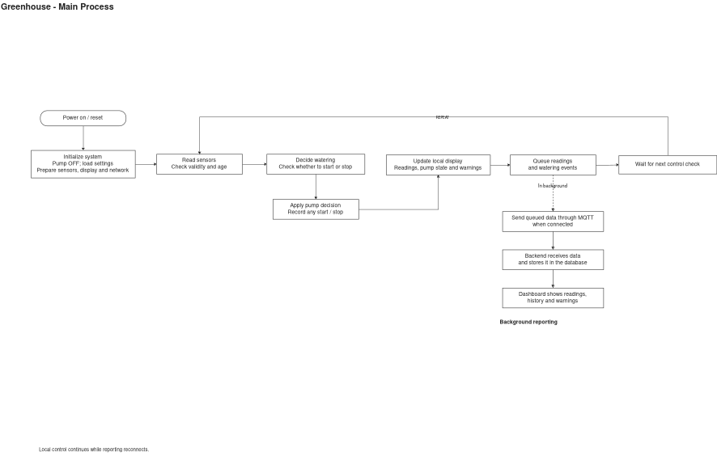
3. Whole system – more detailed

Slide 5
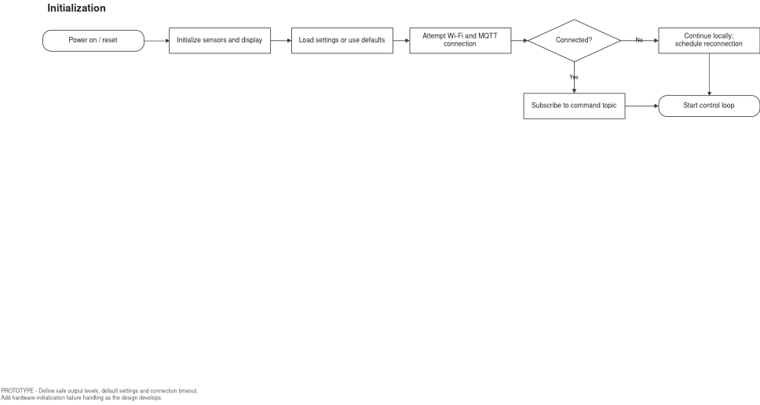
4. Initialization / setup part

Slide 6
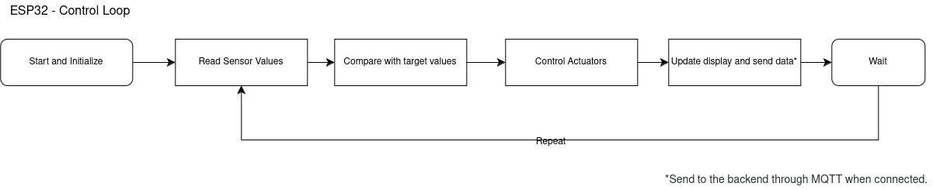
5. Control Loop

Slide 7
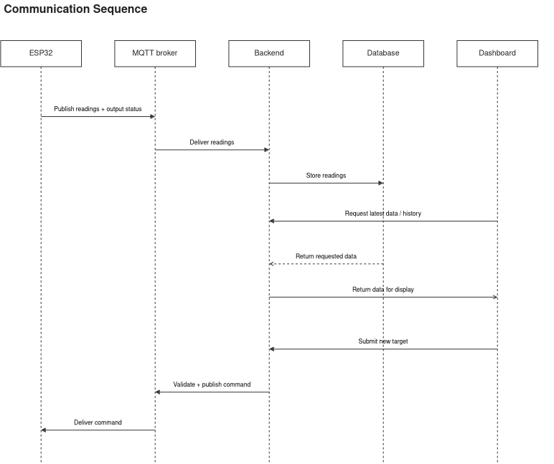
6. Communication protocol

Slide 8
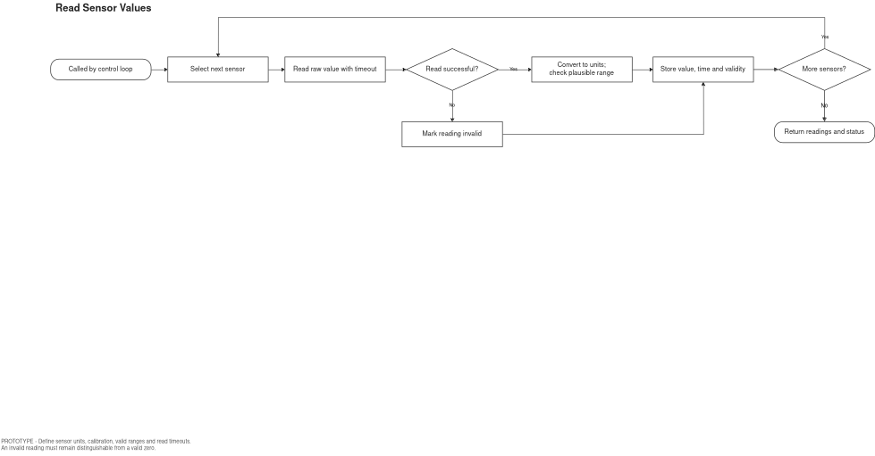
7. Sensor Readings*

