Slide 1
Realization

Slide 2
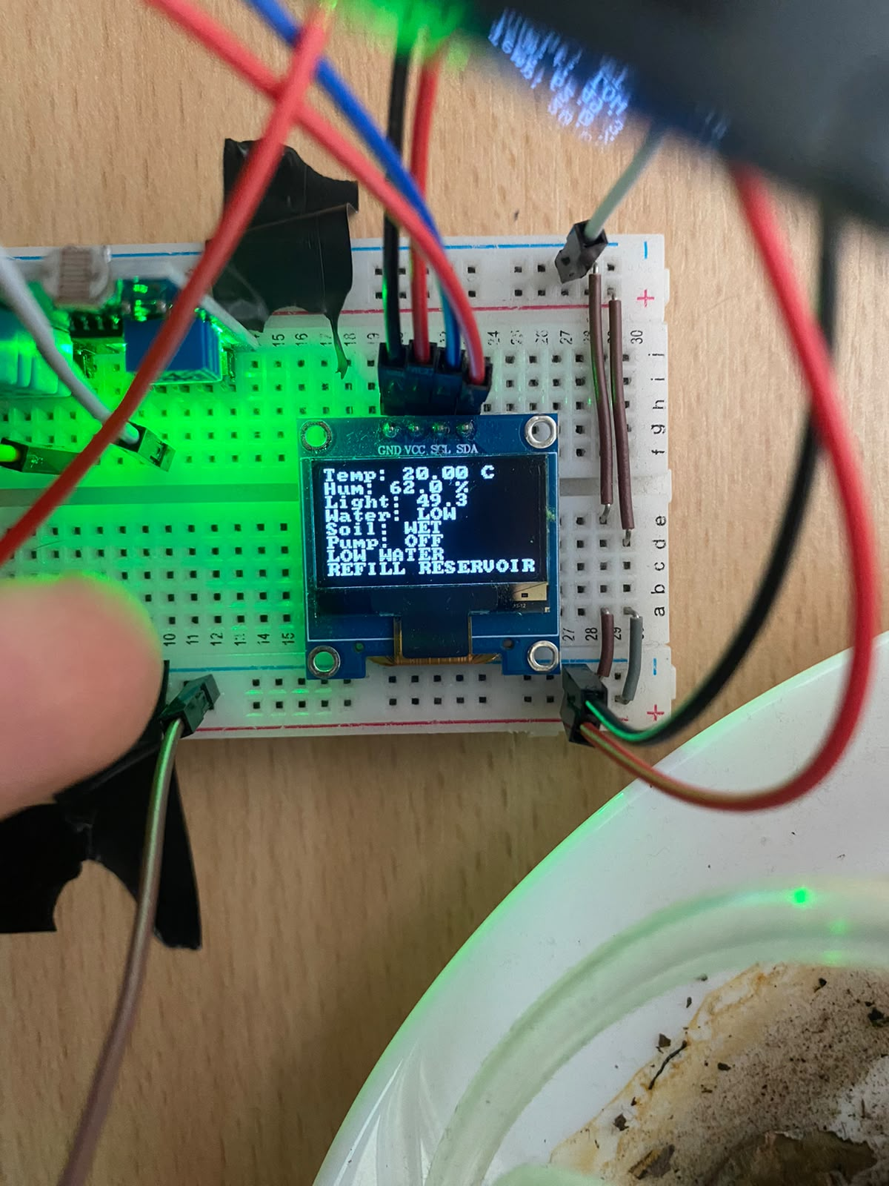
2. OLED View
Temperature
Humidity
Moisture Level
Light Level
Pump Mode
Water Status
Alerts – Local View

Slide 3
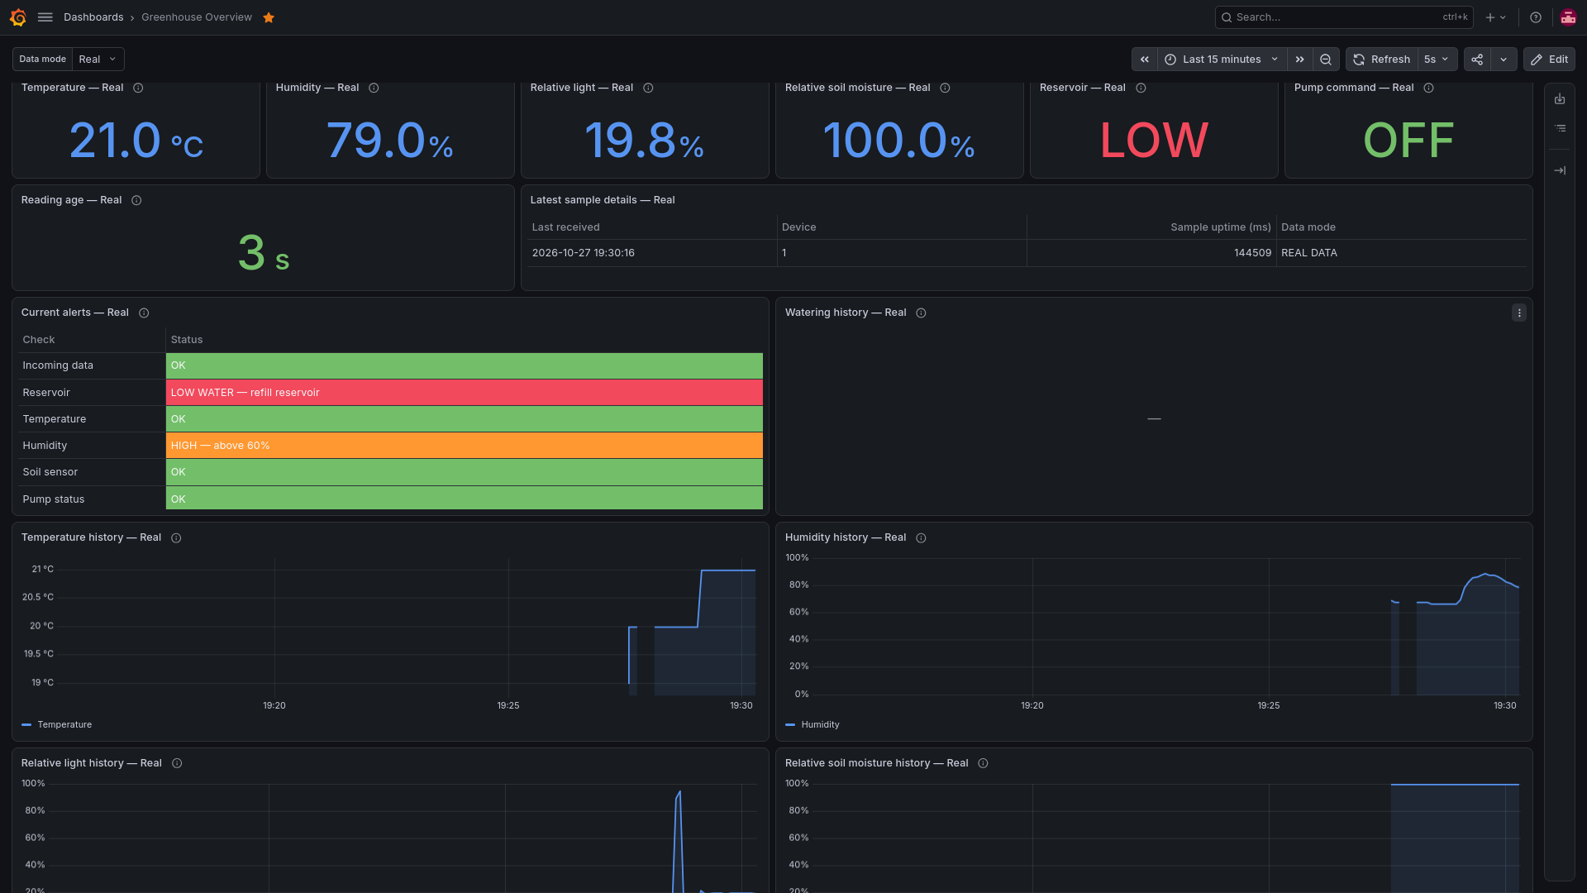
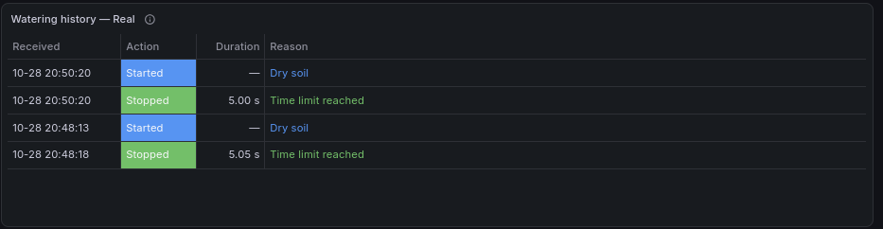
2. Dashboard View
Upper left corner of each panel explains its function

Slide 4
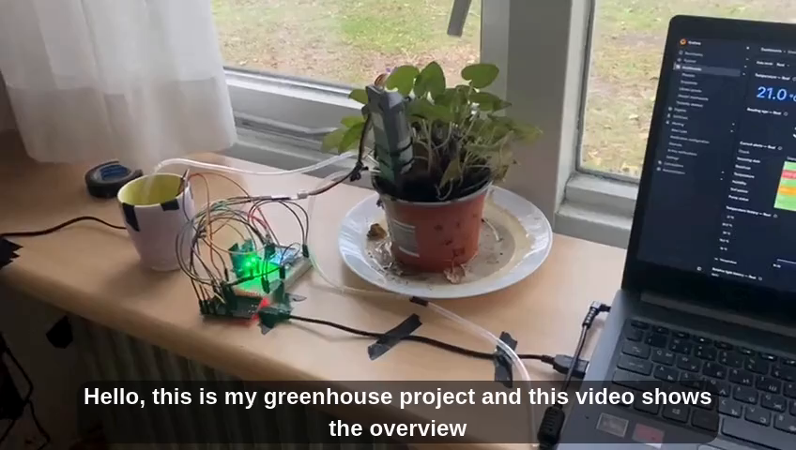
1. Overview

Slide 5
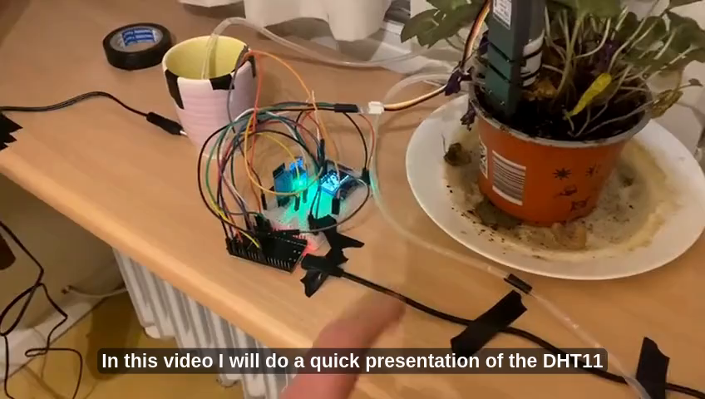
2. Temperature and Humidity functionality

Slide 6
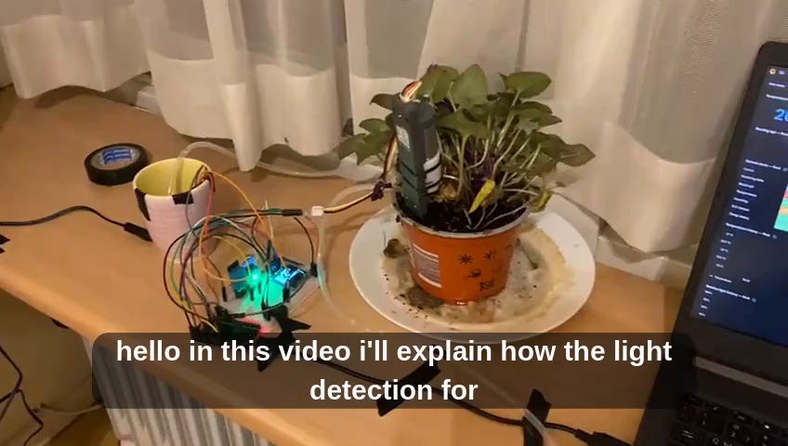
3. Light Level functionality

Slide 7
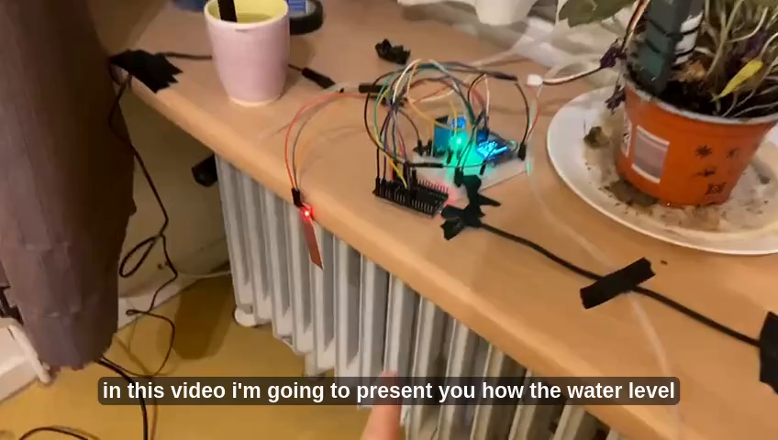
4. Water Status functionality

Slide 8
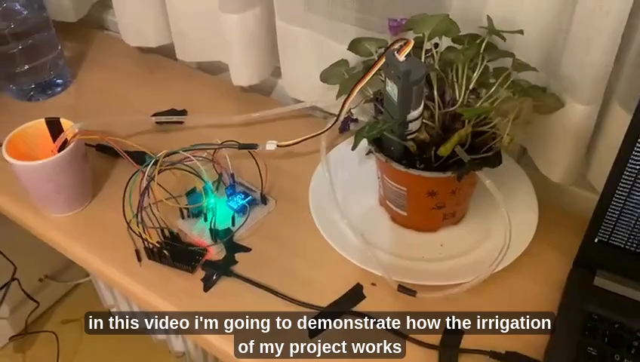
5. Irrigation Example

