Slide 1
SpaceGame
Design
1. Inspirations
2. Prototypes
3. System Design
4. Game objects

Slide 2
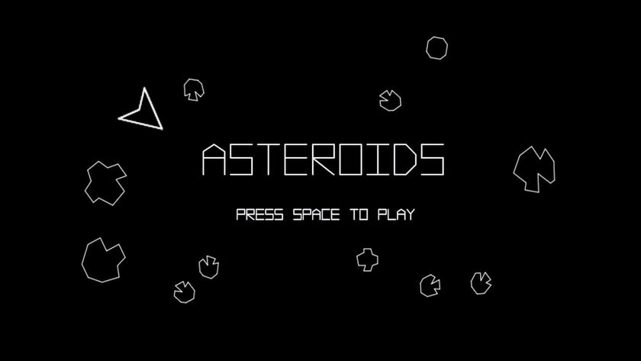
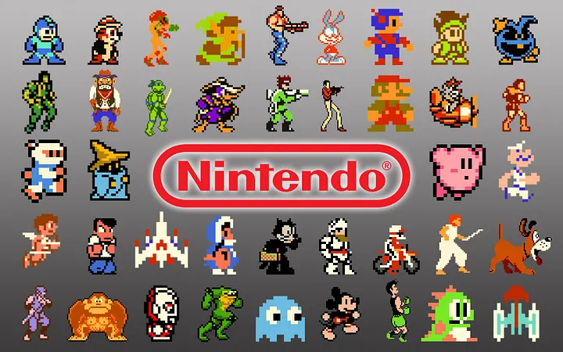
1. Inspirations

Slide 3
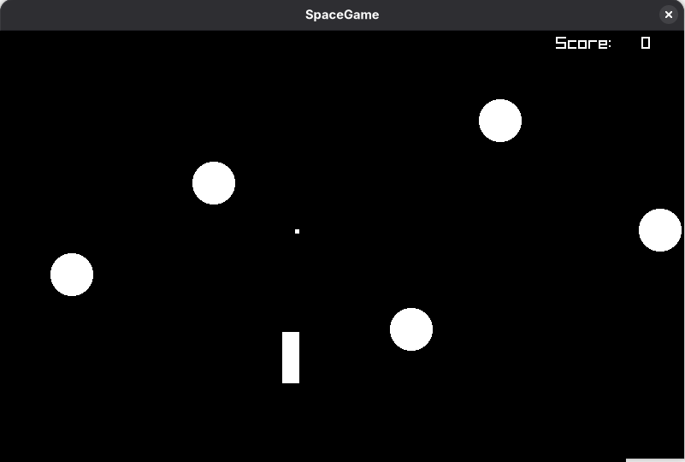
2. Prototypes
1. Early prototype - The image represents the ship as a rectangle, the asteroids as circles, the projectile as a square and the placement of the score counter.

Slide 4
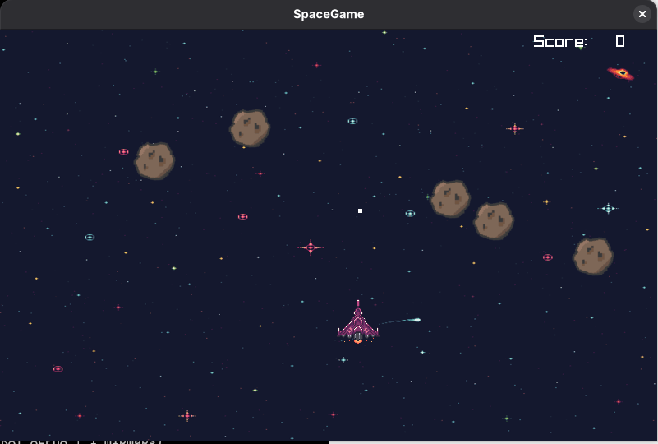

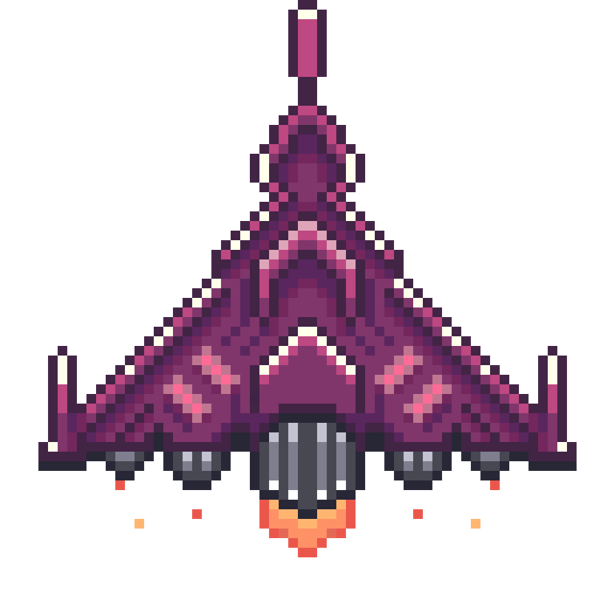
2. Prototype with graphics – static background and images

Slide 5
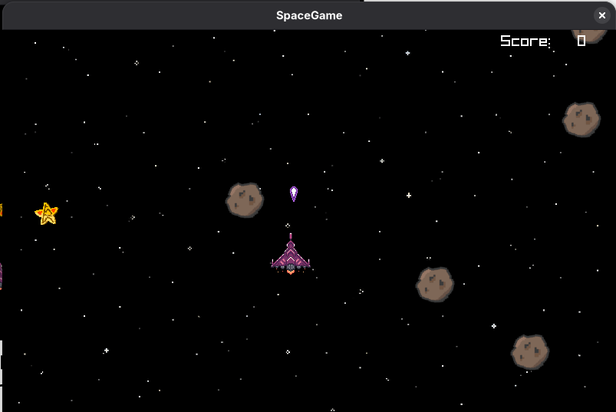
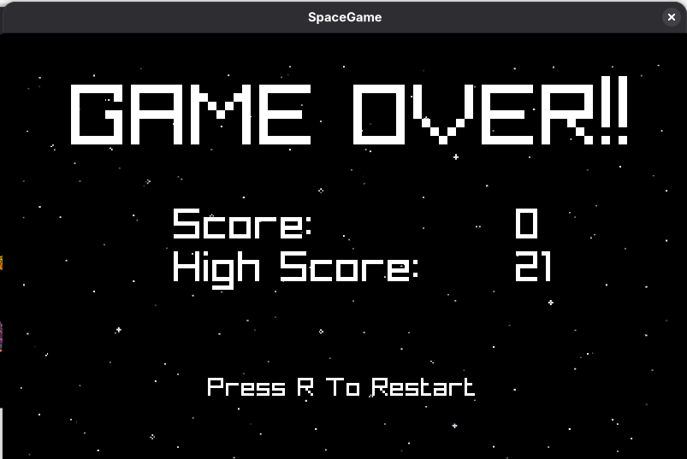


4. Image showing the Game Over menu
3. Image showing the reward design and a different background

Slide 6
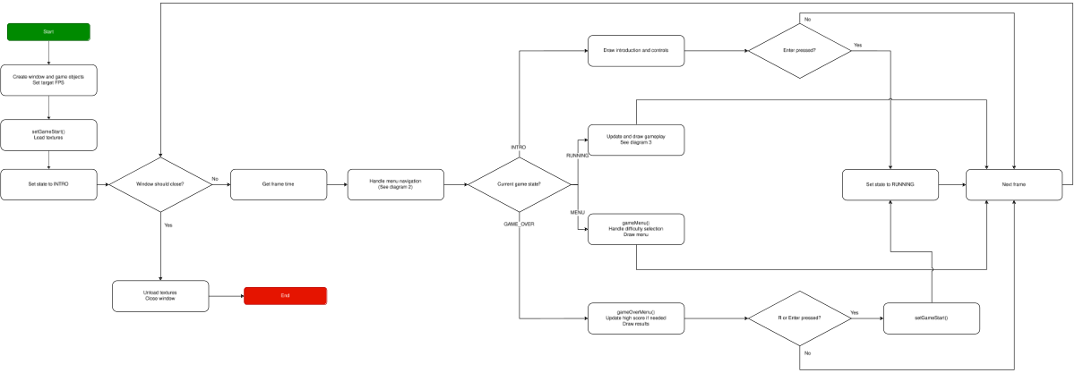
3. System Design
1. Flowchart of the game

Slide 7
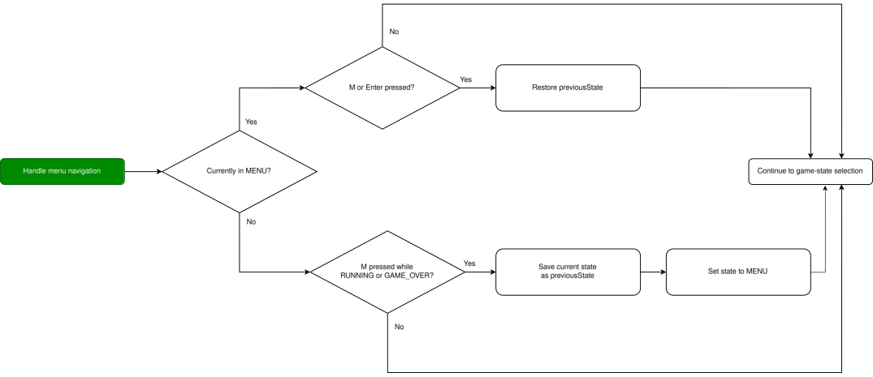
3. System Design
2. Menu navigation flowchart

Slide 8
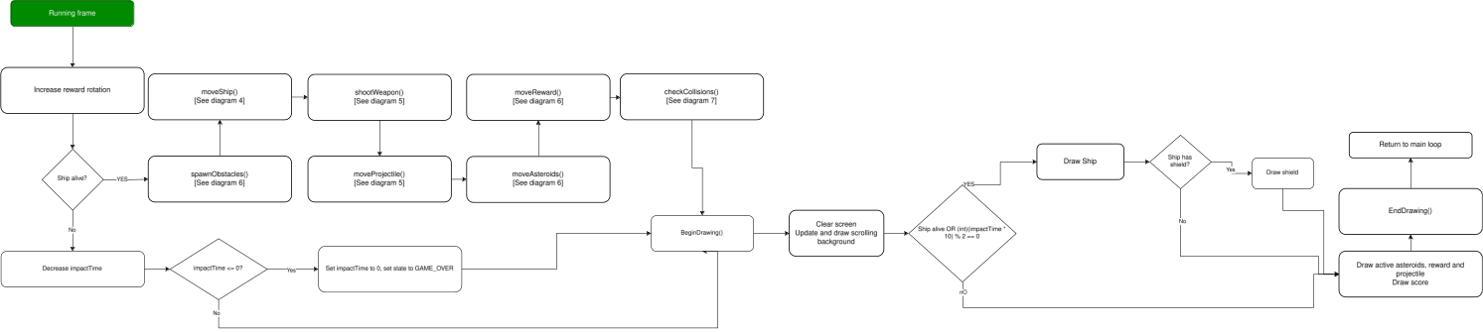
3. System Design
3. GAME_RUNNING flowchart

Slide 9
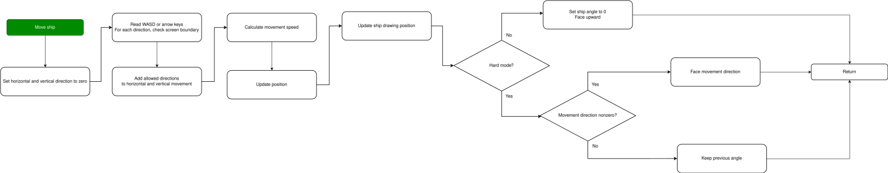
3. System Design
4. Ship movement flowchart

Slide 10
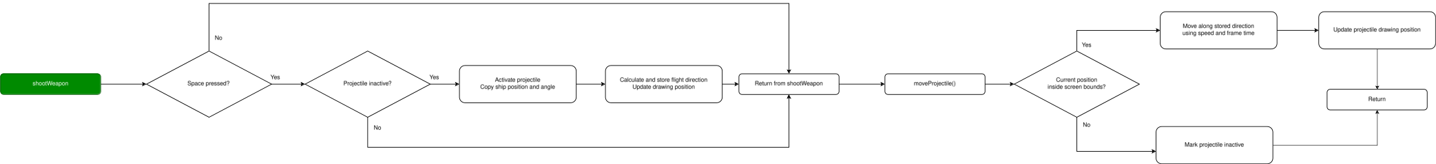
3. System Design
5. Projectile Flowchart

Slide 11
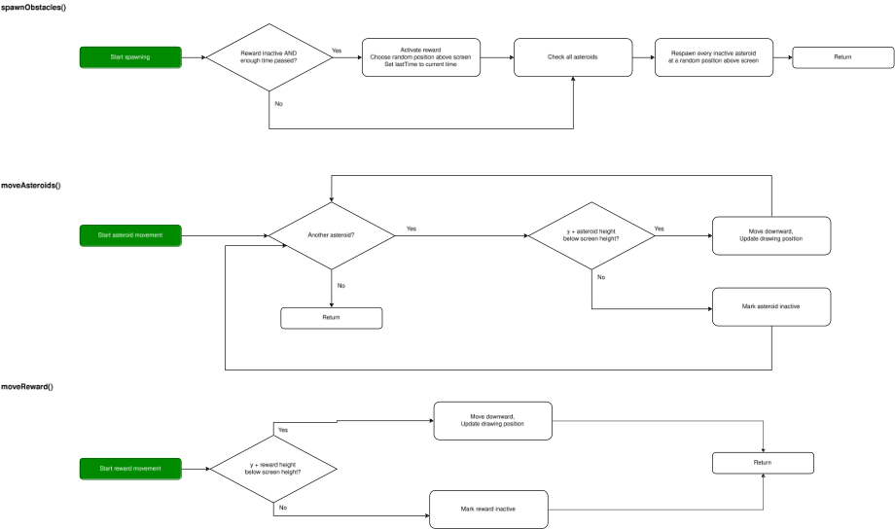
3. System Design
6. Asteroids and Reward flowchart

Slide 12
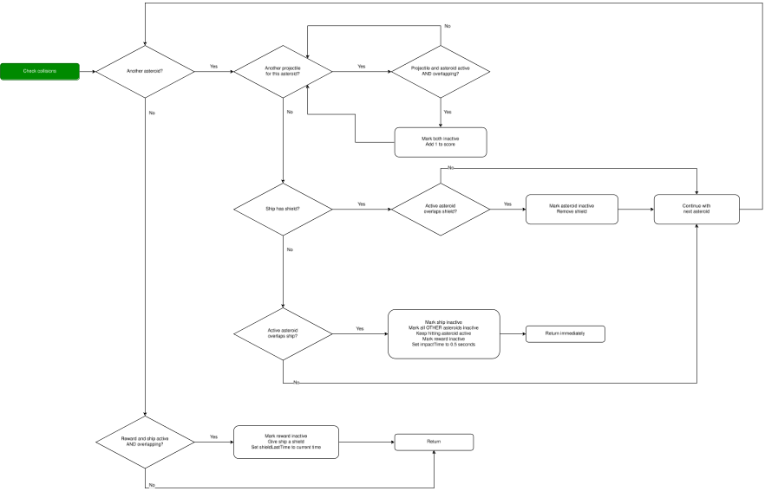
3. System Design
7. Collision checking flowchart

Slide 13
4. Game Objects
Object | Data stored | Behaviour
Player (Player) | Position, radius, speed, alive state, angle, shield state | Moves with WASD/arrows; faces upward in Easy mode or movement direction in Hard mode
Asteroid (Obstacle) | Position, radius, speed, alive state | Moves downwards; respawns when inactive during active gameplay
Projectile (Projectile) | Position, flight direction (dx, dy), alive state, speed, angle | Fires with Space when inactive; keeps the ship’s direction at firing
Reward (Obstacle) | Position, radius, speed, alive state | Moves downwards; grants a shield lasting up to 5 seconds or until an asteroid hit

