Slide 1


Drone based license plate recognition system development(Phase-2)
Project On:
Submitted by:
Internal Guide:
Hardik Maisuria 19BCE106
Dr. Jaiprakash Verma
Dr. Zunnun Narmawala
Manil Shah
19bce116
External Guide:
Kalp Mepani 19bce127
Dr. Yong Wang

Slide 2
Agenda
1
Introduction
Scope
Literature Review
Moving Object Detection under a Moving Camera via Background Orientation Reconstruction
Long Distance Ground Target Tracking with Aerial Image-to-Position Conversion and Improved Track Association
Object Detection from the Video Taken by Drone via Convolutional Neural Networks
License plate detection on drones using deep learning
Robot Localization and 3D Position Estimation Using a Free-Moving Camera And CCNN
Other Useful Papers
Proposed Objectives
References

Slide 3
Introduction
2
To expand the functionality of a prototype License Plate Recognition (LPR) system.
New updates are required in Software and Hardware.
It should be able to detect LP and drone would monitor parked vehicles.
A program that will return registered vehicle information or a notification of an unregistered vehicle via email or text messages.
It should work in real world circumstances.

Slide 4
Scope
3
Static Object
Moving Camera attached on Drone
Real-time Detection
Facing challenges like:
Motion blur
Night video
Angle Of Capturing Video

Slide 5
Moving Object Detection under a Moving Camera via Background Orientation Reconstruction [1]
4
Objective:-
A background orientation field reconstruction method based on Poisson fusion for detecting moving objects under a moving camera.
Datasets Used:-
moseg_dataset
BMS (Background Motion Subtraction)
DAVIS (Densely Annotated Video Segmentation).
Multiple image sequences - contain moving objects in different complex backgrounds captured by moving cameras with different movements.​
[1] Zhang, Wenlong & Sun, Xiaoliang & Yu, Qifeng. (2020). Moving Object Detection under a Moving Camera via Background Orientation Reconstruction. Sensors. 20. 3103. 10.3390/s20113103.

Slide 6
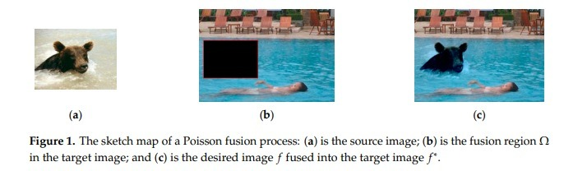
5
Continued..
Approach:-
A background orientation field reconstruction method based on Poisson fusion.
Methodology:-
i. Poisson Fusion:
[1] Zhang, Wenlong & Sun, Xiaoliang & Yu, Qifeng. (2020). Moving Object Detection under a Moving Camera via Background Orientation Reconstruction. Sensors. 20. 3103. 10.3390/s20113103.

Slide 7
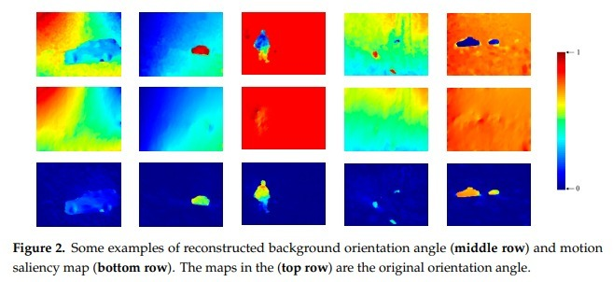
6
Continued..
ii. Motion Saliency through Background Orientation Reconstructed:
[1] Zhang, Wenlong & Sun, Xiaoliang & Yu, Qifeng. (2020). Moving Object Detection under a Moving Camera via Background Orientation Reconstruction. Sensors. 20. 3103. 10.3390/s20113103.

Slide 8
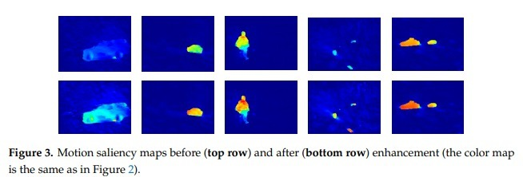
7
Continued..
iii. Enhancement Algorithm Based on Weighted Spatial Accumulation:
[1] Zhang, Wenlong & Sun, Xiaoliang & Yu, Qifeng. (2020). Moving Object Detection under a Moving Camera via Background Orientation Reconstruction. Sensors. 20. 3103. 10.3390/s20113103.

Slide 9
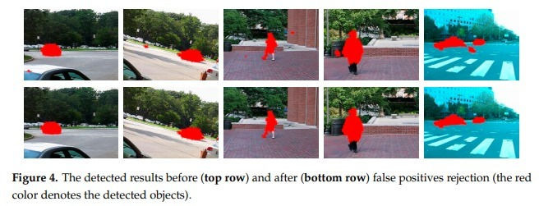
8
Continued..
iv. False Positives Rejection Based on Motion Continuity in the Temporal Domain:
[1] Zhang, Wenlong & Sun, Xiaoliang & Yu, Qifeng. (2020). Moving Object Detection under a Moving Camera via Background Orientation Reconstruction. Sensors. 20. 3103. 10.3390/s20113103.

Slide 10
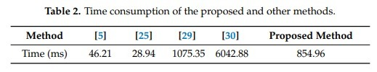
9
Continued..
Advantages:-
Achieve excellent performance compared with current state-of-the-art methods.​
Results:-
63.88 % accuracy - the best
Time taken is 854.96 ms which better than the average
[1] Zhang, Wenlong & Sun, Xiaoliang & Yu, Qifeng. (2020). Moving Object Detection under a Moving Camera via Background Orientation Reconstruction. Sensors. 20. 3103. 10.3390/s20113103.

Slide 11
10
Continued..
Limitations:-
Large amount of memory and a bit time consuming.​
Object moving in the same direction/velocity as the camera cannot be detected​.
Our Suggestions:-
Paper [10]
The algorithm used is very fast and consists of: Camera Motion Compensation, Feature Extraction and Classification, Foreground Extraction with Geodesic Graph Cut.
[1] Zhang, Wenlong & Sun, Xiaoliang & Yu, Qifeng. (2020). Moving Object Detection under a Moving Camera via Background Orientation Reconstruction. Sensors. 20. 3103. 10.3390/s20113103.

Slide 12
Long Distance Ground Target Tracking with Aerial Image-to-Position Conversion and Improved Track Association [2]
11
Objective:-
In this paper, moving vehicle tracking with a small drone at long distances (up to 1 km) is addressed.
Datasets and Drone information:-
A video was captured by a Mavic Air 2 hovering from a fixed position at a frame rate of 30 fps.
The frame size is 3840 × 2160 pixels.
The drone was at an altitude of 400 m and the tilt angle was set to 60 degrees.
Eight supplementary multimedia files (MP4 format) are available online.
[2] Yeom, S. Long DistanceGround Target Tracking with AerialImage-to-Position Conversion andImproved Track Association. Drones2022, 6, 55. https://doi.org/10.3390/drones6030055

Slide 13
12
Continued..
Approach:-
Image-to-position conversion based on the AFOV, tilt angle, and altitude of the camera.
Improved track association for densely distributed track environments(using nearest neighbor approach).
[2] Yeom, S. Long DistanceGround Target Tracking with AerialImage-to-Position Conversion andImproved Track Association. Drones2022, 6, 55. https://doi.org/10.3390/drones6030055

Slide 14
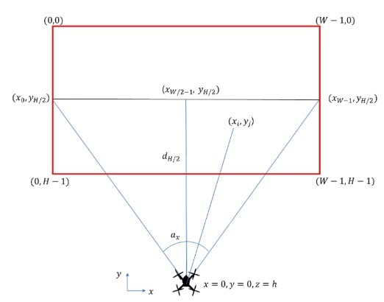
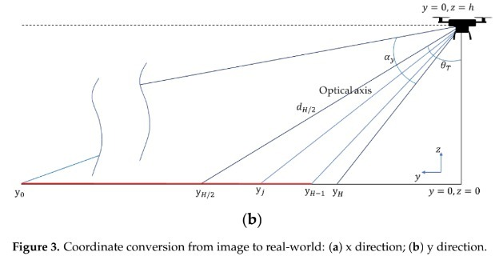
13
Continued..
Methodology:-
(i) Image-Position Conversion
[2] Yeom, S. Long DistanceGround Target Tracking with AerialImage-to-Position Conversion andImproved Track Association. Drones2022, 6, 55. https://doi.org/10.3390/drones6030055

Slide 15
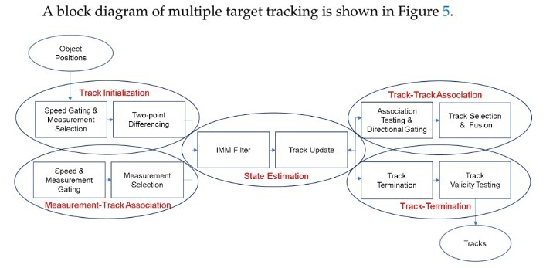
14
Continued..
Methodology:-
(ii) Multiple Target Tracking
(iii) Improved Track Association : The track association procedure is developed to select the fittest track in a dense track environment.
[2] Yeom, S. Long DistanceGround Target Tracking with AerialImage-to-Position Conversion andImproved Track Association. Drones2022, 6, 55. https://doi.org/10.3390/drones6030055

Slide 16
15
Continued..
Advantages:-
Does not require high-resolution video streaming or storage
Training on large-scale data.
Results:-
The average TTL and MTL were obtained as 84.9–91.0% and 65.6–78.2%, respectively.
The number of missing targets were 3–5.
The average TTL and MTL were 89.2–94.3% and 69.7–81.0% excluding the missing targets.
[2] Yeom, S. Long DistanceGround Target Tracking with AerialImage-to-Position Conversion andImproved Track Association. Drones2022, 6, 55. https://doi.org/10.3390/drones6030055

Slide 17
16
Continued..
Future Scope:-
Target tracking using moving drones from various perspectives remains a subject of future study.
Object detection during nighttime or unclear weather
Our Suggestions :-
Paper [6] : This paper will be discussed ahead in the presentation
Paper [12] : IMU sensors (inertial measurement unit)
[2] Yeom, S. Long DistanceGround Target Tracking with AerialImage-to-Position Conversion andImproved Track Association. Drones2022, 6, 55. https://doi.org/10.3390/drones6030055

Slide 18
Object Detection from the Video Taken by Drone via Convolutional Neural Networks [3]
17
Objective:-
Implementation of object detection on drone videos.
Performance of the popular target detection algorithm and feature extractor.
Dataset Used:-
A video from drone is taken as dataset.
[3] Sun, C., Zhan, W., She, J. and Zhang, Y., 2020. Object detection from the video taken by drone via convolutional neural networks. Mathematical Problems in Engineering, 2020.

Slide 19
18
Continued..
Approach:-
TensorFlow’s powerful object detection API
CNN
Transfer Learning
MobileNet, GoogleNet/Inception, and ResNet50 base feature extractors.
Methodology:-
TensorFlow object detection API to realize object detection of UAV videos
Compared SSD and Faster R-CNN object detection systems
Single Shot Detector (SSD) and Faster R-CNN topology as our detection components
[3] Sun, C., Zhan, W., She, J. and Zhang, Y., 2020. Object detection from the video taken by drone via convolutional neural networks. Mathematical Problems in Engineering, 2020.

Slide 20
19
Continued..
Advantages:-
Good accuracy in detecting all the objects.
These experimental results help other researchers to choose a suitable algorithm when implementing for object detection.
Results:-
An average detection accuracy of more than 85% and a maximum of 99% was obtained.
 | SDD MODEL | FASTER R-CNN
Accuracy | Less | More
Speed | More | Less
[3] Sun, C., Zhan, W., She, J. and Zhang, Y., 2020. Object detection from the video taken by drone via convolutional neural networks. Mathematical Problems in Engineering, 2020.

Slide 21
20
Continued..
Limitations:-
Challenges like motion blur and night video situations are not mentioned in the paper.
Our Suggestions :-
Paper [12] : IMU sensors (inertial measurement unit)
Paper [13] : a Blur-driven tracker (BLUT) framework is presented
[3] Sun, C., Zhan, W., She, J. and Zhang, Y., 2020. Object detection from the video taken by drone via convolutional neural networks. Mathematical Problems in Engineering, 2020.

Slide 22
License Plate Detection on Drones using Deep Learning [4]
21
Objective:-
Development of a real-time object detection platform which can be either deployed on a mobile unit or can be controlled from the ground station.
Dataset Used:-
Training : 50-100 samples from 1.5 lakhs images of license plate were collected from different states of US.
Testing : Different real time videos were taken from drones.
Hardware and Drone details:-
NVIDIA Jetson TX2 was used to in initial testing.
AR Drone from Parrot (quadcopter)
[4] Gadhvi, N., 2019. License Plate Detection on Drones Using Deep Learning (Doctoral dissertation, Lamar University-Beaumont).

Slide 23
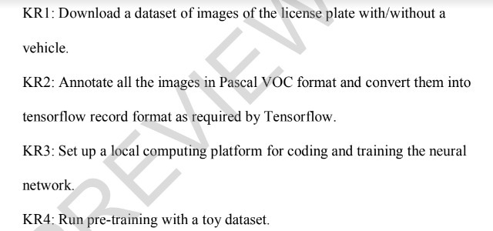
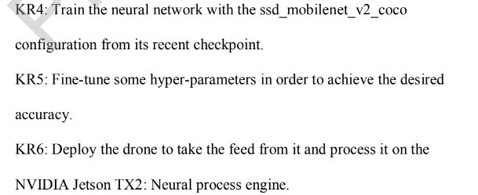
22
Continued..
Approach:-
Deep Learning
Tensor-flow
Methodology:-
[4] Gadhvi, N., 2019. License Plate Detection on Drones Using Deep Learning (Doctoral dissertation, Lamar University-Beaumont).

Slide 24
23
Continued..
Advantages:-
Good accuracy is obtained.
Real-time object detection through drones.
Results:-
Training Accuracy | 96%
Total Loss | 4%
Localization Accuracy | 98.7%
[4] Gadhvi, N., 2019. License Plate Detection on Drones Using Deep Learning (Doctoral dissertation, Lamar University-Beaumont).

Slide 25
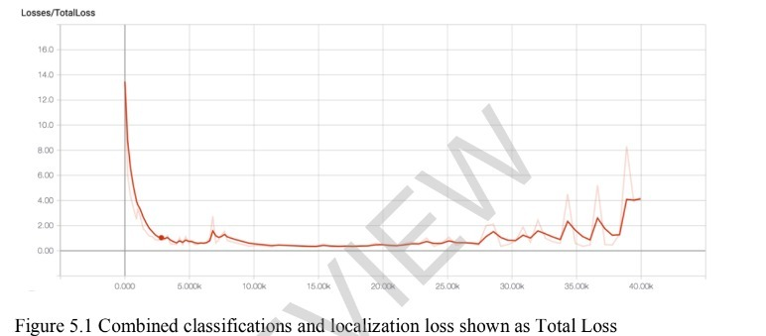
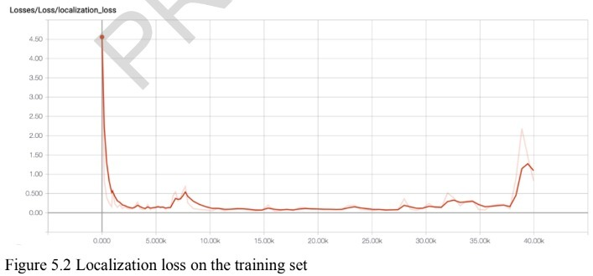
24
[4] Gadhvi, N., 2019. License Plate Detection on Drones Using Deep Learning (Doctoral dissertation, Lamar University-Beaumont).

Slide 26
25
Continued..
Future Scope:-
Ability of the prototype to read LP characters in low visibility.
Flexibility of the program to handle distortions.
Improving auto-zooming to obtain pictures of a distant LP.
Our Suggestions :-
Paper [6] : This paper will be discussed ahead in the presentation.
Paper [13] : A Blur-driven tracker (BLUT) framework is presented.
Paper [14] : The proposed method uses multi-frame images to integrate information from each image based on a subspace method.
[4] Gadhvi, N., 2019. License Plate Detection on Drones Using Deep Learning (Doctoral dissertation, Lamar University-Beaumont).

Slide 27
Robot Localization and 3D Position Estimation Using a Free-Moving Camera And CCNN [5]
26
Objective:-
Remove the constraint of having the need for the robot and the vision sensor.
Datasets and Camera details:-
Datasets involved includes video recordings of three types of robots that are:UR3,UR5 and UR10.
Kinect V2 camera was used.
[5] J. Miseikis et al., "Robot Localisation and 3D Position Estimation Using a Free-Moving Camera and Cascaded Convolutional Neural Networks," 2018 IEEE/ASME International Conference on Advanced Intelligent Mechatronics (AIM), 2018, pp. 181-187, doi: 10.1109/AIM.2018.8452236.

Slide 28
27
Continued..
Approach:-
Deep Learning approach.
Cascaded Convolutional Neural Network.
Methodology:-
Two level cascaded CNN:
One CNN is used for classification task in foreground/background detection of robot body in the image.
Second CNN is used for landmark detection of the robot joint positions in 3D coordinates.
[5] J. Miseikis et al., "Robot Localisation and 3D Position Estimation Using a Free-Moving Camera and Cascaded Convolutional Neural Networks," 2018 IEEE/ASME International Conference on Advanced Intelligent Mechatronics (AIM), 2018, pp. 181-187, doi: 10.1109/AIM.2018.8452236.

Slide 29
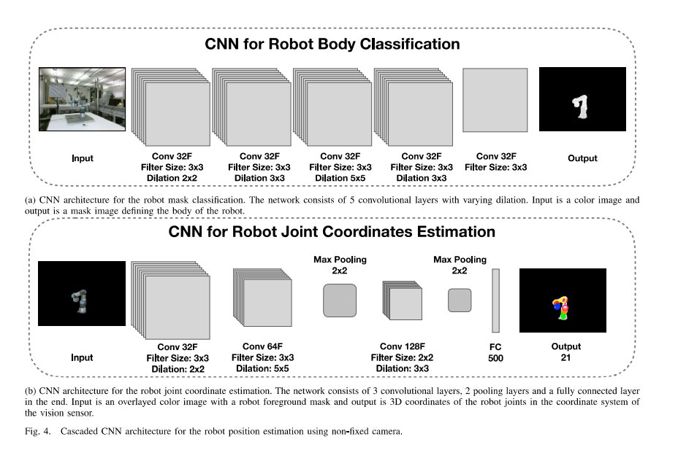
Architecture:-
28
[5] J. Miseikis et al., "Robot Localisation and 3D Position Estimation Using a Free-Moving Camera and Cascaded Convolutional Neural Networks," 2018 IEEE/ASME International Conference on Advanced Intelligent Mechatronics (AIM), 2018, pp. 181-187, doi: 10.1109/AIM.2018.8452236.

Slide 30
29
Continued..
Advantages:-
Got good accuracy results.
Possibility of vision sensor to move freely
Results:-
Accuracy in Classification of robots were as follows:
UR3 : 93.1%
UR5 : 98.1%
UR10 : 92.8%
[5] J. Miseikis et al., "Robot Localisation and 3D Position Estimation Using a Free-Moving Camera and Cascaded Convolutional Neural Networks," 2018 IEEE/ASME International Conference on Advanced Intelligent Mechatronics (AIM), 2018, pp. 181-187, doi: 10.1109/AIM.2018.8452236.

Slide 31
30
Continued..
Future Scope:-
Transfer learning concept from pre-trained CNN which can possibly give good accuracy.
Our Suggestions :-
We can try converting this project into our database based project.
We suggest to use transfer learning concept on pre-trained CNN model of our project in order to generate good results.
[5] J. Miseikis et al., "Robot Localisation and 3D Position Estimation Using a Free-Moving Camera and Cascaded Convolutional Neural Networks," 2018 IEEE/ASME International Conference on Advanced Intelligent Mechatronics (AIM), 2018, pp. 181-187, doi: 10.1109/AIM.2018.8452236.

Slide 32
Other Useful Papers
31
[6] :-
Challenges like following are addressed and approaches and methods to overcome them are mentioned :
Bootstrapping Camouflage Dynamic background foreground aperture Illumination changes low frame rate motion blur shadows | motion parallex 3D moving camera moved background object night video noisy images sleeping foreground object walking foreground object
[6] Chapel, Marie-Neige & Bouwmans, Thierry. (2020). Moving Objects Detection with a Moving Camera: A Comprehensive Review.

Slide 33
32
Continued..
[7] :-
Can handle strong parallax and dynamic background
Computation speed high
Energy-efficient hardware
Can be used while selecting things for our project.​
[7] C. Huang, P. Chen, X. Yang and K. -T. T. Cheng, "REDBEE: A visual-inertial drone system for real-time moving object detection," 2017 IEEE/RSJ International Conference on Intelligent Robots and Systems (IROS), 2017, pp. 1725-1731, doi: 10.1109/IROS.2017.8205985..

Slide 34
33
Continued..
[8] :-
Real time detection of objects
Low-contrast environment efficient
Detection speed is fast enough for real-time application
Can be used to make our model multi-tasking along with having good efficiency.​
[8] Li, Y.B., Cho, W.H. and Hong, K.S., 2009. REAL-TIME DETECTION OF MOVING OBJECTS IN A ROTATING AND ZOOMING CAMERA. In Proceedings of the Korean Society of Broadcast Engineers Conference (pp. 71-75). The Korean Institute of Broadcast and Media Engineers.

Slide 35
34
Continued..
[9] :-
Challenges like following are addressed and approaches and methods to overcome them are mentioned :
Illumination variation Moving object appearance changes Presence of abrupt motion Occlusion Complex Background | Shadow Problems related to camera Camera motion Non-rigid object deformation
[9] Mehran Yazdi, Thierry Bouwmans,New trends on moving object detection in video images captured by a moving camera: A survey,Computer Science Review, Volume 28, 2018.

Slide 36
Proposed Objectives
35
Use of an algorithm that can work on limited amount of memory [10].
Time efficient algorithm [10] .
Detecting objects at night or in low light etc. [6] .
Systems using Low Computational power [10] .
Solving challenges like motion blur, distortion of images or videos [12], [13], [14] .
Detecting number plates in different weather conditions [12], [13] .
Using different techniques like transfer learning, CNN, etc and using different architectures like ResNet, Inception, etc into our algorithm for achieving better accuracy.

Slide 37
Citation and Reference Paper
36
[1] Zhang, Wenlong & Sun, Xiaoliang & Yu, Qifeng. (2020). Moving Object Detection under a Moving Camera via Background Orientation Reconstruction. Sensors. 20. 3103. 10.3390/s20113103.​
[2] Yeom, S. Long DistanceGround Target Tracking with AerialImage-to-Position Conversion andImproved Track Association. Drones2022, 6, 55. https://doi.org/10.3390/drones6030055
​[3] Sun, C., Zhan, W., She, J. and Zhang, Y., 2020. Object detection from the video taken by drone via convolutional neural networks. Mathematical Problems in Engineering, 2020.
​[4] Gadhvi, N., 2019. License Plate Detection on Drones Using Deep Learning (Doctoral dissertation, Lamar University-Beaumont).
​[5] J. Miseikis et al., "Robot Localisation and 3D Position Estimation Using a Free-Moving Camera and Cascaded Convolutional Neural Networks," 2018 IEEE/ASME International Conference on Advanced Intelligent Mechatronics (AIM), 2018, pp. 181-187, doi: 10.1109/AIM.2018.8452236.​

Slide 38
Continued..
37
[6] Chapel, Marie-Neige & Bouwmans, Thierry. (2020). Moving Objects Detection with a Moving Camera: A Comprehensive Review.​
[7] C. Huang, P. Chen, X. Yang and K. -T. T. Cheng, "REDBEE: A visual-inertial drone system for real-time moving object detection," 2017 IEEE/RSJ International Conference on Intelligent Robots and Systems (IROS), 2017, pp. 1725-1731, doi: 10.1109/IROS.2017.8205985..​
[8] Li, Y.B., Cho, W.H. and Hong, K.S., 2009. REAL-TIME DETECTION OF MOVING OBJECTS IN A ROTATING AND ZOOMING CAMERA. In Proceedings of the Korean Society of Broadcast Engineers Conference (pp. 71-75). The Korean Institute of Broadcast and Media Engineers.​
[9] Mehran Yazdi, Thierry Bouwmans,New trends on moving object detection in video images captured by a moving camera: A survey,Computer Science Review, Volume 28, 2018.​
[10] Wan, Yanli & Wang, Xifu & Hu, Hongpu. (2014). Automatic Moving Object Segmentation for Freely Moving Cameras. Mathematical Problems in Engineering. 2014. 1-11. 10.1155/2014/574041.​

Slide 39
Continued..
38
[11] Mehran Yazdi, Thierry Bouwmans,New trends on moving object detection in video images captured by a moving camera: A survey,Computer Science Review, Volume 28, 2018
​[12] Jung, Sukwoo & Cho, Youngmok & Kim, Doojun & Chang, Minho. (2019). Moving Object Detection from Moving Camera Image Sequences Using an Inertial Measurement Unit Sensor. Applied Sciences. 10. 268. 10.3390/app10010268.​
​[13] Y. Wu, H. Ling, J. Yu, F. Li, X. Mei, E. Cheng, Blurred target tracking by blur-driven tracker, in: International Conference on Computer Vision, Nov. 2011, pp. 1100–1107.
[14] Yanadume, S., Mekada, Y., Ide, I. and Murase, H., 2004, November. Recognition of very low-resolution characters from motion images captured by a portable digital camera. In Pacific-Rim Conference on Multimedia (pp. 247-254). Springer, Berlin, Heidelberg.

Slide 40
Thank You!
39

