Slide 1


Tic Tac Toe Using Socket
Prepared By:-
Name: Kalp
Roll no: 156
Enrollment No: 22002171220088
Batch: B5 Branch: CSE

Slide 2
Description :
This project demonstrates the use of sockets to enable two players to play the tic tac toe game over a same network.
It consists of a server and two clients. The server acts as the game manager, listening for incoming connections. Players use server ip-address to connect to the server, input their moves, and receive updates on the game's current state.
The game is played on a 3x3 grid, and the first player to get three in a row wins.

Slide 3
Features :
Uses TCP connection ensuring that it is consistent and connection-oriented.
Two-player functionality over a same network using sockets.
Real-time updates to the console as players make moves.
Winning condition detection and announcement of the winner.

Slide 4
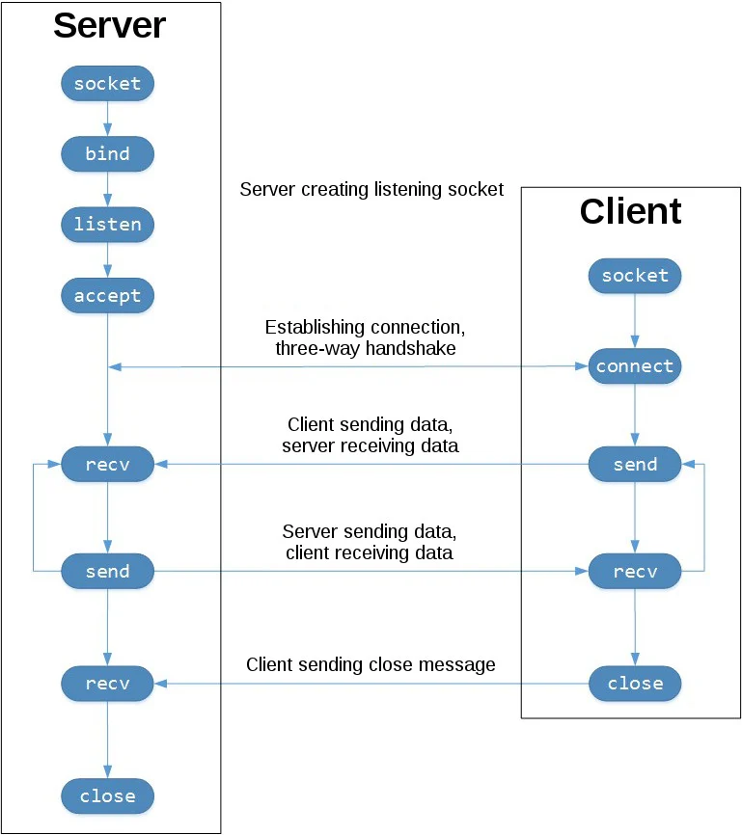
Methods involved in Client-Server Communication :

Slide 5
THANK YOU….

