Slide 1
Predicting credit card payment defaulters
Kalpa Subbaiah
Supratim Chaudhuri
Sasi Kumar

Slide 2
PRESENTATION OUTLINE
Business Problem
Data Source
Methodology
Data Preprocessing/Feature Engineering
Modeling
Evaluation/Results
Summary

Slide 3
BUSINESS PROBLEM
The data depicts the cases of customers’ default payments in Taiwan
Given the specific variables (Credit records, demographic data and repayment history), we want to predict if an individual will default payments in the next month.

Slide 4
METHODOLOGY
Programming Language : R
Machine Learning Algorithm:
Glm
StepAIC
Naïve Bayes
Performance Metrics:
Confusion metrics

Slide 5
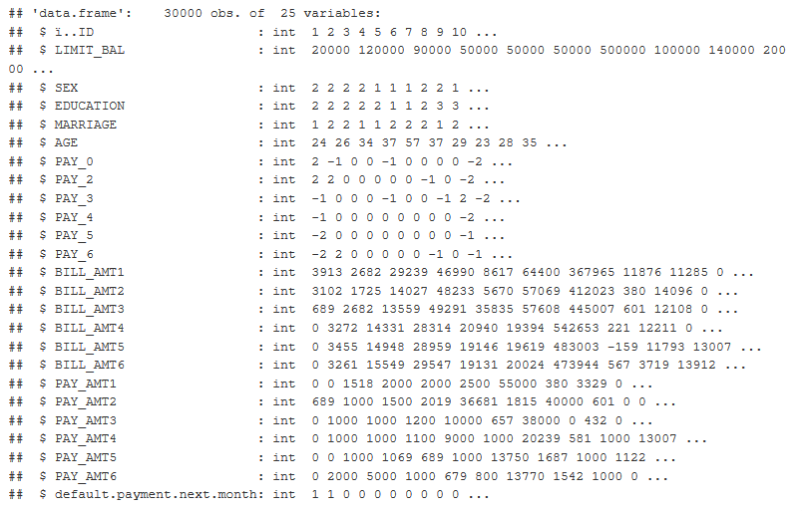
DATA SOURCE

Slide 6
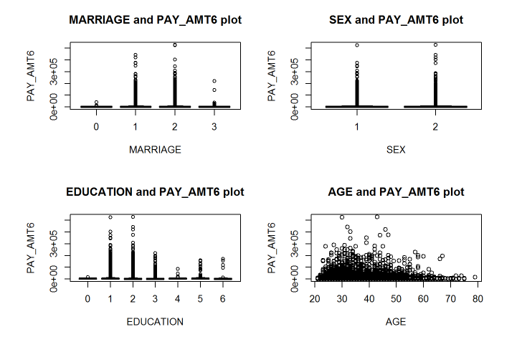
Data Understanding

Slide 7
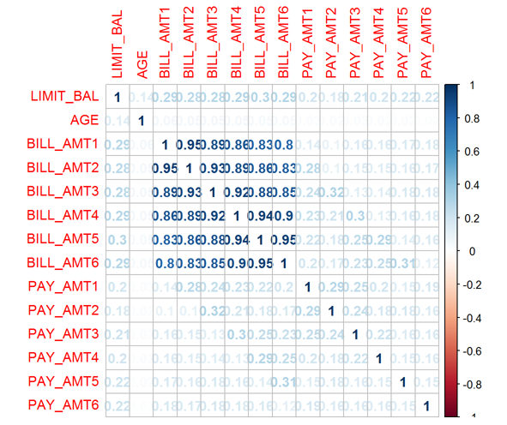
Correlation in Data

Slide 8


Methodology
Data Preprocessing:
Convert the categorical data types into factors
Remove Class Imbalance
Standardize the data
Reduced Features using PCA
Applied modeling
Evaluated using confusion metrics

Slide 9
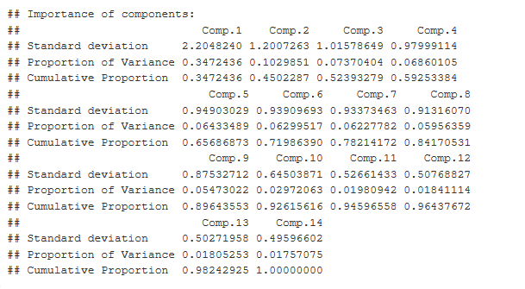
PCA Summary

Slide 10
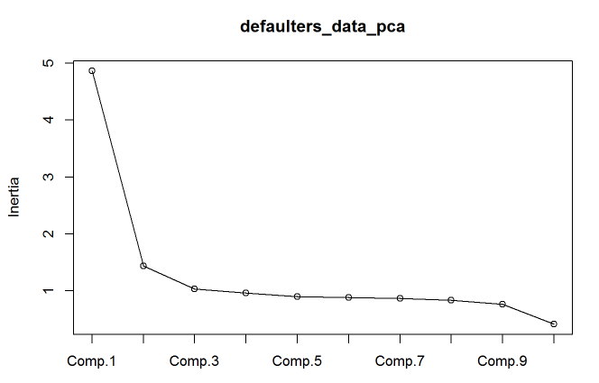
PCA Screeplot

Slide 11
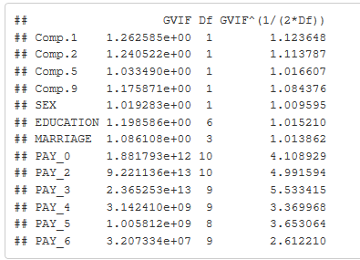
VIF

Slide 12
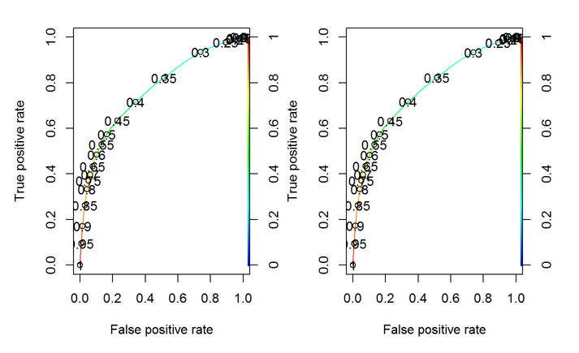
ROC Curve

Slide 13
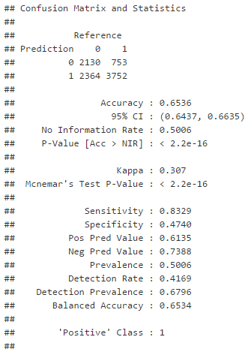
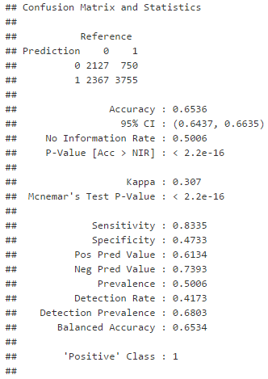
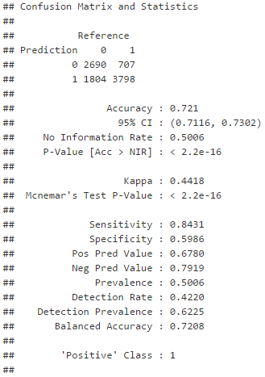
Evaluation Metrics
GLM
StepAIC
Naïve Bayes

Slide 14
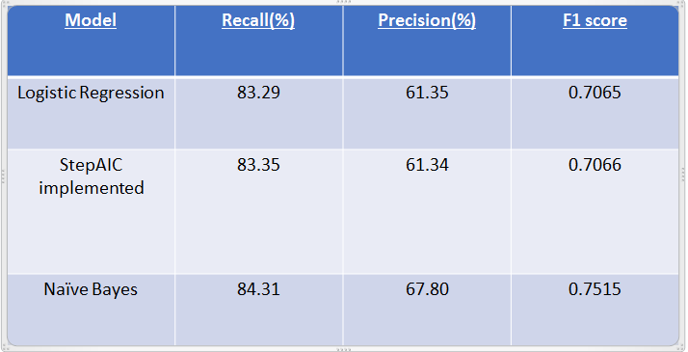
Evaluation Metrics Comparison

Slide 15
Q & A

