Slide 1

Accounting & Financial Management Analysis
  📌 Project Overview
  This project presents a financial performance analysis for a sample accounting & financial services firm (similar to CA / finance BPO organizations). The objective is to analyze revenue, expenditure, profitability, and financial risk using Power BI and provide clear, management‑level insights.
  The project is designed as a realistic junior data analyst portfolio project, focusing on clarity, correct financial logic, and business interpretation rather than complex modeling.

Slide 2
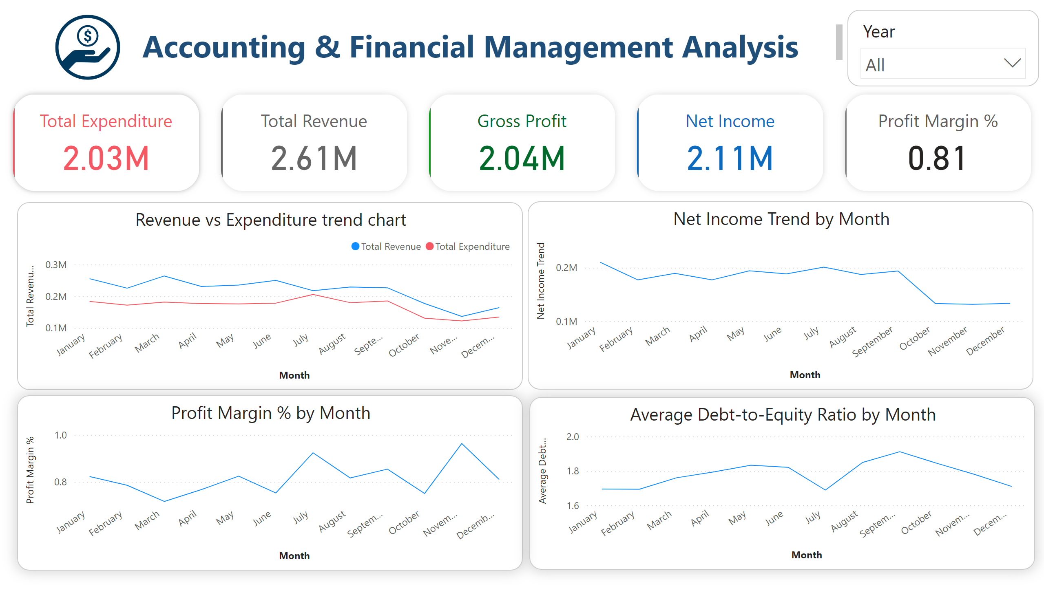
Dashboard
Notes:
textbox
No alt text provided
cardVisual
No alt text provided
Revenue vs Expenditure trend chart
No alt text provided
lineChart
No alt text provided
lineChart
No alt text provided
lineChart
No alt text provided
slicer
No alt text provided
image
No alt text provided

Slide 3
Accounting & Financial Management Analysis Executive Summary
Total Revenue: 2.61M, consistently higher than expenditure, indicating stable business performance.
Total Expenditure: 2.03M, closely aligned with revenue, showing controlled cost management.
Gross Profit: 2.04M, reflecting strong core operational profitability.
Net Income: 2.11M, remaining stable for most of the year with a slight dip during Oct–Nov due to lower activity.
Profit Margin: 81%, indicating high operational efficiency across the period.
Debt-to-Equity Ratio: Averaging around 1.7–1.9, suggesting manageable financial leverage with no major risk concerns.

Slide 4
📈 Revenue Trend (Sales Performance)
Revenue shows strong performance during the first half of the year, with the highest revenue observed in March at around 0.27M. Sales remain relatively strong again during the mid-year period (July–August), averaging around 0.23–0.24M. However, revenue declines noticeably in October and November, reaching the lowest level in November at approximately 0.14M, which indicates a seasonal slowdown. A small recovery is seen in December, suggesting early signs of demand improvement.
💰 Expenditure Trend (Cost Behavior)
Expenditure closely follows the revenue pattern, indicating controlled and predictable cost behavior. The highest expenditure occurs in July at around 0.21M, aligning with peak business activity. The lowest expenditure is observed in November at approximately 0.12M, reflecting reduced operational activity. Overall, expenses remain consistently lower than revenue throughout the year, which supports healthy operating performance.

Slide 5
📉 Net Income Trend (Profitability)
Net income remains relatively stable for most of the year, highlighting consistent profitability. The highest net income is seen in January and July at around 0.20–0.21M, corresponding to periods of strong revenue. A noticeable decline occurs during October and November, where net income falls to approximately 0.13–0.14M, driven by reduced sales. A slight stabilization toward December indicates improving performance.
📊 Profit Margin Trend (Operational Efficiency)
Profit margin fluctuates across the year but remains strong overall, averaging above 80%, which indicates high operational efficiency. The highest profit margin is observed in November at approximately 95%, showing effective cost control even during low sales periods. The lowest margin appears in March at around 72%, suggesting higher costs relative to revenue during that month. This trend highlights opportunities for cost optimization during high-revenue months.
.

Slide 6
⚖️ Debt-to-Equity Ratio Trend (Financial Risk)
The debt-to-equity ratio increases gradually from the beginning of the year and reaches its highest point in September at around 1.9, indicating higher leverage during business expansion. Lower ratios are observed in January and July at approximately 1.7, reflecting a more balanced capital structure. Toward the end of the year, the ratio declines slightly, suggesting improved financial discipline and controlled borrowing

Slide 7
Conclusion & Recommendation
Overall, the company demonstrates stable revenue growth, controlled expenditure, consistent profitability, and manageable financial risk. While seasonal declines are observed in the last quarter, strong cost control helps maintain healthy profit margins, indicating a financially stable and well-managed business.
The analysis shows that the company maintains
**stable profitability, controlled expenses, and acceptable debt levels**.
Opportunities exist to:
Improve performance during seasonal downturns
Monitor mid‑year expense increases
Maintain optimal leverage ratios
This project demonstrates the ability to:
Clean and model financial data
Build professional Power BI dashboards
Translate data into meaningful business insights

