Slide 1
Trader Performance vs Market Sentiment
Insights from Crypto Trading & the Fear-Greed Index

Slide 2
Project Goal
Explore how trader behavior and profitability vary across different market sentiment levels.
Analyze real-world trade data and Bitcoin Fear & Greed Index.
Deliver actionable insights for smarter trading decisions.
📈 Analytics
📊 Sentiment
📉 PnL

Slide 3
Datasets Used
1. Historical Trader Data from Hyperliquid (200K+ trades)
2. Bitcoin Fear & Greed Index (daily sentiment values)
Merged using the 'date' field for alignment.
🗂️ Data
🧾 Trades
Sentiment

Slide 4
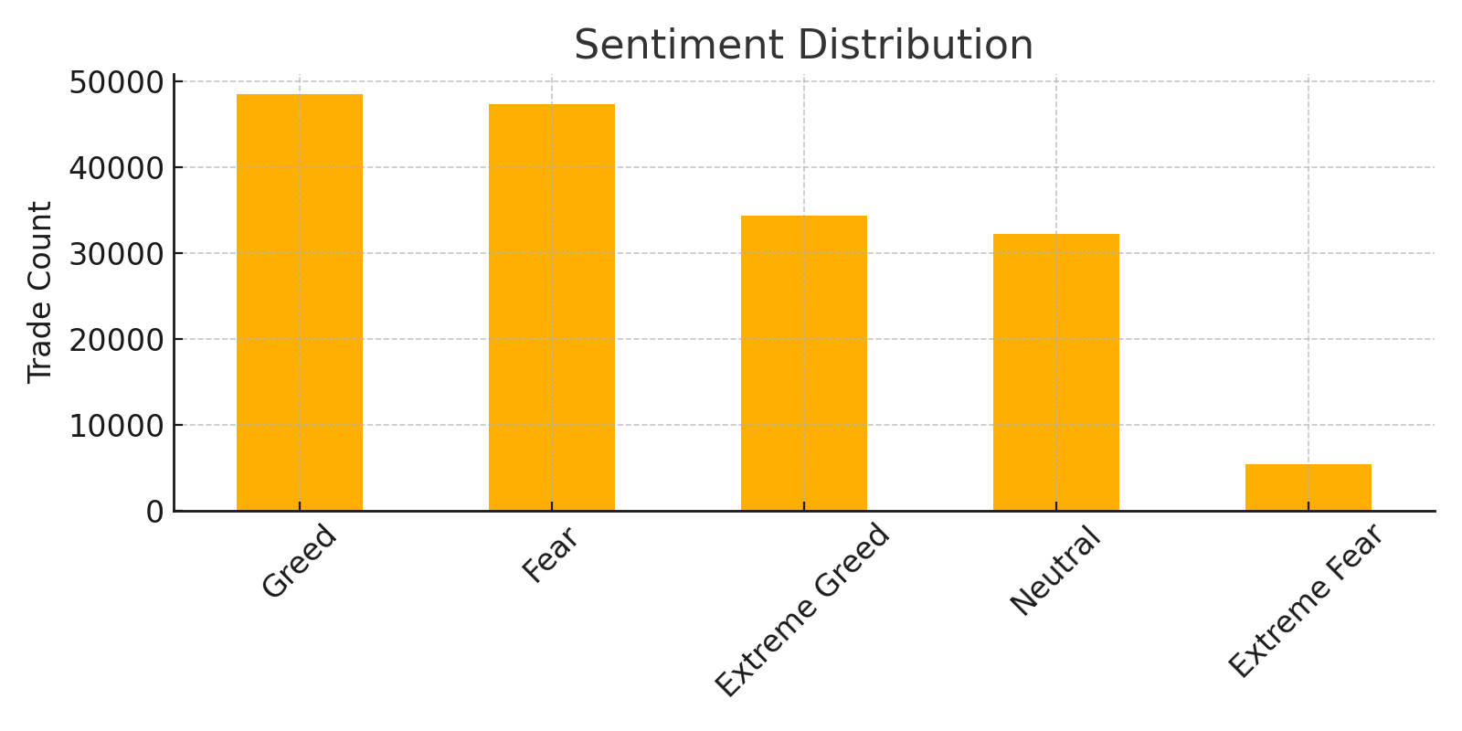
Sentiment Distribution
Most trades occur during Neutral and Greed sentiment levels.
Lowest number of trades happen during Extreme Fear.
Trader activity aligns with emotional tone of the market.

Slide 5
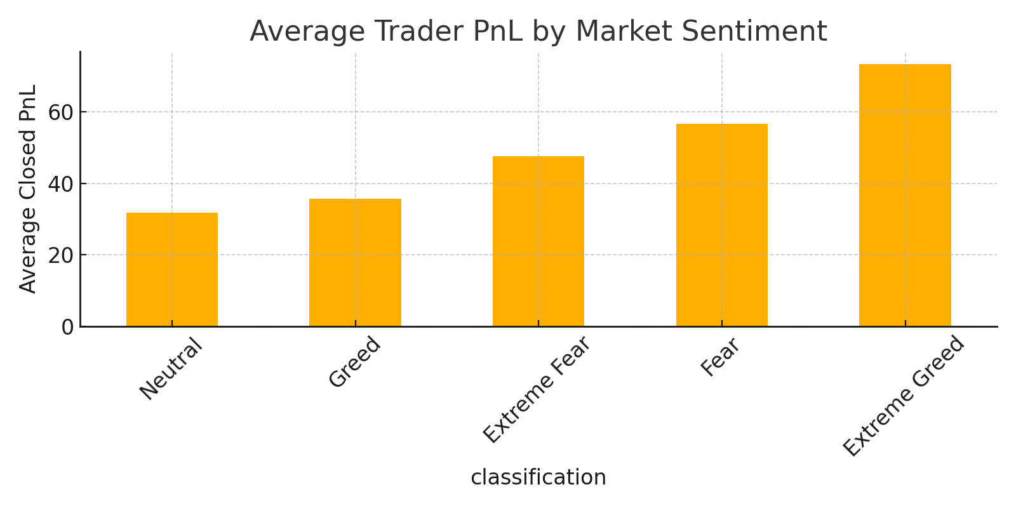
Average PnL by Sentiment
Traders earn the most during Greed and Extreme Greed phases.
Performance drops in Fear and becomes negative in Extreme Fear.
Clear positive correlation between optimismand profitability.

Slide 6
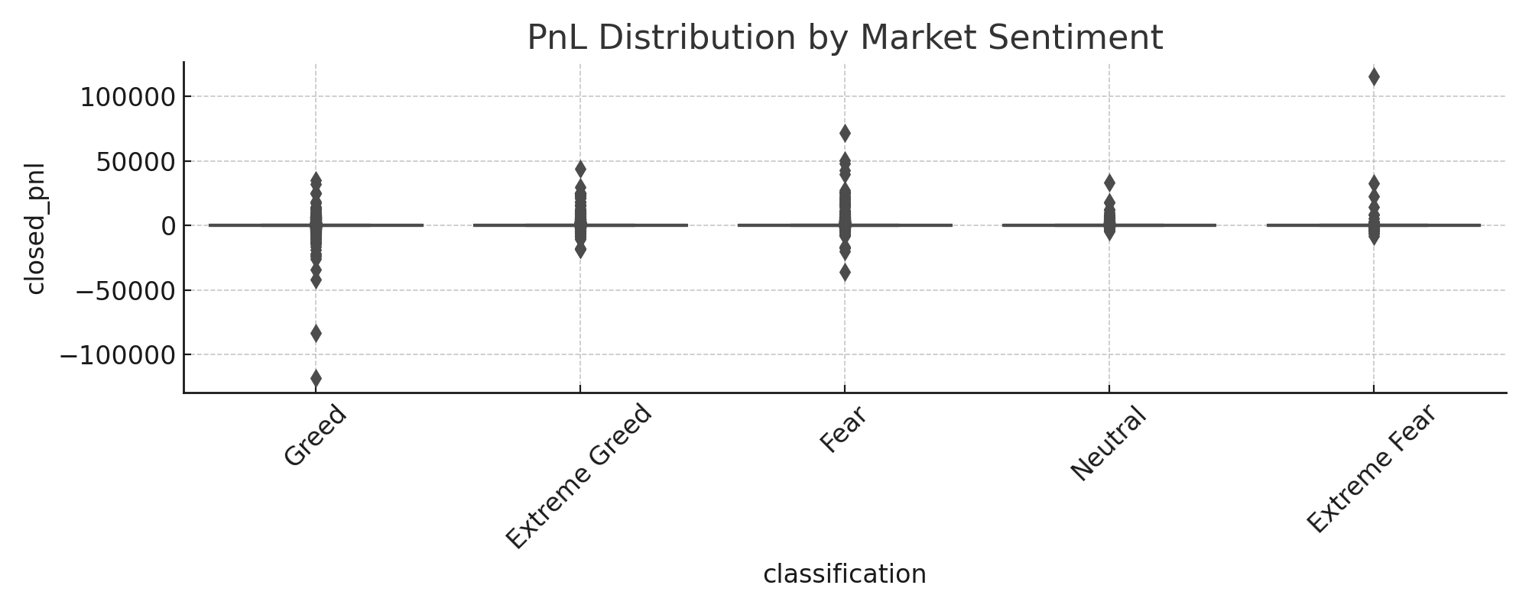
PnL Distribution by Sentiment
Greed phases show tighter and more profitable PnL distributions.
Fear phases have wider spreads and more outliers, indicating high risk.
Stable returns are more common in confident markets.

Slide 7
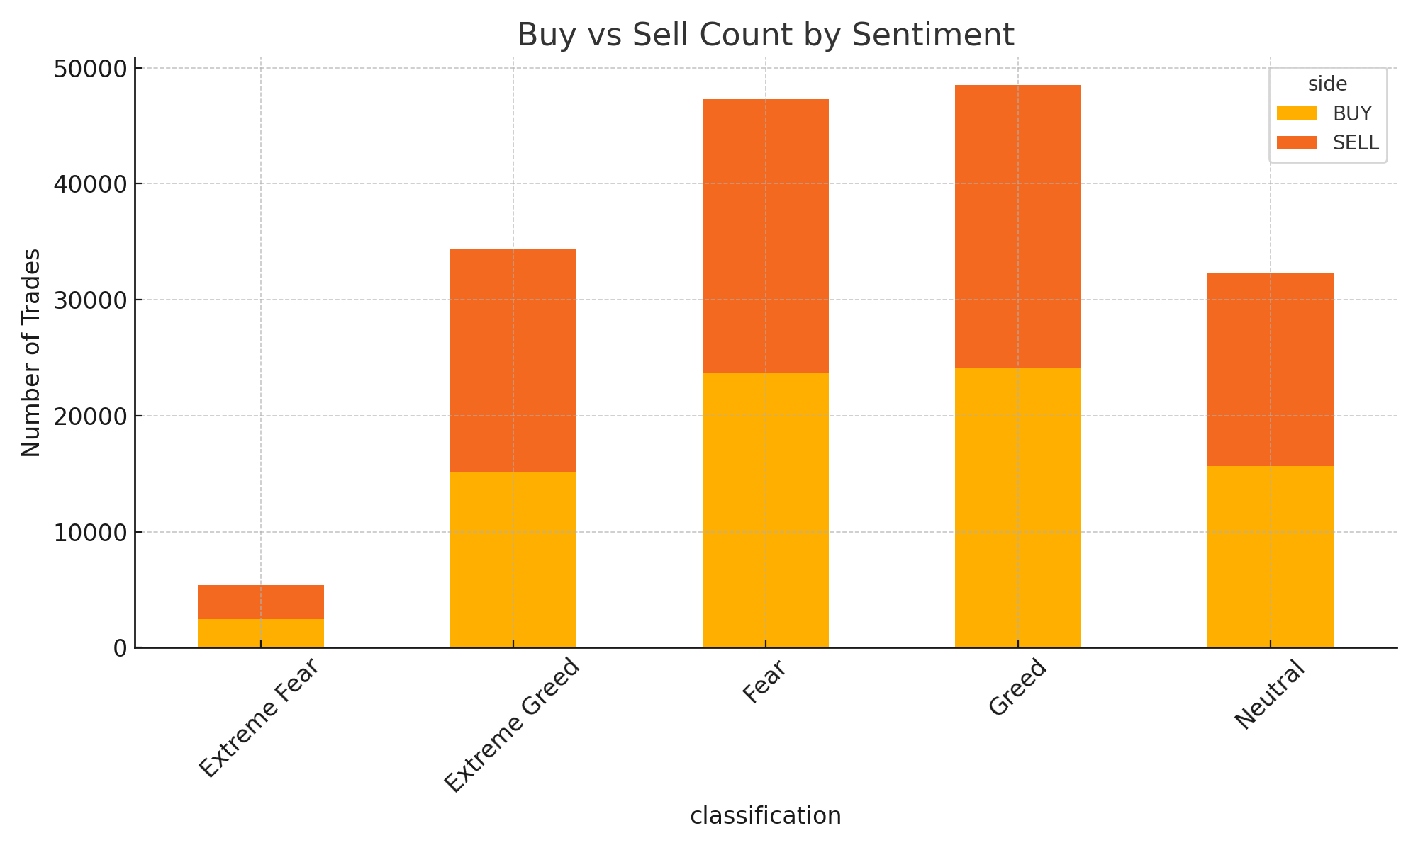
Buy vs Sell Behavior
Buy trades increase during Greed, reflecting trader optimism.
Sell trades dominate during Fear, showing risk aversion.
Traders react emotionally to market sentiment.

Slide 8
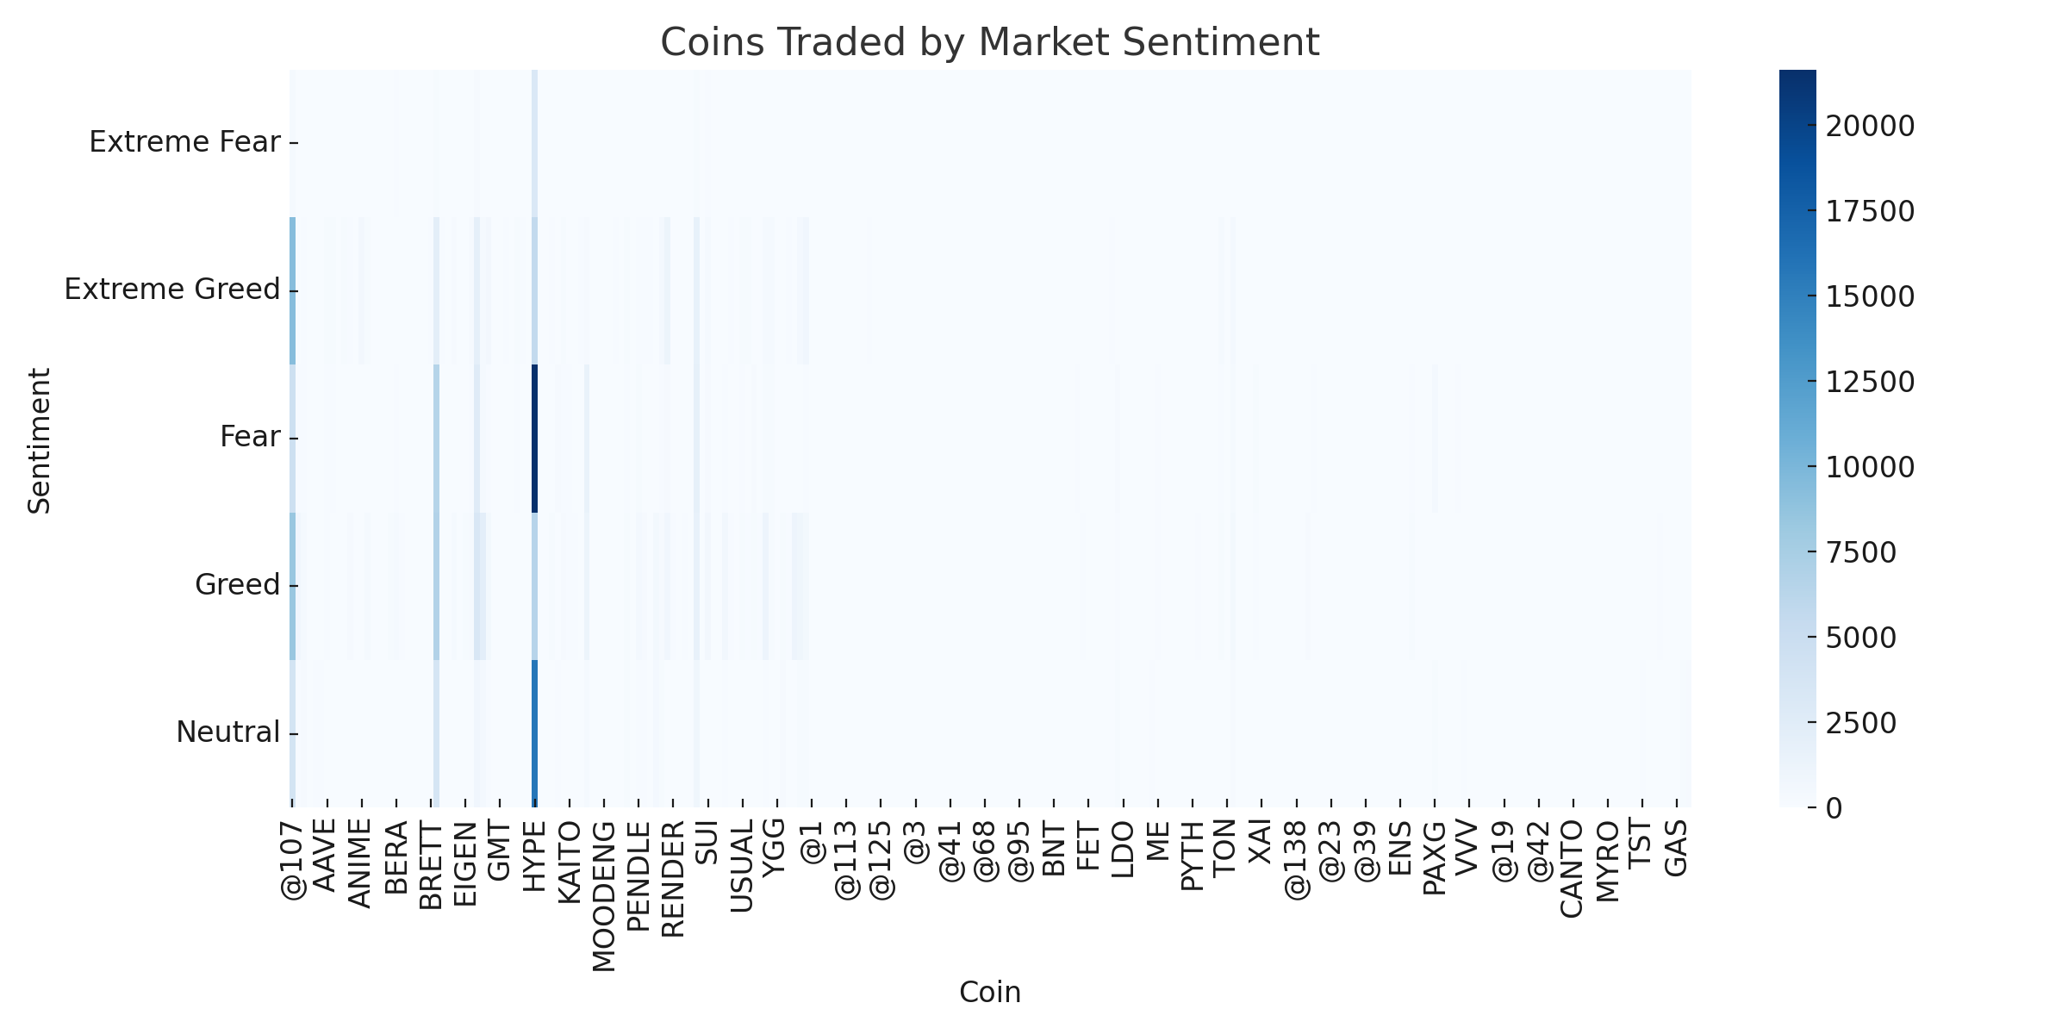
Coins Traded by Sentiment
BTC and ETH are heavily traded in all sentiment states.
Speculative coins appear more often in Greedphases.
Risk-taking increases when sentiment is positive.

Slide 9
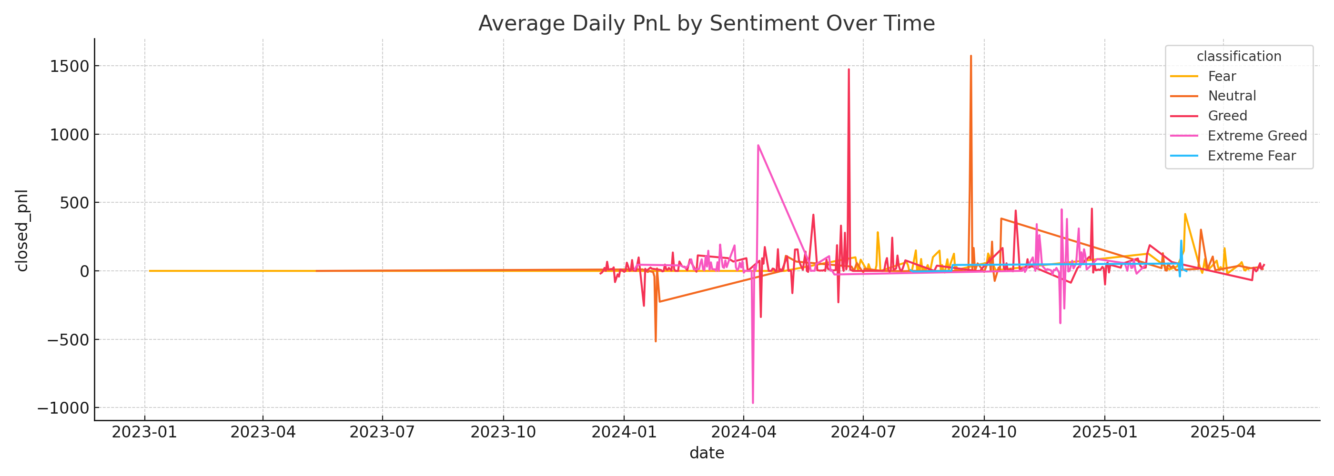
Daily PnL Trend vs Sentiment
Greed phases align with consistent daily profits.
Extreme Fear periods cluster around negative PnL.
Sentiment timing is a key driver of performance.

Slide 10
Conclusion & Recommendations
Trader performance clearly correlates with market sentiment.
Use sentiment as a signal for timing entries and managing risk.
Next steps: Integrate sentiment scores into predictive models.

