Slide 1
Crafting & Compelling Website Analysis, Audit and Recommendations Project

Slide 2
AMAZON
Amazon is a multinational technology company. The company was originally called "Cadabra", but Bezos changed the name to "Amazon" before launch. Jeff Bezos founded Amazon in his garage in Bellevue, Washington on July 5, 1994. The Amazon website launched for public sales on July 16, 1995

Slide 3
PRODUCT
Amazon product lines include (books, DVDs, music CDs, videotapes, and software), apparel, baby products, consumer electronics, beauty products, gourmet food, groceries, health and personal-care items, industrial and scientific supplies, kitchen items, jewelry and watches, lawn and garden items, musical instruments, sporting goods, tools, automotive items and toys/games. It contains 350 millions of products.

Slide 4
SERVICES
DELIVERY AND LOGISTICS (Amazon Logistics is Amazon's delivery and shipping service that uses a variety of delivery partners to get packages to customers).
AMAZON WEB SERVIES (Amazon Web Services (AWS) is a cloud computing platform that offers a variety of services).
AMAZON PRIME (Amazon Prime is a subscription membership to Amazon that offers customers premium services for a yearly or monthly fee. Amazon Prime provides discounts on shipping, a free membership to Prime Video, Twitch Prime, Amazon Drive and thirty minutes early access to Lightning Deals for a yearly subscription fee).
ENTERTAINMENT (Amazon offers a variety of home entertainment products, including music systems, amplifiers, and projection screens).

Slide 5
WEBSITE PLATFORM IDENTIFICATION
AWS FOR CLOUD SERVIES
JAVASCRIPT FOR FRONTEND
JAVA,C++ AND PERL FOR BACKEND
DYNAMODB, RDS/AURORA, REDSHIFT FOR DATABASE

Slide 6
RESPONSIVE DESIGN TESTING
RESPONSIVE DESIGN TEST REPORT:
WEBSITE - https://www.amazon.com/
TOOL - (PAGESPEED INSIGHTS WEB DEVELOPER).
HOME PAGE ( Render-Blocking Resources, Defer Offscreen Images, Minimize main-thread work ).
HELP PAGE ( Page Speed, First Consenful Paint, Reduce unused JavaScript ).

Slide 7
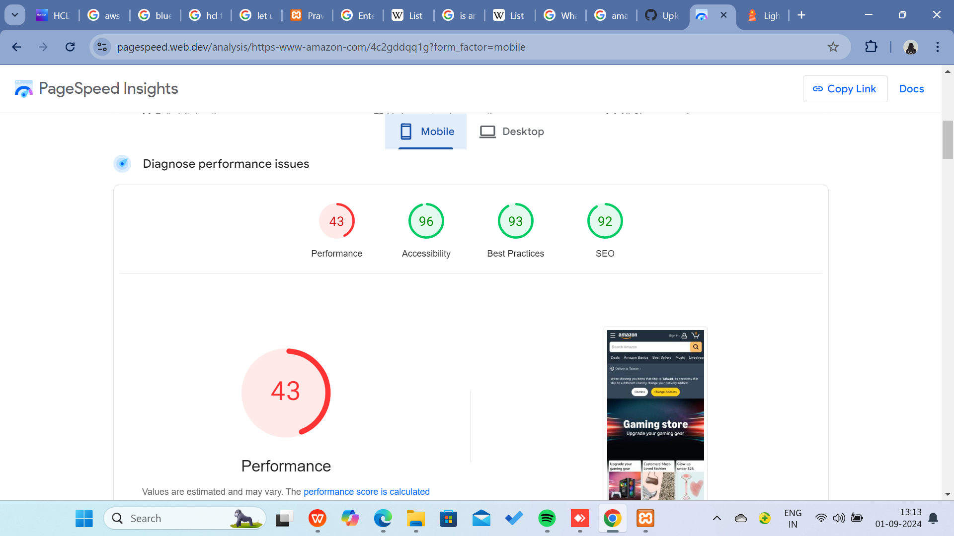
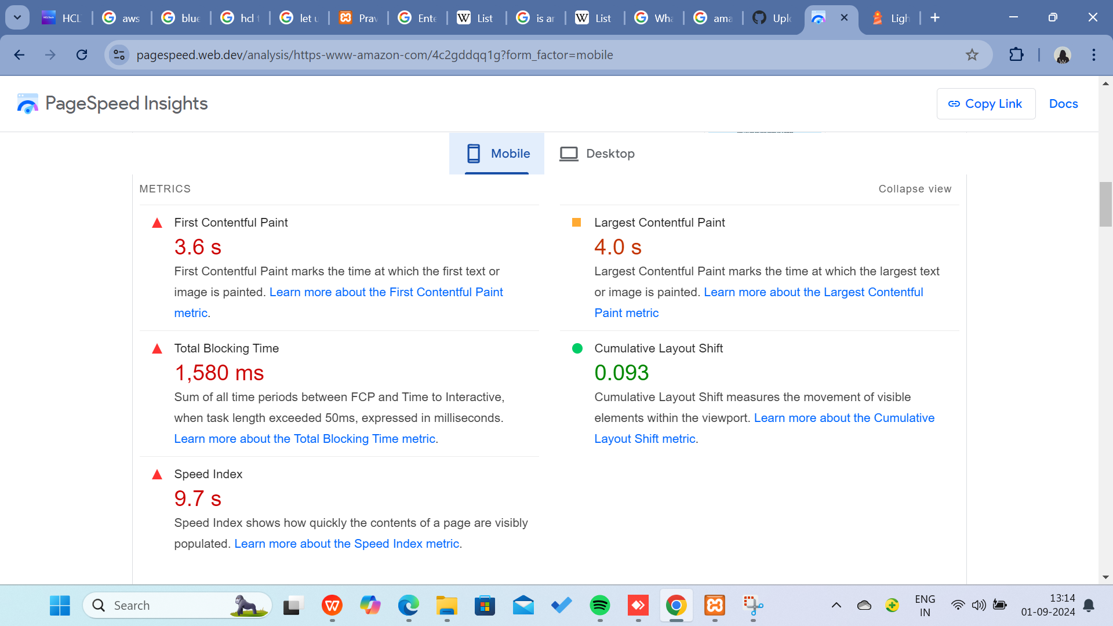
DIGITAL SERVICES PAGE ( Interaction to Next Paint (INP), Interaction to Next Paint (INP), Serve images in next-gen formats, Avoid enormous network payloads ).
SELL PAGE ( Speed Index, Properly size images, Minimize main-thread work ).
I Added Screenshot of the Page Report Down Below:

Slide 8
WEBSITE MISTAKES IDENTIFICATION
TO IMPROVE THE MISTAKES:
Reduce the buffering and Increase the loading Page Speed.
Modifying your webservers configuration file or use a plugin like 10Web Booster hosting to ensure your site is configured with optimized caching settings.
Cluttered layouts: Too many elements, inconsistent spacing, and overwhelming visuals and white spaces can confuse visitors.
Poor image optimization, slow servers can decrease users.
Optimise the image size low with good quality.

Slide 9
BEST PRACTICES LIST
BEST PRACTICE LIST FOR THE WEBSITE:
SIMPLICITY
VISUAL HIERARCHY
NAVIGABILITY
RESPONSIVITY
ACCESSIBILITY
CONSISTENCY
FAST LOAD TIMES
ENGAGING CONTENT
USER-CENTRIC DESIGN
SEO-FRIENDLY

