Slide 1
Online Quiz
Kalpana Ramanan C0715368

Slide 2
Kids Quiz Application
Tab Bar Controller
Start the Quiz
Read the Instruction
Statistics
Result of the Quiz

Slide 3
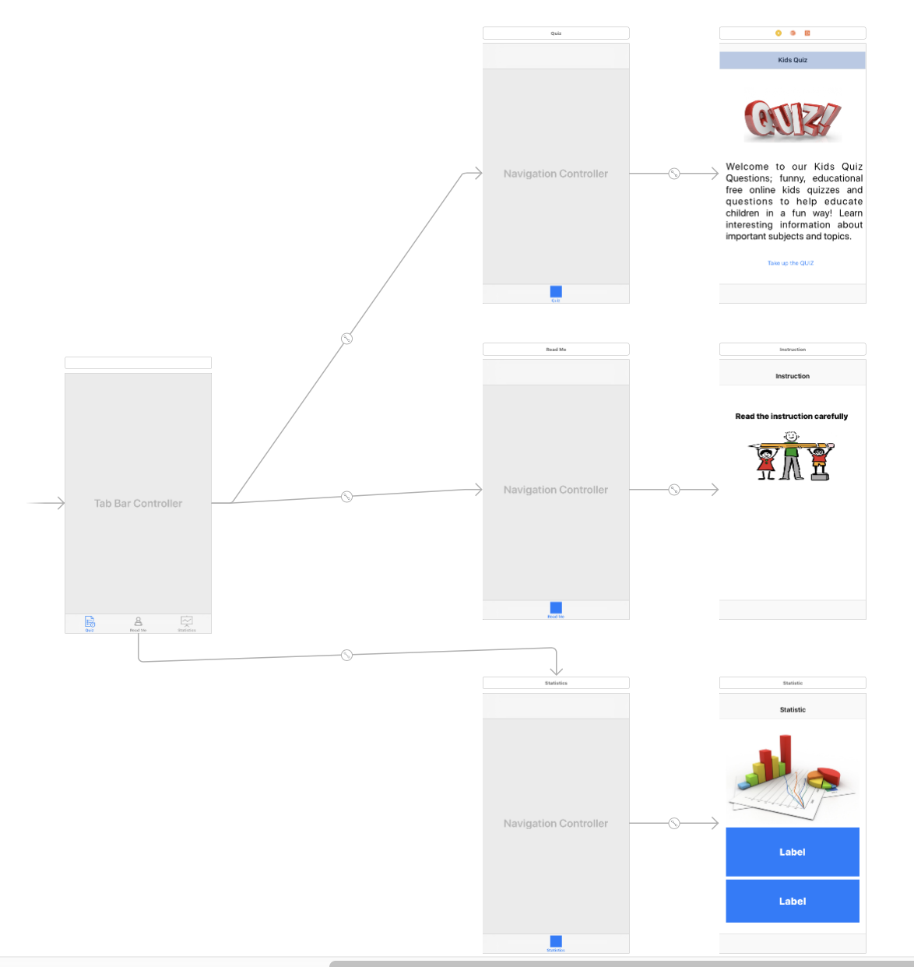
Tab Bar Controller For Quiz

Slide 4
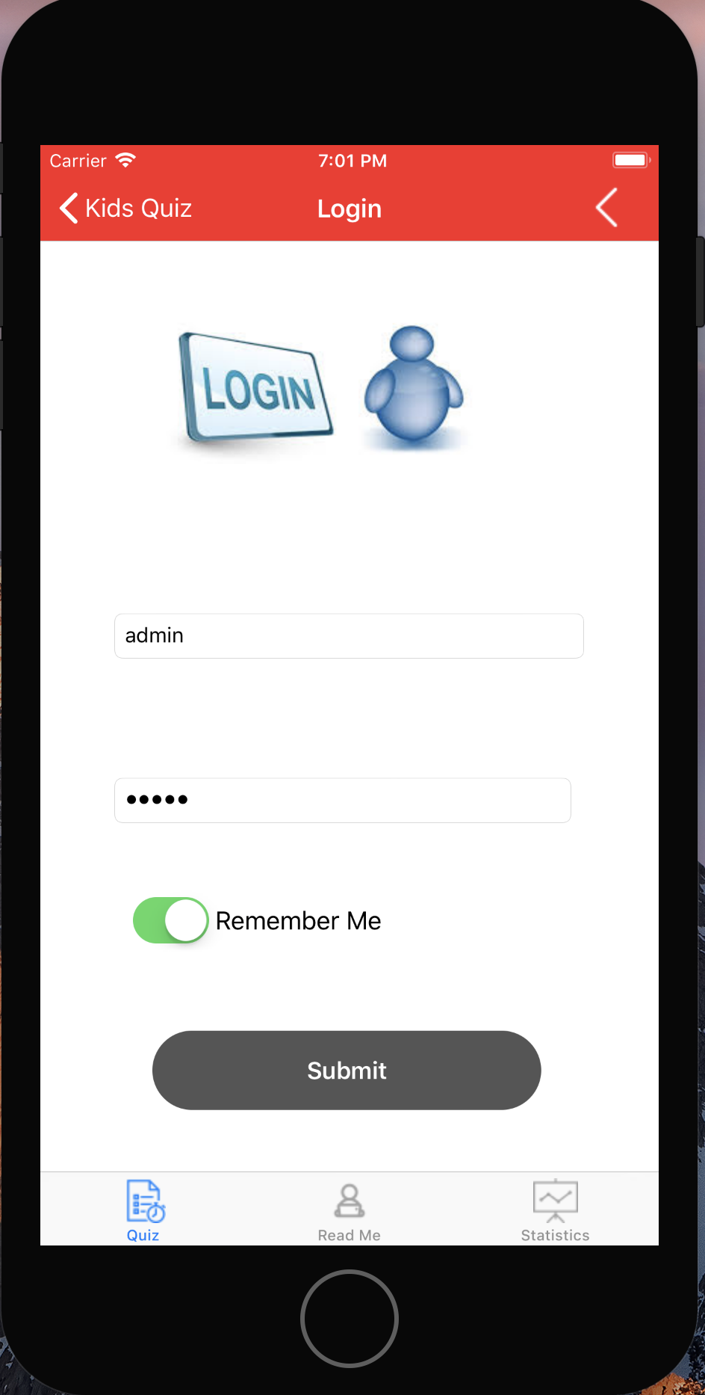
Login Screen
Login Screen shows the username and password.
On successful login it navigates to the next page.
Remember is the switch control

Slide 5
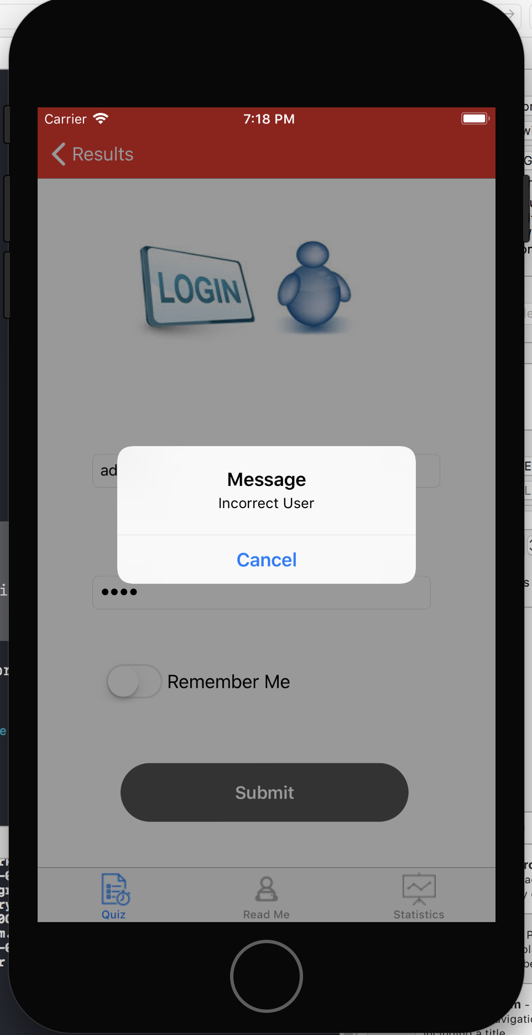
Screen Shot 2017-10-31 at 7.18.38 PM
In-Valid Screen
let alert = UIAlertController(title: "Message", message: "Incorrect User", preferredStyle: UIAlertControllerStyle.alert);
//Cancel Action
let cancelAction = UIAlertAction(title: "Cancel", style: UIAlertActionStyle.cancel, handler: {
_ in print("Incorrect Username!!!! Try again");
})
alert.addAction(cancelAction);
self.present(alert, animated: true, completion: nil);

Slide 6
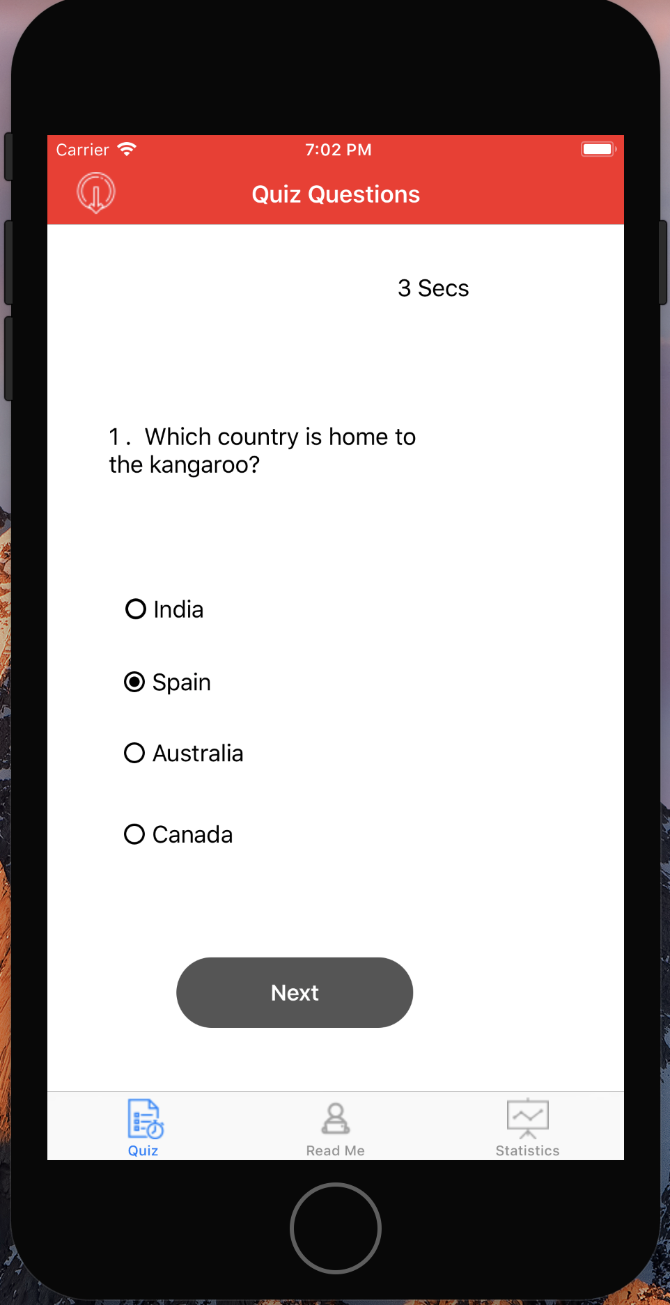
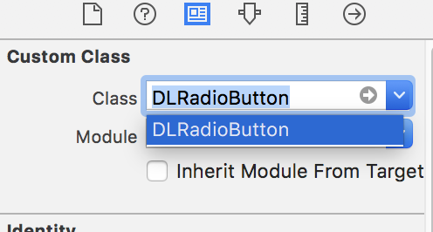
Quiz Screen
Radio Button Implementation for Button
DLRadioButton.m
DLRadioButton.h
HealthHabits-Bridging-Header.h
#import "DLRadioButton.h"

Slide 7
Quiz Screen
Radion Button – UIButton has been implemeted as Radio Button
Timer – Default 10 Secs is allocated for each questions
Once the timer reached 0 Secs it will navigate to the next question
Or the user can move to next page by clicking the next button

Slide 8
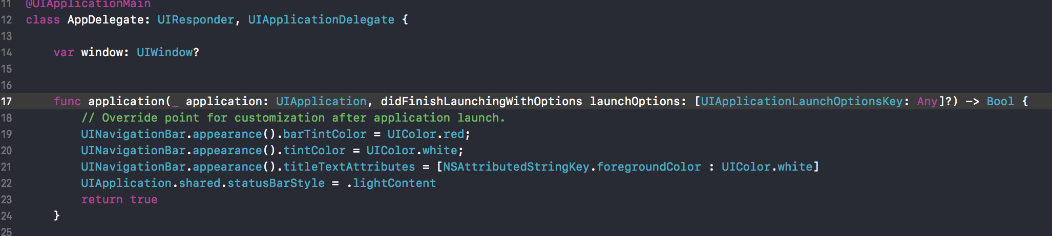
Using Color Palette for the Navigation Controller

Slide 9
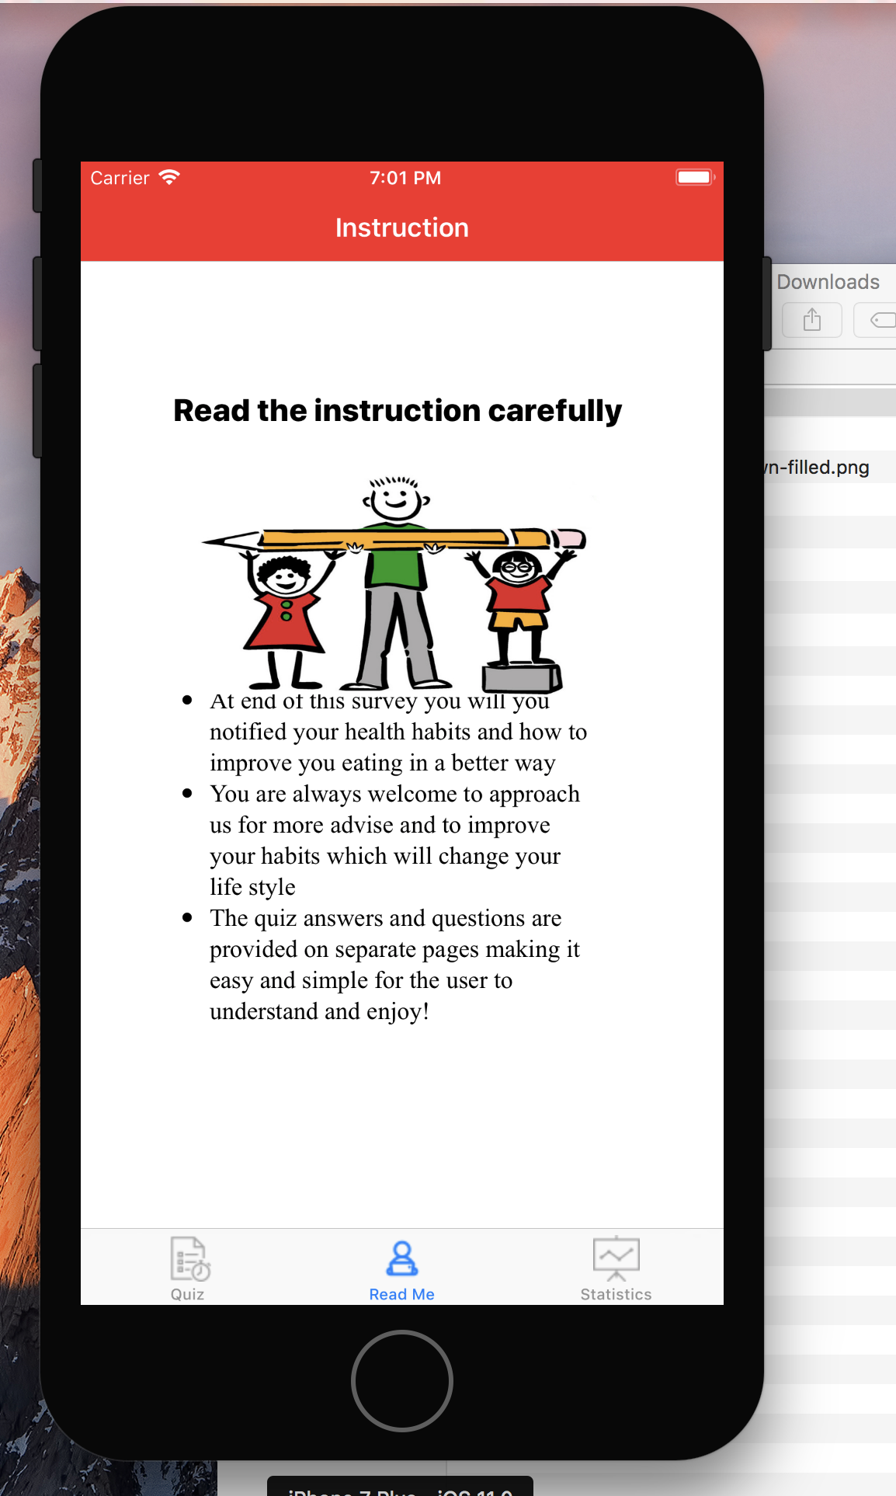
Read the instructions
Read the Instruction has been implemented using web View

Slide 10
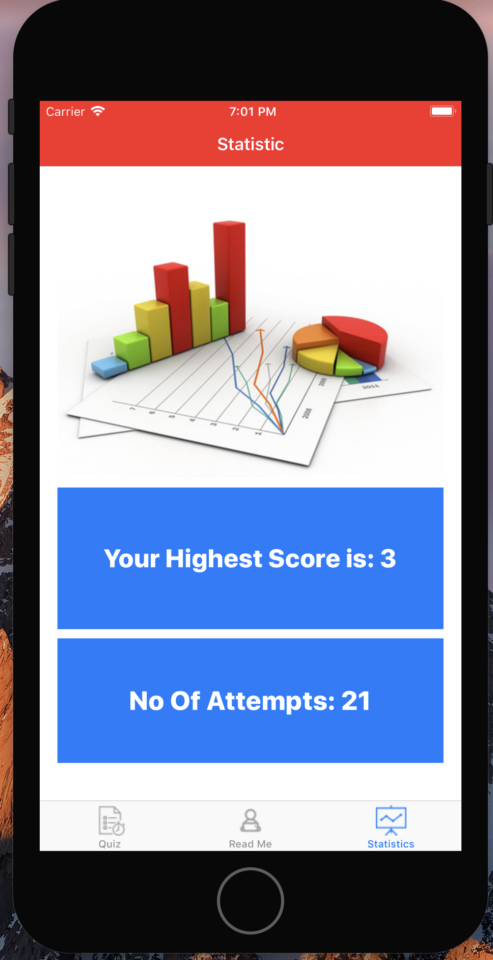
Statistics
Statistics shows the no of attempts the user tried the quiz
Also show the highest score among the number of attempts.

Slide 11
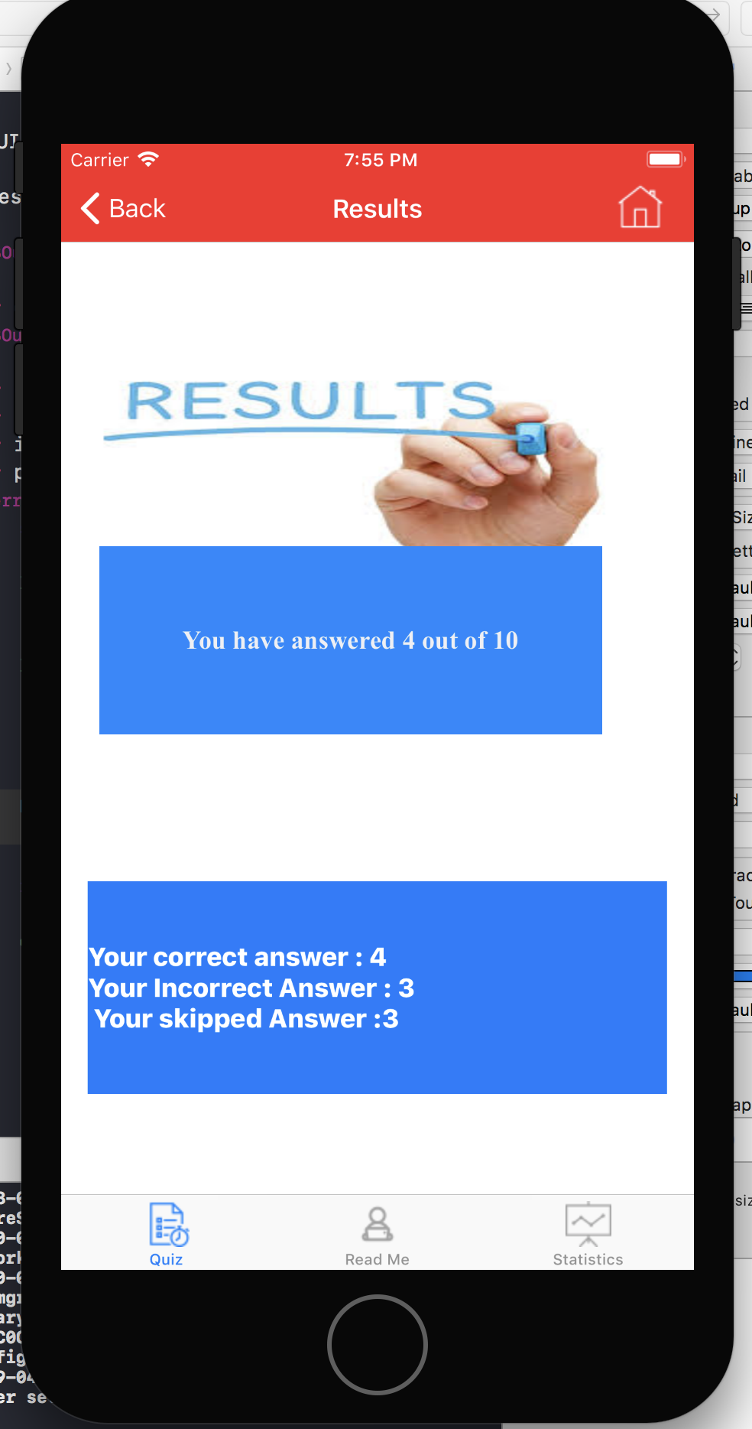
Results
Result Page will display the total number of question
Total no of question is correct, skipped and incorrect

Slide 12
References
https://github.com/DavydLiu/DLRadioButton
https://developer.apple.com/library/content/referencelibrary/GettingStarted/DevelopiOSAppsSwift/

Slide 13
Thank You

