Slide 1
Introduction to version control System
Version control enables multiple people to simultaneously work on a single project. Each person edits his or her own copy of the files and chooses when to share those changes with the rest of the team. Thus, temporary or partial edits by one person do not interfere with another person's work.
Version control integrates work done simultaneously by different team members. In most cases, edits to different files or even the same file can be combined without losing any work. In rare cases, when two people make conflicting edits to the same line of a file, then the version control system requests human assistance in deciding what to do.
Version control gives access to historical versions of your project. If you make a mistake, you can roll back to a previous version. You can reproduce and understand a bug report on a past version of your software. You can also undo specific edits without losing all the work that was done in the meanwhile. For any part of a file, you can determine when, why, and by whom it was ever edited.

Slide 2

VCS overview

Slide 3
Keywords
Repository
Working Copy

Slide 4
GIT Overview
Creating git Remote Repository
Creating git local repository
Git operations
Find the solution for the problems

Slide 5
Creating Remote Repository
Follow the Shared Document “git_demp.pdf”

Slide 6
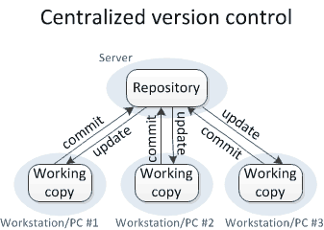
Centralizes Version Control System

Slide 7
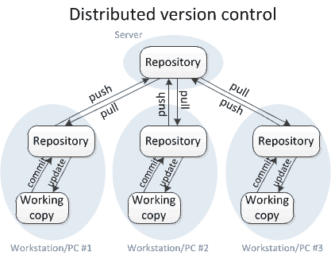
Distributed Version Control System

Slide 8
Cloning
- To create a local repository in the system from the remote repository
$ git clone git@gitlab.vvdntech.com:git-learners/gitplayground.git
Cloning into 'gitplayground'...
remote: Counting objects: 3, done.
remote: Compressing objects: 100% (2/2), done.
remote: Total 3 (delta 0), reused 0 (delta 0)
Receiving objects: 100% (3/3), done
$

Slide 9
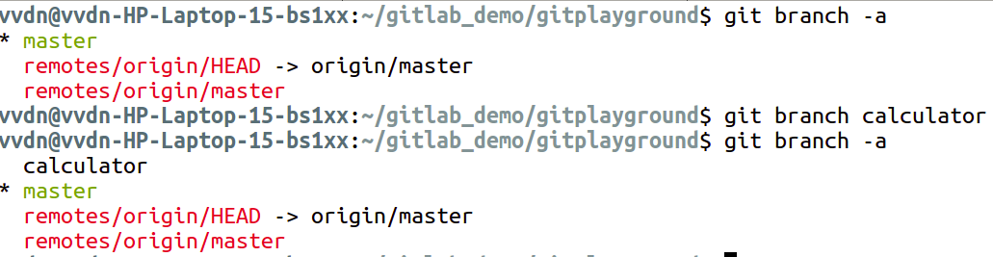
Branching - To create and list branches in the local repository.
To create and list branches:

Slide 10
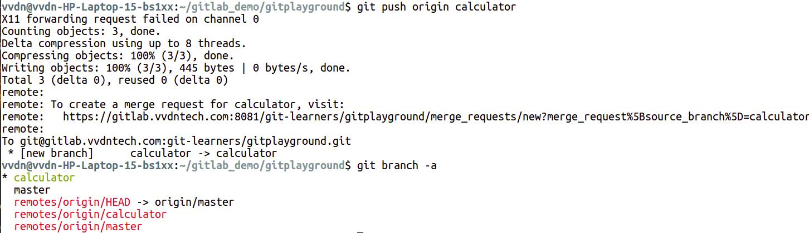
Branching- To Push the new branch to remote repository.

Slide 11
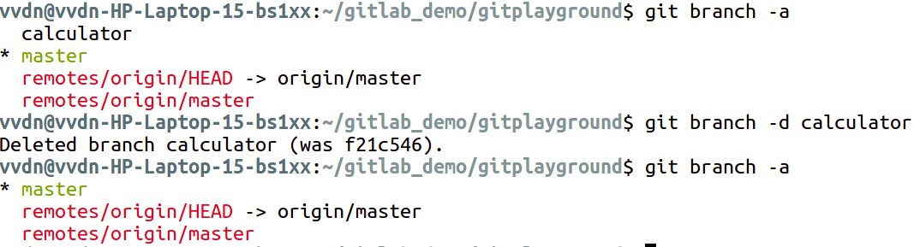
Branching - To delete the branch in local repository.

Slide 12
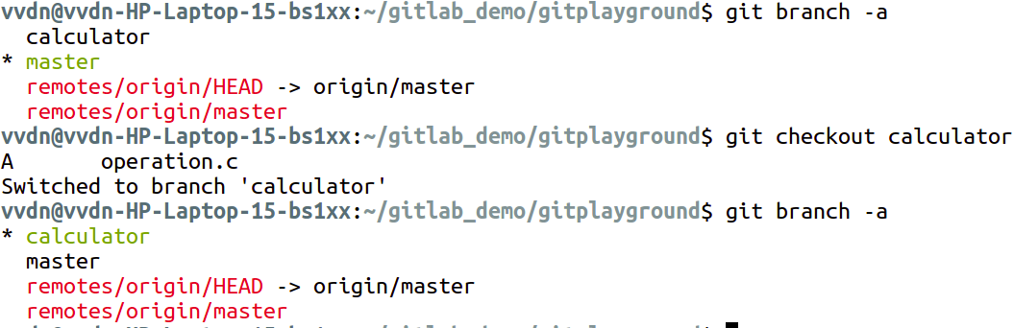
Branching - To switch between branches

Slide 13
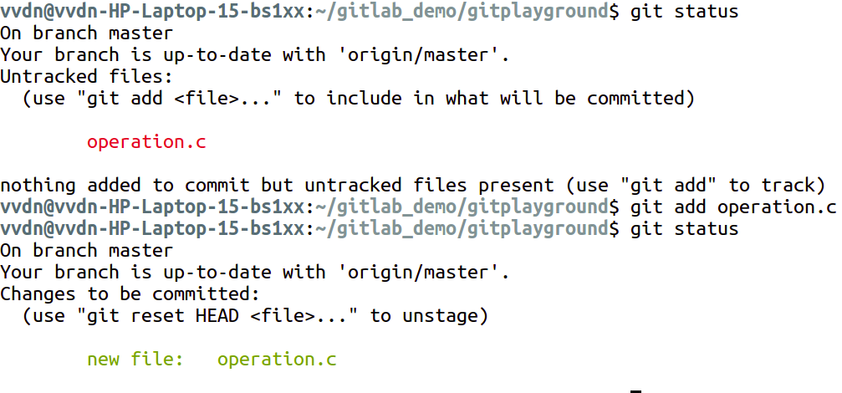
Local commit - Create a file, edit it and add the file to commit list

Slide 14
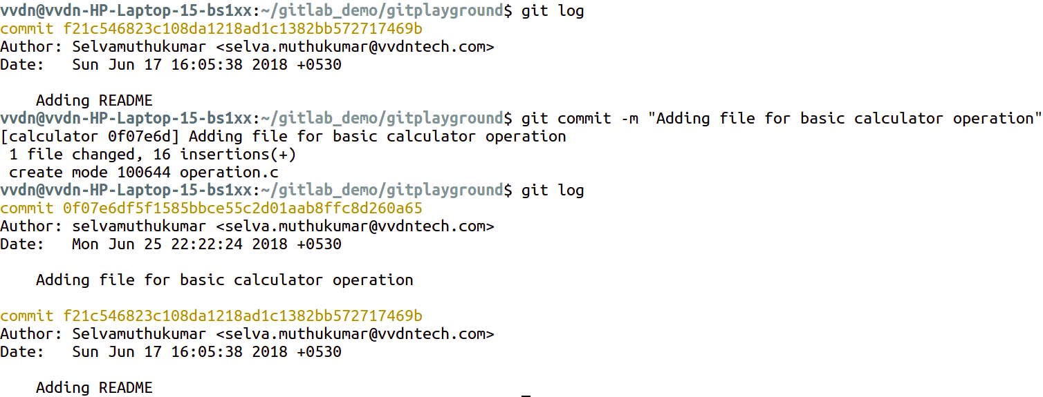
Local Commit and Log messages - Commit the file in the local repository

Slide 15
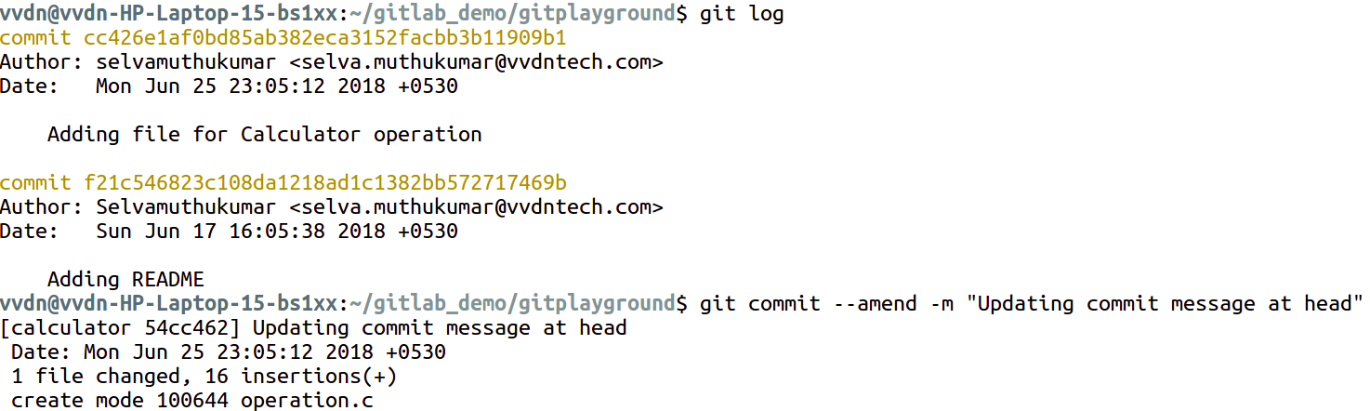
Change commit log message in local repo

Slide 16
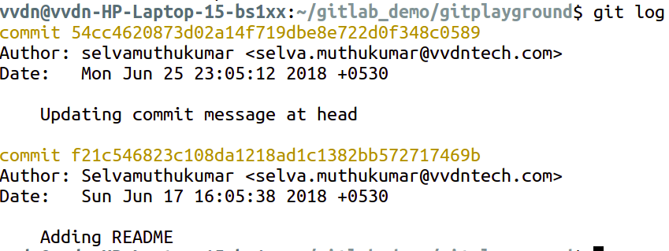
Change commit log message in local repo

Slide 17
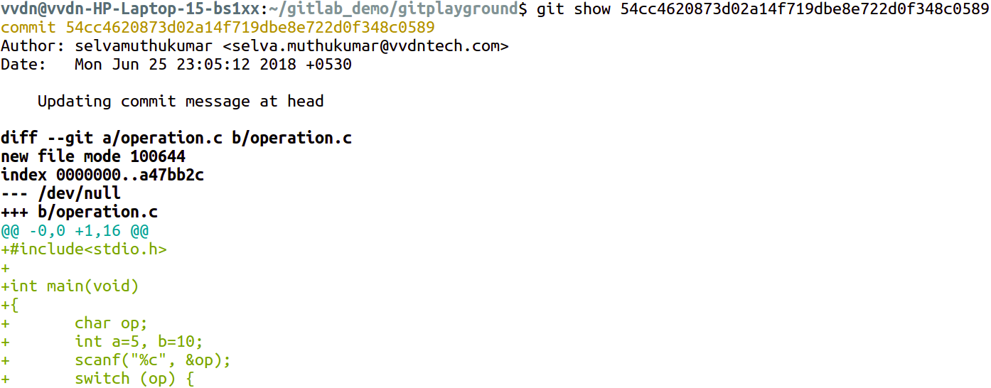
View the changes in particular commit

Slide 18
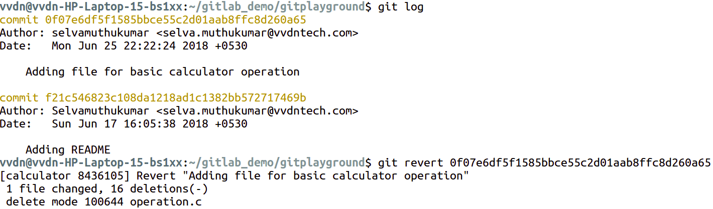
Revert local commits

Slide 19
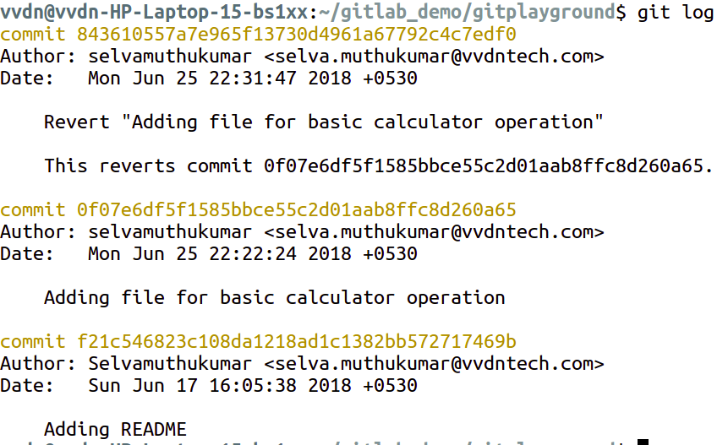
Revert local commits - Commit log after revert. History is maintained in the git log message.

Slide 20
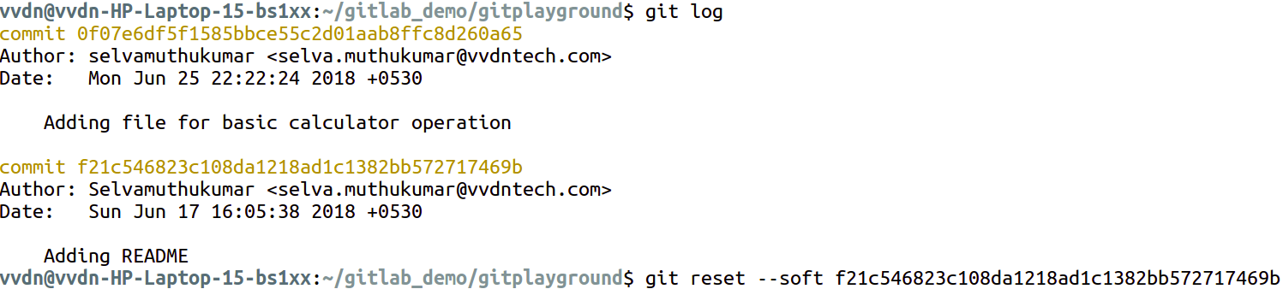
Reset the local commit

Slide 21
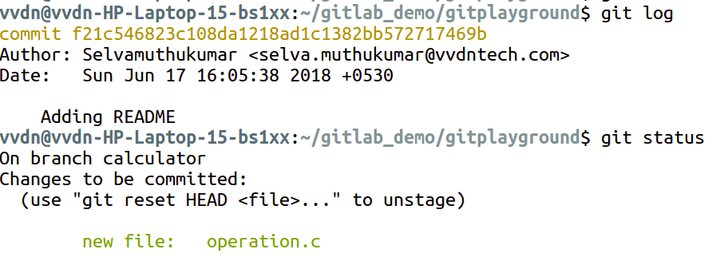
Reset the local commit

Slide 22
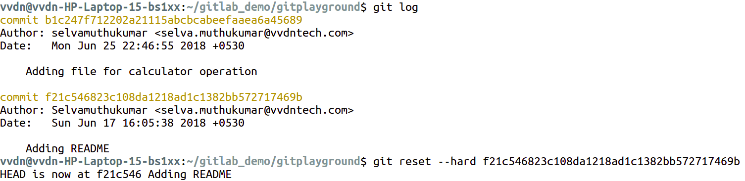
Reset local commit

Slide 23
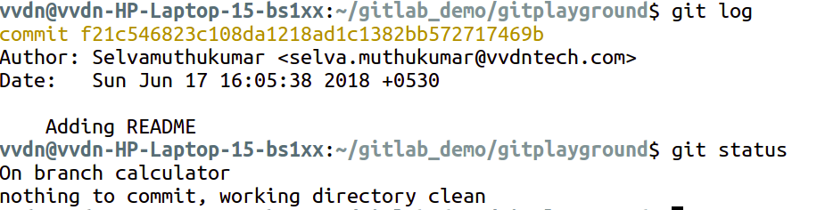
Reset local commits

Slide 24
reset --soft vs reset --hard
With --soft as argument the file changes in the local commit will be retained after reset
With --hard as argument the file changes in the local commit is completely lost

Slide 25
Reset Vs Revert
With git revert, the file changes history is maintained in the git log messages
With git reset, the file changes history is lost in the git log messages

Slide 26
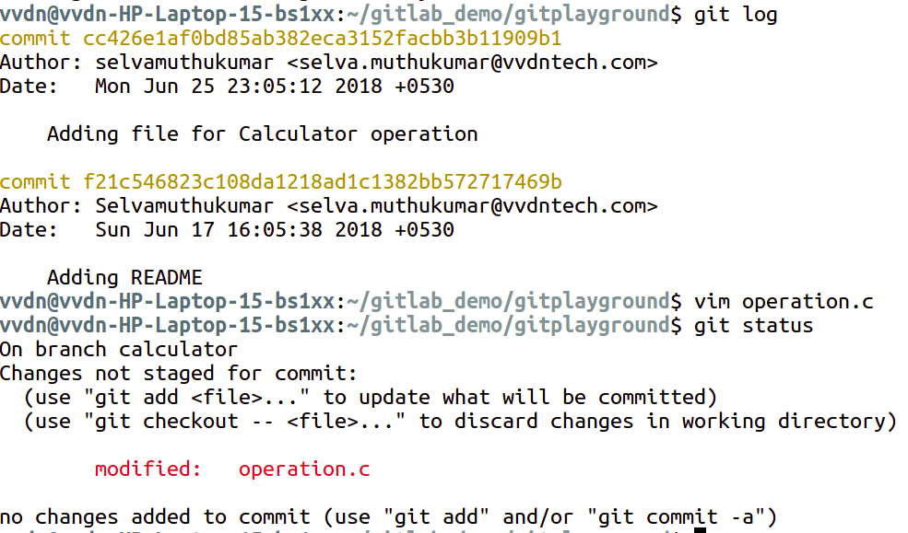
View changes in the working directory

Slide 27
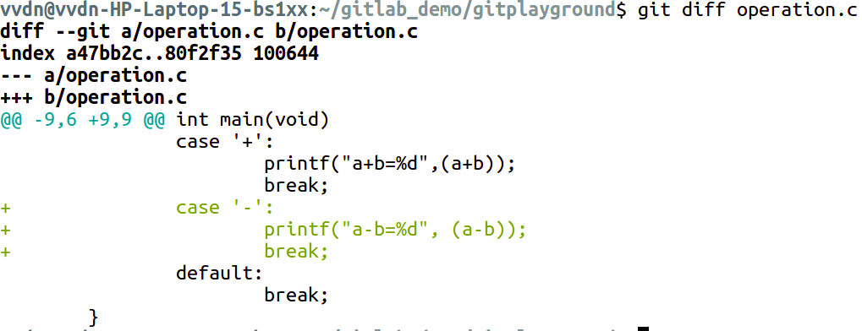
View changes in the working directory

Slide 28
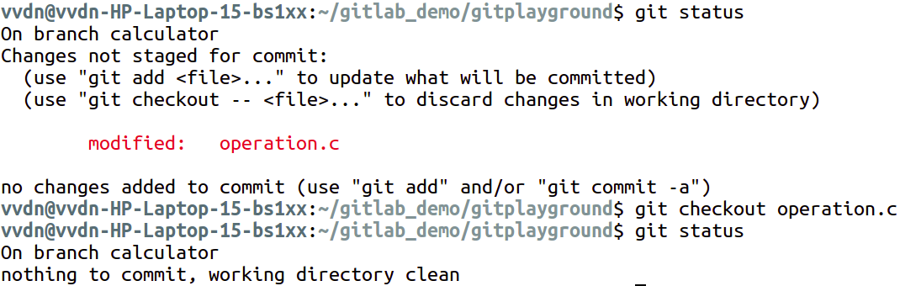
Discard file changes in the local repository

Slide 29
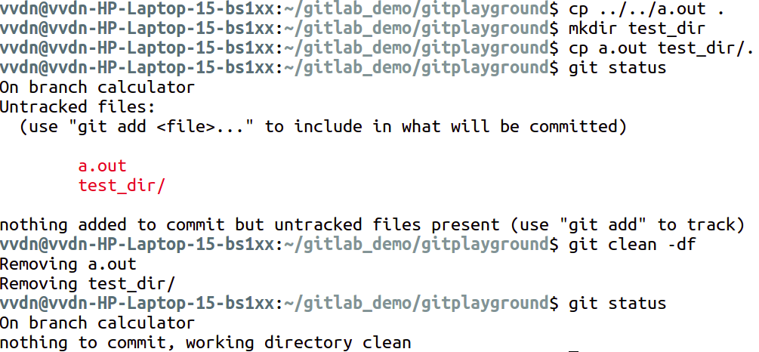
Clean untracked files/directories in the local repo

Slide 30
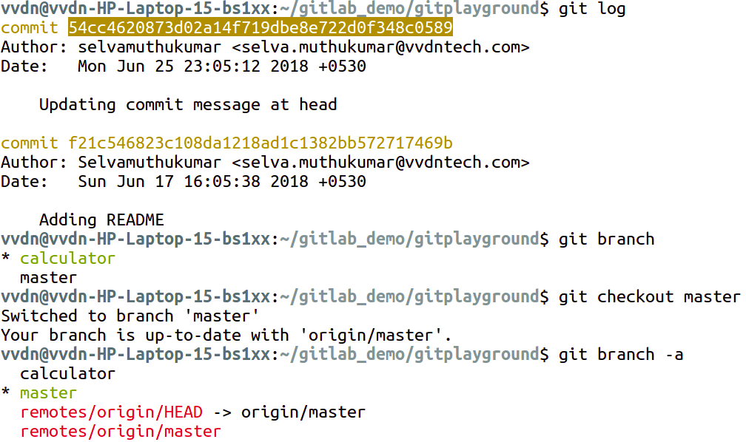
Cherrypick - Commit changes from one branch to another in local repo

Slide 31
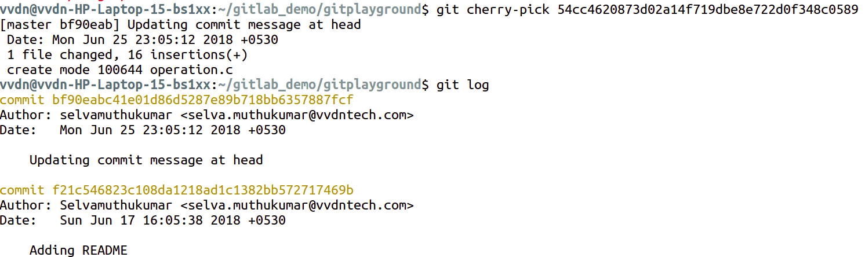
Cherrypick

Slide 32
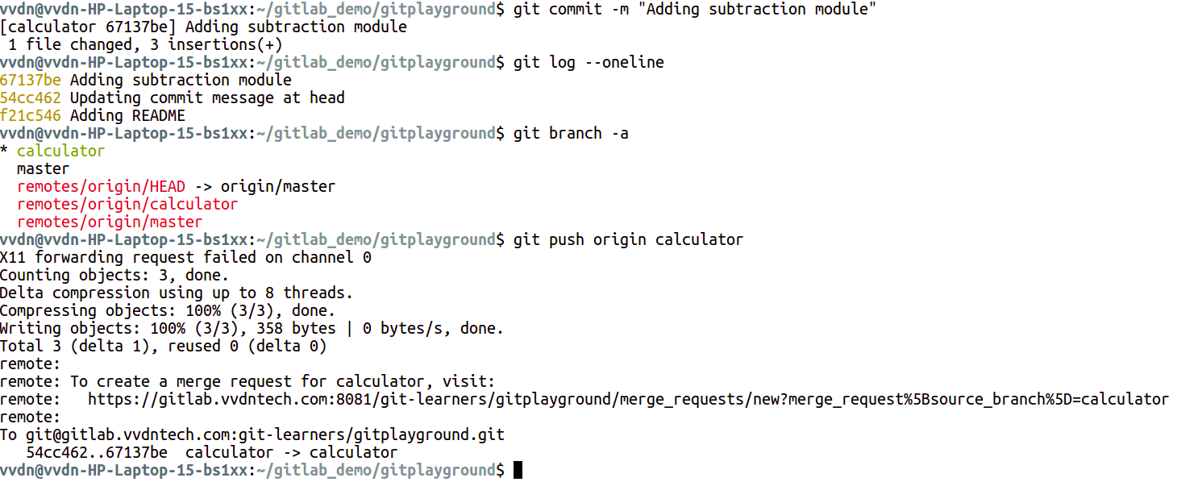
Pushing Changes - Update the commits in local repo to remote repo

Slide 33
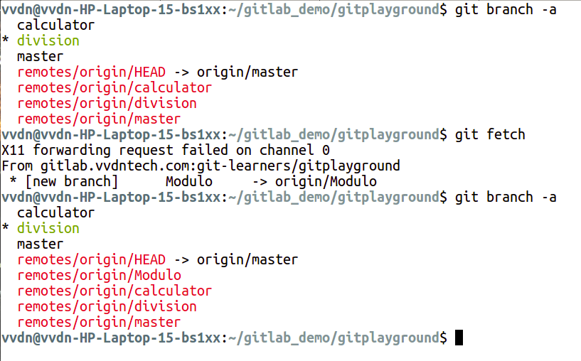
Fetch

Slide 34
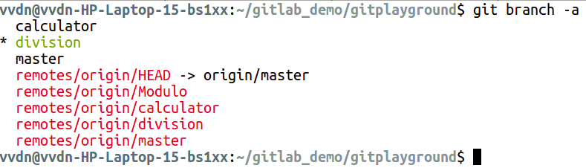
Merge branches - terminal view of branches

Slide 35
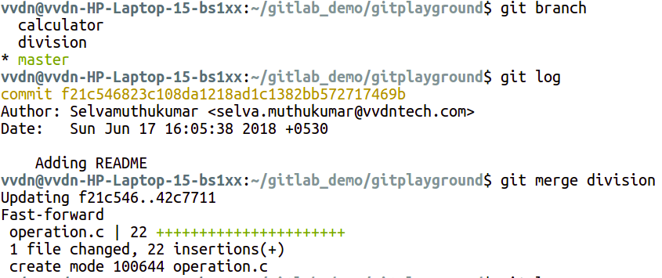
Merge changes from division to master branch

Slide 36
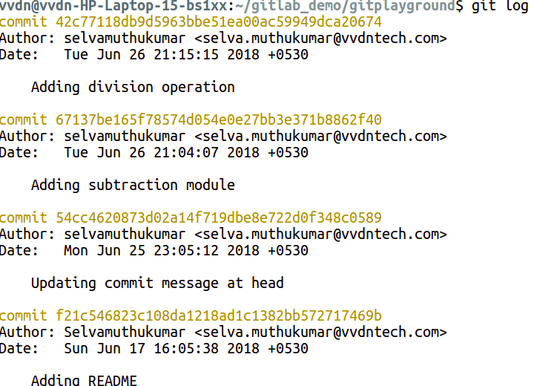
Merging changes from division to master branch

Slide 37
Git rebase

Slide 38
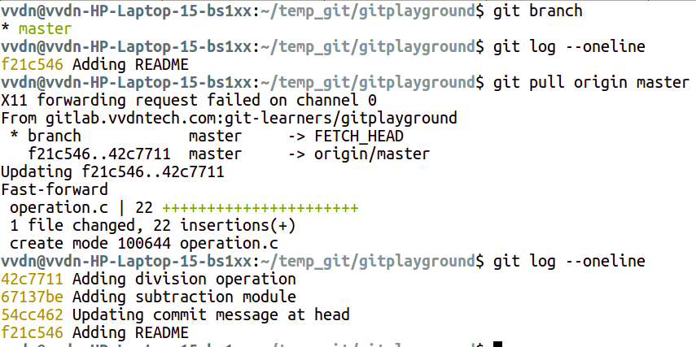
Pulling changes from server

Slide 39
Reverting Changes
git revert
git reset

Slide 40
Cherry pick

Slide 41
Tagging Releases

Slide 42
JIRA integration

