Slide 1
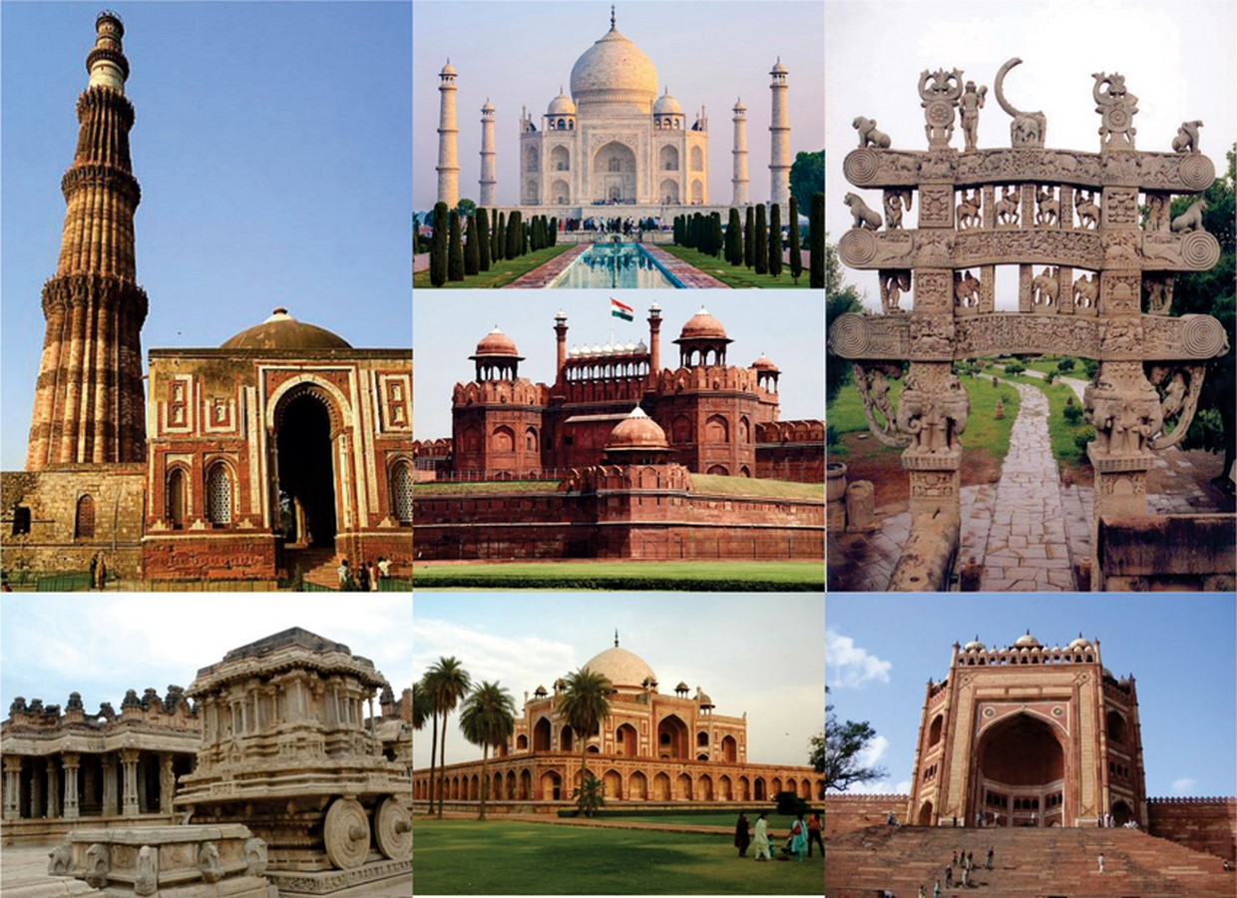

ATEET - Identification of Monuments
from Aerial Images using Deep Learning Techniques

Slide 2


Slide 3

Delhi is the capital of India and the center of heritage monuments and individual architectural or artistic monuments and historic urban centers. Such places are also UNESCO heritage sites and centers of tourism. Monitoring and developing the application to identify and locate these sites from an aerial view.
Unmanned Aerial vehicles (UAVs) are used to acquire aerial photographs and collection of high-resolution imaging data in a stipulated time at a low cost and revolutionize the practice by allowing surveyors to detect possible areas of interest, before going messy. With the combination of aerial data and deep learning, identification and localization are quite easy which is helpful to connect with other technologies such as IoT, AR, and VR.
OBJECTIVE:
The objective of the research focused to prepare the custom aerial imagery dataset of some monuments of Delhi (Qutub minar, Lotus temple, Jama masjid, Humayun's tomb) and implementing deep learning techniques to detect the monuments.
VGG-16 and YOLO v5 model is used for monument detection and compared the accuracy to choose the best analysis model.
Develop an ATEET web user interface to demonstrate the research project.

Slide 4
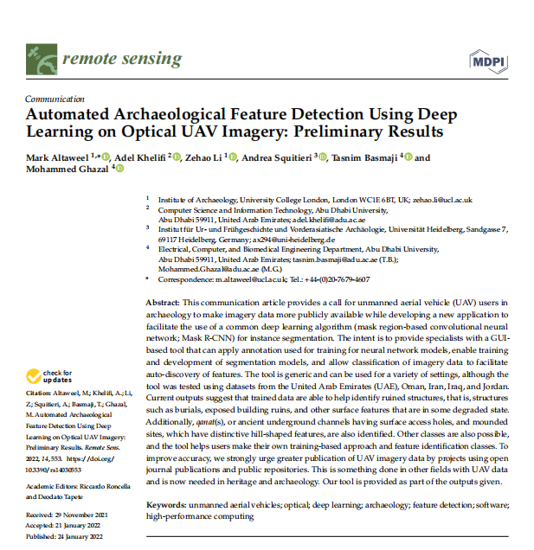
BASE PAPER

Slide 5

PREREQUISITE
Technology
Software
Computer Vision
Deep Learning
Web Development
Anaconda(Jupyter Notebook)
PyCharm
HTML, CSS, Flask
Programming/Libraries
Algorithm and Techniques
Python
TensorFLow 2.10
PyTorch
LabelImg Data Annotation Tool
Mosaic Data Augmentation
VGG - 16
YOLOv5

Slide 6

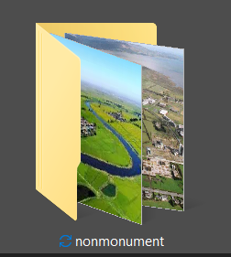
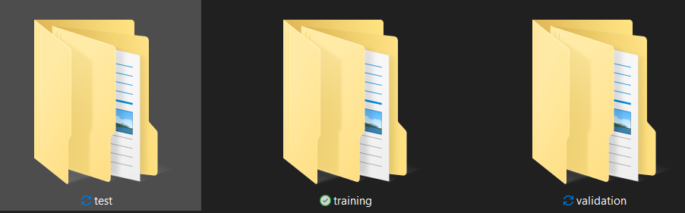
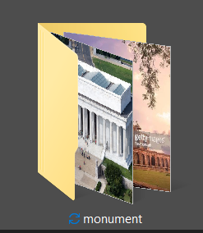
Aerial Imagery Dataset Structure
Images
Images
Images and
Labels
Labels
Labels

Slide 7
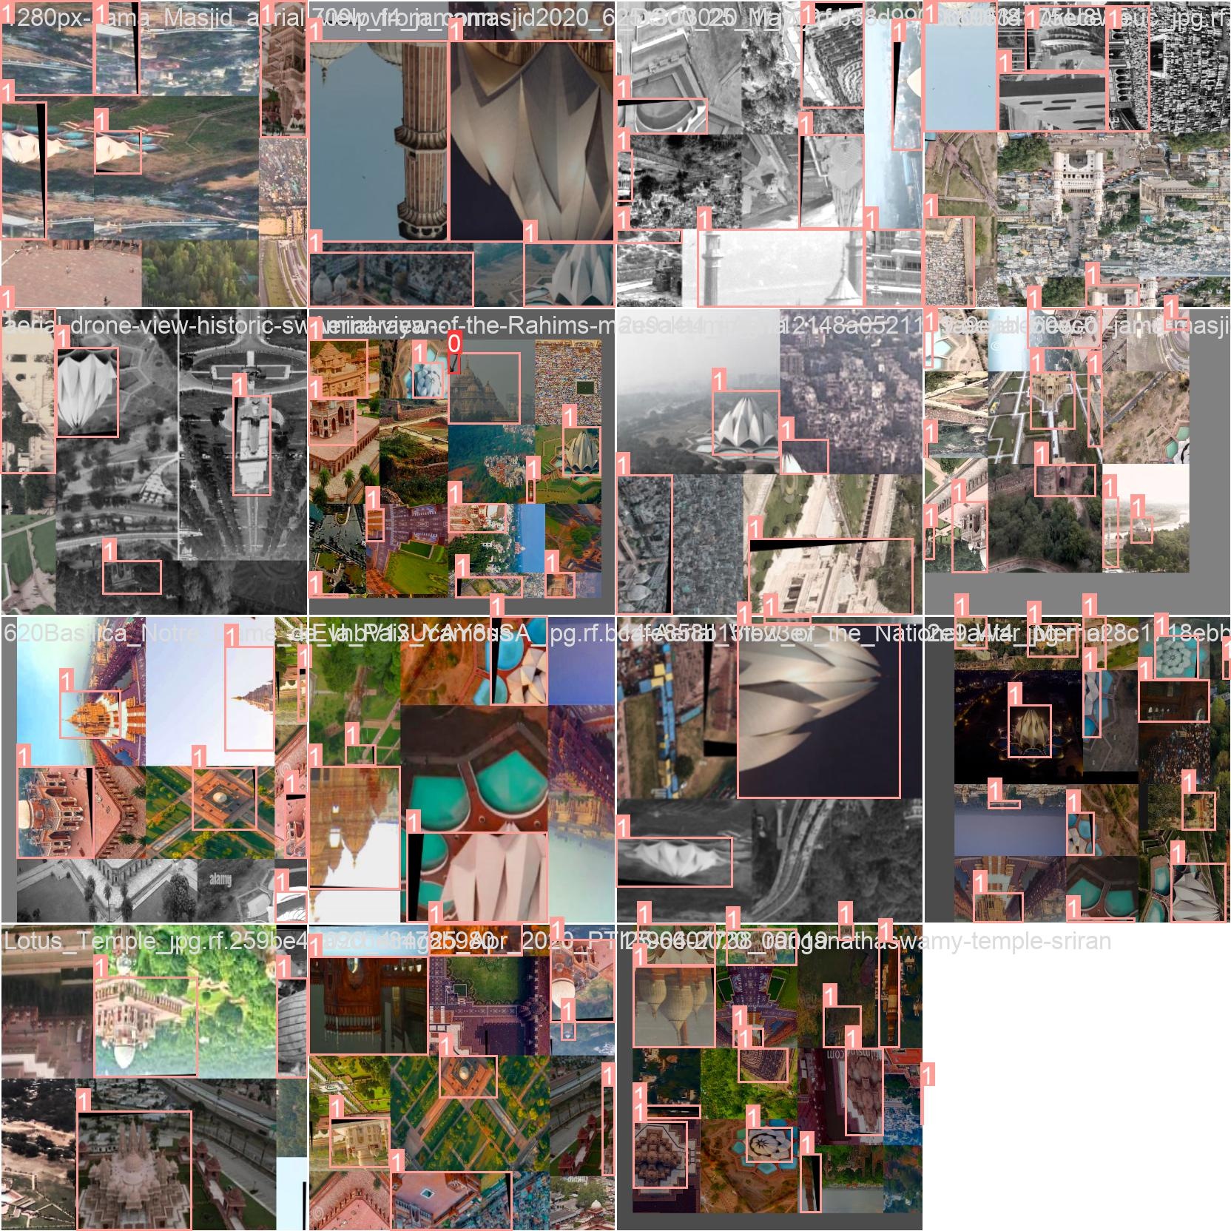
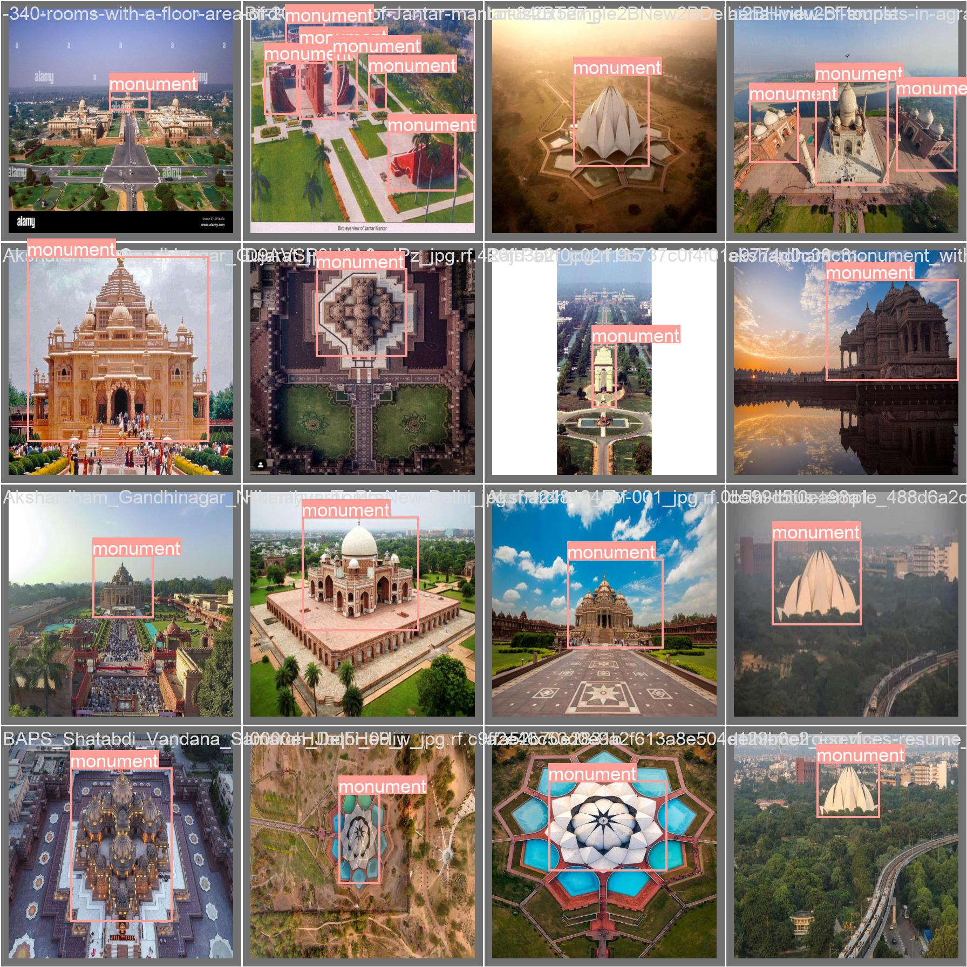
Aerial Imagery Data Annotation/Labelling
Training Data Annotation
Validation Data Annotation

Slide 8
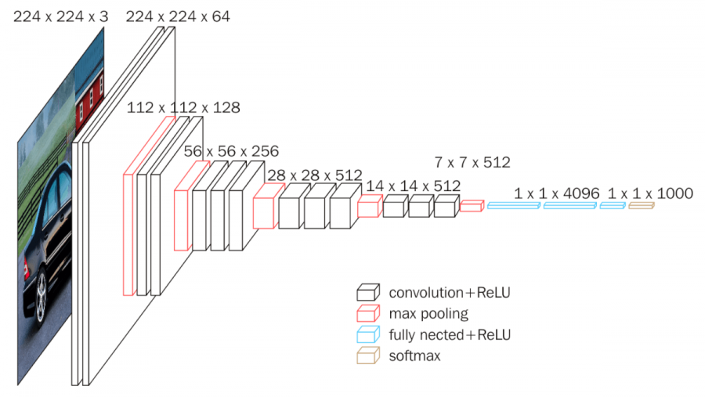
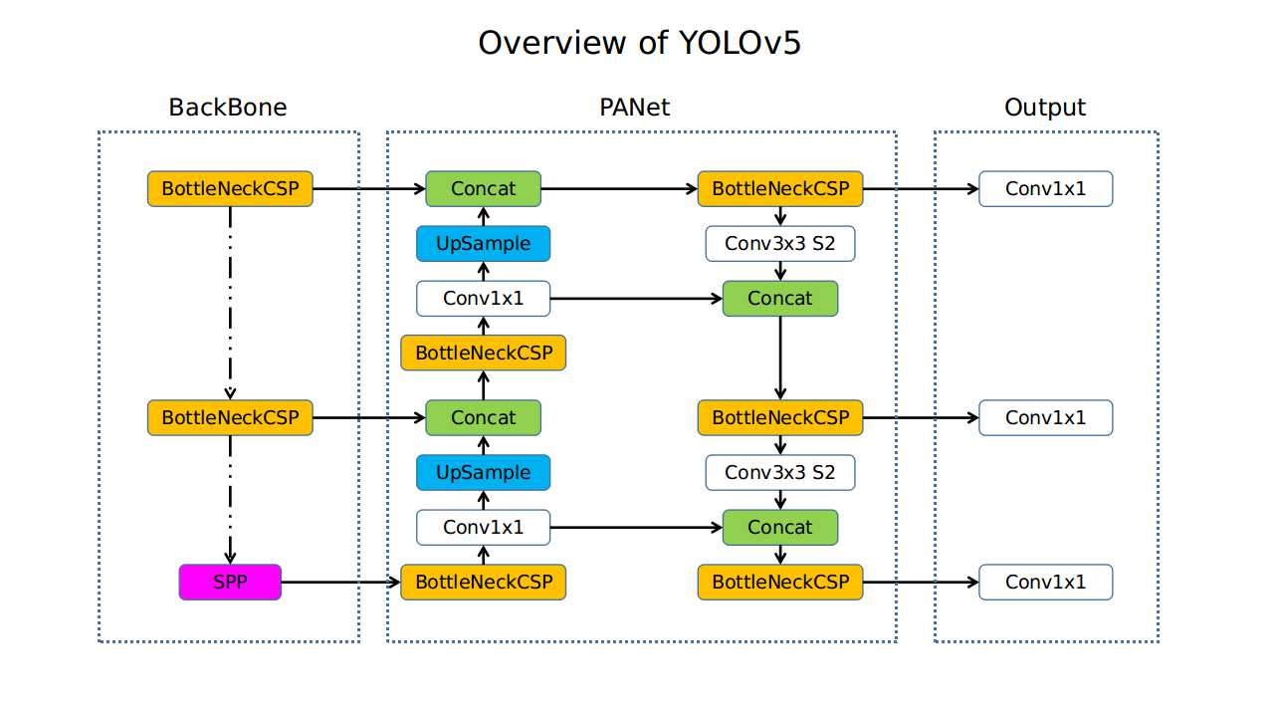
DL Algorithms and It’s Architecture
YOLO v5 (You Only Look Once)
Architecture
VGG16 Architecture

Slide 9
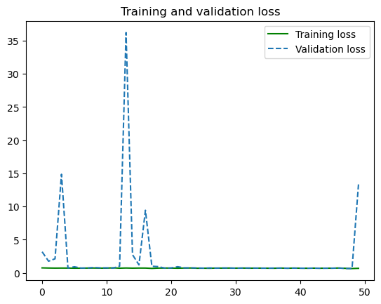
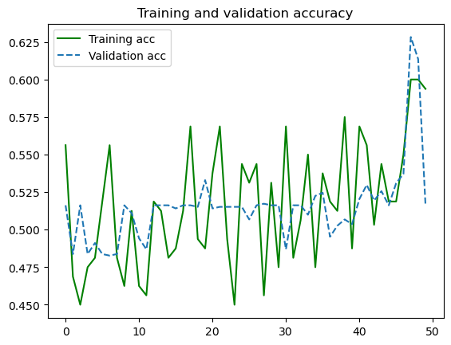
VGG-16 Model Evaluation Metrics and Analysis

Slide 10
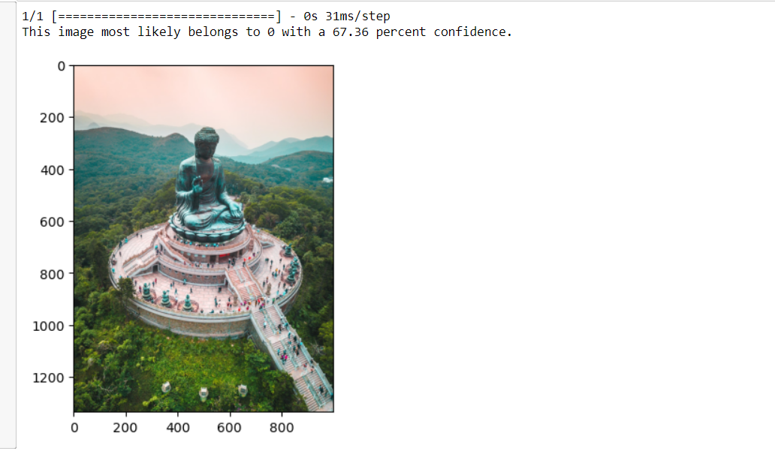

Slide 11
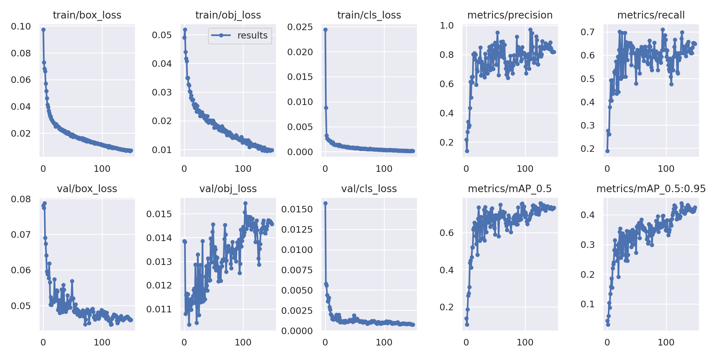
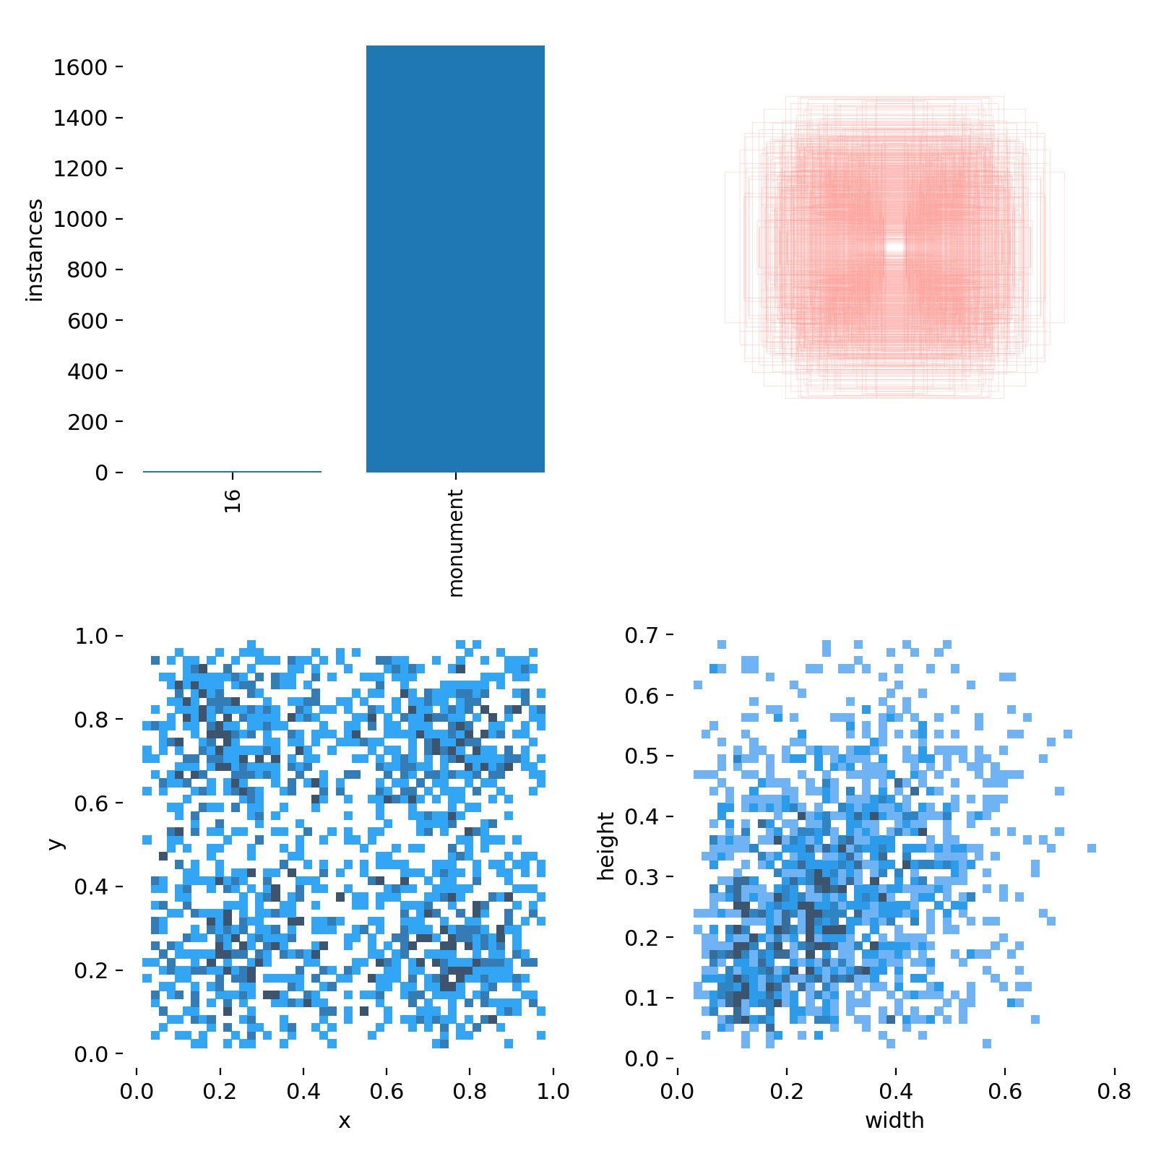
YOLO v5 Model Evaluation Metrics and Analysis

Slide 12
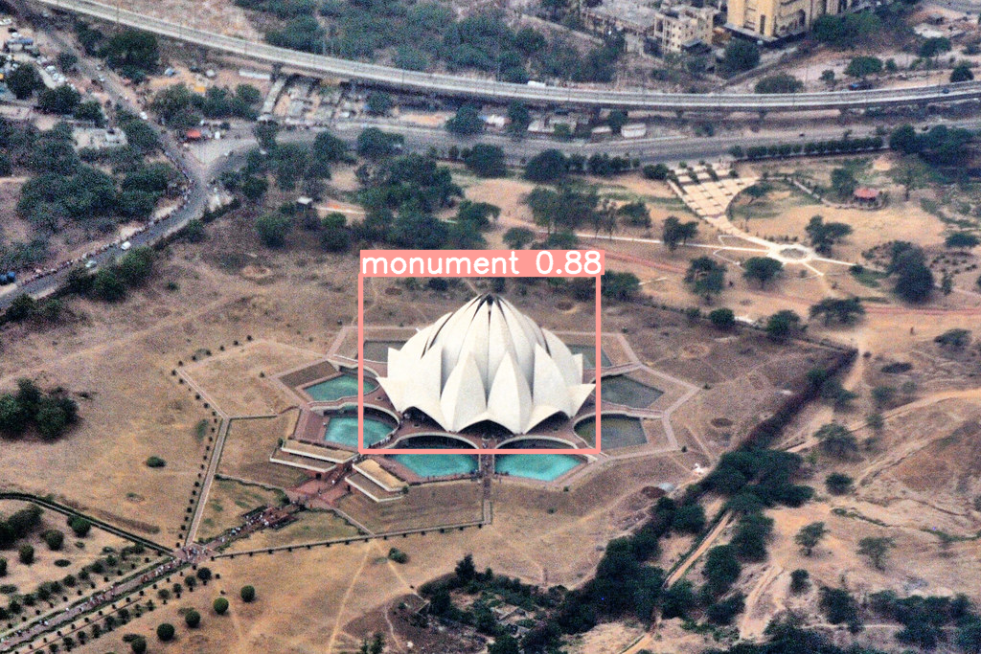
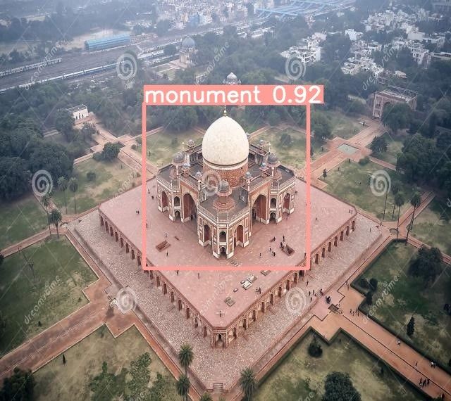
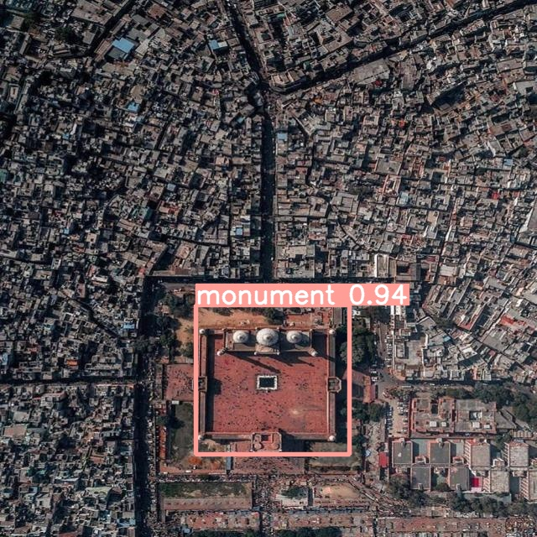
Prediction

Slide 13
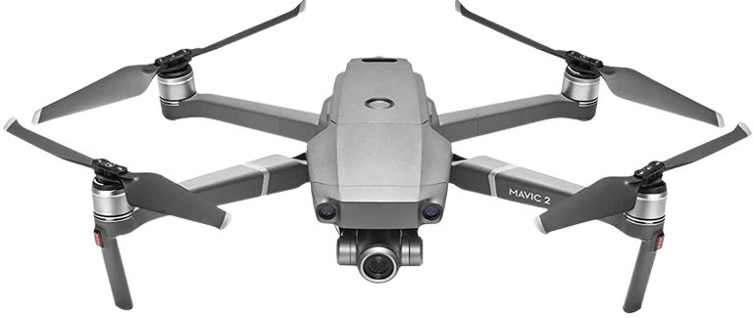
Summary
This Minor Project is based on Computer Vision and Deep Learning to identify the monuments from Aerial Imagery and Integration of Interpretability for the predicted outcomes (Explainable AI).
Created high resolution aerial imagery dataset from Airbone platforms and internet.
This work implements VGG-16 and YOLOv5 to Monuments Detection, showcasing the architecture of both VGG-16 and YOLOv5 network architecture, process hyper-parameters, and dataset pre-processing. In the end, comparison of both models through parameters such as training and validation losses, precision, recall, and mAP with IoU threshold.
YOLOv5 found the best model compare to VGG-16 for Monuments Detection which can detect some mentioned monuments rapidly from aerial imagery.

Slide 14

Future Scope
This Research will help to idenitfy heritage sites and medium of information for public.
Research will continue to add new techniques that will work on low resolution and deem light.
It will further extend to satellite imagery.
Further will extend this reserach on different object identification.

Slide 15
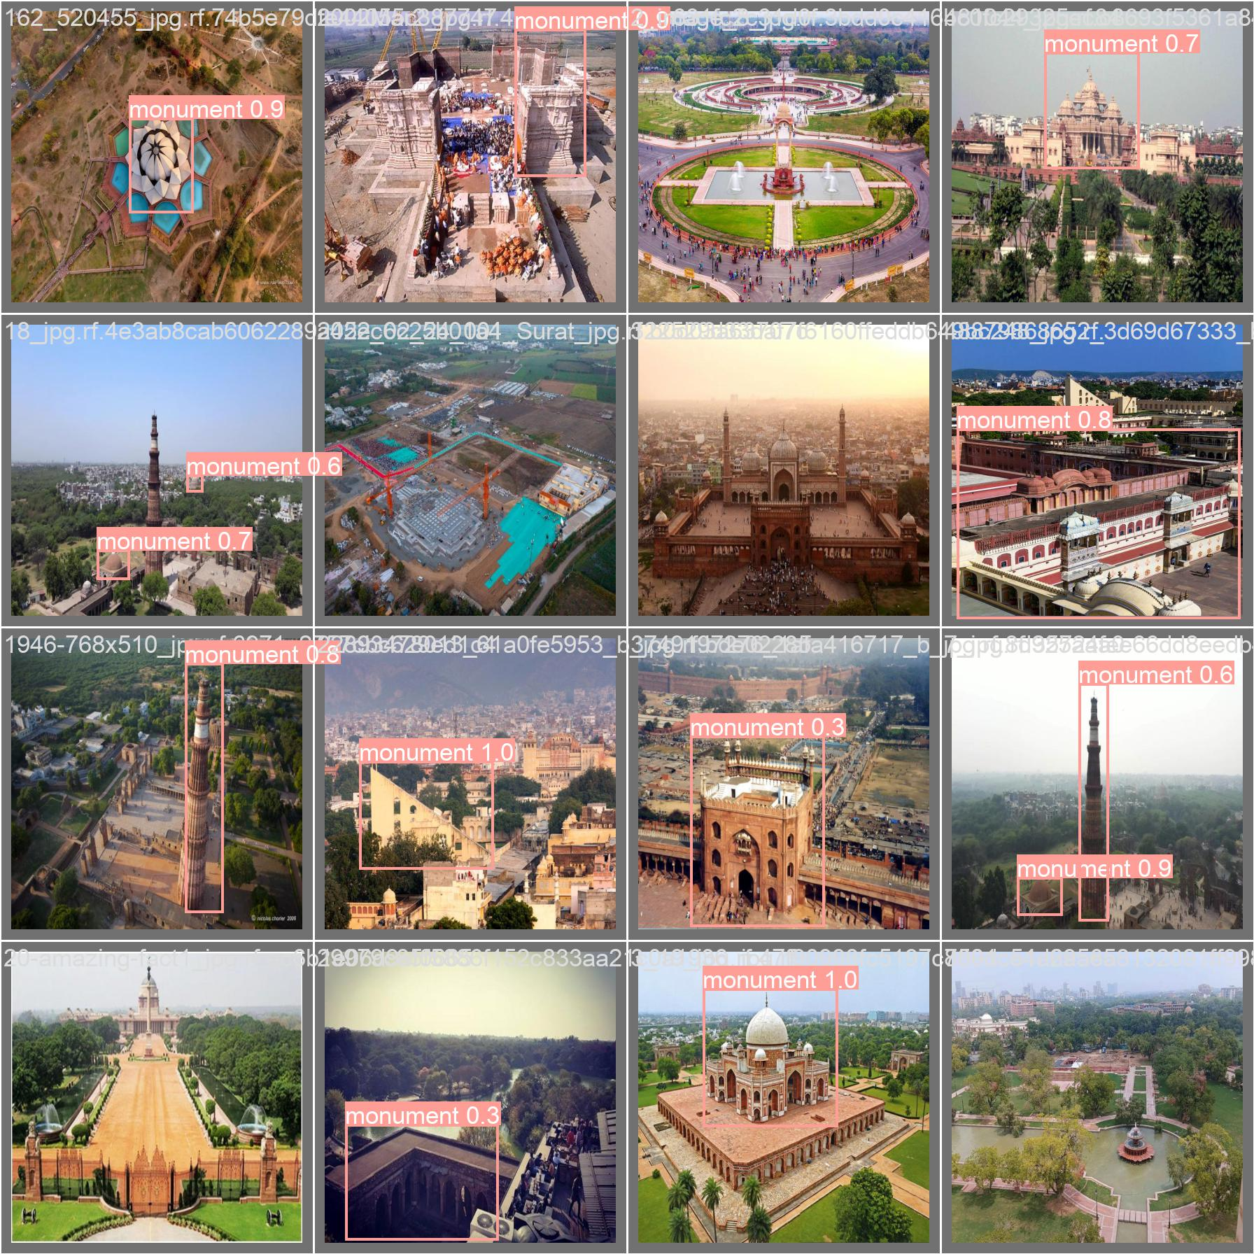
Thank You!

