Slide 1


DATA ANALYST PROJECT ON
College Analytics: Exploring ROI, Placements, and Trends with Data-Driven Insights

Slide 2


PROBLEM STATEMENT
Every year, thousands of students in India struggle to choose the right engineering college.
The decision is complicated because:
High tuition fees vs. uncertain placement packages
Multiple entrance exams and confusion about eligibility
Lack of clear information on Return on Investment (ROI)
Students need data-driven insights to make smarter choices about their future.

Slide 3

OBJECTIVE
To provide data-driven insights that help students make informed college decisions.
Key goals of the project:
Analyze tuition fees, placements, ratings, and entrance exams of top colleges.
Identify ROI (Return on Investment) by comparing placements vs. fees.
Compare colleges across locations and entrance exams.
Highlight hidden gems – colleges with affordable fees but strong placements.
Build a decision-support system that acts as a guide for students in choosing the right college.

Slide 4

PROCESS OF THE PROJECT
Data Collection.
Data Cleaning.
Feature Engineering
Exploratory Data Analysis (EDA)
Visualization
Insights & Recommendations

Slide 5
Tools & Technologies Used
Web Scraping:
BeautifulSoup
Requests
Regular Expressions (Regex)
Data Analysis:
Python
Pandas, NumPy
Matplotlib & Seaborn
Visualization & Reporting:
Power BI / Tableau

Slide 6
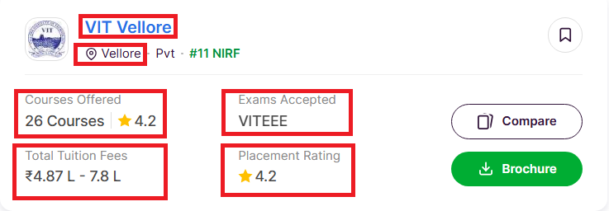
DATA COLLECTION
Web Scraping : Used Python libraries (BeautifulSoup, Requests, Regex) to extract data.
Website Source: url ="https://www.shiksha.com/engineering/colleges/b-tech-colleges-india"
Scraped Information: College Name, Location, Fees, Placements, Ratings, Exams, Courses.
Total Pages Scraped: ~200 pages covering 1500+ engineering colleges.

Slide 7
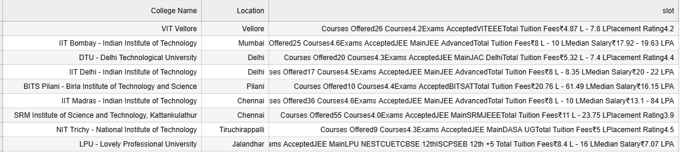

DATAFRAME AFTER SCAPING DATA FROM WEBISTE
OPERATION PERFORM ON DATAFRAME
Check duplicates data in dataframe
Remove duplicates data
Check the null values
Extract data from column slot column using regural expression

Slide 8
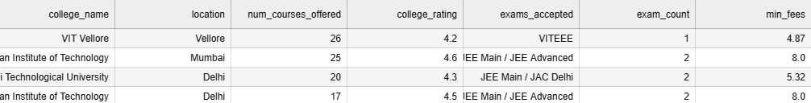
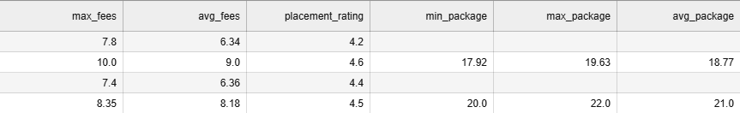
DATA AFTER WEB SCAPING
DATA AFTER SCAPING

Slide 9
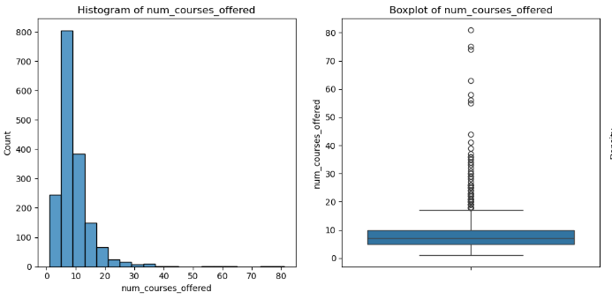
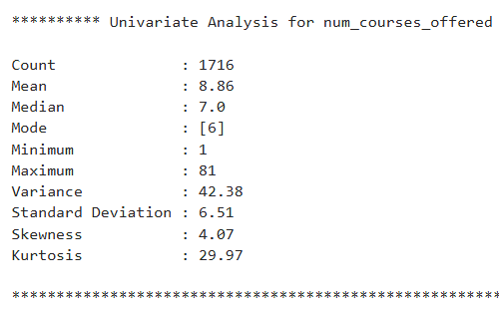
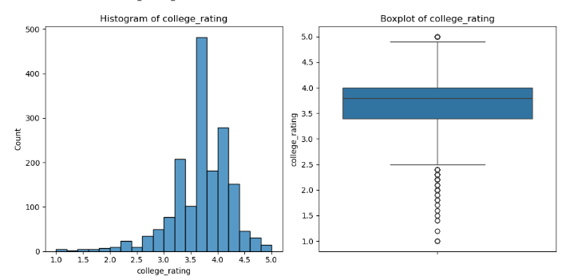
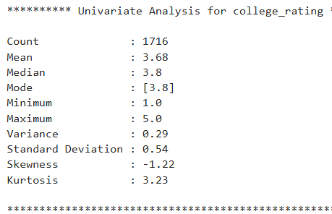
Univariate Analysis on numerical columns

Slide 10
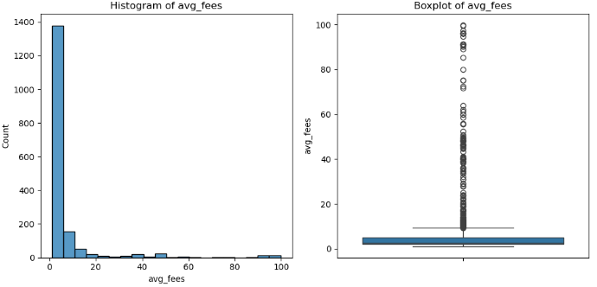
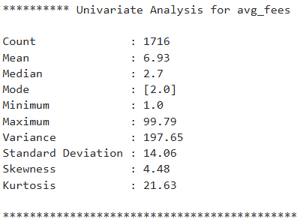
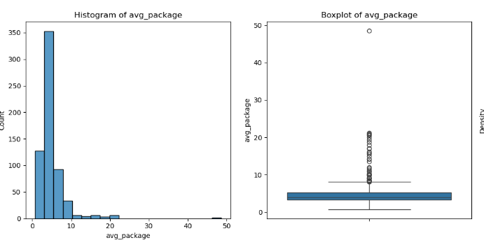
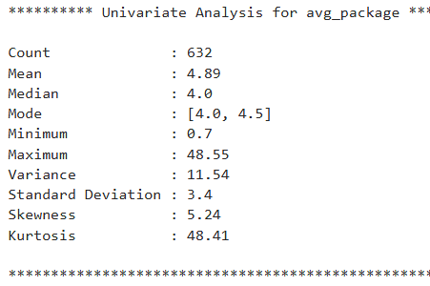

Slide 11
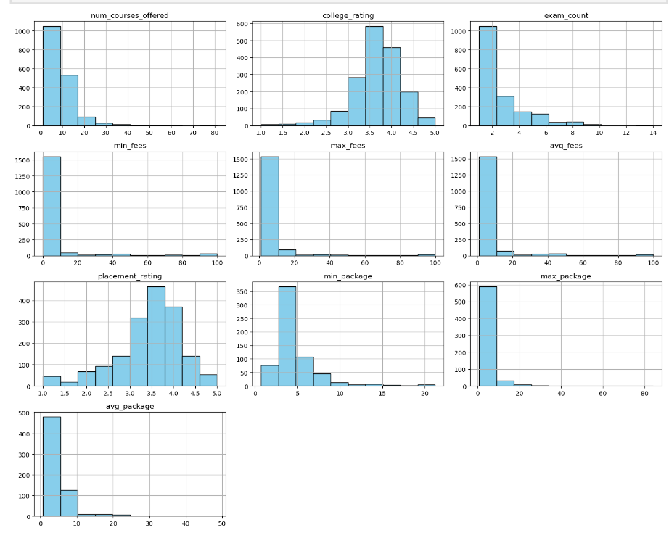
PLOT HISTOGRAMS FOR NUMERICAL COLUMN

Slide 12
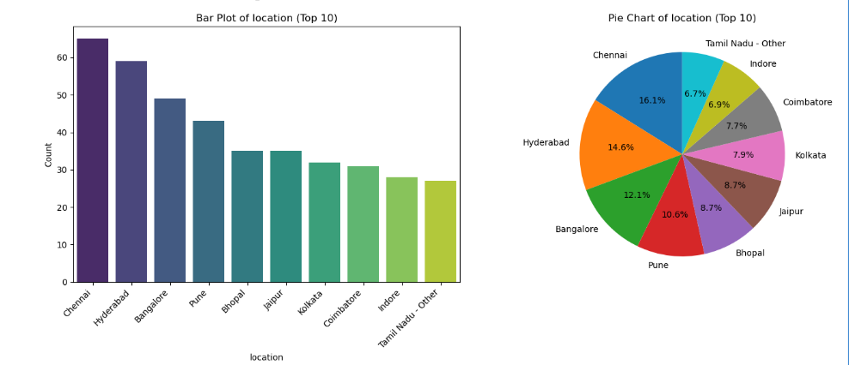
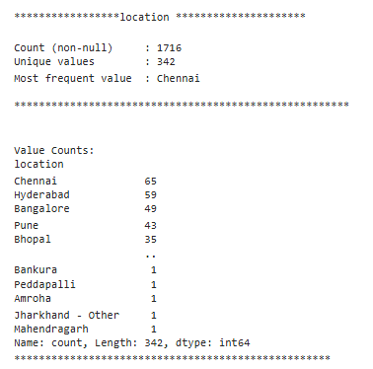
UNIVARIATE ANALYSIS ON CATEGORICAL COLUMNS
Chennai, Hyderabad, and Bangalore have the highest number of colleges, while Indore and Tamil Nadu (Other) have the least.

Slide 13
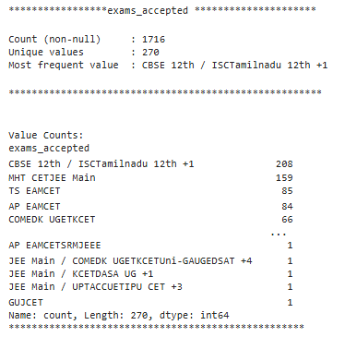
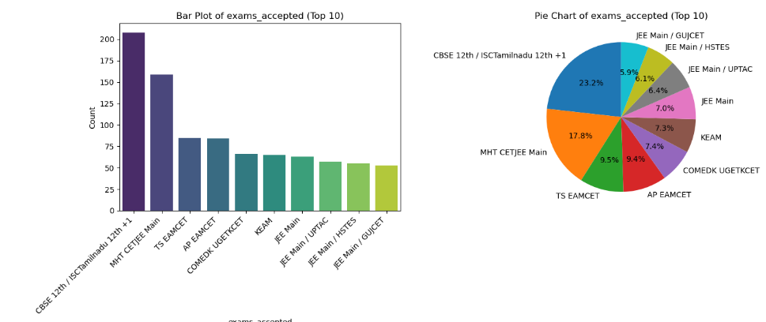
CBSE 12th / ISC and MHT CET/JEE Main are the most widely accepted exams, while GUJCET and HSTES are among the least accepted in the top 10.

Slide 14
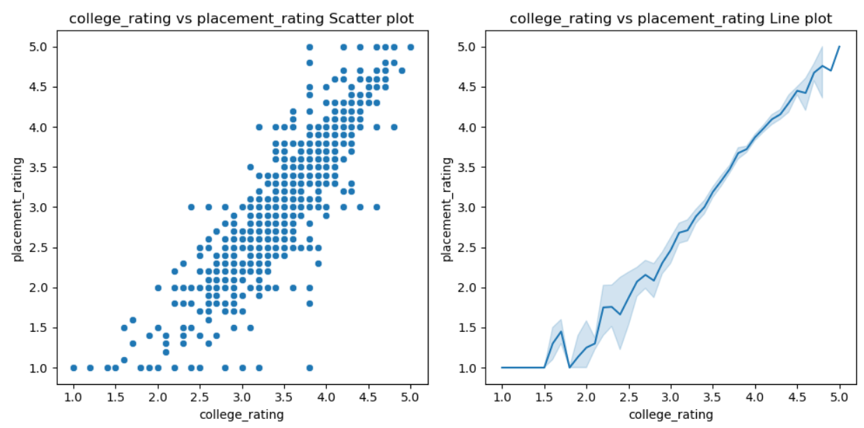
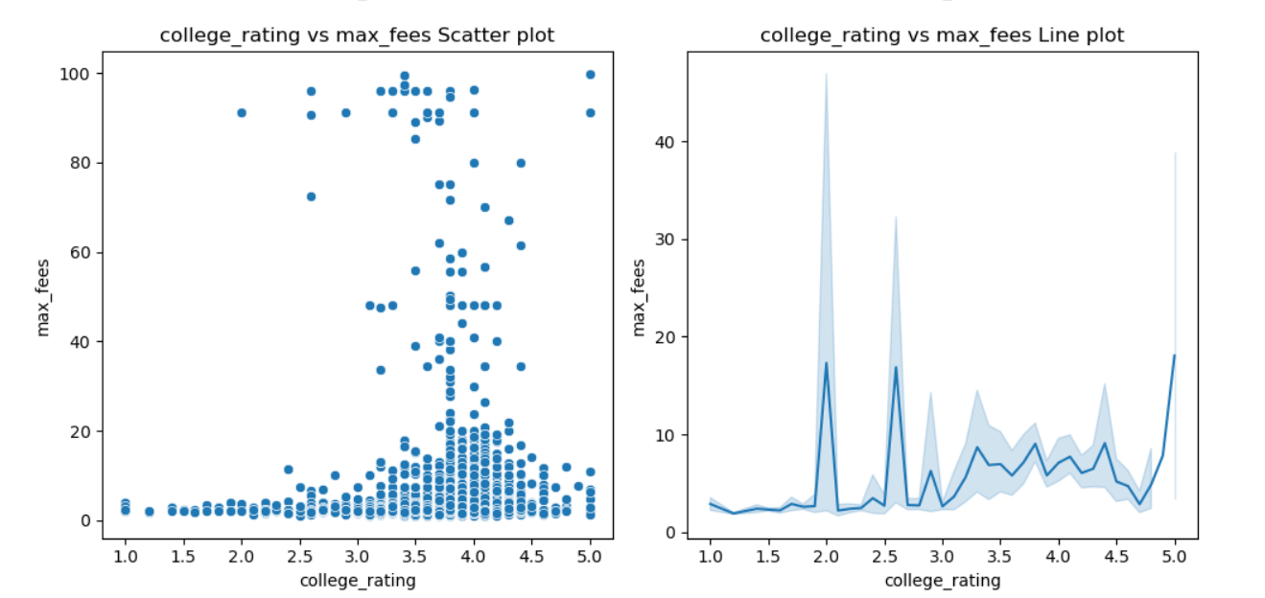
BIVARIATE ANALYSIS ON NUMERICAL VS NUMERICAL COLUMNS

Slide 15
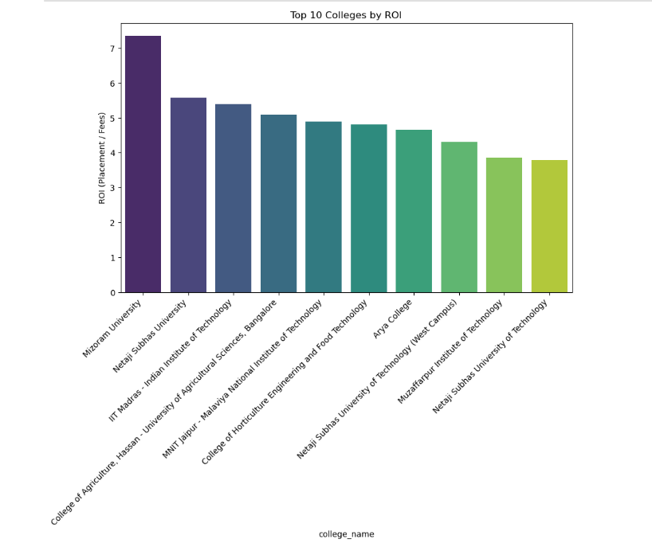
College ROI (Return on Investment) Finder
Observation
Mizoram University has the highest ROI.
Netaji Subhas University and IIT Madras also show strong returns.
Some lesser-known colleges (like Arya College, Muzaffarpur Institute of Technology) perform well → hidden gems for students.
ROI is not only about big names; affordable colleges also give great value.

Slide 16
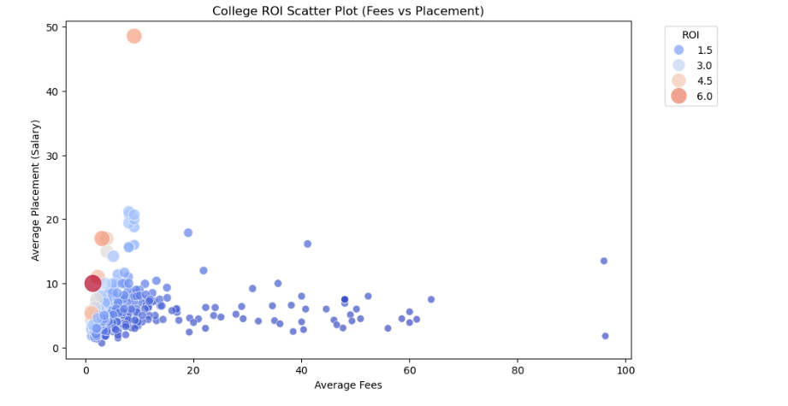
Observation
Most colleges cluster around low to moderate fees (0–20L) with average placements (2–10L).
A few collegs show exceptionally high placements (up to 48L) even with low fees → very high ROI.
Colleges with very high fees (>50L) do not always guarantee high placement → lower ROI.

Slide 17
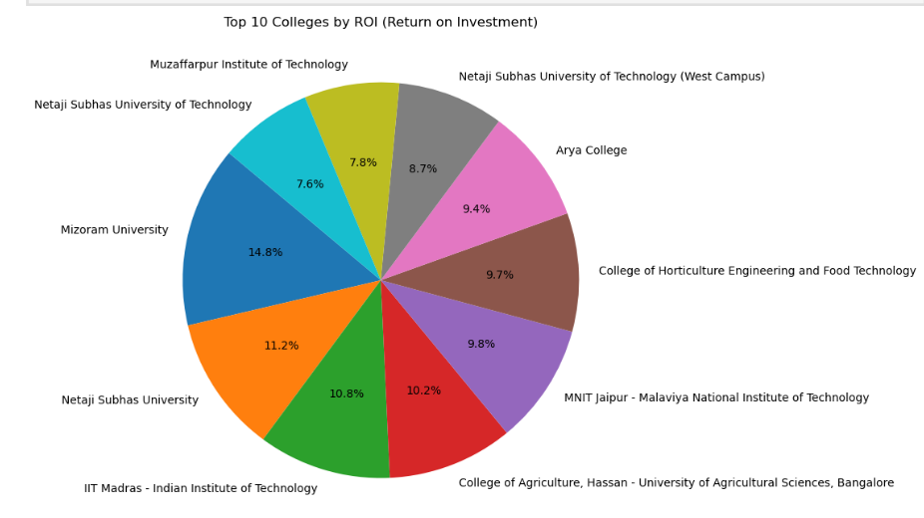
Observation
Mizoram University has the highest ROI among top colleges (14.8%).
Other top ROI colleges include Netaji Subhas University (11.2%), IIT Madras (10.8%), and MNIT Jaipur (9.8%).
The top 10 colleges show a balanced distribuion of ROI, with each contributing significantly.

Slide 18
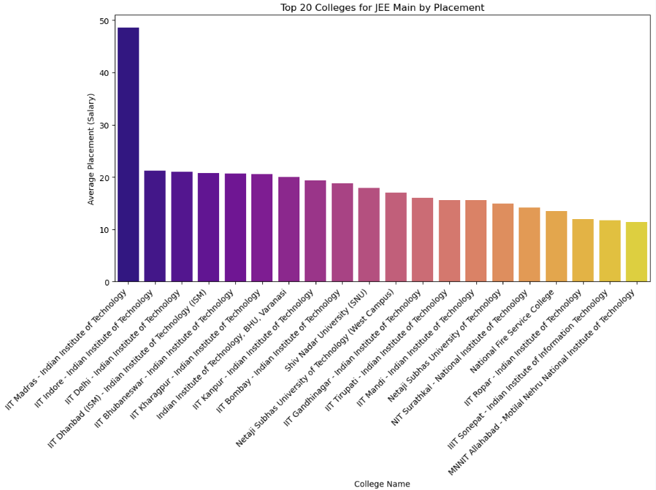
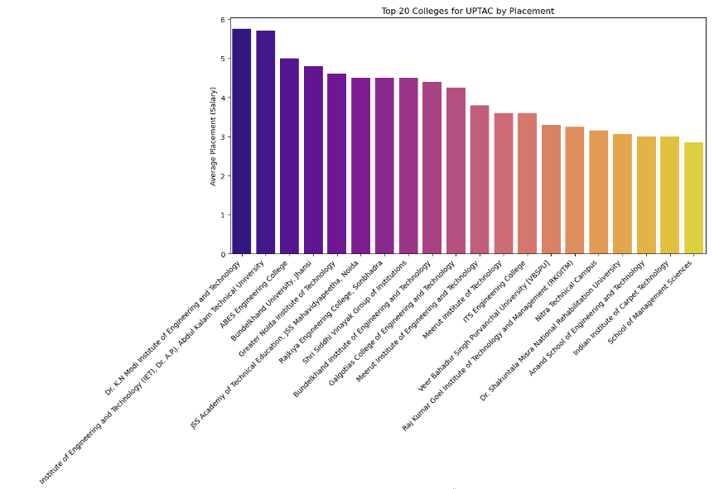
2. Best College for a Specific Entrance Exam

Slide 19
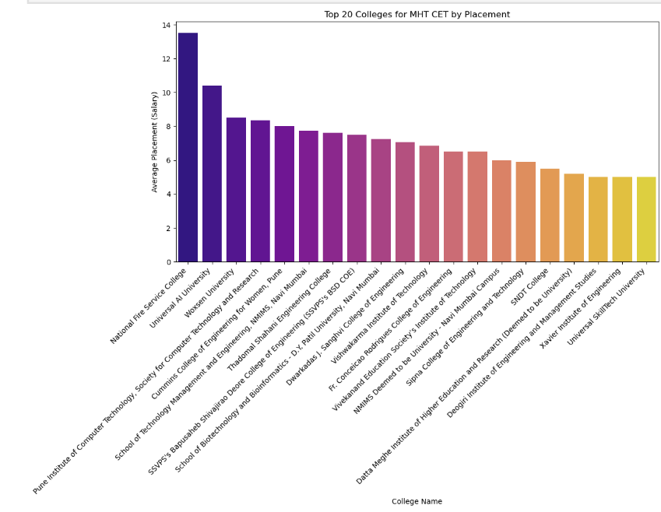
These three graphs show the Top 20 Colleges based on their average placement packages for the entrance exams JEE Main, MHT-CET, and UPTAC.

Slide 20
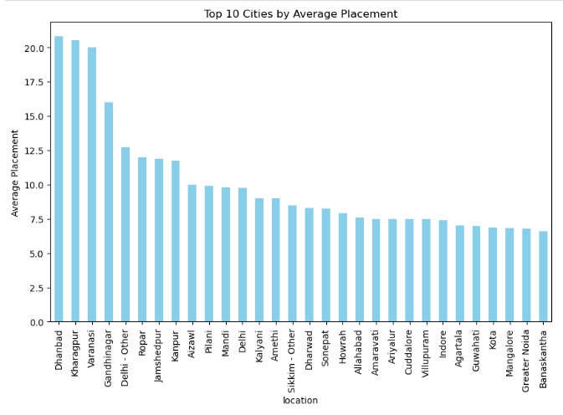
CITY WISE COMPARISON

Slide 21
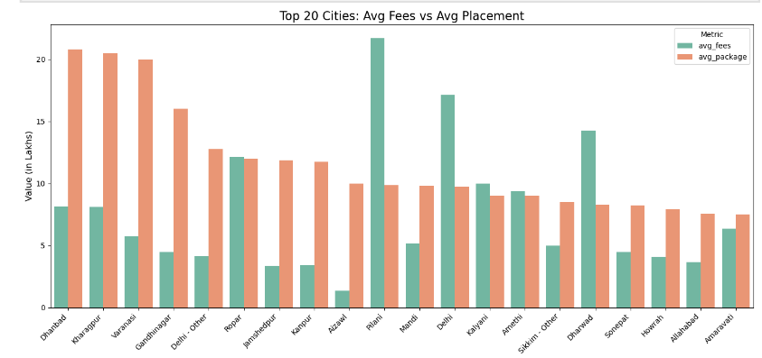

Slide 22
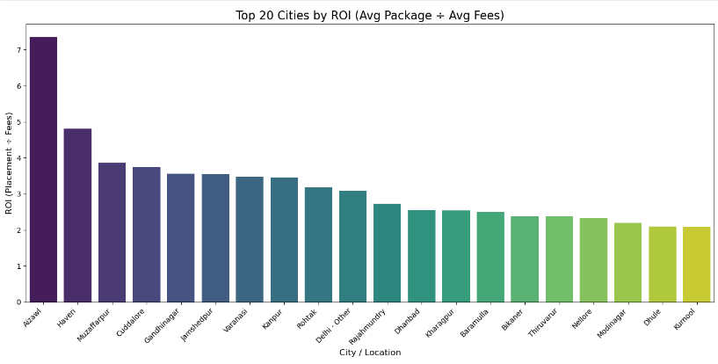

Slide 23
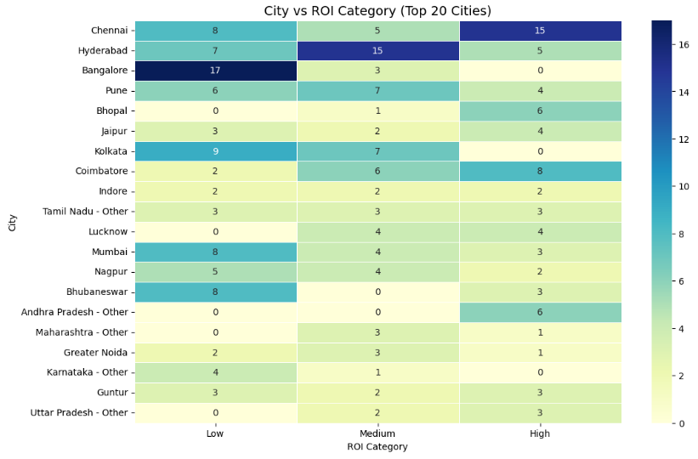

Slide 24
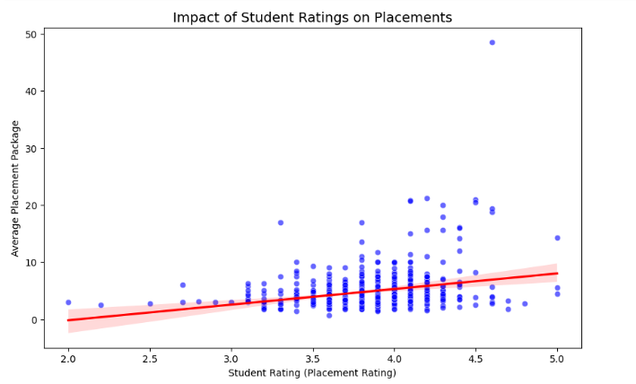
IMPACT OF RATINGS ON PLACEMENTS

Slide 25
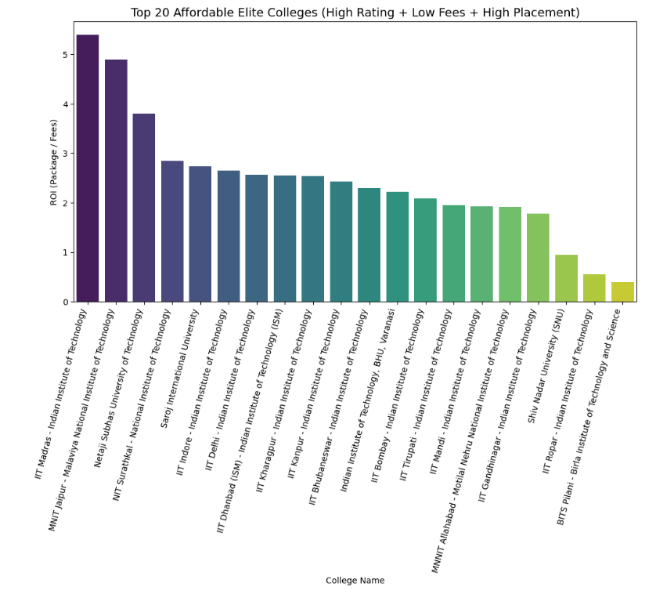
TOP 20 AFFORDABLE ELITE COLLEGES

Slide 26
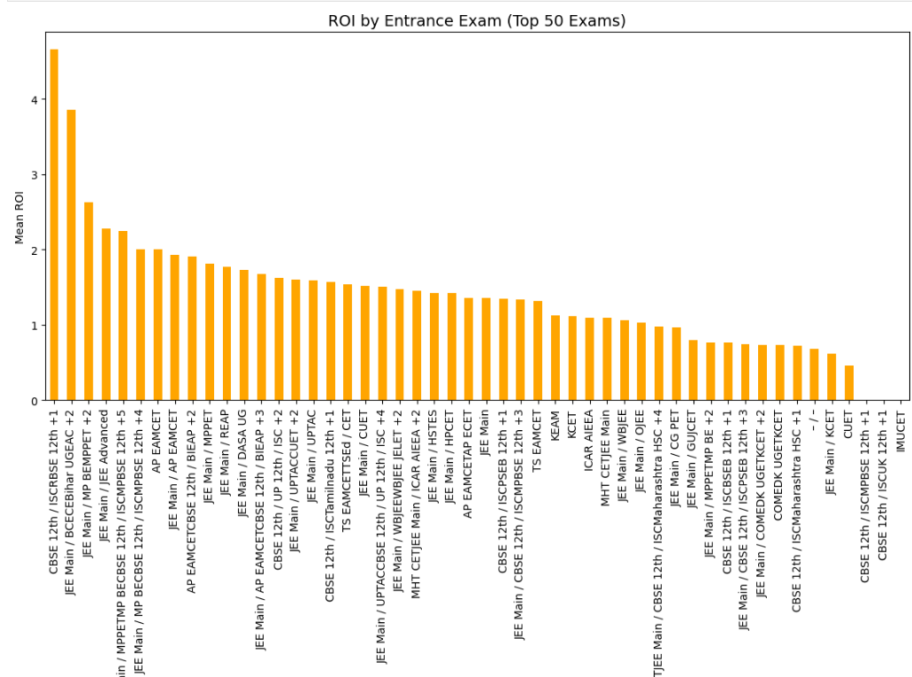
BEST EXAM TO GET GOOD COLLEGE

Slide 27
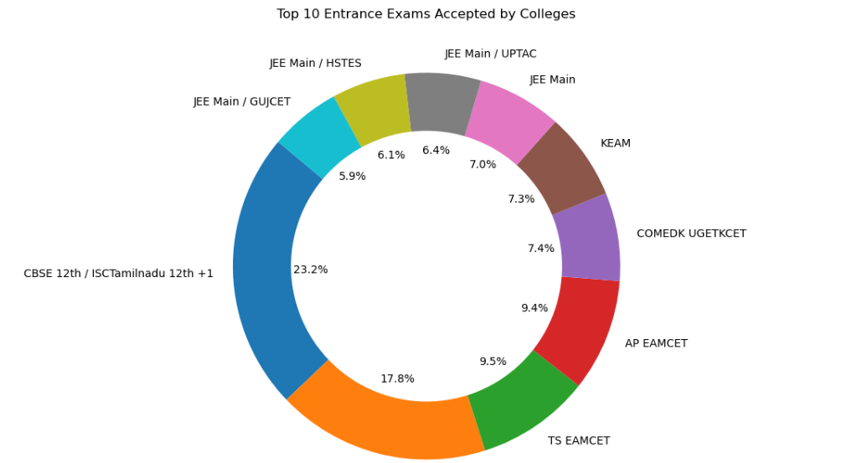
TOP EXAM TO GET GOOD COLLEGE

Slide 28

CONCLUSION
In this project, we analyzed college data to help students make better decisions while choosing the right college. The study highlighted the importance of ROI by comparing average fees with placement packages, identified top entrance exams, and revealed affordable colleges that still provide good placement opportunities.

Slide 29


Thank you !

