Slide 1
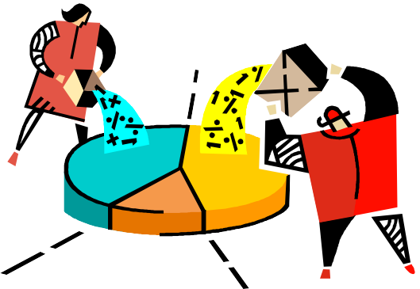





Collecting Data

Slide 2
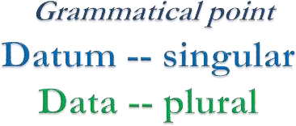
DATA
A dictionary defines data as facts or figures from which conclusions may be drawn.
A collective recording of observations either numerical or otherwise is called data

Slide 3
Statistics is a tool for converting data
into
Statistics
informati
on
Information
Data
But where then does data come from ?
How is it gathered ?
How do we ensure its accurate ?
Is the data reliable?
Is it representative of the population from which it was drawn?
5.3

Slide 4
Methods of Collecting Data
Direct Observation
Experiments, and
Surveys.

Slide 5
Methods
Mailing paper questionnaires to respondents, who fill them out and mail them back
Having interviewers call to respondents on the telephone and ask them the question in a telephone interview
Sending the interviewers to the respondent’s home or office to administer the questions in face-to-face interviews

Slide 6
Depending upon the nature
of the variable data is classified into 2
broad categories
Qualitative Data
Quantitative Data:-
discrete
continuous

Slide 7
Qualitative data :-
(characterized by words)
when the data is collected on the basis of attributes or qualities like sex, malocclusions, cavity etc.

Slide 8
Quantitative data :- (characterized by numbers)
when the data is collected through measurement, like arch length, fluoride concentration etc.
Discrete data :-
when the variable under observation takes only fixed values like whole numbers.
Continuous data :-
if the variable can take any value in a given range, decimal or fractional.

Slide 9

Quantitative: numbers | breadth | generalizability
Qualitative: words | depth | specific
Remember, "Not everything that counts can be counted."

Slide 10


Quantitative methods – Qualitative methods
Quantitative | Qualitative
Surveys Questionnaires | Focus groups
Tests | Unstructured interviews
Existing databases | Unstructured observations

Slide 11
Common data collection methods
Survey
Case study
Interview
Observation
Group assessment
Expert or peer reviews
Portfolio reviews
Testimonials
Tests
Photographs, videotapes, slides
Diaries, journals, logs
Document review and analysis

Slide 12
Are the data reliable and valid?
Validity:
Are you measuring what you think you are measuring?
Reliability:
if something was measured again using the
same instrument, would it produce the same (or nearly the same) results?

Slide 13
The main sources of data are :-
surveys
experiments
records in OPD
Data can be collected through either :-
primary source
secondary source

Slide 14
Primary Source :-
Here the data is obtained by the investigator himself. This is a first hand information.
Advantages :-
Precise information and reliable.
Disadvantages :-
Time consuming, expensive.
Primary data can be obtained using :-
Direct personal
Oral health examination
Questionnaire method

Slide 15
Secondary Source :-
The data already recorded is utilized to serve the purpose of the objectives of study.
Ex:- The records of opd of the dental clinics.

Slide 16
Data Gathering Techniques
Observation
Questioning

Slide 17
Data domains
Cognitive -- paper and pencil
Affective -- interview Psychomotor -- observation

Slide 18
Data Presentation
The objective of classification of data is to make the data simple, concise, meaningful and interesting and helpful in further analysis.

Slide 19
There are 2 methods of presenting data:-
Tabulation
Diagrams

Slide 20
Tabulation :-
Is the first step before the data is used for analysis or interpretation.
In the process of tabulation the following type of classification are encountered.
Geographical i.e area wise
Chronological i.e on the basis of time
Qualitative i.e. according to attribute
Quantitative i.e. in terms of magnitude

Slide 21
TABLE FORMAT :
Number of Primary Health Centres in India at 5-year Intervals during 1970-1990
YEAR | No.of PHCs
1970 | 5015
1975 | 5293
1980 | 5484
1985 | 7284
1990 | 18,981

Slide 22
Classification by Space :-
Data are classified by location of occurrence
Arrangement of set of categories in alphabetical order of the terms defining these categories,
In the order of their geographical location may be found to be suitable in many cases.

Slide 23
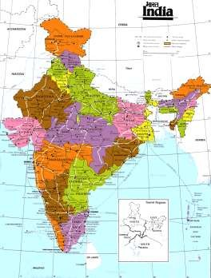
Table 2
Number of Literates in Rural and Urban Areas in India (state wise list).
STATES | No.of literates ( in thousands)
 | RURAL | URBAN
Andhra Pradesh | 14,821 | 10,119
Assam | 7921 | 1709
Bihar | 20,358 | 6485
Maharastra | 22,164 | 20,774
Gujarat | 12,096 | 9179
Kerala | 16,443 | 6228
Madhya Pradesh | 14,464 | 9027
Tamil Nadu | 17,424 | 12,958
Karnataka | 12,267 | 8812
Orissa | 10,303 | 2608
Punjab | 6253 | 3699
Rajastan | 8189 | 5428
Uttar Pradesh | 33,079 | 13,968
West Bengal | 20,337 | 12,382
TOTAL | 216,119 | 123,376

Slide 24
Chronological i.e. On the basis of time :-
In this case data are classified by time of occurrence of the observations
Arrangement of categories is almost always in chronological order

Slide 25
Number of Primary Health Centres in India at 5-year Intervals during 1970-1990
Table 3
YEAR | No.of PHCs
1970 | 5015
1975 | 5293
1980 | 5484
1985 | 7284
1990 | 18,981

Slide 26
Classification by attribute :-
When the data represent observations made on a qualitative characteristic the classification in such a case is made according to this qualities.
Alphabetical arrangement of categories may be suitable for general purpose table
In the case of special purpose table arrangement may be made in the order of importance of these categories

Slide 27
Table 4
Patients who attended Leprosy Clinics during 1993
Type of leprosy | No. of patients
Tuberculoid | 604
Lepromatous | 272
Indeterminate | 72
Borderline | 48
TOTAL | 996

Slide 28
Classification by the size of observations :-
when the data represent observations of some characteristic on a numerical scale, classification is made on the basis of the individual observations.
The range of observations is suitable divided into smaller divisions called class intervals.
The numerical scale adopted may be either discrete or continuous.

Slide 29
Table 5
Distribution of Single Live Born with respect to Birth Weight
Birth Weight (grams) | No.of children (n)
< 1500 | 24
1500 - 1999 | 60
2000 - 2499 | 422
2500 and above | 3202
TOTAL | 3708

Slide 30
Principles (in tabulation of data) :-
Every table should contain a title, should be concise and meaningful.
The tables should be numbered
The heading of columns or rows should be clear and concise .eg: ht in cm, age in years , wt in kg etc
The number of class intervals should be sufficient to condense the data bringing out their significant features .
The class intervals should be at equal width

Slide 31
Uniform size class intervals are preferable
Sometimes open end class intervals are used
The class intervals should be clearly defined to avoid ambiguity .eg- 0-4, 5-9, 10-14 etc.
Units of measurements should be specified.
If the data is not original , the source of the data should be mentioned at the bottom of the table.
Groups should be tabulated in ascending or descending order.

Slide 32
If certain data is omitted or excluded deliberately, the reason for same should be given.
For many arithmetic calculations the midpoint of each class interval will be used as a representative of each item in that interval.
The interval should be so chosen that the mid point of each interval is approximately the average of the items in that interval.
It will be convenient if mid points and limits are whole numbers.

Slide 33
16. The class intervals should be same through out table except in case of age
0-<1 (infant up to 1yr)
1-4 (toddlers 1to 5yrs but not completed 5 yrs)
5-14 ( School children < 15yrs)

Slide 34
Presentation by Graphs and Diagrams:-
Diagrams and graphs are extremely useful because
They are attractive to the eyes
Give a birds eye view of the entire data
Have a lasting impression on the mind of the layman
Facilitate comparison of data.

Slide 35
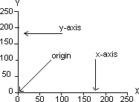
Basic rules in the construction
of diagrams and graphs :-
Every diagram must be given a title
It should be simple
The vertical axis is always labeled as the ‘y’ axis. It is also “ordinate”.
The horizontal axis is always labeled as ‘x’ axis . It is also called “abscissa”.
The x axis and y axis meet at right angles at a point called origin (o)
The values of variables are presented on the x axis and the frequency on y axis

Slide 36
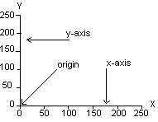
The number of lines drawn in any graph should not be many so that the diagram does not look clumpsy.
The scale of presentation for the x axis and y axis should be mentioned at the right hand corner of the graph
The scale of division of two axis should be proportional and the division should be mark along with the details of the variables and frequencies presented on the axis.

Slide 37
1. Histogram
Presentation of quantitative data is through graphs, the common graphs in use are:-
Frequency polygon
Frequency curve
Line graph
Scatter or dot diagram

Slide 38
1. Bar diagram
Presentation of qualitative data is through diagrams, the common diagrams in use are:-
Pie/sector diagram
Pictogram or picture diagram
Map diagram or spot map

Slide 39
Line diagram:
This diagram is useful to study changes of values in the variable overtime.
Simplest type of diagram.
On the X axis the time such as hours, days, weeks, months or years are represented.
The value of any quantity pertaining to this is represented along the Y axis.
OP
500
450
400
350
300
250
200
150
100
50
0
467
NO OF OUT-PATIENT
380
400
402
367
354
380
300
346
250
265
289
Jan-06
Feb-06
Mar-06
Apr-06
May-06
Jun-06
Jul-06
Aug-06
Sep-06
Oct-06
Nov-06
Dec-06

Slide 40
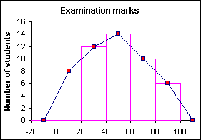
Frequency polygon:
1. The most commonly used graphic device to illustrate statistical distribution.
2. Used to
represent distribution
frequency
of quantitative data.
3. Useful to compare 2 or more frequency distributions.

Slide 41
A frequency polygon is a variation of a histogram, in which the bars are replaced by lines connecting the midpoints of the tops of the bars.
Advocates of the frequency polygon argue that the purpose of a histogram is to show the shape of the data distribution and removing the bars makes the shape clearer and smoother.

Slide 42
1. To draw a frequency polygon, A point is marked in the midpoint of the class interval, corresponding to the frequency.
Construction of frequency polygon:
Then these points are connected by straight lines.
The first point and last point are joined to the midpoint of previous and next class respectively.
Rather than leaving the graph suspended in space , we assume that there is another interval above and below which is having frequency of 0 .
5. so the
midpoint of group are assume having
frequency of 0.the group is now allowed to meet x- axis on both the ends.

Slide 43
Advantages of frequency polygon:
It is very easy to construct and very easy to interpret.
It is useful in portraying more distributions on the same graph
than two paper with
different colors. So it is very useful to compare 2 or more than 2 distributions.

Slide 44

Frequency curve:-
When the number of observations are very large and groups are more (ie; small class intervals) the frequency polygon tends to loose its angulation and it forms a smooth curve known as frequency curve.

Slide 45
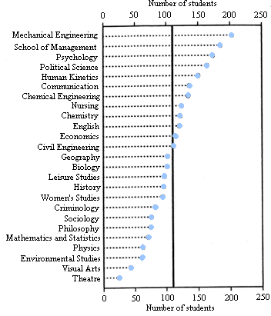
Scatter diagram or dot diagram:
It is a graphic presentation of data.
It is used to show the nature of co- relation between 2 variables

Slide 46
Bar diagram
This diagram is used to represent qualitative data.
It represent only one variable.
The width of the bar remains the same and only the length varies according to the frequency in each category.
There are 3 types of bars:
simple bar
multiple bar
component bar diagram

Slide 47
Simple bar:
The limitation of this method is that they can represent only on the classification and hence cannot be used for comparison
500
467
OP
450
400
380
400
402
380
346
367
354
350
300
250
200
150
100
50
0
NO OF OUT-PATIENT
300
289
250
265
Jan-06
Feb-06
Mar-06
Apr-06
May-06
Jun-06
Jul-06
Aug-06
Sep-06
Oct-06
Nov-06
Dec-06

Slide 48
Multiple bar:
This diagram is used to compare qualitative data with respect to a single variable.
This diagram is similar to the bar diagram except that for each category of the variable we have a set of bars of the same width corresponding to the different section without any gap in between the width and the length corresponds to the frequency.
OP IP
500
467
450
400
350
300
250
200
150
100
50
0
400
402
380
367
380
346
354
NO OF PATIENT
300
289
250
265
154
120
102
86
67
90
70
78
60
45
59
48
Jan-06
Feb-06
Mar-06
Apr-06
May-06
Jun-06
Jul-06
Aug-06
Sep-06
Oct-06
Nov-06
Dec-06

Slide 49
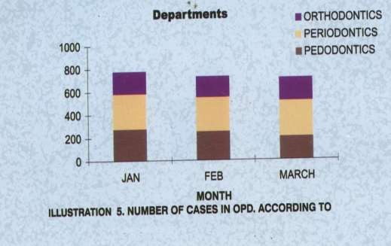
Component bar diagram:
This diagram is used to represent qualitative data.
It is desired to represent both the no of cases in major groups as well as the subgroups simultaneously

Slide 50
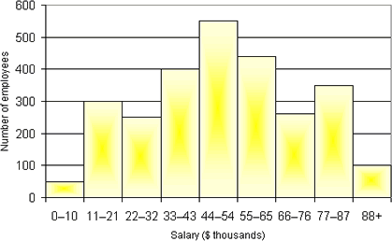
Histogram:
this diagram is used to
depict quantitative data
1. It is a
bar diagram without gap between
bars.
If we draw frequencies of each group or class intervals in the form of columns or rectangles such a diagram is called histogram.
It represents a frequency distribution.

Slide 51
The histogram is constructed as follows:
On the X axis the size of the observation is marked.
Starting from 0 the limit of each class interval is marked, the width corresponding to the width of the class interval in the frequency distribution.
On the Y axis the frequencies are marked
A rectangle is drawn above each class interval with height proportional to the frequency of that interval.

Slide 52
Advantages of Histogram:
Easy to understand
Disadvantages of Histogram:
Only 1 histogram can be placed at a time.
More time consuming to construct than a frequency polygon.

Slide 53
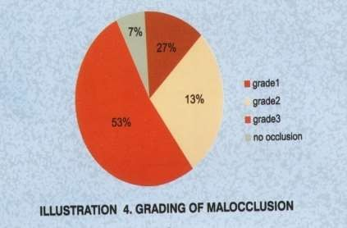
Pie diagram:
These are popularly used
to show percentage break downs for qualitative data.
It is so called because the
entire graph looks like a
pie and its components
represent slices cut from a pie.
A circle is divided into
different sectors
corresponding to the
frequencies of the distribution.
Some knowledge of circles and degrees is necessary

Slide 54
The total angle at the center of the circle is 360 degrees and it represents the total frequency.
After the calculation of angle, segments are drawn in the circle and the segments are shaded with different shades or colors and an index is provided for the shaded colors
Cannot be used to represent 2 or more data sets

Slide 55
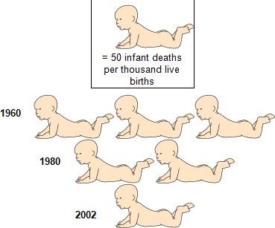
Pictogram
Display of data through pictograms was initiated by Dr Otto Neurath in 1923.
Data are displayed by the pictures of the items to which the data pertain.
A single picture represents a fixed no.
They are the least satisfactory type of diagrams.
They are inaccurate too.

Slide 56
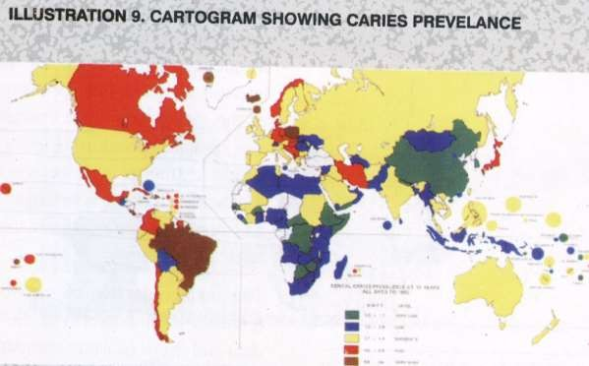
Map diagram or spot map or cartograms:
1. These maps are used to show geographical distribution of frequencies of a characteristics.

Slide 57
References
Kirkwood BR, Sterne JAC. Essentials in Medical Statistics. 2nd edition. Oxford: Blackwell; (2010).
Jay S. Kim And Ronald J. Dailey. Biostatistics For Oral Healthcare. Blackwell Publishing Company. 2008
C.R Kothari. Research Methodology methods and technologies. 2nd edition. New age international private ltd publishers; 2004. reprint 2007

