Slide 1
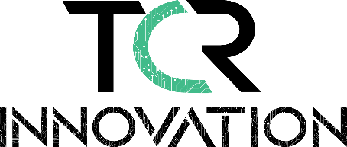
Date of Submission : 06-03-2023
Technical Coding Research Innovation, Navi Mumbai,
Maharashtra, India-410206
CLOUD COMPUTING USING AWS INTERNSHIP PROGRAM
By Kalpesh Pravin Pawar
Problem Statement :
Build out AWS service architecture for Enterprise retail store with below mentioned
assumptions:
1. 100+ store
2. Inventory Management
3. Analytics services to be run by the stores
Requirements :
Storage: Amazon S3
Networking: VPC
Server: Amazon EC2
Backup and Restore: Amazon S3 Glacier
Data Warehouse: AWS Redshift
API Service : AWS lambda
Load Balancing : Load Balancer

Slide 2
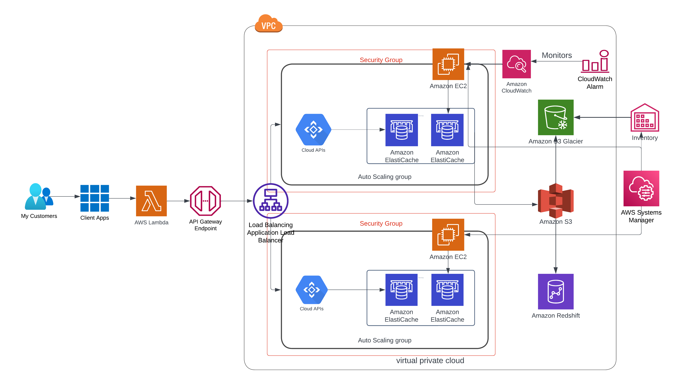
AWS Solution Architecture

Slide 3
ADVANTAGES OF COST OPTIMIZATION
Cost optimization enables the free flow of data through the optimal usage of network system resources.
Cost optimization tracks performance metrics, providing real-time reporting to help network managers proactively manage the network.
Cost optimization provides analytics and predictive modeling so that network managers can determine the impact any changes to the architecture will have on the network before they are implemented.
Focus on structural costs : Never block short term costs increase that would speed up the business, or enable a technical migration. Everyone is responsible to provide tooling to each team to make them autonomous on their cost optimization.
All these benefits add up to the most important benefit: driving greater cost optimization.

