Slide 1
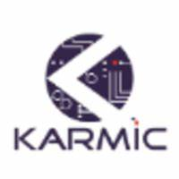
Software Development Life Cycle
Presented By:
Kalpesh H. Mali

Slide 2
Content…
Introduction of SDLC
Phase’s of SDLC.
FarmBeats Application.
Conclusion.

Slide 3
Introduction :

Slide 4
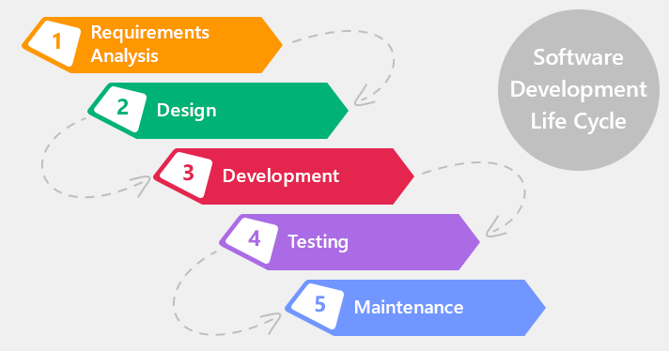
Phases of SDLC

Slide 5
Types of SDLC
Waterfall Model.
V Model
Prototype Model
Spiral Model
RAD Model: Rapid Application Development
Iterative and Incrementive Model
Agile Model.

Slide 6
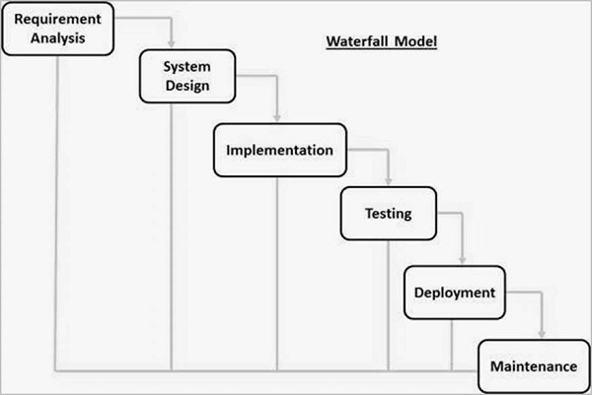
Waterfall Model

Slide 7
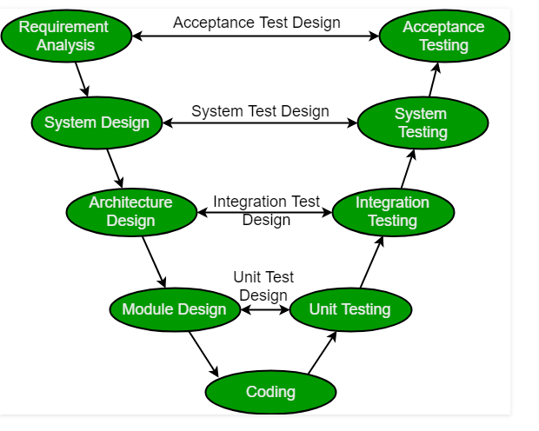
V Model

Slide 8
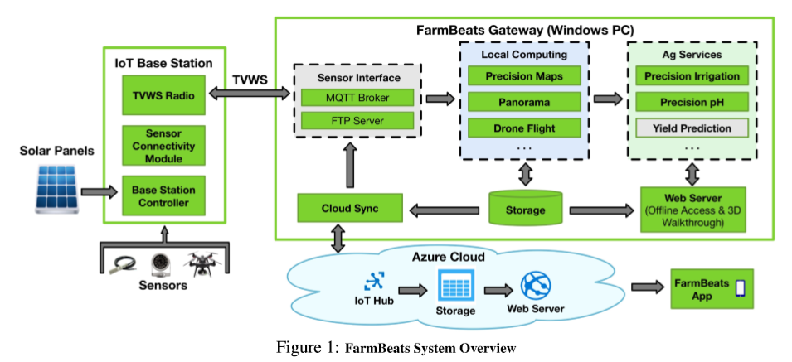
FarmBeats System Overview:

Slide 9
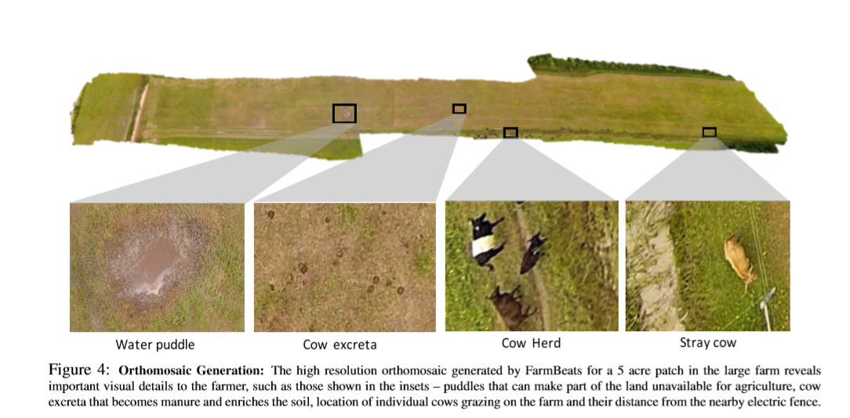

Slide 10
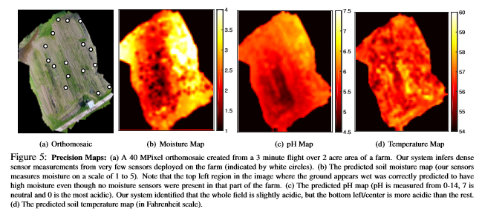

Slide 11
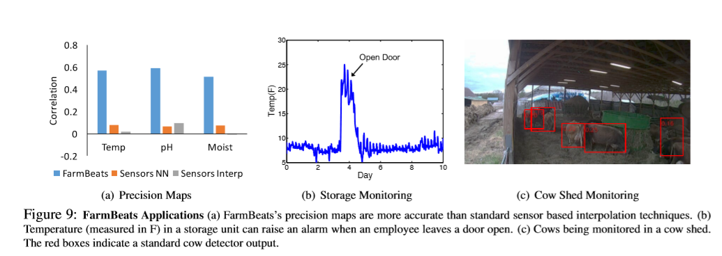
FarmBeats Application:

Slide 12
CONCLUSION:
FarmBeats is a low cost,highly available IoT platform for agriculture. It supports high bandwidth sensors using TVWS, which is a low-cost, long range technology. FarmBeats uses a weather aware solar powered IoT base station, and an intelligent Gateway that ensure that services are available in the Cloud and ofﬂine.

Slide 13
https://www.youtube.com/watch?v=KTvdjcU0lf8
https://www.youtube.com/watch?v=BCIohEJYxdY

Slide 14


