Slide 1
FarmBeats: An IoT Platform for Data-Driven Agriculture
Presented By:
Kalpesh H. Mali

Slide 2
Content…
Introduction
UAV Path Planning:
FarmBeats System Overview.
UAV Path Planning.
FarmBeats Application.
Conclusion.

Slide 3
Introduction :
March 27,2017
International Food Policy Research Institute, data-driven techniques can help ..
Drones can help farmers map their ﬁelds, monitor crop
Automating sensor required : Internet Connection.

Slide 4
FarmBeats ,an end-to-end IoT platform for data-driven agriculture, that enables seamless data collection from various sensor types, i.e., cameras, drones and soil sensors, with very different bandwidth constraints.
FarmBeats to enable three applications for the farmer: precision agriculture, monitoring temperature and humidity in food storage, and monitoring animalshelters.

Slide 5
Connection of Sensor to Farmer Home Internet used unlicensed TV White Spaces. Sensors, cameras and drones can connect to this base station over a Wi-Fi fron to end.
Base station is powered by battery-backed solar power
FarmBeats uses a novel weather-aware IoT base station design.

Slide 6
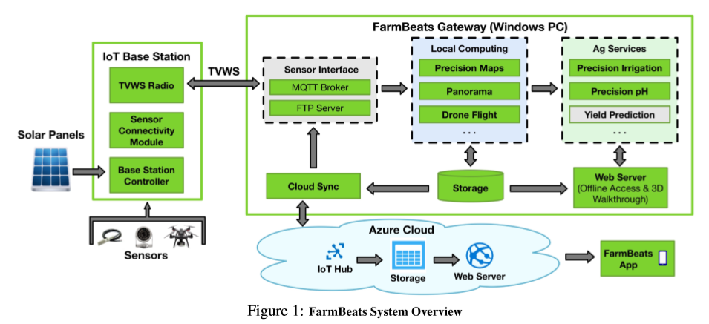
FarmBeats System Overview:

Slide 7
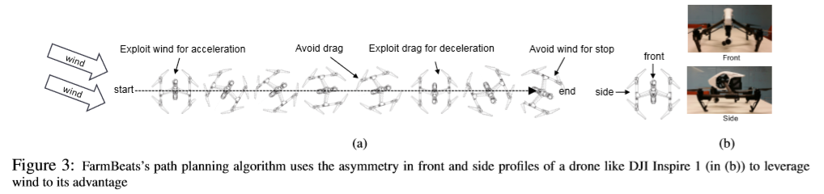
UAV Path Planning

Slide 8
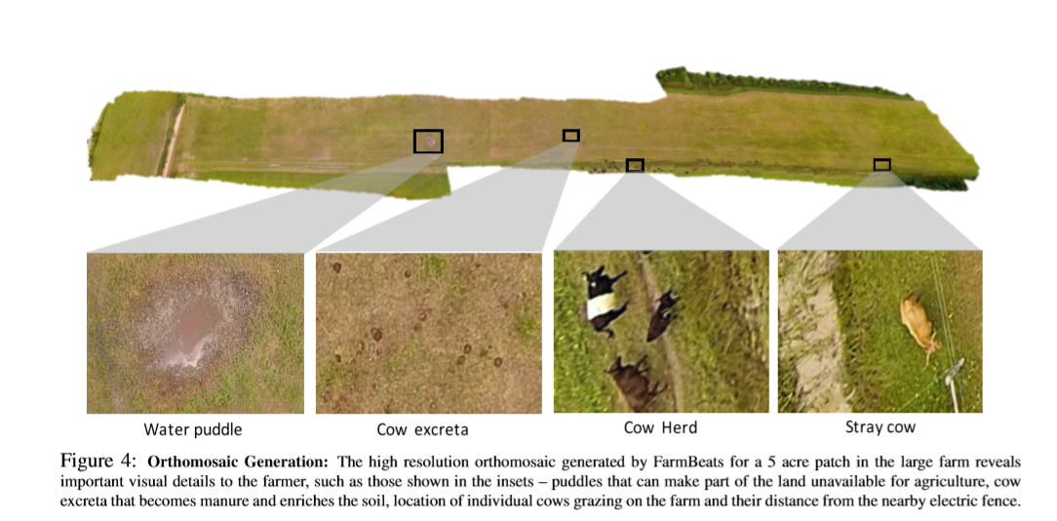

Slide 9
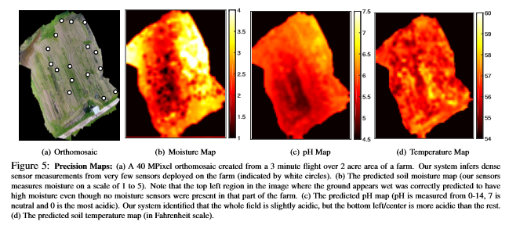

Slide 10
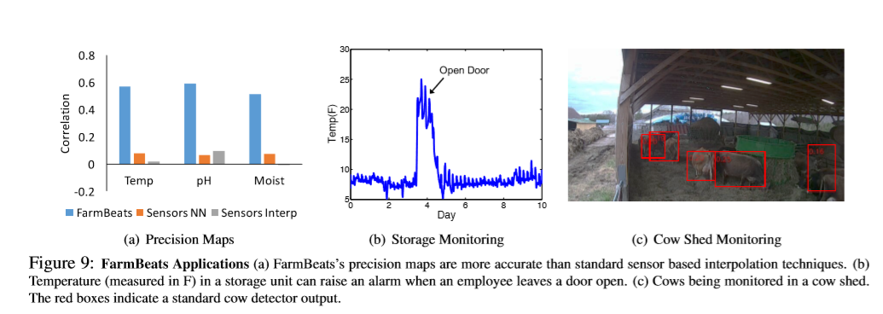
FarmBeats Application:

Slide 11
CONCLUSION:
FarmBeats is a low cost,highly available IoT platform for agriculture. It supports high bandwidth sensors using TVWS, which is a low-cost, long range technology. FarmBeats uses a weather aware solar powered IoT base station, and an intelligent Gateway that ensure that services are available in the Cloud and ofﬂine.

Slide 12
https://www.youtube.com/watch?v=KTvdjcU0lf8
https://www.youtube.com/watch?v=BCIohEJYxdY

Slide 13


