Slide 1
DevOps Life Cycle
CICD Pipeline

Slide 2
DevOps Lifecyle Tools

Slide 3
CICD Tools
1
Web Server
2
Docker Container
3
Git hub
4
Jenkins
5
Ansible

Slide 4
Web Server
How to host Web Site in IIS Server
Install IIS Server role in Windows 10 Server.
Copy Your Web Site to C:\inetpub\wwwroot\.
Create New Web Site in IIS Server.
Assign Path of Website where you Copy in Step 2.
Assign Port Address to your Website.
Start Your Website.
Check your Website running or not from Web Browser.
http://localhost

Slide 5
Task
Create/Download 5 Web Site.
Host all the 5 Website in IIS With Different port no as shown Below
http://localhost:5000
http://localhost:5001
http://localhost:5002
http://localhost:5003
http://localhost:5004

Slide 6
Install Web Server using Powershell
Set-ExecutionPolicy Bypass -Scope Process
Enable-WindowsOptionalFeature -Online -FeatureName IIS-WebServerRole,
IIS-WebServer, IIS-CommonHttpFeatures, IIS-HttpErrors, IIS-HttpRedirect,
IIS-ApplicationDevelopment, NetFx4Extended-ASPNET45m, IIS-NetFxExtensibility45,
IIS-WebServerManagementTools, IIS-IIS6ManagementCompatibility, IIS-Metabase,
IIS-ManagementConsole, IIS-BasicAuthentication, IIS-WindowsAuthentication,
IIS-StaticContent, IIS-DefaultDocument, IIS-WebSockets, IIS-ApplicationInit,
IIS-ISAPIExtensions, IIS-ISAPIFilter, IIS-HttpCompressionStatic, IIS-ASPNET45

Slide 7
Host Website Using Powershell
Import-Module -Name WebAdministration
Site-1
New-Item iis:\Sites\TestSite -bindings @{protocol="http";
bindingInformation=":5000:"} -physicalPath c:\test
Site-2
New-Item iis:\Sites\TestSite1 -bindings @{protocol="http";
bindingInformation=":5001:"} -physicalPath c:\test1
Site-3
New-Item iis:\Sites\TestSite2 -bindings @{protocol="http";
bindingInformation=":5003:"} -physicalPath c:\test2

Slide 8
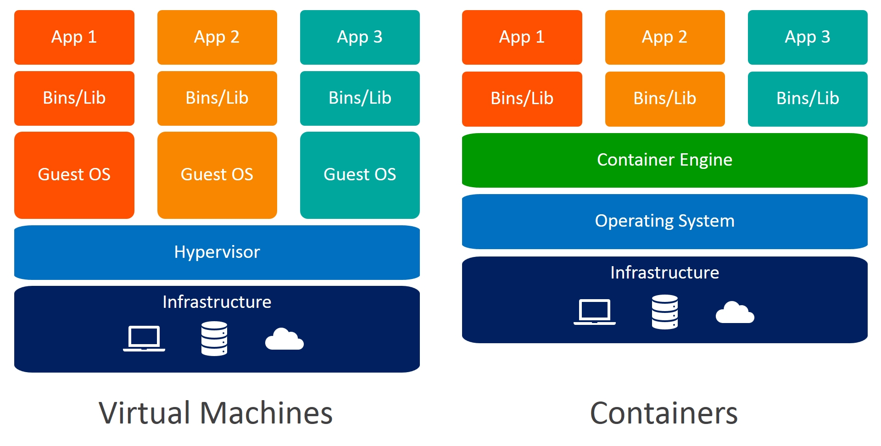
Docker
Docker is a set of platform as a service (PaaS) products that use OS-level virtualization to deliver software in packages called containers.

Slide 9
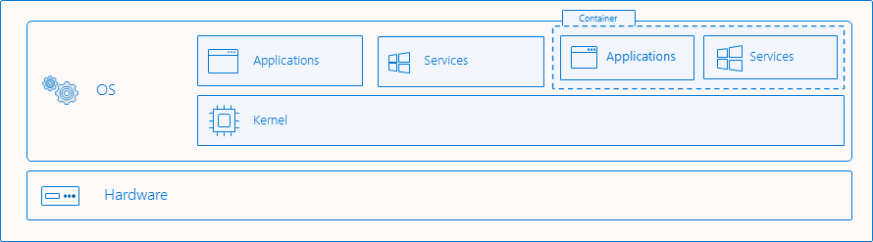
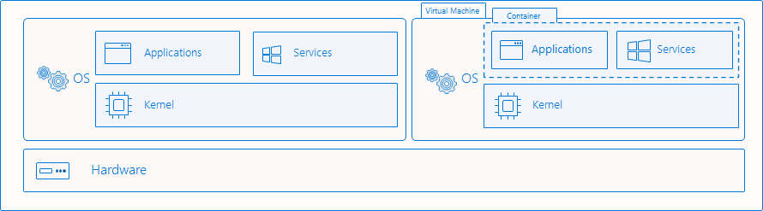
Docker Isolation Mode for Windows
Process Isolation
Hyper-V isolation

Slide 10
Docker Installation on Windows 10
Installation Process
Download Docker for Windows Setup file from Docker Site
URL: https://desktop.docker.com/win/stable/amd64/Docker%20Desktop%20Installer.exe
Download WSL 2 Packages to Support Linux Containers
URL: https://wslstorestorage.blob.core.windows.net/wslblob/wsl_update_x64.msi
Download IIS Manager for Remote Administration
URL: https://download.microsoft.com/download/2/4/3/24374C5F-95A3-41D5-B1DF-34D98FF610A3/inetmgr_amd64_en-US.msi

Slide 11
Pulling Docker Images for Windows
Find Windows Images
Explore Windows Images from Docker Hub
URL: https://hub.docker.com/search?q=&type=image
Pull IIS container image from Docker hub
docker pull mcr.microsoft.com/windows/servercore/iis
List Images
Docker Images

Slide 12
Run Container from Docker Images
Create Container from Images
Run Docker container from Powershell
docker run -d -p 15001:80 --name Server nanoserver/wamp
Display Running Docker
docker ps
Display All container (start/stop)
docker ps -a
Delete Container
docker rm <dockername/id>
Connect to running Container
docker exec –it <ContainerName> PowerShell

Slide 13
Other container Command
To copy file/Folder to container first Stop container then copy
docker stop <ContainerName>
docker cp c:\File or FolderName <ContanerName>:c:\
docker start <ContainerName>
Map Windows Directory Inside Container
docker run -it --name mywamp10 -v C:\test:c:\test
-p 5001:80 nanoserver/wamp powershell
Create Volume & run Container with Volume
docker volume ls //List Volume
docker Volume create <VolumeName>
Default Path= C:\ProgramData\Docker\volumes\
docker run -it --name mywamp10 --mount source=bhavin1,
target=c:\bhavin1 -p 5001:80 nanoserver/wamp powershell

Slide 14
Docker Monitor Tools
To inspect Details
docker inspect <ContainerName>
docker inspect <VolumeName>
Get IP Address of Existing Container
docker inspect -f "{{ .NetworkSettings.Networks.nat.IPAddress }}" mysql
Create Volume & run Container with Volume
docker volume ls //List Volume
docker Volume create <VolumeName>
Default Path= C:\ProgramData\Docker\volumes\
docker run -it --name mywamp10 --mount source=bhavin1,
target=c:\bhavin1 -p 5001:80 nanoserver/wamp powershell

Slide 15
Docker Network
To List Network
docker network ls
Get All network with ID
docker network ls --no-trunc
Remove Network that are not attach with container (unused)
docker network prune
Install Portainer to Manage Other Docker
docker run -d -p 9010:9000 --restart always -v
/var/run/docker.sock:/var/run/docker.sock
-v /data/portainer:/data --name Portainer portainer/portainer

Slide 16
Docker Network
Set Static IP Address to Windows Container
Connect to Existing Docker Container
Docker exec –it WindowsServer Powershell
Get Adapter Information
Set Static IP Address
New-NetIPAddress -InterfaceIndex 4 -IPAddress 172.16.12.240 -DefaultGateway 172.16.0.1 -PrefixLength 8
Set DNS IP Address
Set-DnsClientServerAddress -InterfaceIndex 4 -ServerAddresses 172.16.0.1,8.8.8.8

Slide 17
Enable IIS Remote Administration
Install Remote Administration tools on Host Machine
URL: https://download.microsoft.com/download/2/4/3/24374C5F-95A3-41D5-B1DF-34D98FF610A3/inetmgr_amd64_en-US.msi
Connect to iis container to Set Administrator Password
docker exec –it <ContainerName> powershell
Net User Administrator Pr0ject
Connect IIS Docker to Host IIS Manager

Slide 18
TASK
Task1 (Must Attach volume at C:\Website inside Container)
Pull Microsoft iis Image from docker hub
Map host Port 15000:15005 to Container 15000:15005 Port
Create/download 5 Website inside Container
Check All the Website from Another PC of Lab
Task2
Create two container as below
IIS
Wamp
Create small Database & table in Wamp container
Create Web Page & host at IIS Container that display data from Wamp
container

Slide 19
Git & GitHub
Centralized version control System/Source Code Management
Git Developed by linus Torvald in 2005.
Before 2005 Linus used Third party CVCS called Bitkeeper.
Git is software. Git Repository

Slide 20
Git Push
To know Git version
Git --version
Configure git
Git config –global user.name “kalpesh”
Git config –global user.email kalpeshpatel.ce@charusat.ac.in
To Verify Git config
Git config –list
Initiate git first create directory go inside directory using cd
Mkdir c:\Project1
Cd c:\Project1
Git init
Git status
To add content to staging area
Git add .
Git status
To Commit Code to Storage
Git commit -m “My first Commit”
Git status
To Check Log
Git log
To see commit Details
Git show <CommitID>
To configure Remote GitHub Repository
Git remote add origin <GitHub URL>
Push code To GitHub
Git push -u origin master

Slide 21
Git Pull
Initiate git first create directory go inside directory using cd
Mkdir c:\Project1
Cd c:\Project1
Git init
Git status
To configure Remote GitHub Repository
Git remove add origin <GitHub URL>
Pull code To GitHub
Git pull origin master
To Check Log
Git log
To see commit Details
Git show <Commit ID>

Slide 22
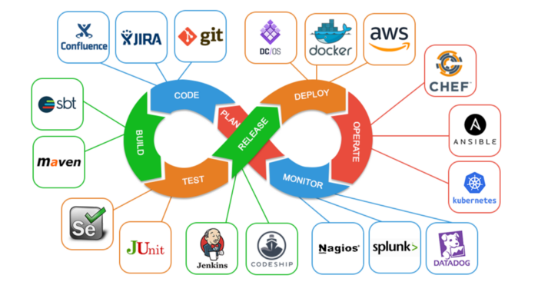
Jenkins

Slide 23

Jenkins
Continuous Integration Tools

Slide 24
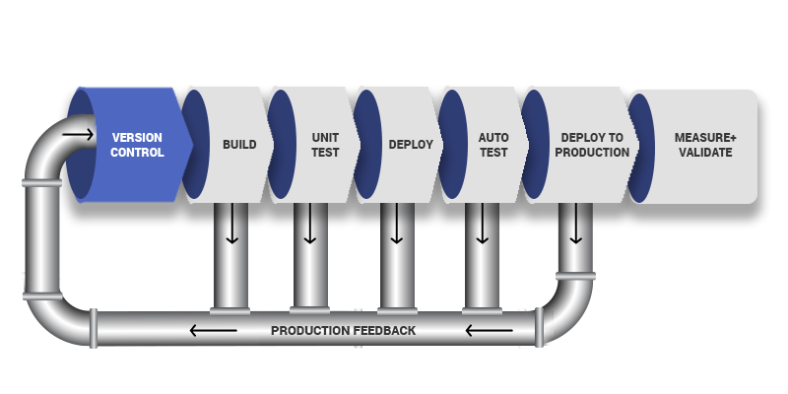
What is CICD Pipeline
PLAN
CODE
Build
Test
Deploy
Operate
Monitor

Slide 25
What is Jenkins
Jenkins is the leading open source continuous Integration Tool
that written in JAVA run on Windows, Linux & MacOS.
It is free & community supported.
Jenkins was originally developed as Hudson project.
Hudson project is started in summer of 2004 at sun micro system.
In January 2011 change the project name Hudson to Jenkins.
Jenkins automate the entire software Development Life Cycle (SLDC).
Jenkins builds and tests our software continuously and monitor the
execution and status of remote jobs, making it easier for team members
and users to Regularly obtain the latest stable code.
Jenkins is just framework, it achieves Continuous integration by
the help of plugins. It support over 1000 plugins.

Slide 26
What is Jenkins
Demo

