Slide 1
Capturing and Detecting Relevant Mobile Moments
Context Intelligence For Mobile
Akhil Garg, IIT Kanpur
Kalpesh Patil, IIT Bombay
Keerthana Shanmugam, IIT Madras
Sanket Mehta, Adobe Research Lab

Slide 2
Problem Statement Revisited
“ Information used to characterize situation of an entity ”
Entity – person/place/object relevant to the interaction
How to model the real time behavior of customers in m-commerce scenario & what are those relevant purchase moments(context + intent) which marketers should focus on?

Slide 3
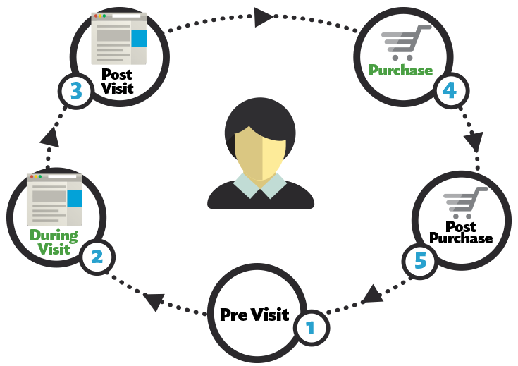

Problem Statement Revisited
Sub Problem 1:
How do we segment the customer-app interaction into sub-sessions for real time modelling?

Slide 4
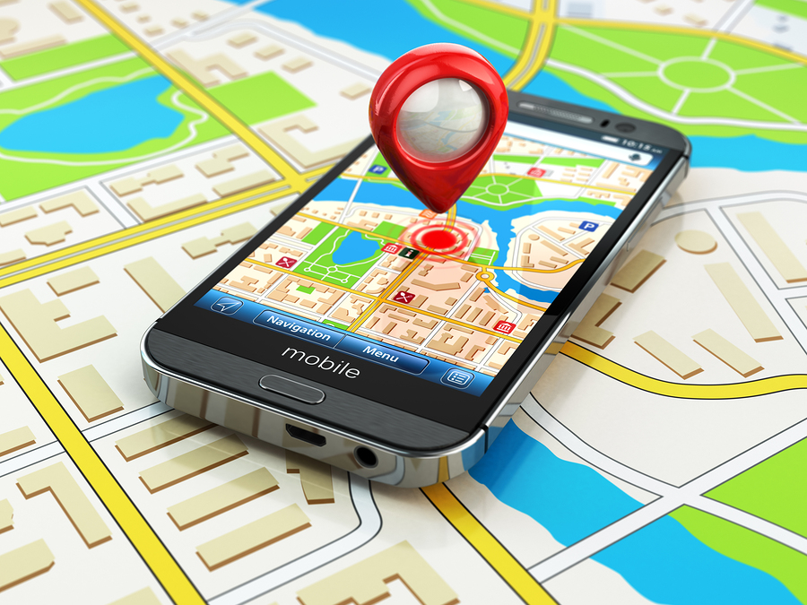

Problem Statement Revisited
Sub Problem 2:
How to acquire and interpret user's context during these app sub-sessions?

Slide 5


Problem Statement Revisited
Sub Problem 3:
How to detect and quantify relevant purchase moments which the marketer should focus on?

Slide 6


Slide 7
Solution Flow
M-Commerce App Data
Raw in-app features
Raw context data
Feature selection and processing
Inferring and assigning context semantics
Segmenting sessions into sub-sessions
Hidden State Identification
Purchase Moment
Notes:
From e retail app data , we get user’s in app features. Analyzing the data , features for which purchase and non purchase customers showed difference in behavior were chosen. After which at individual level user’s app interaction time was divided into sub-sessions and feature values were collected. Coming to context features we used GPS timestamp to get context semantics. Combining context and user’s app interaction features we get moment . From which intent of the user was identified . Based on a score of evaluation purchase propensity of user was measures.

Slide 8
Sub Problem 1
M-Commerce App Data
Raw in-app features
Raw context data
Analyzing data to extract relevant features and segmenting user sessions into sub-sessions
Feature selection and processing
Inferring and assigning context semantics
Segmenting sessions into sub-sessions
Hidden State Identification
Purchase Moment
Notes:
Our first sub-problem was to analyze and process features and collect them for each segment of user interaction.

Slide 9
In App features
No. of products viewed
No. of previous purchases
No. of visits to search page
No. of juggles between categories
Cumulative no. of products viewed
Cumulative no. of juggles between categories
Cumulative time spent on search
Cumulative time spent on product view
Cumulative time spent on research
Time spent on search page
Time spent on list page
Time spent on product page
Time spent on specification page
Time spent on seller page
Time spent on review page
Time spent in image gallery
Notes:
We started with a multiple no of in app features , such as time spent on different kinds of pages, no of juggles between categories. But only some of them were significant. Analyzing the data for the considered in app features we came up with some significant ones.

Slide 10
In App features
No. of products viewed
No. of previous purchases
No. of visits to search page
No. of juggles between categories
Cumulative no. of products viewed
Cumulative no. of juggles between categories
Cumulative time spent on search
Cumulative time spent on product view
Cumulative time spent on research
Time spent on search page
Time spent on list page
Time spent on product page
Time spent on specification page
Time spent on seller page
Time spent on review page
Time spent in image gallery
Notes:
We started with a multiple no of in app features , such as time spent on different kinds of pages, no of juggles between categories. But only some of them were significant. Analyzing the data for the considered in app features we came up with some significant ones.

Slide 11
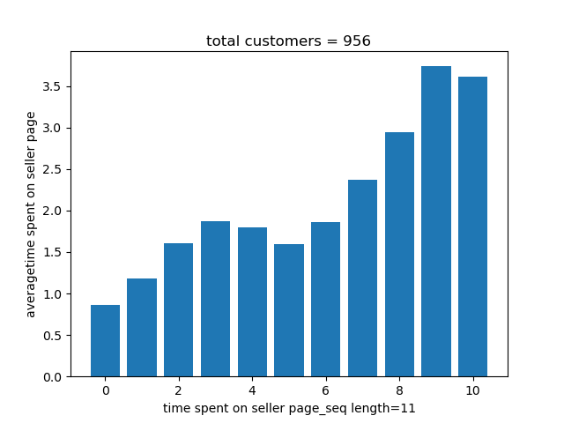
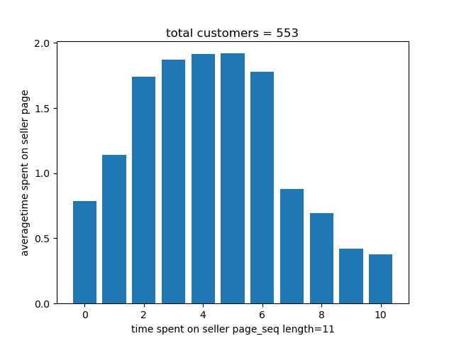
Why these features ?
Purchase Customer
Non Purchase Customer
Notes:
The features were selected after analyzing the e retail data of 14 days. For example here are the plots for time spent on seller page. As we can see, the pattern of behavior shown by purchase customers is very different from that of non purchase customers.

Slide 12
Extracting Relevant Portions of App Interactions
Total app interaction
Total Time Spent
PC/Mobile accessories
Mobile
PC/Mobile accessories
Women Clothing
PC/Mobile accessories
Effective interaction for PC/Mobile accessories
Effective time spent on Foot Wear
Home Page
Search Page
List Page
Product Page
Specification Page
Image Gallery Page
Review Page
Seller Page
Cart Page
Pages of consideration
Time on relevant pages
Search Page
List Page
Product Page
Specification Page
Image Gallery Page
Review Page
Seller Page
Semantic bucketing of app interaction
Semantic bucketing of time
Search Activity
Product View Activity
Research Activity
Notes:
The total time spent by the user was partitioned according to categories, which was further filtered by the page types. And we define the user’s time spent on app to be the time spent on pages of consideration. We considered only those page types in which purchase and non purchase customers had significant difference in behavior.

Slide 13
Segmenting Customer Interactions
Segment 2
Effective time spent by user on app
K sec
T + K sec
0
T sec
Segment 1
T = 120 secs
K = 30 secs
Notes:
We segmented user’s effective time into segment of length 120 . Every consecutive segment is considered by sliding by 30secs. We considered sliding of time buckets in order to get a smooth change in observables.

Slide 14
Sub Problem 2
M-Commerce App Data
Raw in-app features
Raw context data
Acquiring context and assigning meaning to context
Location
Time of day
Weekend/ Weekday
Feature selection and processing
Inferring and assigning context semantics
Segmenting sessions into sub-sessions
Hidden State Identification
Purchase Moment
Notes:
Our first sub-problem was to analyze and process features and collect them for each segment of user interaction.

Slide 15
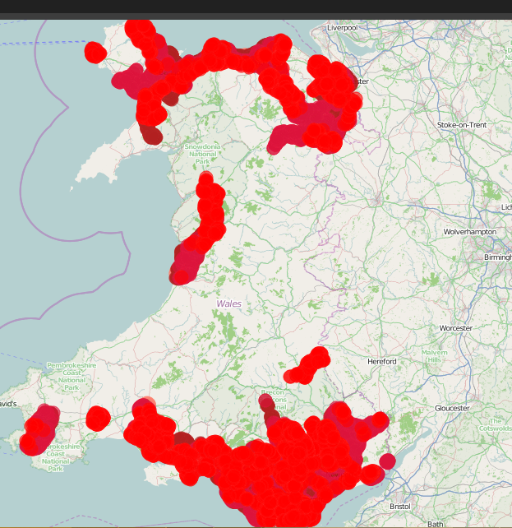
Location Semantics
Primary Clustering
DBSCAN (Density Based Spatial Clustering of Applications with Noise)
Robust to noise
Arbitrarily shaped clusters

Slide 16

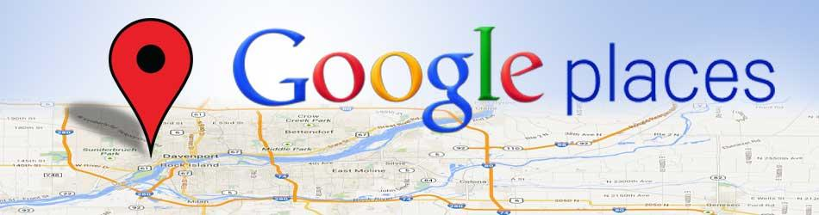
Location Semantics
Cluster Labelling
Home
Office
Shopping Malls, Stores, Airports etc.

Slide 17
Sub Problem 3
M-Commerce App Data
Raw in-app features
Raw context data
Identifying hidden Intent and calculating purchase probability
Feature selection and processing
Inferring and assigning context semantics
Segmenting sessions into sub-sessions
Hidden State Identification
Purchase Moment
Notes:
Our first sub-problem was to analyze and process features and collect them for each segment of user interaction.

Slide 18
Non-homogeneous HMM
O1
O2
O3
O4
O5
Emission Covariates
Emission Covariates
Emission Covariates
Emission Covariates
Emission Covariates
S1
S2
S3
S2
S1
Transition Covariates
Transition Covariates
Transition Covariates
Transition Covariates

Slide 19
Non-homogeneous HMM Inputs
States
Observables
Emission Covariates for Purchase
Transition Covariates
Exploration
Focused Research
Search Activity
Research Activity
Product View Activity
Purchase Status
Cumulative time on search per segment
Cumulative time on research per segment
Cumulative on product view per segment
Previous purchase history
Location Semantics
Time Semantic
Weekend
Mode of entry into app
Product Overview
Diffused Research

Slide 20
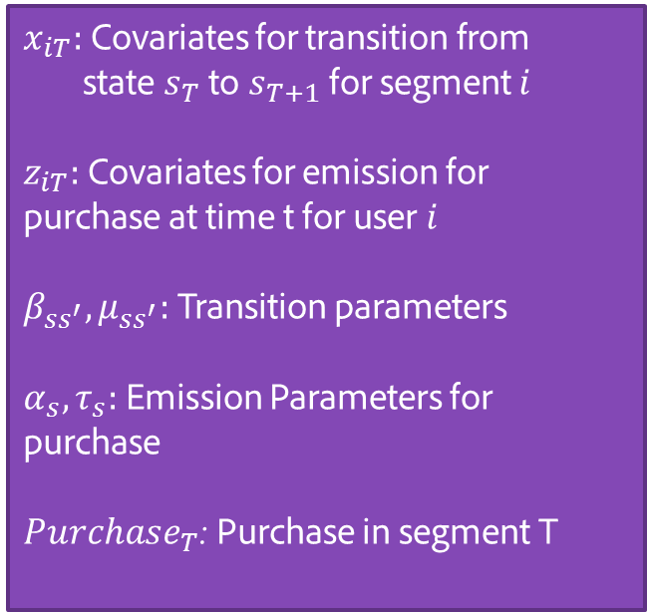
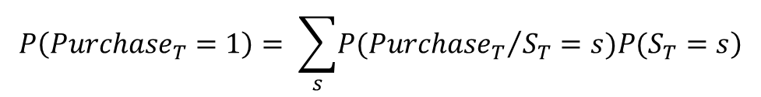
Mathematical Framework
Transition Probabilities
Current State Purchase Emission Score
Next State Purchase Emission Score
Notes:
Well that was the geeky definition. For practical purposes, we can think in terms of context being the answer to different questions one can ask about a situation, e.g. who answers identity of the user such as past behaviors and purchase, where gives location, when gives time, how gives mode of interaction, etc.

Slide 21
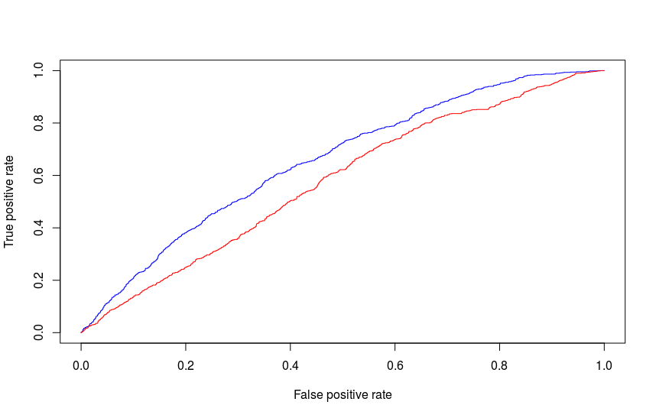
Results
M-commerce data for 14 days
20K customers for training
4 sets of 5k customers each for testing
Baseline Model (Logistic Regression)
AUC = 0.578
Proposed Model (NHMM)
AUC = 0.658
Notes:
To simplify things, we can divide context into two categories: User’s context and environmental context. User’s context focuses on aspects of the user such as where he is, what he is doing, how he is feeling etc.
Environmental context focuses on surroundings, anything external to the user, such as how the weather is, what is happening nearby, the trending news and so on.

Slide 22
Effect of Context
Case 1
“Weekend + deep-linking” vs “Weekday + notification”
Probability of transition increased (6.53% vs 5%)
Product Overview
Focused Research
Case 2
“Home + late night” vs “office + evening”
More than 3 times increase in probability of transition (0.7% vs 0.22%)
Exploration
Focused Research
Notes:
To simplify things, we can divide context into two categories: User’s context and environmental context. User’s context focuses on aspects of the user such as where he is, what he is doing, how he is feeling etc.
Environmental context focuses on surroundings, anything external to the user, such as how the weather is, what is happening nearby, the trending news and so on.

Slide 23
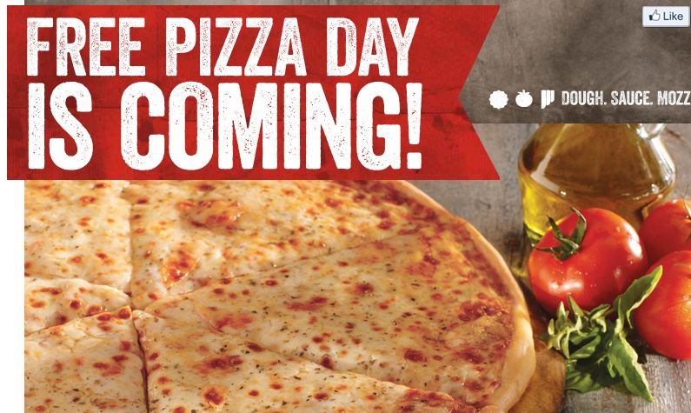

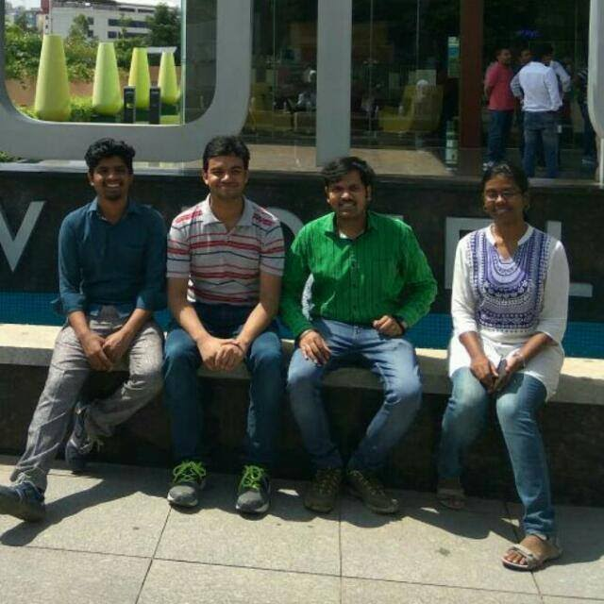
Fun@Adobe

Slide 24
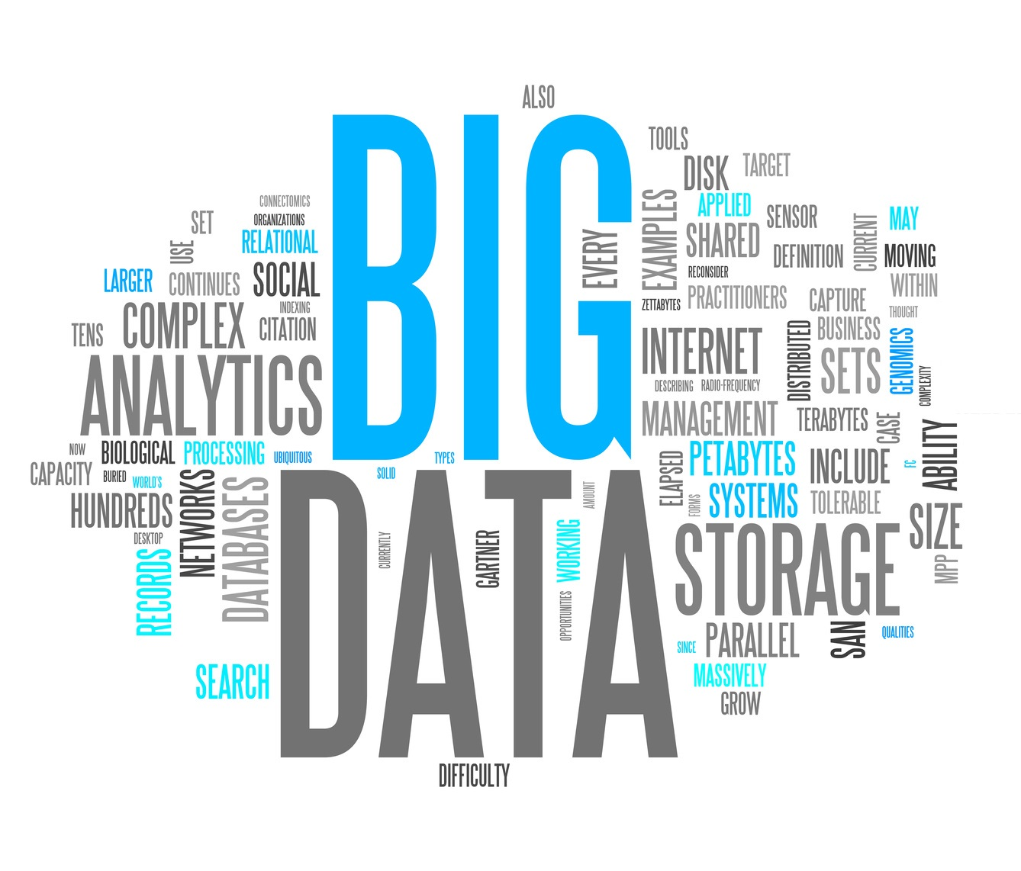


Bragging

Slide 25
IP and Paper
Patent
Context driven real time behavior of customers in m-commerce scenario to predict purchase score
Paper
Modelling context driven user behavior in m-commerce using nonhomogeneous hidden markov model to determine relevant purchase moments

Slide 26



Acknowledgements
Meghnath Macha
Prof. Atanu Sinha
Prof. Niloy Ganguly

Slide 27
Questions?

