Slide 1
Object Tracking And Following by Quadcopter
- Kalpesh Patil

Slide 2
Aim
An object will be selected on computer screen
Gimbal should rotate camera such that object comes at the centre of the frame
Then quad should move and hover above the object
Whenever object moves, quad should track it continuously and hover above it

Slide 3
Project Division
Simultaneously running three loops
Loop for gimbal tilt control
Loop for quad yaw control
Loop for X-Y set point to be given to the quad for movement
Discarded the idea of three different motions which was mentioned earlier

Slide 4
Image Processing

Slide 5
Image Processing
Input:
Video feed given by on board camera
Output:
Controlling amount of tilt in Gimbal (motion 2)
Controlling yaw required for the quad (motion 1)
Giving set point to the quad (motion 3)
Major Components:
Undistortion
Object Tracking Algorithm
C++ and openCV implementation of the algorithm

Slide 6
Image Processing: Input
Distorted camera feed from SJ4000 attached to Gimbal on quad
5.8 GHz Audio Video Transmitter
5.8 GHz Audio Video Receiver
Object Tracking Algorithm
Remove distortion using camera parameters
EasyCap cable
(AV out to USB)

Slide 7
Undistortion
Found out camera parameter matrix using standard chessboard sample images
Remove distortion in each frame using the camera parameters matrix
Things to be done:
Take more sample and achieve better undistortion
Remove slight offset generated at the right edge of the image

Slide 8
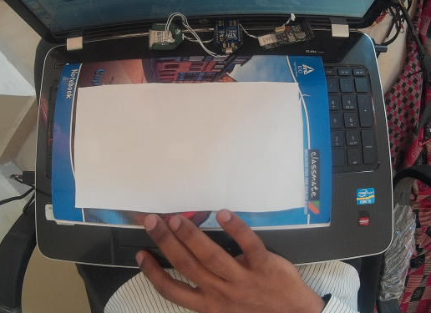
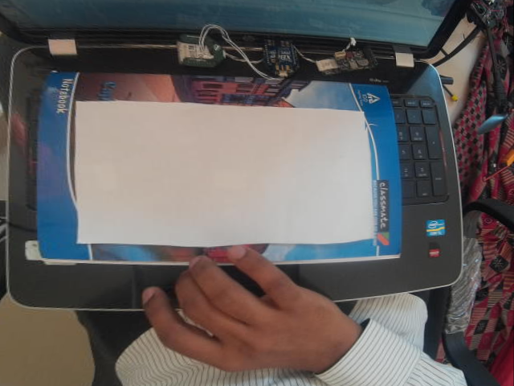
Distorted vs Undistorted
Original (distorted) image
Undistorted image

Slide 9
Object Tracking Algorithms
Studied different algorithms for object tracking and their performance against standard cases (video databases)
Shortlisted few algorithms on the basis of surveys and implemented them using OpenCV and C++
STRUCK, Particle Filter based tracking, TLD, Mean Shift, Compressive Tracking

Slide 10
Comparing Different Algorithms
Algorithm | Occlusion | Change in shape or orientation | Robustness | Fast movement of object | Execution Speed
TLD | very good | good | good | very good | good
STRUCK | very good | very good | very bad | very bad | depends
Particle Filter | good | bad | bad | bad | bad
Compressive Tracking | bad | bad | bad | good | very good
Mean Shift (simple colour based) | very good | very good | very bad | good | very good

Slide 11
TLD: Tracking, Learn and Detection
Tracker:
Track object box frame to frame
Median Flow tracker with failure detection
Detecter:
Localizes each appearance of the object learnt so far in each frame and corrects the tracker in each frame
Cascading classifier
Learn: (P-N learning)
Estimate detector’s errors and updates it to avoid those errors in future

Slide 12
Image Processing Output
X-Y coordinate of the object
Yaw set point for the quad
X-Y set point for the quad
Direction of tilt motion of the gimbal

Slide 13
Gimbal Tilt Motion

Slide 14
Gimbal Movement
Input:
PWM Signals:
Tilt, Roll and Mode (Velocity / Position Control)
Output:
Changed image
Change in angle of tilt
Major Components:
Calibration of Gimble angles for tilt
Configuring PWM output code in NavStik firmware
Establishing wireless communication link between NavStik and off board computer

Slide 15
Gimbal Movement
Image Processing code giving roll and tilt PWM values
Encoding PWM values and corresponding PWM channel numbers in MAVLINK message
Send data using XBee connected to computer using IvyGS port
Connections from PWM output pins on pro board to Gimbal
Decode MAVLINK message and set required PWM value at each channel
Receive message XBee connected on NavStik

Slide 16
Gimbal tilt motion
Able to track object in every image and move gimbal accordingly to bring it to the centre using constant step size
Problems:
1. Since there is no feedback from gimbal, PID controller can’t be
controller can’t be implemented
2. Step size should be appropriately determined so that gimbal achieves it
set point in every iteration of the loop

Slide 17
Gimbal
Work done so far
Work to be done
Able to control gimbal by giving manual PWM commands
Controlling gimbal motion from the object tracking code and bring object to the centre
Somehow get feedback from the gimbal (which seems almost impossible, not needed if constant step size is used)

Slide 18
Using Constant Step-size
Pros
Cons
Current angle of the gimbal is known in every frame
This is also easier to implement than using PID control
Comparatively slower than PID control which we were thinking of implementing earlier
Need to find an optimized value of step size which would neither let gimbal lag behind nor make it wait for too long after each frame

Slide 19
Quad Motion

Slide 20




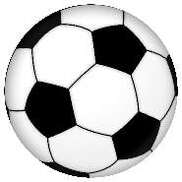
Angle | Angle in Image | Angle on Ground
AngleX | o.C.x | Og.C.Xg
AngleY | o.C.y | Og.C.Yg
AngleB | o.C.b | Og.C.Bg
Focal length (f)
C
tilt
y
b
Height (h)
o
x
Note: Xg and Yg are not coordinates of Bg
Yg
Og
Bg
Xg

Slide 21
Angles in image will increase/decrease if angles on ground increase/decrease
They can be substituted for the angles on ground while giving inputs in closed loop controller
Calculation for the exact set point was done using vector analysis and it comes out to be very complex
Quantity | Value used
Y set point | h*tan(tilt + angleY)
X set point | h*tan(angleX)/cos(tilt)
Yaw set point | angleX
Quantity | Value
angleX | atan(x*p/f)
angleY | atan(y*p/f)
tilt | From gimbal feedback
h: height p: pixel size f: focal length
x: X coordinate in image y: Y coordinate in image

Slide 22
Quantity | Value
angleX | atan(x*p/f)
angleY | atan(y*p/f)
Tilt | From gimbal feedback
Y set point | h*tan(tilt + angleY)
X set point | h*tan(angleX)/cos(tilt)q
Yaw set point | angleX

Slide 23
Alternate Strategy
Mount a permanent line/block exactly below the gimbal on the quad frame
Rotate gimbal till object is brought at the centre.
Since you know the heading direction, two possible set points can be given:
Giving constant velocity setpoint
Giving constant position setpoint
Repeat these two steps until that line/block is observed along with the object at the centre, which will imply quad is hovering above the object

Slide 24
Hardware integration
NOTE: Sandeep has major role in hardware part. I’ve just been a helping hand for him

Slide 25
Lidar Integration
Mounted Lidar on quad
Calibrated the sensor and made changes accordingly in the code to get actual height
Also tried tested Altitude hold in Navcon (not yet done on the quad)

Slide 26
Connectors
Quad Assembly
Changed old ESCs of and installed new all in one ESC for motors
Created mounts for NavStik and other hardware parts
Mounts for various parts were created
Assembled connector for getting video feed for connecting AV receiver to computer
Created connector for getting PWM signal from Lidar to the GPIO pins of NavStik

Slide 27
Testing

Slide 28
Flight Testing
Manual flight of the quad was conducted once after calibration
Need to conduct it again since many changes have been made in quad
Lidar Testing
Lidar was calibrated and suitable changes were made into the code
Also set point of altitude was checked in Navcon after putting it into altitude hold mode

Slide 29
Gimbal Testing
Gimbal calibration was done to ensure if it follows the relation between angle and PWM value
Gimbal was tested for bringing object to the centre
Object Tracking Testing
Various algorithms were tested against parameters like partial occlusion, fast movement, zoom in/out, rotations etc
After finalising TLD as base algorithm, tests were performed changing parameters used in the code

Slide 30
Blogs

Slide 31
Blogs
I’ve written 5 blogs so far along with screenshots and code snippets wherever required
Integrating CodeBlocks IDE with opencv
Pairing Xbee modules using XCTU in linux
Integrating Gimbal with NavStik
Controlling Gimbal through NavStik by sending values from computer wirelessly
General instructions / precautions for setting up quadrotor

