Slide 1

Artificial Intelligence in Oncology - Current Capabilities and Future Opportunities Nitin Bisht Indian Institute Of Technology Kharagpur, West Bengal Master’s Thesis Project ,April 2023 Under the supervision of Professor Sudipta Mukhopadhyay

Slide 2
INDEX
 | Content | Page
1. | Introduction | 3
2. | Motivation | 4-5
3. | Objective | 6
4. | Literature Survey | 7-8
5. | Current Work | 9-13
6. | Results | 14-20
7. | Conclusion | 21
8. | Future Scope | 22
9. | References

Slide 3
Introduction
Cancer accounts for 1/6th of total deaths every year. Every year 10 million people [1] die of Cancer.
An end-to-end cure is difficult- significant genetic and cellular heterogeneity
Artificial Intelligence has the potential to assist clinicians in increasing cancer detection and diagnosis – image analysis, genetic analysis, medical records (EHR) analysis etc.
This work utilises image analysis and genetic analysis in Oral Cancer Detection and detection of Subtypes of B-Cell Progenitor ALL repectively.

Slide 4
Motivation
Early Detection of Oral Cancer
6th most common form of Cancer worldwide. Most common in India [2].
>85% 5 year survival rate if detected in early stages. <15% when detected later.
Biopsy- a gold standard. But invasive and requires expert intervention.
Imaging modalities like USG and CT -suboptimal results if <5 of 1000 cells affected.
Need to utilise the machine learning algorithms to assist the clinicians in making a early detection of Oral Cancer with resource constraints particularly in rural setting.

Slide 5
Detection of B-Cell Progenitor Acute Lymphoblastic Leukaemia
Largest cause of deaths in age group 0-14. 30% of the total deaths are caused by leukaemia.
High relapse rate and side effects due to aggressive treatment.
Cytometry for phenotype characterisation [3] – a gold standard but expensive and requires technical expertise.
Need to identify subtypes of the BCP-ALL for precision medicine by identifying target molecules resulting in less harmful side effects.

Slide 6
Objective
Early Detection of Oral Cancer
Consolidation of the algorithm developed by previous researchers on Dr. R Ahmad Dental College to newer dataset i.e. Burdwan Dental College Dataset.
Finding the best Machine Learning Algorithm for Clinical Dataset and comparing it to Imaging Results.
Developing a robust multi-modal machine learning algorithm by combining clinical and imaging dataset
Finding Subtypes of BCP-ALL
Making a biological interpretable neural network with high prognosis rate.
Making the results explainable by using explainable AI model.
Comparing the results with the vanilla neural network models.

Slide 7
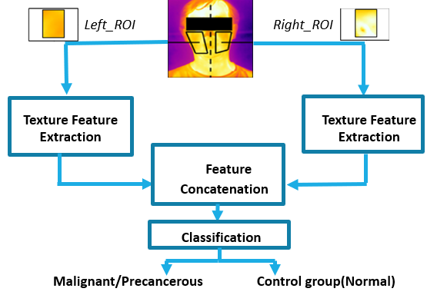
Literature Survey
The fig depicted highlights the algorithm developed by previous researchers. It involves identifying ROI, applying Gabor filter and extracting and quantising features at different scales and augmentation.
Image courtesy :- M Chakraborty, S Mukhopadhyay, A Dasgupta,S Patsa,JG Ray, "A new approach of oral cancer detection using bilateral texture features in digital infrared thermal images," Engineering in Medicine and Biology Society (EMBC), 2016
The features extracted from the above algorithm will be used in developing a better performing multi-modal machine learning model.

Slide 8
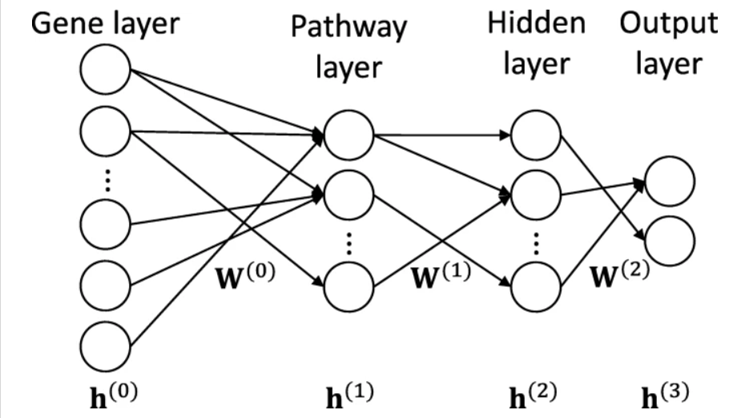
The figure depicts the basic architecture of Pathway Associated Sparse Deep Neural Network (PASNET). The pathway layer shows a combination of genes and is developed using the REACTOME database.
Image courtesy :- https://bmcbioinformatics.biomedcentral.com/articles/10.1186/s12859-018-2500-z/figures/5
This network ensures that the biological domain knowledge is inculcated as well as the model is sparse and interpretable.

Slide 9
Work Done

Slide 10
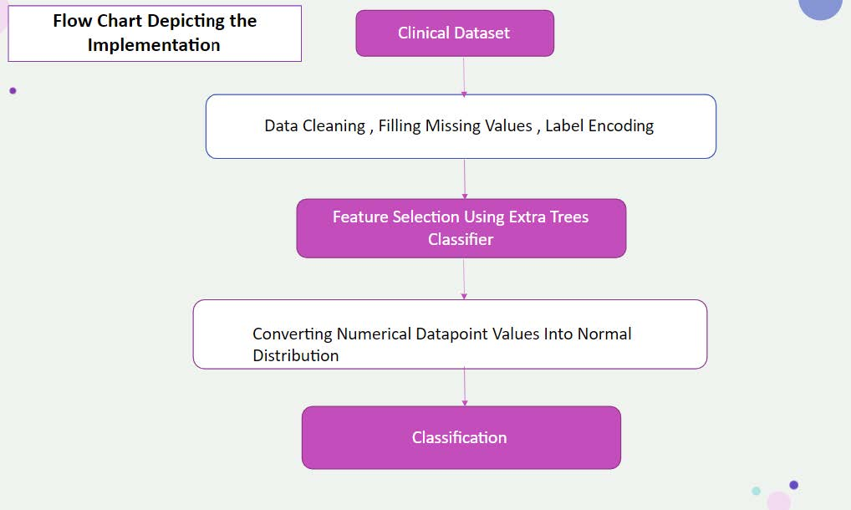
Early Detection of Oral Cancer
The flowchart depicts the implementation of algorithm for implementing ML algorithms on Clinical Dataset
a) The primary step is data cleaning – converting string to numerals, filling NaN with statistical inferences and encoding the labels.
b) The important features are extracted using Extra Trees Classifier.
c) Standardisation of numerical features as pre-assumption in many ML models is that the data is obtained from Gaussian distribution.
d) ML models like Tree based, ANN, SVM and clustering based are compared.
Fig 3. Flow Chart for ML model implementation on Clinical Dataset

Slide 11
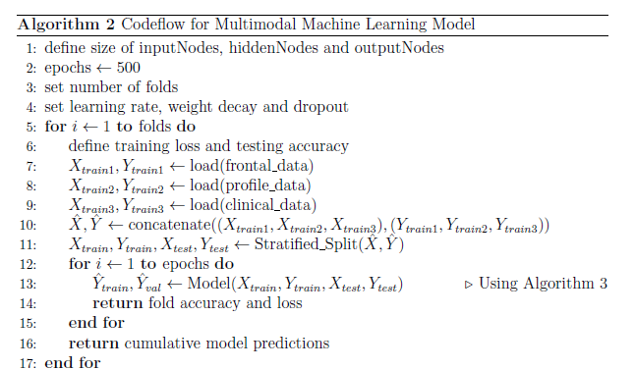
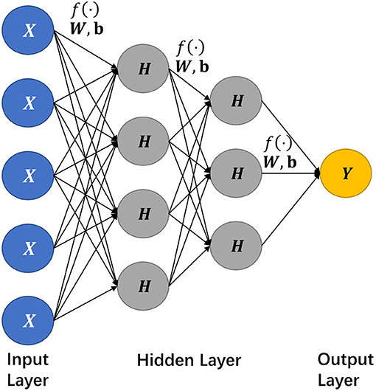
The code flow for the multimodal model is depicted on fig 2 (a)
a) Set the number of layers, number of nodes, folds, learning rates and dropout values.
b) Concatenate the dataset after preprocessing and feed it to the deep neural network as depicted in fig 2 (b).
c) Return the fold accuracy, loss values and cumulative evaluation scores.
The results are depicted in the Results section.
Fig 4. top(a) pseudocode for multimodal model below(b) The architecture implemented

Slide 12
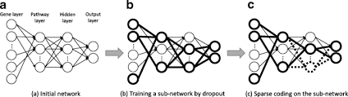
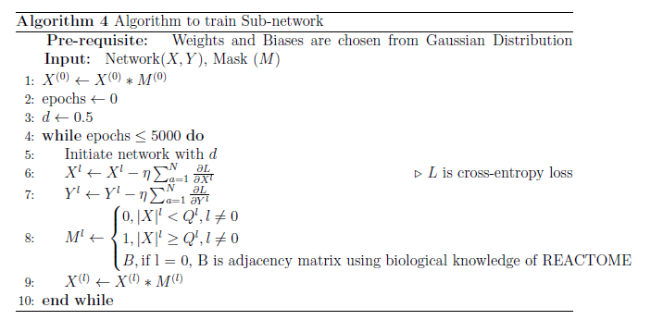
BCP-ALL Subtypes
The fig 3 (b) depicts the algorithm to train sub-network 3(a). This step ensures sparsity and interpretability of the model.
a) Assign a dropout value, weights from gaussian distribution.
b) update the weights by calculating the gradient of loss function.
c) Dot product the weights in each layer with the adjacency matrix which is obtained by setting a thresholding value.
d) Repeat the experimentation for the epochs set.
Fig 5. top(a) the subnetwork training flowchart
(b) pseudocode to train sub-network

Slide 13
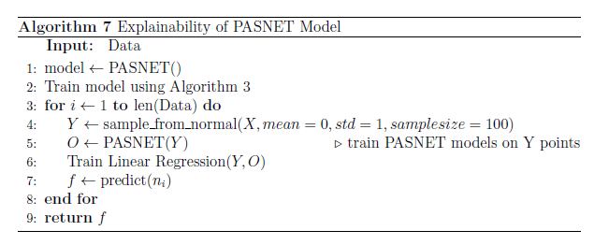
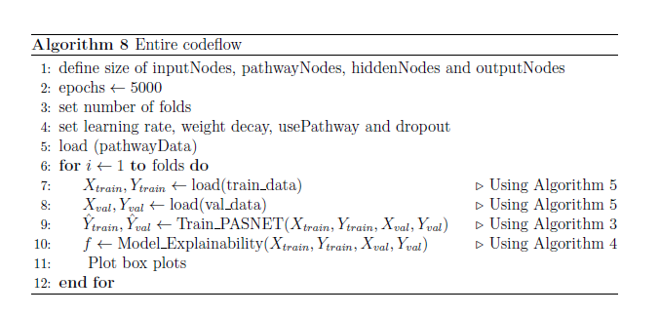
The fig (b) denotes the code flow for PASNET [4] architecture.
a) set nodes in each layer, folds and hyper-parameters.
b) Train the model defined in the literature survey using the algorithm defined in previous slide.
c) obtain explainablity using approach developed in fig (a).
d) obtain the plots using the evaluation parameters.
Fig 6. top(a) pseudocode for explainablity bottom(b) code-flow for PASNET Architecture

Slide 14
Results

Slide 15
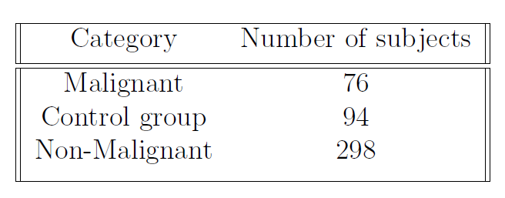
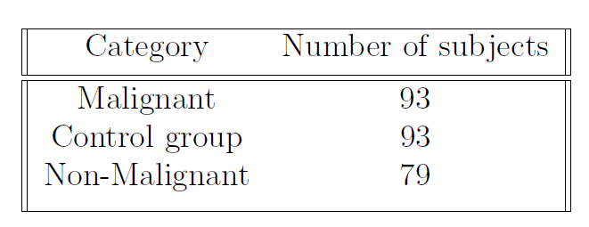
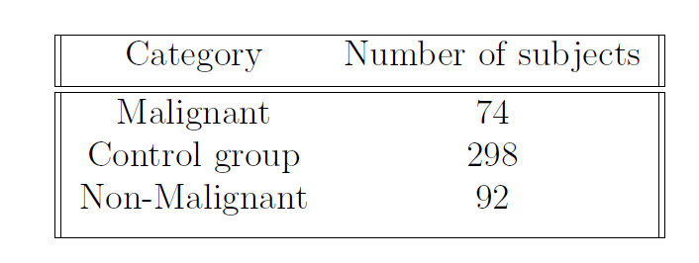
Fig 6.clockwise a) Burdwan Dataset b) R. Ahmad Dataset c) Clinical Dataset

Slide 16
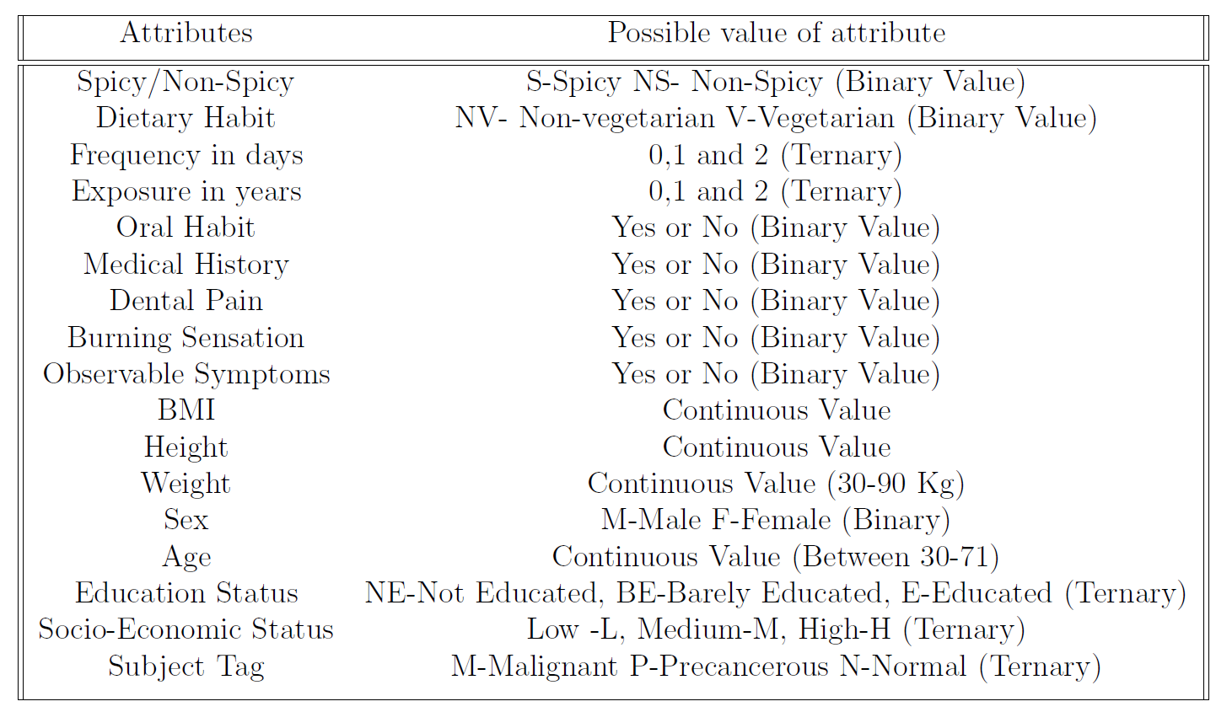
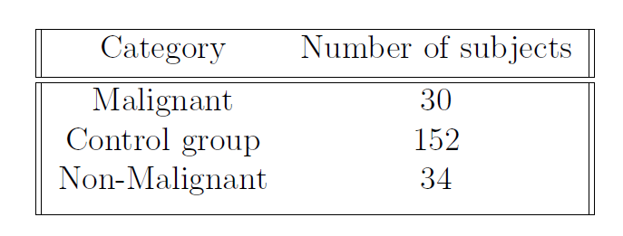
Fig 7. (left) Clinical Dataset features (right) Combined dataset

Slide 17
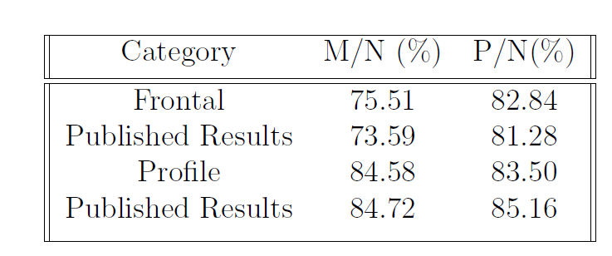
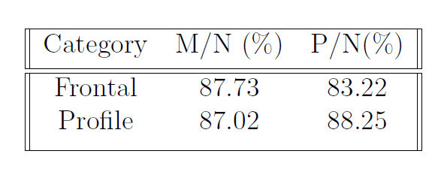
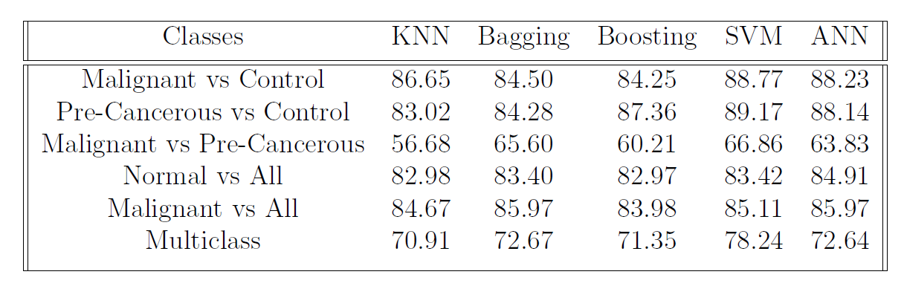
Fig 8.clockwise a) R. Ahmad Dataset results b) Burdwan Dataset Results c) Clinical Dataset Results

Slide 18
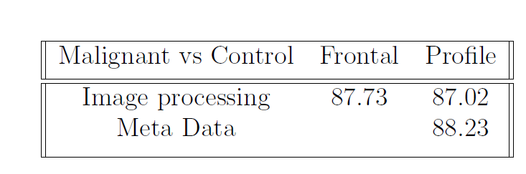
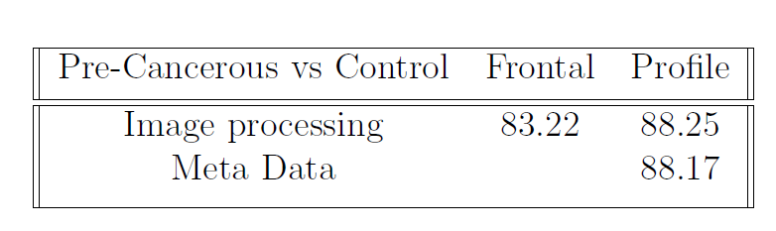
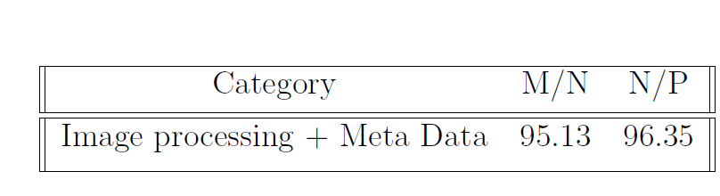
Fig 9.clockwise a) Malignant vs Control Burdwan Dataset b) Pre-Cancerous vs Control Burdwan Dataset c) Combined Dataset

Slide 19
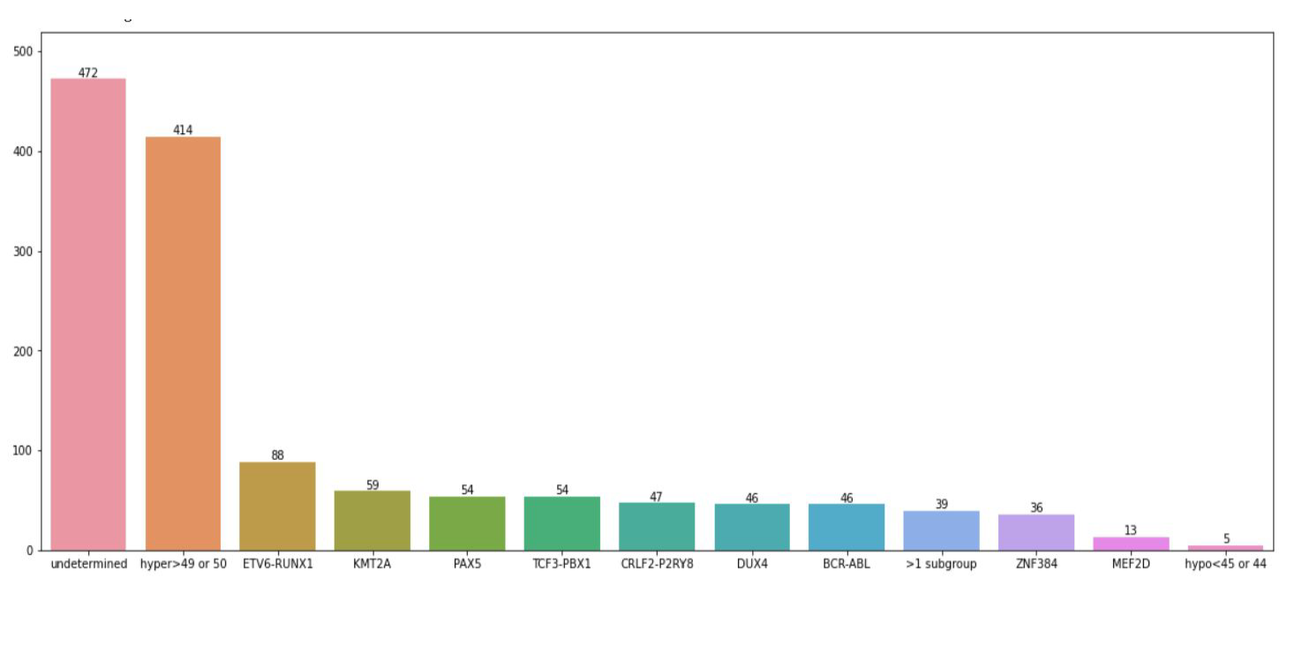
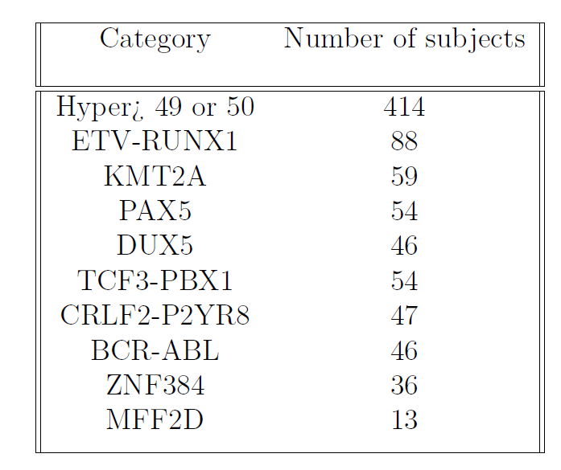
Fig 10.left a) Subjects with labels after combining the genetic expression and label file b) Subjects after removing the non-ML classes

Slide 20
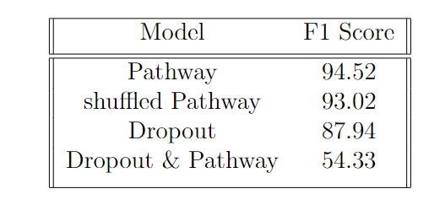
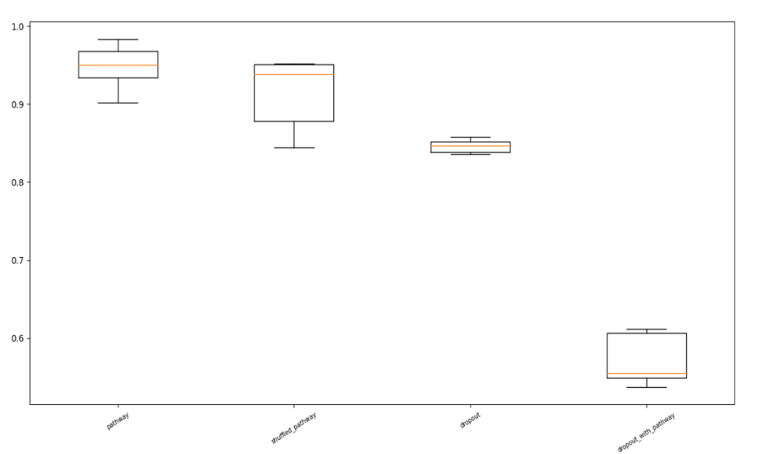
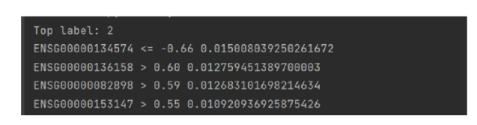
Fig 8.clockwise a) Foldwise classification for different classes b) Box plot representation of the results c) Explainable results for the first subject

Slide 21
Conclusion
Early Detection of Oral Cancer
The algorithm developed by previous researchers was successfully replicated on the newer dataset.
The clinical dataset with almost same size performed similar to the Image dataset.
The multimodal model developed has much higher accuracy compared to the previous models which much less dataset size.
Identifying Subtypes of BCP-ALL
High prognosis rates were obtained while inculcating biological interpreteblity.
The model explainablity was obtained using explainablity models.
The model fared much better compared to vanilla Neural Network Architecture.

Slide 22
Future Works
Early Detection of Oral Cancer
Developing a CNN architecture for feature extraction.
Combining top-view imaging dataset to already existing model.
Deploying the multi-modal model in GUI.
Identification of subtypes in BCP-ALL
Performing the explainablity class-wise than individually to develop precision medicine.
Use federated learning to remove biases in the model.

Slide 23
References
[1] Sung H., Ferlay J., and Siegel R. L.and Laversanne M.and Soerjomataram I.and Jemal A. & Bray F. Global cancer statistics 2020: Globocan estimates of incidence and mortality worldwide for 36 cancers in 185 countries. CA: A Cancer Journal for Clinicians, 71(3:209–249, 2021
[2] Borse, Vivek et al. “Oral cancer diagnosis and perspectives in India.” Sensors international vol. 1 (2020): 100046. doi:10.1016/j.sintl.2020.100046
[3] Theunissen, P., Mejstrikova, E., Sedek, L., van der Sluijs-Gelling, A. J., Gaipa, G., Bartels, M., Sobral da Costa, E., Kotrová, M., Novakova, M., Sonneveld, E., Buracchi, C., Bonaccorso, P., Oliveira, E., Te Marvelde, J. G., Szczepanski, T., Lhermitte, L., Hrusak, O., Lecrevisse, Q., Grigore, G. E., Froňková, E., … EuroFlow Consortium (2017). Standardized flow cytometry for highly sensitive MRD measurements in B-cell acute lymphoblastic leukemia. Blood, 129(3), 347–357. https://doi.org/10.1182/blood-2016-07-726307
[4] Hao, J., Kim, Y., Kim, TK. et al. PASNet: pathway-associated sparse deep neural network for prognosis prediction from high-throughput data. BMC Bioinformatics 19, 510 (2018). https://doi.org/10.1186/s12859-018-2500-z
[5] Alzubaidi, L., Zhang, J., Humaidi, A.J. et al. Review of deep learning: concepts, CNN architectures, challenges, applications, future directions. J Big Data 8, 53 (2021). https://doi.org/10.1186/s40537-021-00444-8
[6] Talwalkar A. Li T., Sahu A. K. and Smith V. Federated learning: Challenges,methods, and future directions. IEEE Signal Processing Magazine, 2019

