Slide 1
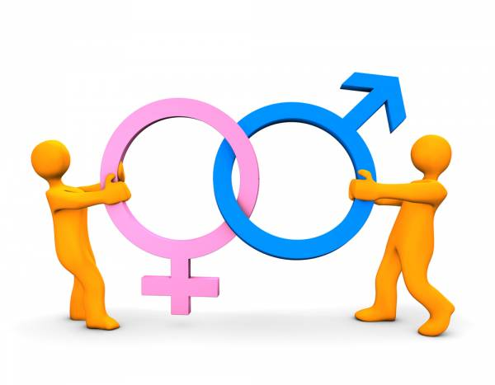
MYTHBUSTERS:
The Battle of Sexes - Men V. Women
BY: Vyjayanthi Kamath & Kalpita Raut (Team 10)
Copyright: https://breakingmuscle.com/view-image?src=images/bydate/20121207/shutterstock43253221.jpg

Slide 2
What was our motivation for choosing this topic?

Slide 3

Source: http://www.shradhahrd.com/blog/series-multi-tasking-women-vs-men/

Slide 4
Introduction
Multitasking is the human ability to perform more than one task at the same time.
It poses several advantages like increased productivity, time management, focus etc.
Unfortunately, it may not be easy for everyone to multitask.
The age old war of Men v. Women has found a new battlefield here as well.

Slide 5
And, the quest to find our answers begins...

Slide 6


Slide 7
Study Design
Type of study: Observational
Population: All men and women
Sample: University of Maryland students who participated in the tasks.
Hypothesis:
Null hypothesis: There is no difference in the multitasking abilities of men and women
Alternative Hypothesis: There is a difference in the multitasking abilities of men and women.
Symbolically,
H₀: μ_{M} = μ_{F}
H_{A}: μ_{M} ≠ μ_{F}
Notes:
Talk about the type of study. Why it is observational
Talk about the hypothesis

Slide 8
Data Collection
We came up with two tasks:
TASK 1:
Folding clothes while reading out a passage from the book “Around The World in 80 Days.”
TASK 2:
Dribbling a basketball while answering general trivia questions.
The data was collected at three locations on the University Campus.
Namely, Adele H. Stamp Student Union, McKeldin Library and Van Munching Hall.
Notes:
Mention that the tasks were not biased. One task was male centric and the other female.
Challenges faced during data collection

Slide 9
Data Preparation & Cleaning
With reference to the two tasks conducted, the following were the variables we collected:
Independent variable: Gender
Response variable: Time, Quality points, Score Percent
TASK 1 | TASK 2
Gender | Gender
Time taken to complete(T1) | Time taken to complete(T2)
Number of words read (T1_words) | Number of correctly answered questions(T2_score)
Quality of folding clothes(T1_qual) | Quality of dribbling the ball(T2_qual)
Notes:
Talk about the variables.
Talk about intra-rater
Variables that were converted into %, variables whose average was taken

Slide 10
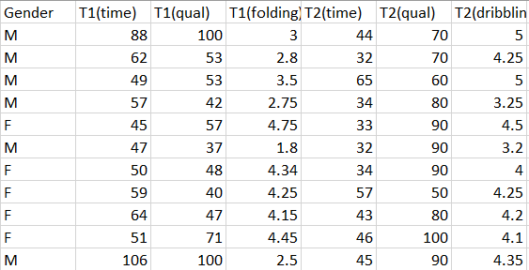
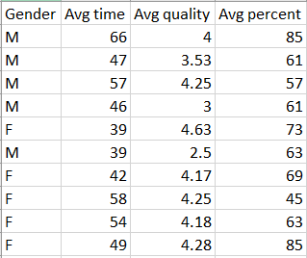
Snapshot of our data
Original Data Collected
Refined data used for analysis
Notes:
Why we refined the data and how?

Slide 11
What is MANOVA?
It stands for Multivariate Analysis of Variance
Used to analyze data that involves more than one dependent variable at a time
Used when dependent variables are correlated
In order to run a one-way MANOVA, you require the following
An independent categorical variable with two or more levels (Eg: Gender)
Two or more dependent variables that are continuous (Eg: Time,Scores)
Why not perform ANOVA for this study?
Can only assess one dependent variable at a time in the model
Can’t identify patterns in multiple dependent variables at a time
Won’t be able to produce statistically significant results
Notes:
http://statisticsbyjim.com/anova/multivariate-anova-manova-benefits-use/

Slide 12
Data Analysis
Notes:
To explain
-manova types

Slide 13
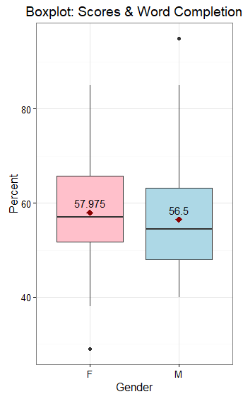
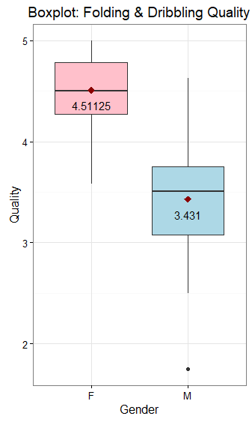
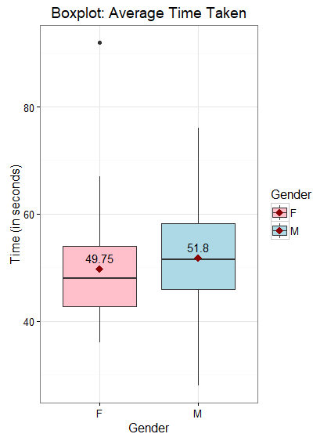

Slide 14
Results
 | Df | Wilks | Approx F | Pr(>F)
Gender | 1 | 0.358 | 45.25 | <0.01
Residuals=78
MANOVA Test results
P-value: is less than the significance value (0.05)
Wilks: tests if there are differences between group means for a particular combination of dependent variables
variability between sample means is greater than the variability within sample means
we reject H₀.
Notes:
Talk what we do about the null hypothesis (reject/accept)
Wilks: A value of zero means that there isn’t any variance not explained by the independent variable (which is ideal)closer to zero the statistic is, the more the variable in question contributes to the model. You would reject the null hypothesis when Wilk’s lambda is close to zero, although this should be done in combination with a small p-value.

Slide 15
To analyze the effect of gender on the different responses, we run the summary function again to look at each effect individually.
Avg Time
Avg Score Percent
 | Df | Sum Sq | Mean Sq | F | Pr(>F)
Gender | 1 | 84.0 | 84.05 | 0.80 | 0.37
Residuals =78 |  | 8171.9 | 104.77
 | Df | Sum Sq | Mean Sq | F | Pr(>F)
Gender | 1 | 43.50 | 43.51 | 0.30 | 0.58
Residuals =78 |  | 11231.0 | 143.98
Avg Quality
Quality variable affects gender significantly because of the p-value being lesser than the level of significance(0.05)
Data provides convincing evidence that at least one mean is different from the other
 | Df | Sum Sq | Mean Sq | F | Pr(>F)
Gender | 1 | 23.339 | 23.338 | 106.25 | <0.01
Residuals =78 |  | 17.134 | 0.219
Notes:
Explain for each response the pvalue.
Say why quality is significant

Slide 16
Conclusion
We found that the p-value < α (0.05). So, we reject the null hypothesis.
we found significant difference in the two means of the groups (male and female)
Clearly, the myth is busted!!

Slide 17

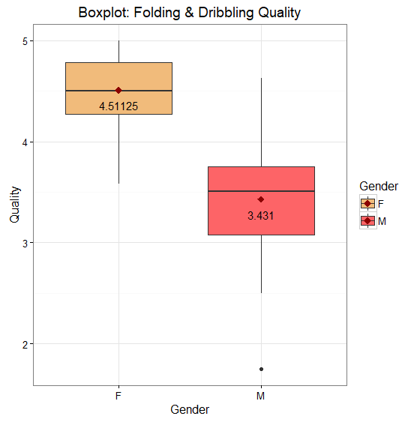
The response variable ‘Average Quality of Folding Clothes and Dribbling’ has a significant impact on the results since the it is the only variable with a p-value lower than the significance value.
Notes:
Talk about the means here to explain who won in the next slide

Slide 18
Guess who won?

Slide 19
WOMEN WIN!!

Slide 20
Limitations & Biases
Can you guess the most obvious bias in our project?
Attention spans can differ - different genders can prefer different tasks
Multiple gender identities
Convenience sampling
Nature of environment

Slide 21
Questions

