Slide 1


SO YOU LIKE ART?

Slide 2

WITH THE HELP OF FOURSQUARE API YOU CAN FIND OUT ANYTING ABOUT ABSOULTELY ANY PLACE!!!

Slide 3
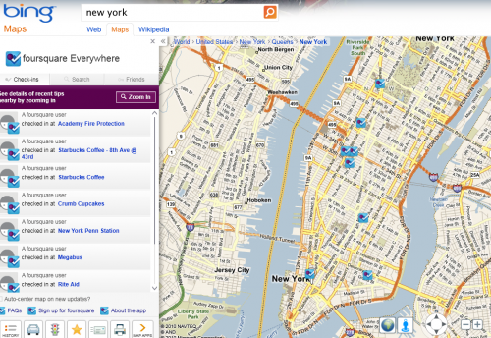
SINCE WE ARE IN NEW YORK, LETS MAKE SURE FOURSQUARE KNOWS THAT AS WELL.

Slide 4
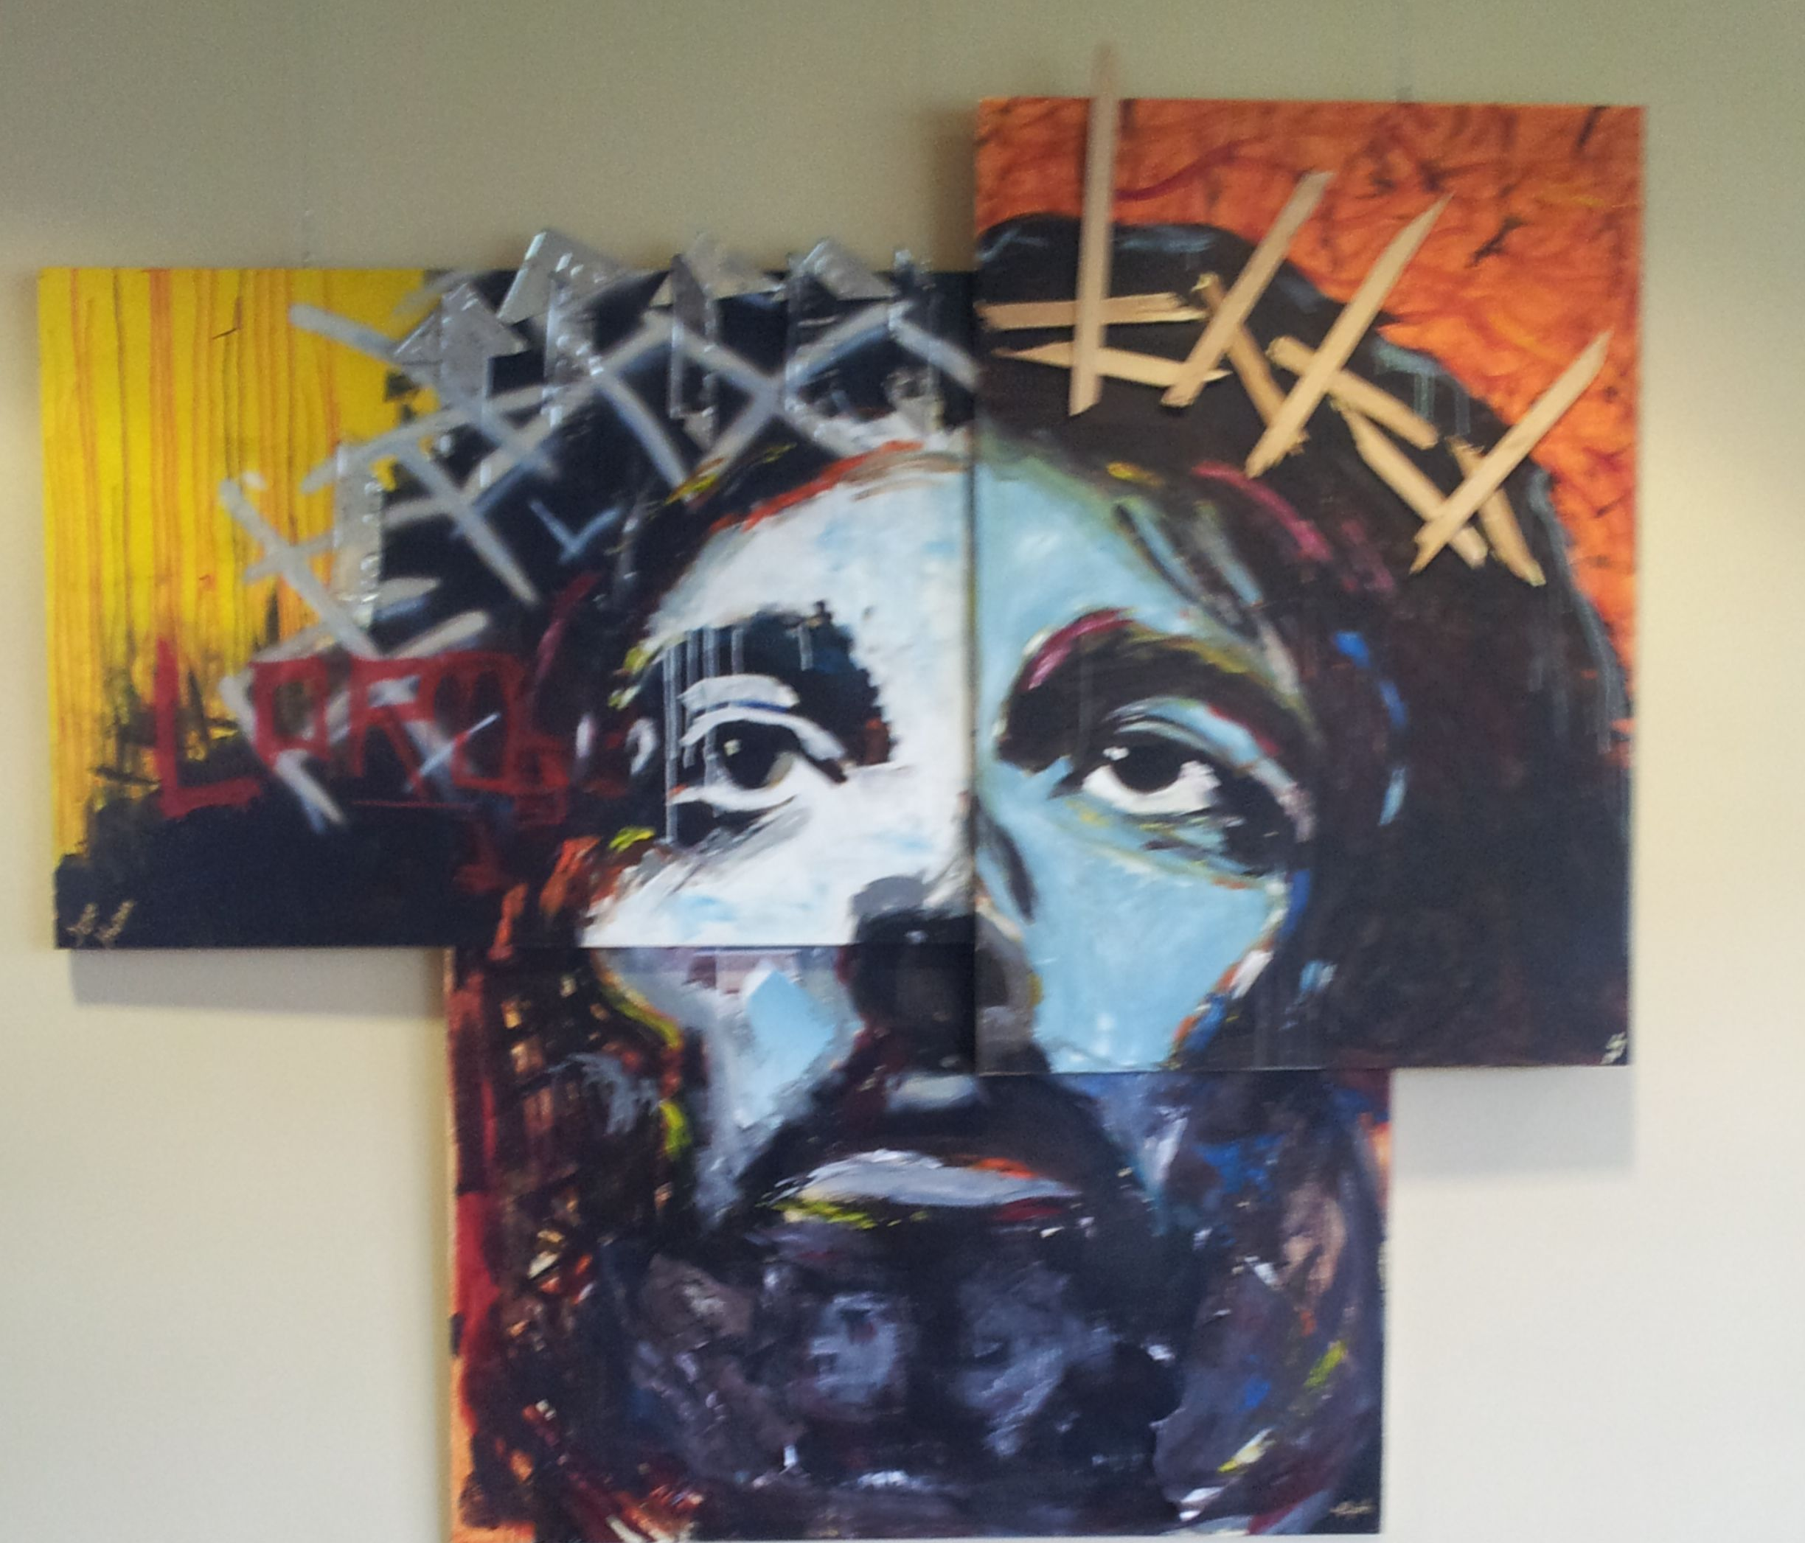
WE LOVE ART RIGHT? LET’S LOOK FOR ART MUSEUMS NEAR US!

Slide 5
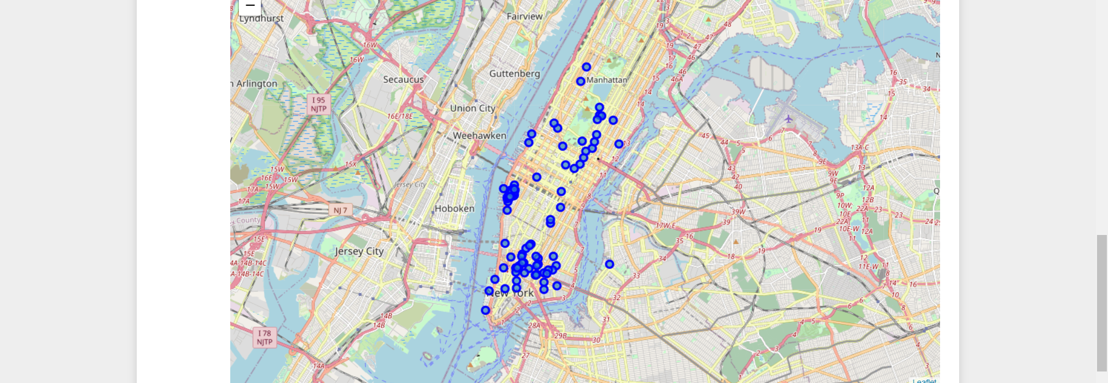

LOOKS LIKE WE ARE IN FOR A TREAT! THERE ARE MORE THAN 200 ART GALLERIES IN NEW YORK!

Slide 6
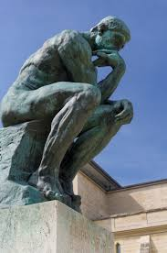
WHAT NOW?
Since we have implemented everything we can, we can rely on our foursquare account benefits to find us the artist we are looking for. But we can always try new thing and maybe check out what other artists have to show us, totally our choice! We have done our part and saved the hassle of finding many Art Galleries or asking strangers for whereabouts of places. We have done our work!

Slide 7
THANK YOU FOR YOUR TIME!
-A project by Kalpit Gupta

