Slide 1


JSS MAHAVIDYAPEETHA
JSS ACADEMY OF TECHNICAL EDUCATION
BENGALURU-60
Department of Computer Science and Engineering
Final Year Project Presentation
(18CSP83)
“Biometric Authentication”
Date: 24/05/2023
Team ID: CSE22PT39
Kalpitha S- 1JS19CS071
Nithya M Kattimani- 1JS19CS109
Palguni B M- 1JS19CS111
R Sahana- 1JS19CS128
Under the guidance of:
Mrs. Impana KP
Assistant Professor, Dept of CSE
‹#›

Slide 2
ABSTRACT
With the rapid pace of technological growth, it is very important to secure user data.
A robust technique which not only secures data but prevents it from various attacks is necessary.
Biometric authentication is one such practice seen today.
Contrast to other forms of authentication, biometric recognition provides a strong link between a data record and an individual and it guarantees high level of accuracy and security.

Slide 3
LITERATURE SURVEY
[1]Ojasvi Dere, Srushti Gaikwad” Biometric Accreditation Adoption using Iris and Fingerprint” 07 | July 2021
The importance of this paper stems from the need that fingerprint and iris can be used in a variety of applications for authentication purposes.
This method is easy as people can log in without having to remember any passwords
Biometrics can be accustomed to enhancing privacy since it yields a secure transaction and correct identification of the individual without any errors.

Slide 4
LITERATURE SURVEY
2]Naga Lakshmi, Ruchitha, Lavanya, Sai Greeshmanth, Bhanu Prakash “Digital Watermarking Technology In Information security” 05 May 2022
At present-day data can be replicated simply due to the collaboration and alphanumeric communication of software data.
This material makes alphamerical image watermarking a significant field of inquiry.
Digital image watermarking using many methods has been valuable as a significant tool for image authorization, honesty verification, restricted detection, copyright safety, and digital safety of an image.

Slide 5
LITERATURE SURVEY
[3]Harshala Pundkar, Dr. Atul Joshi “STEGANOGRAPHIC SCHEME FOR OUTSOURCED BIOMEDICAL TIME SERIES DATA USING AN INTELLIGENT LEARNING-A RESEARCH “11 November 2019
[4]Divya Audichya, Dr. Vikas Soni “A Review on Colour Image Watermarking based on Wavelet and QR Decomposition”12 Dec 2019
[5]J.Menaka Gandhi, T.J Shredha, S.Vishali, V.K. Vishnupriya “A Genetic Approach for Reversible Database Watermarking using Fingerprint masking” 03 Mar 2020

Slide 6
Problem Statement
The problem addressed in this report is the need for a more secure and reliable method of data authentication.
Traditional methods of authentication, such as passwords and PINs, are vulnerable to hacking and fraud, leading to data breaches and security threats. To overcome these limitations, biometric authentication using iris and fingerprint data is a promising solution.
This aims to explore the potential of using iris and fingerprint biometrics for authentication purposes, examine the existing systems, and propose a solution for secure authentication.
This project's objective is to create and authenticate the users data that is precise, inexpensive, and available to a variety of users.

Slide 7
DESIGN AND ITS IMPLEMENTATION
Zero-bit watermarking technique uses the unique features of an iris image to generate a binary pattern without altering the original image.
The above technique embeds the watermark bits from the fingerprint image into the segmented iris image of the user.
The technique is mainly involved in creating a master share which is secure and robust.

Slide 8
METHODOLOGY
The unique feature extracted in the proposed watermarking algorithm which is from the iris is integrated with the fingerprint which is the binary watermark to produce the unique ID which undergoes encryption to generate a master share. The Watermarking technique mainly involves 2 processes:
• Embedding Process: This process is involved in the generation of a unique encrypted ID / master share
• Extraction Process: This process involves extracting the fingerprint (watermark image) with the help of unique encrypted ID (master share).

Slide 9
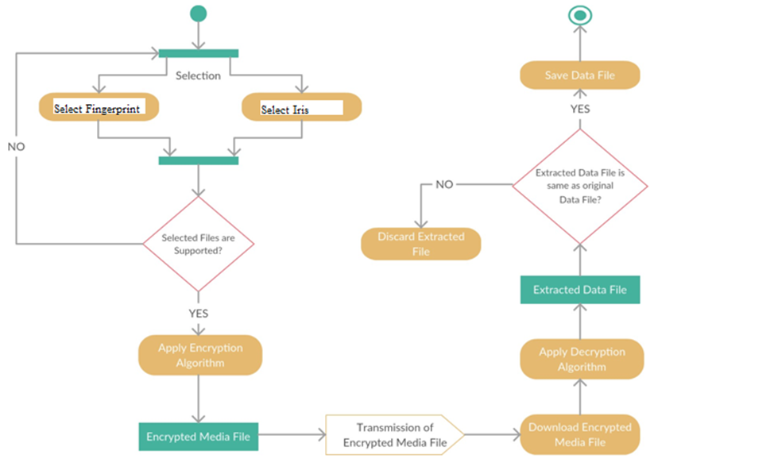
IDEATION

Slide 10
MODULES
Encryption
Decryption
Iris Detection
Fingerprint Matching

Slide 11
Advantages of the Proposed System
Highly reliable
Accurate
Inexpensive
Low memory requirement

Slide 12
Future enhancements
Can be used for security purposes of data in fields such as
ATM machines
Banking systems
Government Documents
Watermarking

Slide 13
THANK YOU

