Slide 1

RNS Institute of Technology
INTERNSHIP PROJECT
on
Covid Tracker using REACT
Coordinator :
Mr. Ravi Kumar SG Assistant Professor
Dept. of ISE, RNSIT
Guide:
Mrs Tejashwini P
Assistant Professor
Dept. of ISE, RNSIT
Presented by:
Kalpit Patira
1RN17IS040
1

Slide 2
Introduction
The world is facing the Pandemic situation for past 9-10 months because of Deadly Novel Covid-19 Corona Virus.
The main aim of this Project is to show important counts and numbers regarding the TOTAL INFECTED and RECOVERED people along with the total numbers of DEATHS all till now and in last 24 hours of time.

Slide 3
Technologies Used:
◆
FOR FRONTEND-
React JS
HTML
CSS
FOR DATA-
-disease.sh

Slide 4
Brief Description about Technologies Used
5
React is a front-end library developed by Facebook. It is used for handling the view layer for web and mobile apps. ReactJS allows us to create reusable UI components. It is currently one of the most popular JavaScript libraries and has a strong foundation and large community behind it.
Disease.sh is open api which is used to collect the data of the total number of infected and recovered people.

Slide 5
CODE-
scales: {
xAxes: [
{
type: "time",
time: {
format: "MM/DD/YY",
tooltipFormat: "ll",
},
},
],
yAxes: [
{
gridLines: {
display: false,
},
ticks: {
// Include a dollar sign in the ticks
callback: function (value, index, values) {
return numeral(value).format("0a");
},
},
},
],
},
};
For Line Graph and Chart:
const options = {
legend: {
display: false,
},
elements: {
point: {
radius: 0,
},
},
maintainAspectRatio: false,
tooltips: {
mode: "index",
intersect: false,
callbacks: {
label: function (tooltipItem, data) {
return numeral(tooltipItem.value).format("+0,0");
},
},
},

Slide 6
function LineGraph({ casesType }) {
const [data, setData] = useState({});
useEffect(() => {
const fetchData = async () => {
await fetch("https://disease.sh/v3/covid-19/historical/all?lastdays=120")
.then((response) => {
return response.json();
})
.then((data) => {
let chartData = buildChartData(data, casesType);
setData(chartData);
console.log(chartData);
// buildChart(chartData);
});
};
fetchData();
}, [casesType]);
const buildChartData = (data, casesType) => {
let chartData = [];
let lastDataPoint;
for (let date in data.cases) {
if (lastDataPoint) {
let newDataPoint = {
x: date,
y: data[casesType][date] - lastDataPoint,
};
chartData.push(newDataPoint);
}
lastDataPoint = data[casesType][date];
}
return chartData;
};

Slide 7
return (
<div>
{data?.length > 0 && (
<Line
data={{
datasets: [
{
backgroundColor: "rgba(204, 16, 52, 0.5)",
borderColor: "#CC1034",
data: data,
},
],
}}
options={options}
/>
)}
</div>
);
}

Slide 8
Table
function Table({ countries }) {
return (
<div className="table">
{countries.map((country) => (
<tr>
<td>{country.country}</td>
<td>
<strong>{numeral(country.cases).format("0,0")}</strong>
</td>
</tr>
))}
</div>
);
}

Slide 9
Map
function Map({ countries, casesType, center, zoom }) {
return (
<div className="map">
<LeafletMap center={center} zoom={zoom}>
<TileLayer
url="https://{s}.tile.openstreetmap.org/{z}/{x}/{y}.png"
attribution='&copy; <a href="http://osm.org/copyright">OpenStreetMap</a> contributors'
/>
{showDataOnMap(countries, casesType)}
</LeafletMap>
</div>
);
}

Slide 10
Info Box
function InfoBox({ title, cases, total, active, isRed, ...props }) {
console.log(title, active);
return (
<Card
onClick={props.onClick}
className={`infoBox ${active && "infoBox--selected"} ${
isRed && "infoBox--red"
}`}
>
<CardContent>
<Typography color="textSecondary" gutterBottom>
{title}
</Typography>
<h2 className={`infoBox__cases ${!isRed && "infoBox__cases--green"}`}>
{cases}
</h2>
<Typography className="infoBox__total" color="textSecondary">
{total} Total
</Typography>
</CardContent>
</Card>

Slide 11
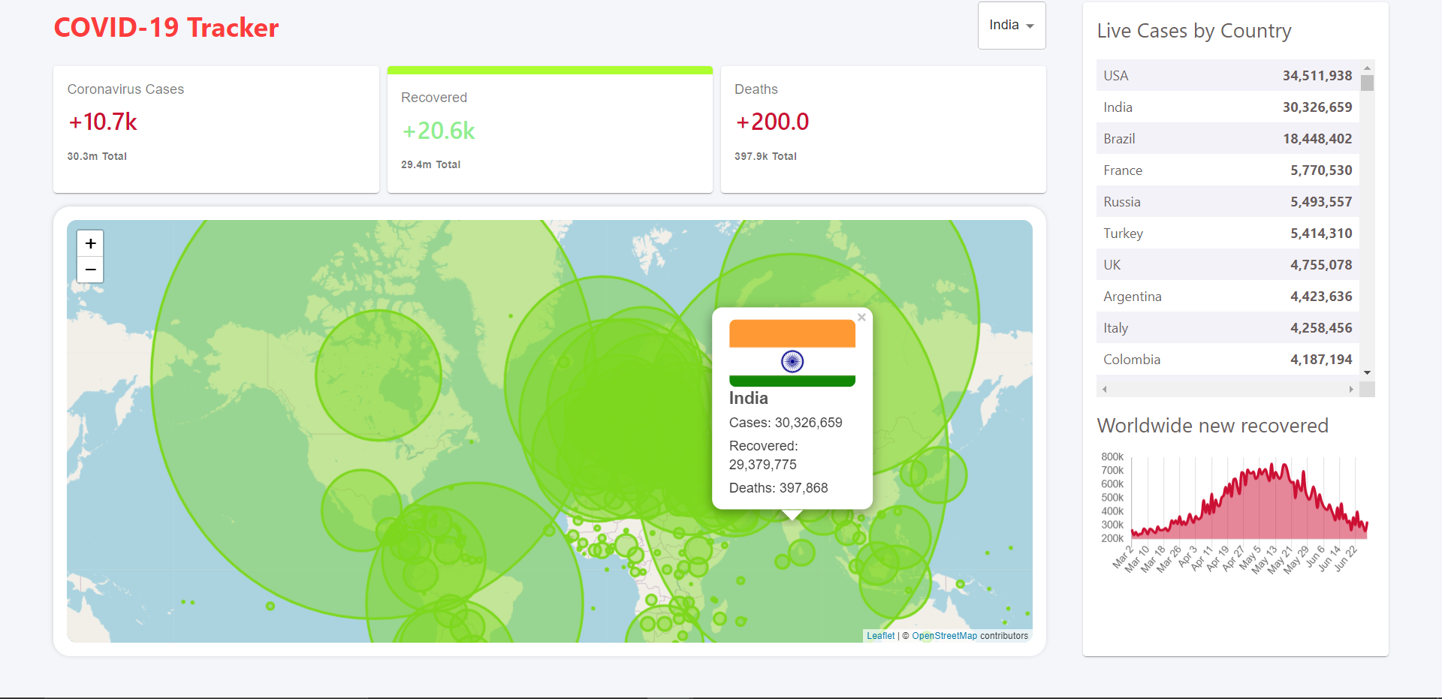
SNAPSHOTS
For Recovered Cases

Slide 12
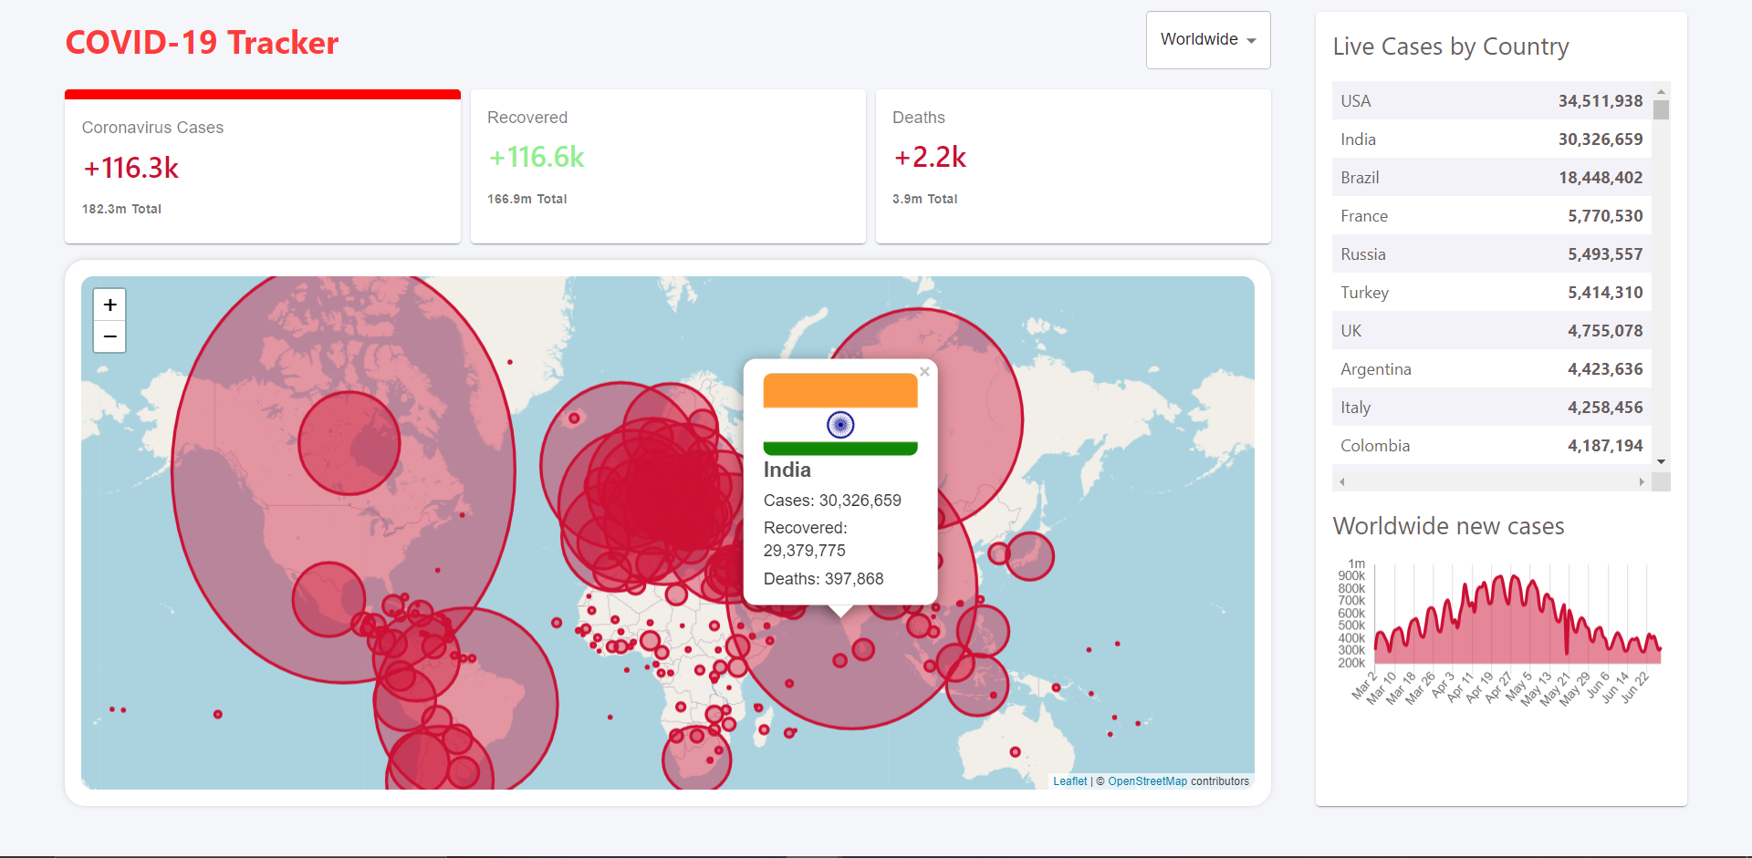
For Total Infected Cases

Slide 13
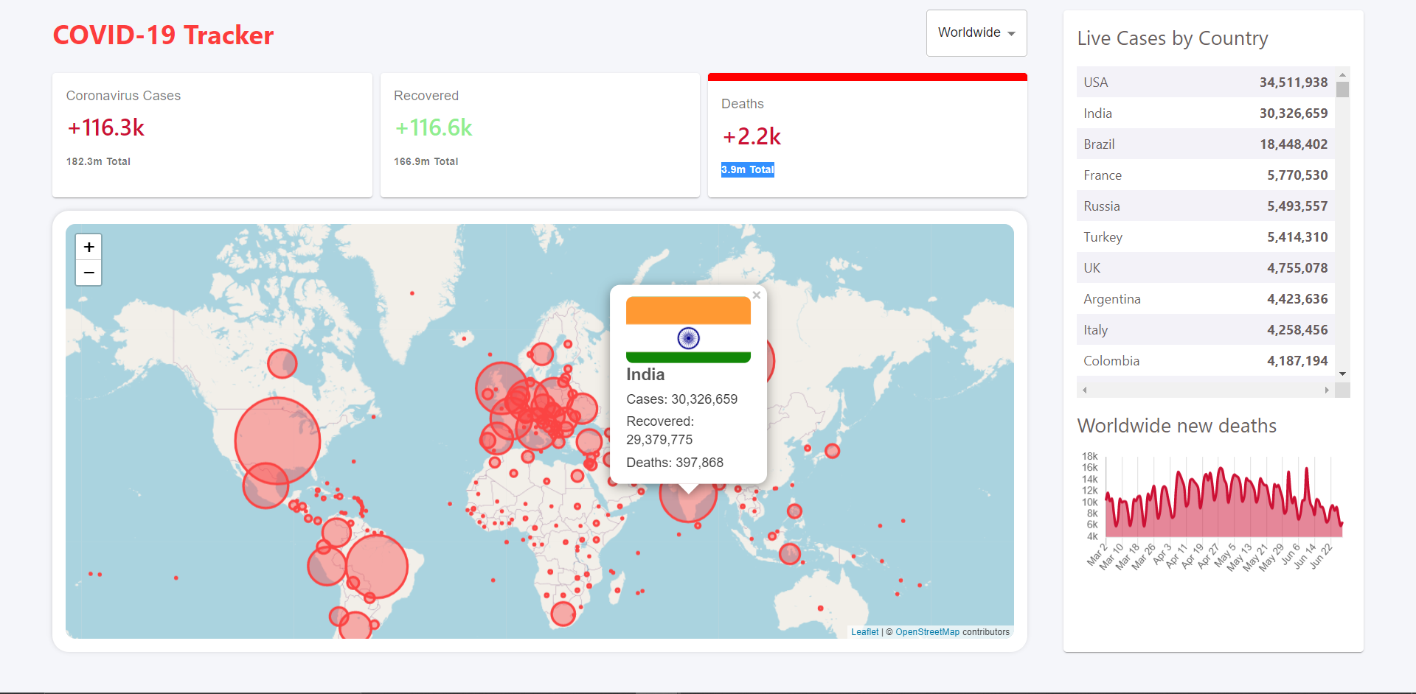
For Total Number of Deaths

Slide 14
Future Work
◆ This was the basic approach to build a React App for the Covid Tracker.
We can make it for an individual basis which can keep track of their activities and location, that can be useful for the users to send them an alert in case they contact someone infected.
The Data is not printed correcly which can be improved in future work.
The user experience can be made better by making it more user interactive.
Map Can be used in a better to improve user experience.

Slide 15
THANK YOU

