Slide 1
A Century of Natural Disasters
More events, fewer deaths, bigger bills
Visual exploration of the EM-DAT Emergency Events Database, 1900-2022
Lakshya Jain (BT2024044)
When? The temporal record
Arnav Jain (BT2024233)
Where? The geography of exposure
Kalpit (BT2024093)
What? The impact signature of hazards
DAS732 Data Visualization · Programming Assignment 1 · IIIT Bangalore
Notes:
0:00-0:10 TITLE. Hold while Lakshya opens.
"Everyone believes natural disasters are getting worse. We took EM-DAT - 123 years, 225 countries, 15,015 recorded events - and asked one question."

Slide 2
One question
Over 1900-2022, has the burden of natural disasters actually grown -
and has the world become better or worse at surviving it?
A disaster has no single cost - and the four costs do not move together.
Counted
Killed
Displaced
Cost
15,015 events
22.9M deaths
8.5B affected
$6.7T damage
Three sub-questions, one per member - so no task is split across the team.
Lakshya Jain
Notes:
0:10-0:20 THE QUESTION.
"Has the burden actually grown, and are we getting better at surviving it? The answer turned out to be yes to both - and the two halves don't fit together the way you'd expect."

Slide 3
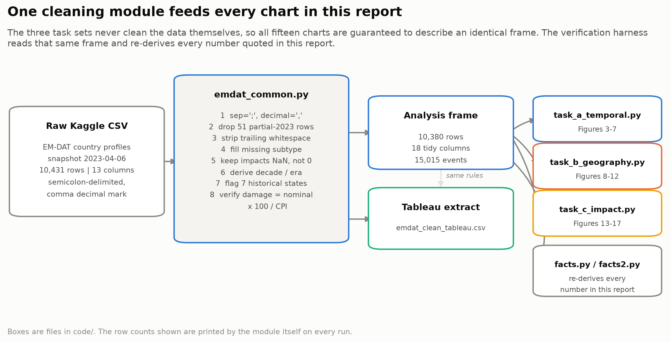
Four things to fix before any chart
1
Semicolon-separated, comma decimals
read naively, every number arrives as text
2
2023 is a part-year
51 rows dropped, or every trend fakes a collapse
3
Trailing spaces in hazard labels
"Extreme temperature " split one category in two
4
Missing impacts kept as missing
zero-filling would flatter every historical decade
10,431 rows -> 10,380 rows · 15,015 events · 225 countries
One cleaning module feeds all 15 charts, so no two figures can disagree.
Lakshya Jain
Notes:
0:20-1:00 PREPROCESSING (Lakshya - the brief allows the first minute for this).
"Four things had to be fixed before any chart. The file is semicolon-separated with comma decimals. It's an April 2023 snapshot, so 2023 is a part-year - we dropped those 51 rows or every trend would fake a collapse at the end. Some hazard labels carry a trailing space, which silently splits 'Extreme temperature' into two categories. And we verified rather than assumed that the adjusted damage column is constant 2022 dollars - nominal times 100 over CPI, and CPI is exactly 100 in 2022.
Critically, we left missing impact values missing, never zero - treating 'not reported' as 'nobody died' would have flattered every historical decade."

Slide 4
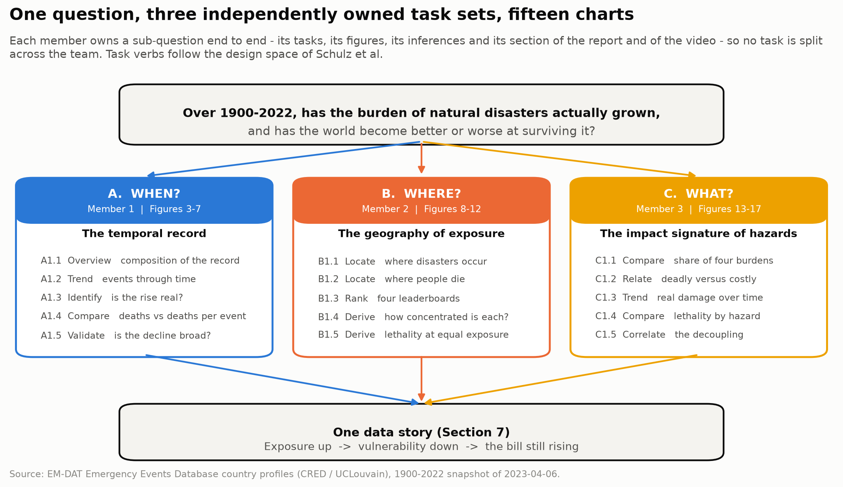
One question, three owned task sets, fifteen charts
All three
Notes:
1:00 HANDOVER.
"We split it three ways - when, where and what. Each of us owns a sub-question end to end: its tasks, its charts and its inferences."

Slide 5
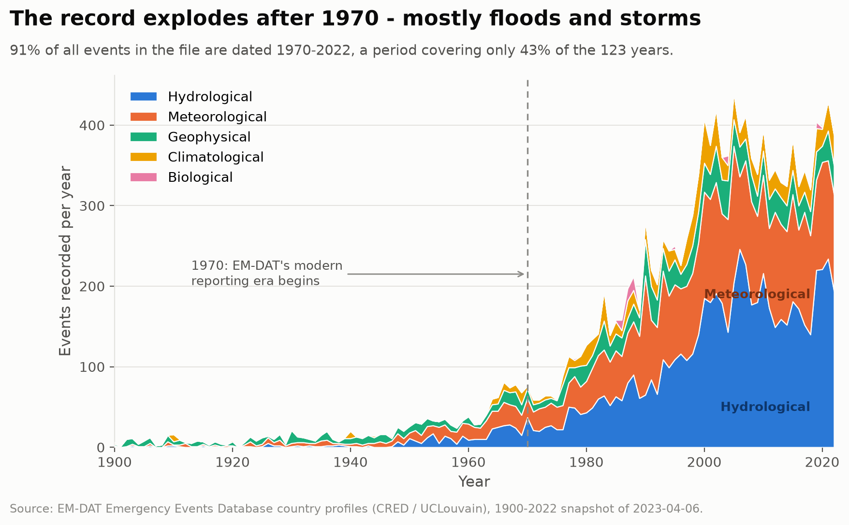
The record explodes after 1970
That shape is also exactly what a step-change in data collection looks like.
Lakshya Jain
Notes:
1:00-1:15 A1.2 TREND.
"Events per year. It looks like an explosion after 1970 - and this is where we nearly went wrong."

Slide 6
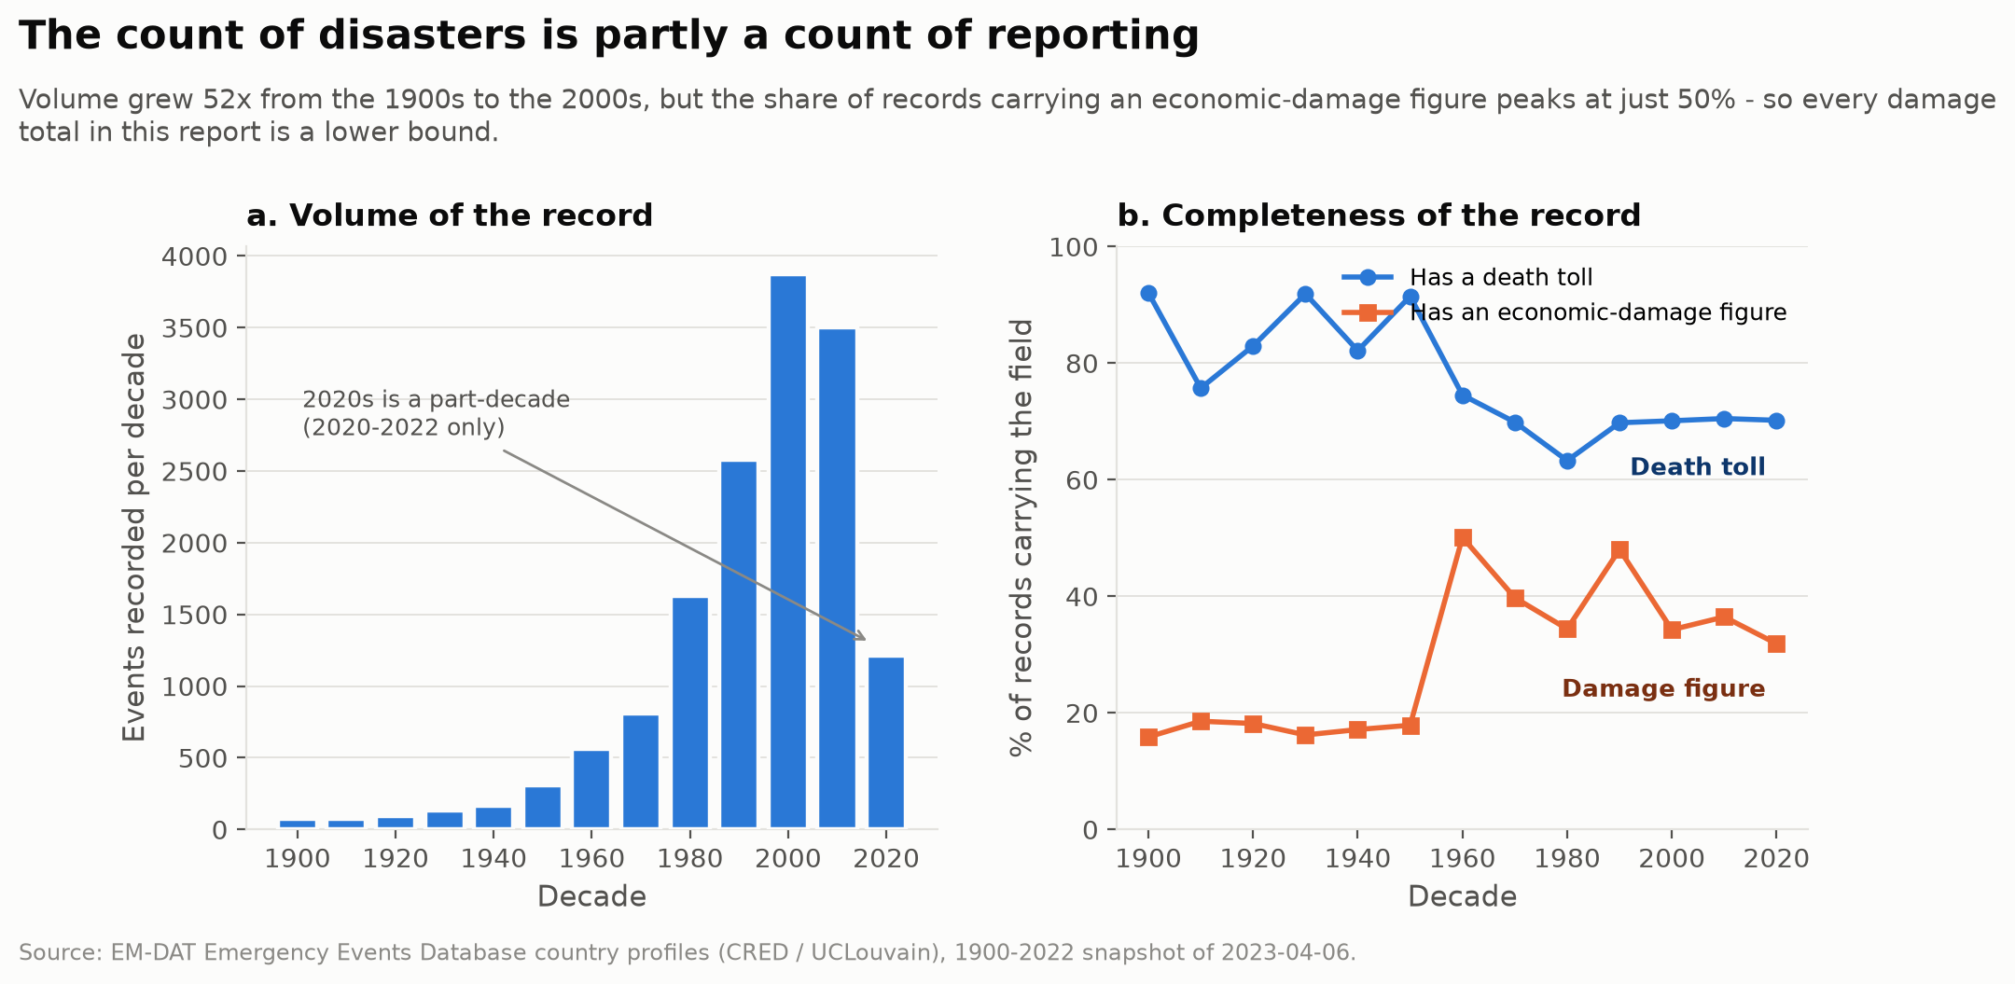
...but it is partly a count of reporting
91% of the record sits in 43% of the years. So we use rates, not counts, from here on.
Lakshya Jain
Notes:
1:15-1:35 A1.3 IDENTIFY - the diagnostic figure.
"Volume grew 52-fold, which no physical change in hazard could produce on its own. And damage reporting covers at most half the records in any decade. So the count measures reporting as much as it measures hazard. Everything after this uses rates."

Slide 7
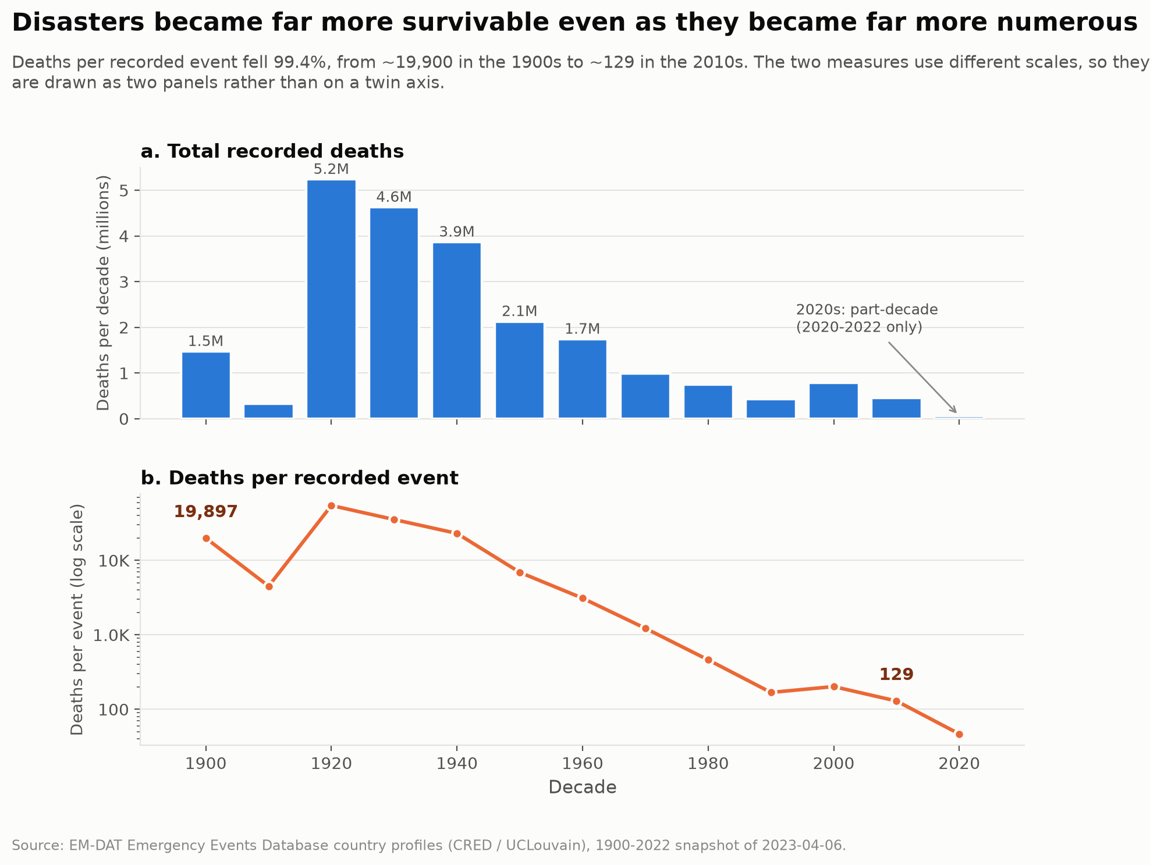
Deaths per recorded event fell 99.4%
Two panels, never a twin axis - a twin axis lets the author pick the crossing point.
Lakshya Jain
Notes:
1:35-1:55 A1.4 COMPARE - the headline finding.
"Total deaths peaked in the 1920s at 5.2 million. But look at panel b - deaths per recorded event fell from about nineteen nine hundred to a hundred and twenty-nine. An individual recorded disaster today kills roughly one 150th of what one did a century ago."

Slide 8
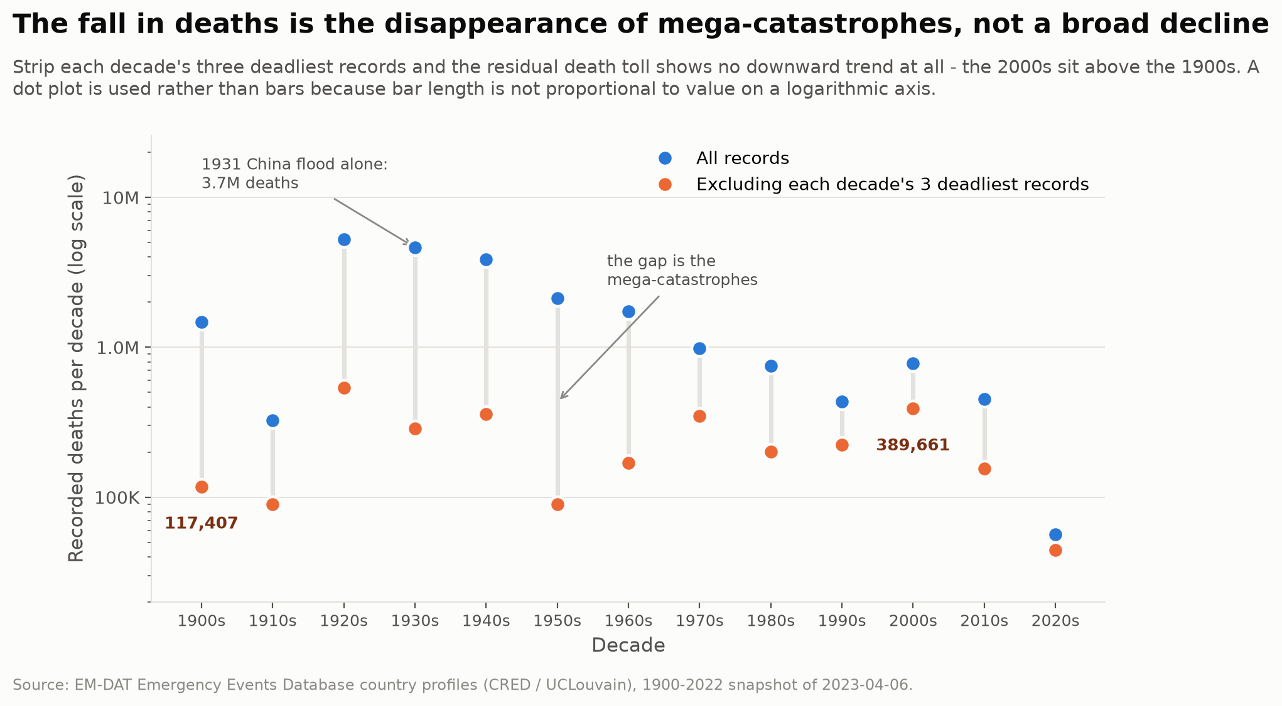
Then we tried to break our own finding
Strip each decade's three deadliest records and the decline vanishes entirely.
Lakshya Jain
Notes:
1:55-2:15 A1.5 VALIDATE - the honest caveat. Do not skip this slide.
"The 2000s sit above the 1900s once the mega-catastrophes are removed. So the century-scale fall in TOTAL deaths is mostly the disappearance of events like the 1931 China flood, not a broad improvement. The per-event improvement is the claim that survives."
Handover to Arnav.

Slide 9
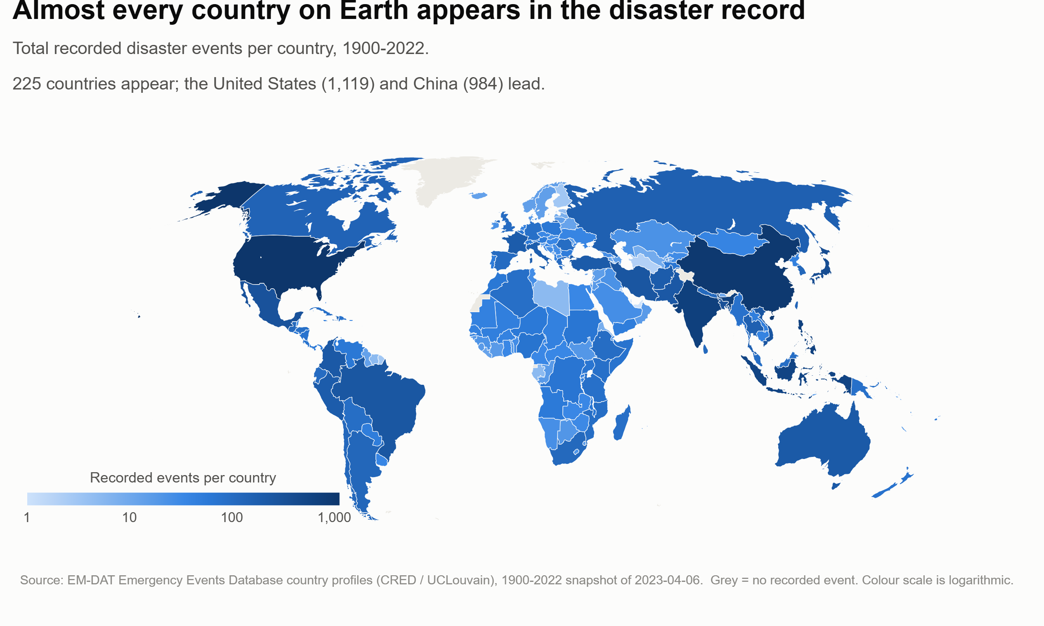
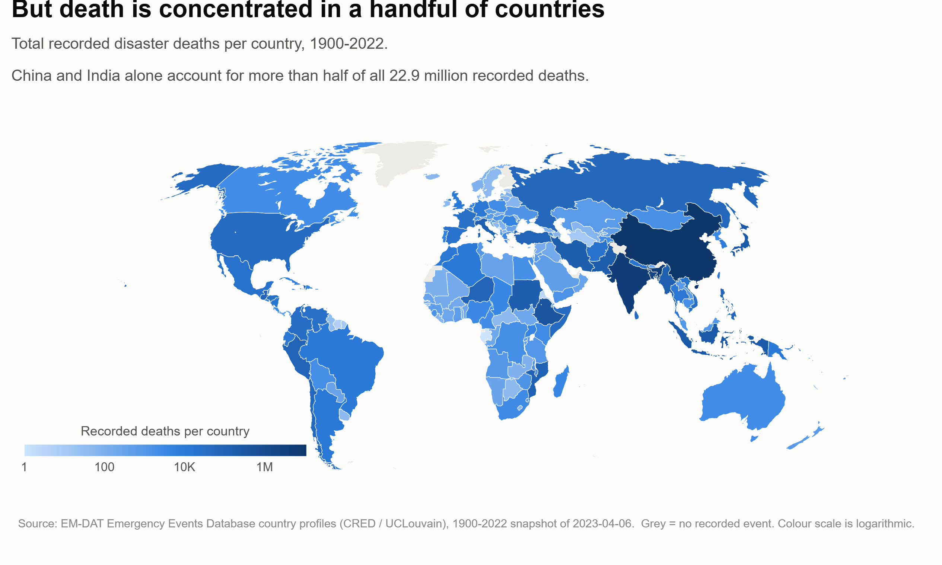
Disasters are global. Death is not.
All 225 countries appear
China + India = 68% of all deaths
LIVE IN TABLEAU: switch the map here
Arnav Jain
Notes:
2:15-2:35 B1.1 / B1.2 LOCATE. *** DO THE MAP SWITCH LIVE IN TABLEAU ***
The rubric names "Tableau demo" explicitly - this is the moment to earn it.
"Here is where disasters are recorded - all 225 countries, fairly evenly shaded. Now watch what happens when I switch the same map to deaths. [SWITCH] It collapses onto two countries. China and India alone are 68% of all 22.9 million recorded deaths."

Slide 10
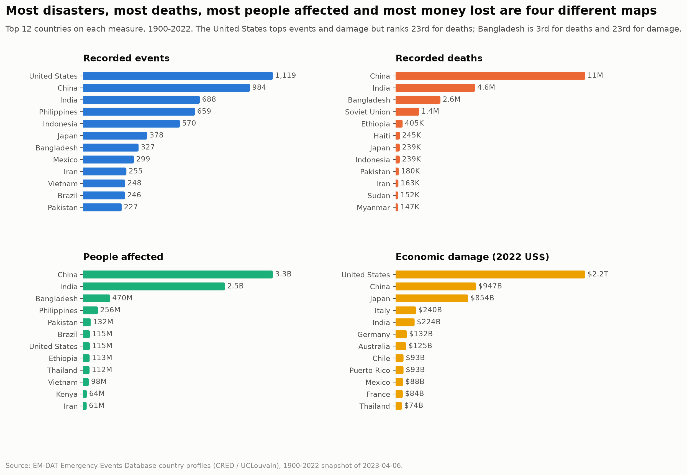
Four measures, four different leaderboards
The US is 1st for events and 1st for damage - and 23rd for deaths.
Arnav Jain
Notes:
2:35-2:55 B1.3 RANK.
"The four leaderboards barely overlap. The United States is first for events and first for damage, and twenty-third for deaths. Bangladesh is third for deaths and twenty-third for damage. Wealth converts disaster exposure into property loss instead of death."

Slide 11
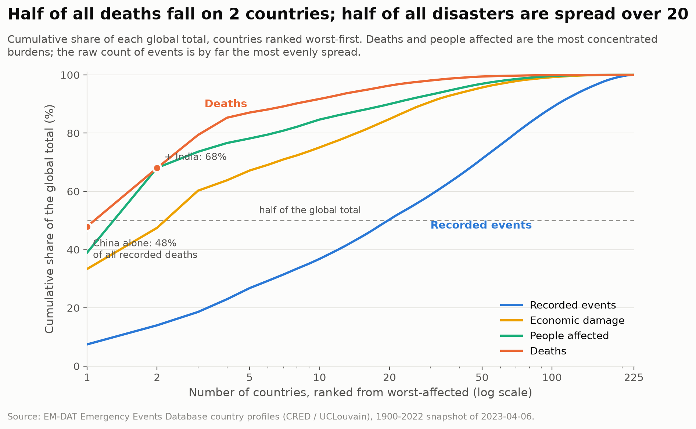
Two countries hold half of all deaths
But it takes twenty countries to reach half of all recorded events.
Arnav Jain
Notes:
2:55-3:10 B1.4 DERIVE.
"Deaths are far more concentrated than disasters. The top five countries hold 87% of deaths but only 27% of events. Disasters happen nearly everywhere; dying from them does not."

Slide 12
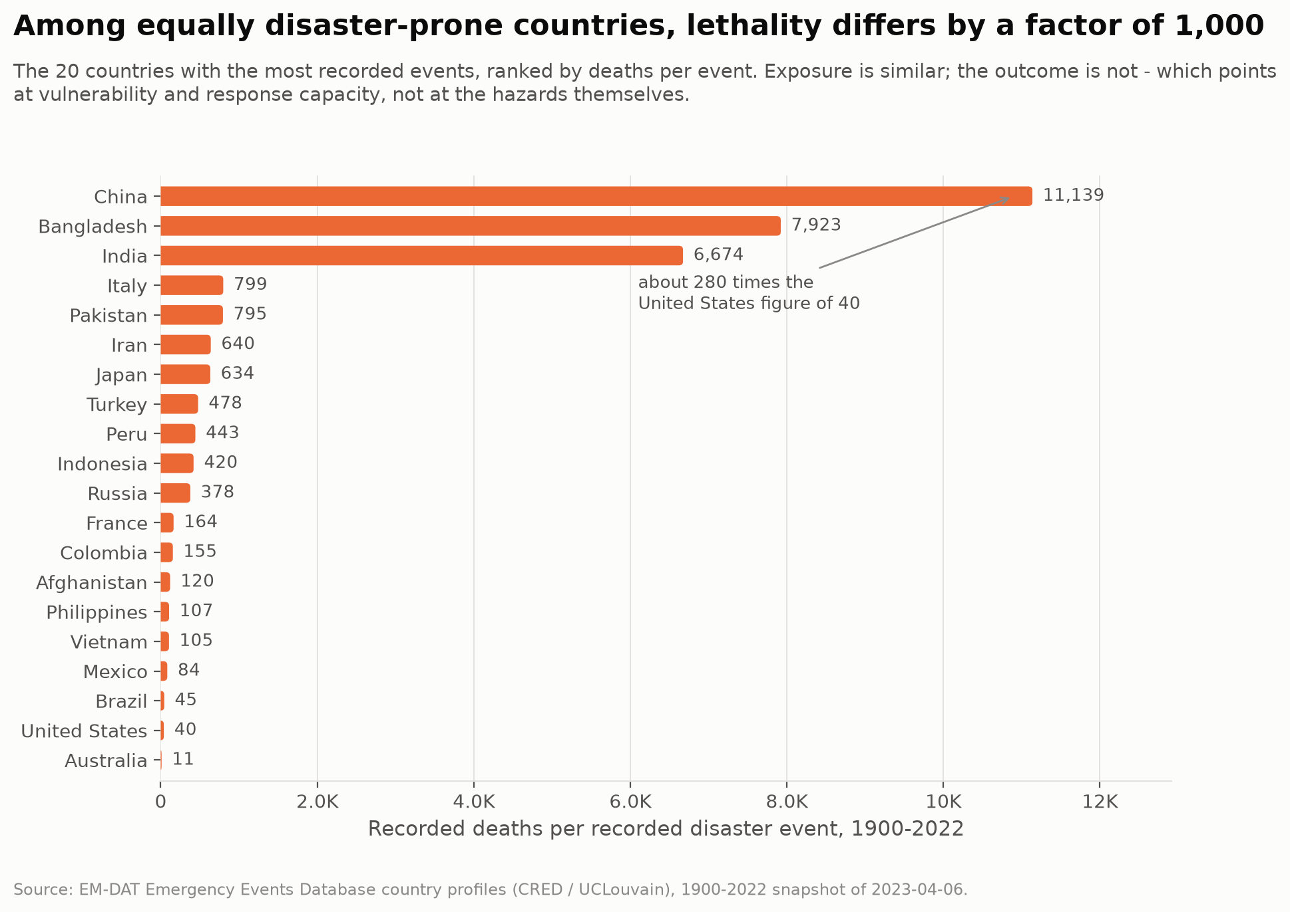
Same exposure, 1,000x the lethality
China 11,139 deaths per event; Australia 11. That gap is not hazard - it is vulnerability.
Arnav Jain
Notes:
3:10-3:30 B1.5 DERIVE - the slide that changed how we read the data.
"Take the twenty most disaster-prone countries, so exposure is roughly held constant, and lethality still spans a factor of a thousand. Two honest caveats: there is no population denominator, and China's figure is loaded by the pre-1960 famines. Even so, the spread is far too wide to be hazard."
Handover to Kalpit.

Slide 13
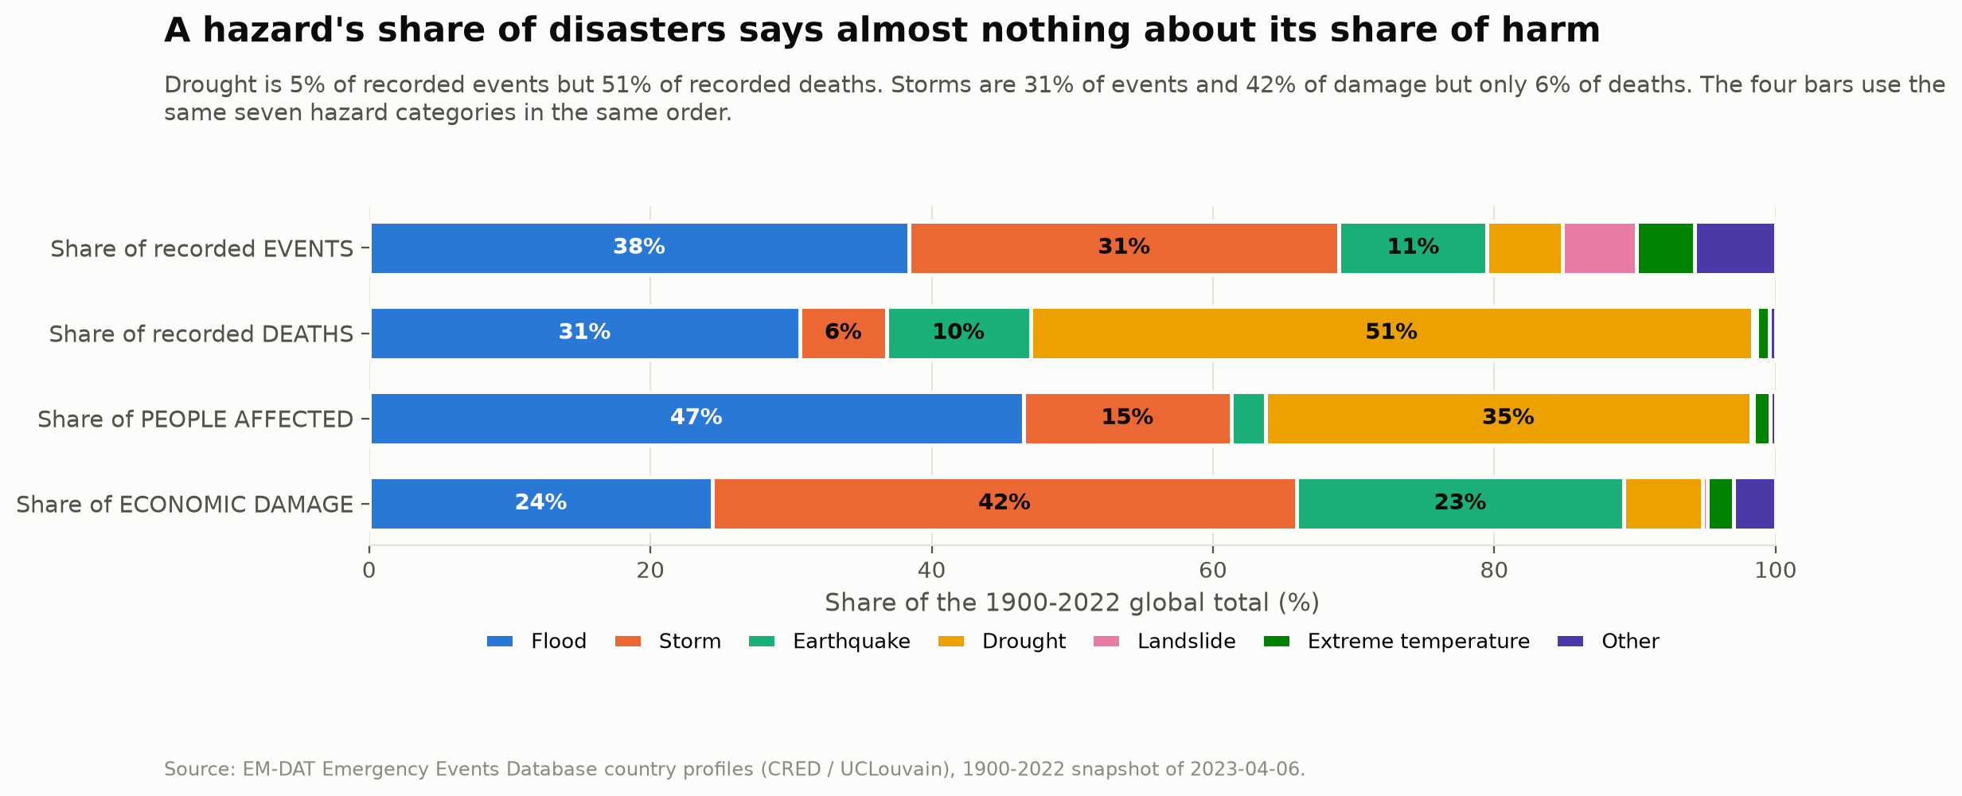
5% of events. 51% of deaths.
Four bars, the same seven hazards, the same colour order.
Drought kills, storms cost, floods displace - they are different hazards.
Kalpit
Notes:
3:30-3:55 C1.1 COMPARE - the key chart of Task Set C.
"Drought is five percent of recorded events and fifty-one percent of recorded deaths. Storms are the mirror image: 31% of events, 42% of the money, six percent of the deaths. Earthquakes are the concentrated destroyer - a tenth of events, a quarter of the damage, but only 2.4% of people affected."

Slide 14
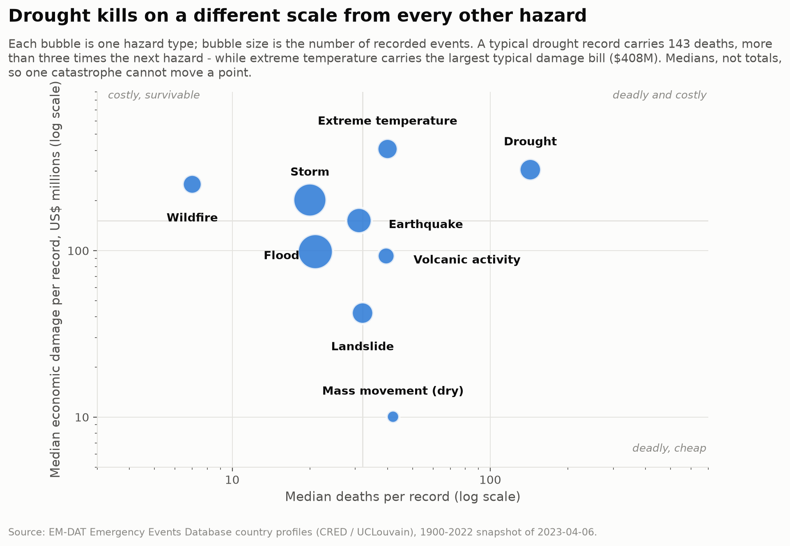
Deadly and costly are different hazards
Drought: 143 deaths per record. Wildfire: $250M and a median of 7 deaths.
Kalpit
Notes:
3:55-4:05 C1.2 RELATE.
"Each hazard sits somewhere in a deadliness-cost plane. Drought is alone on the right. Wildfire is the opposite corner - expensive, but almost harmless to life. There is no single severity axis."

Slide 15
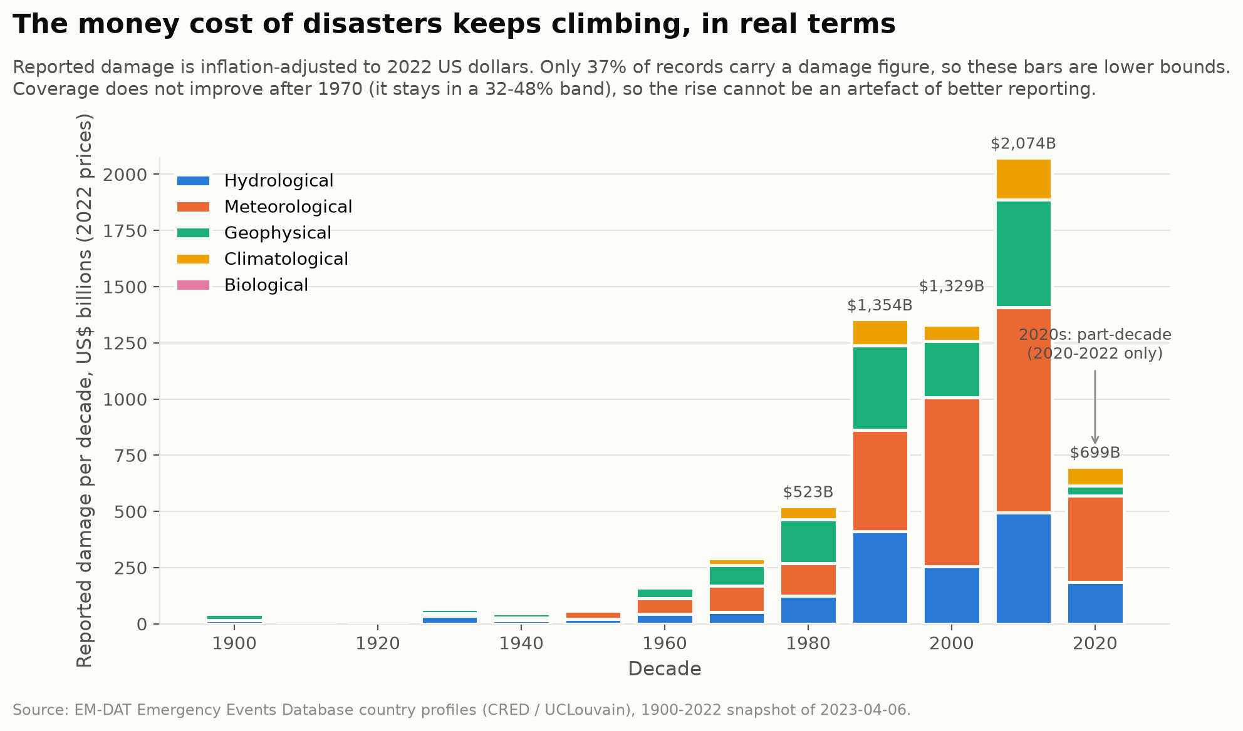
$2.07 trillion - the costliest decade yet
Damage coverage does not improve after 1970, so this rise is not a reporting artefact.
Kalpit
Notes:
4:05-4:20 C1.3 TREND.
"Real damage, inflation-adjusted to 2022 dollars. The 2010s cost 2.07 trillion - a record - and the 2020s are already at 699 billion with only three years counted."

Slide 16
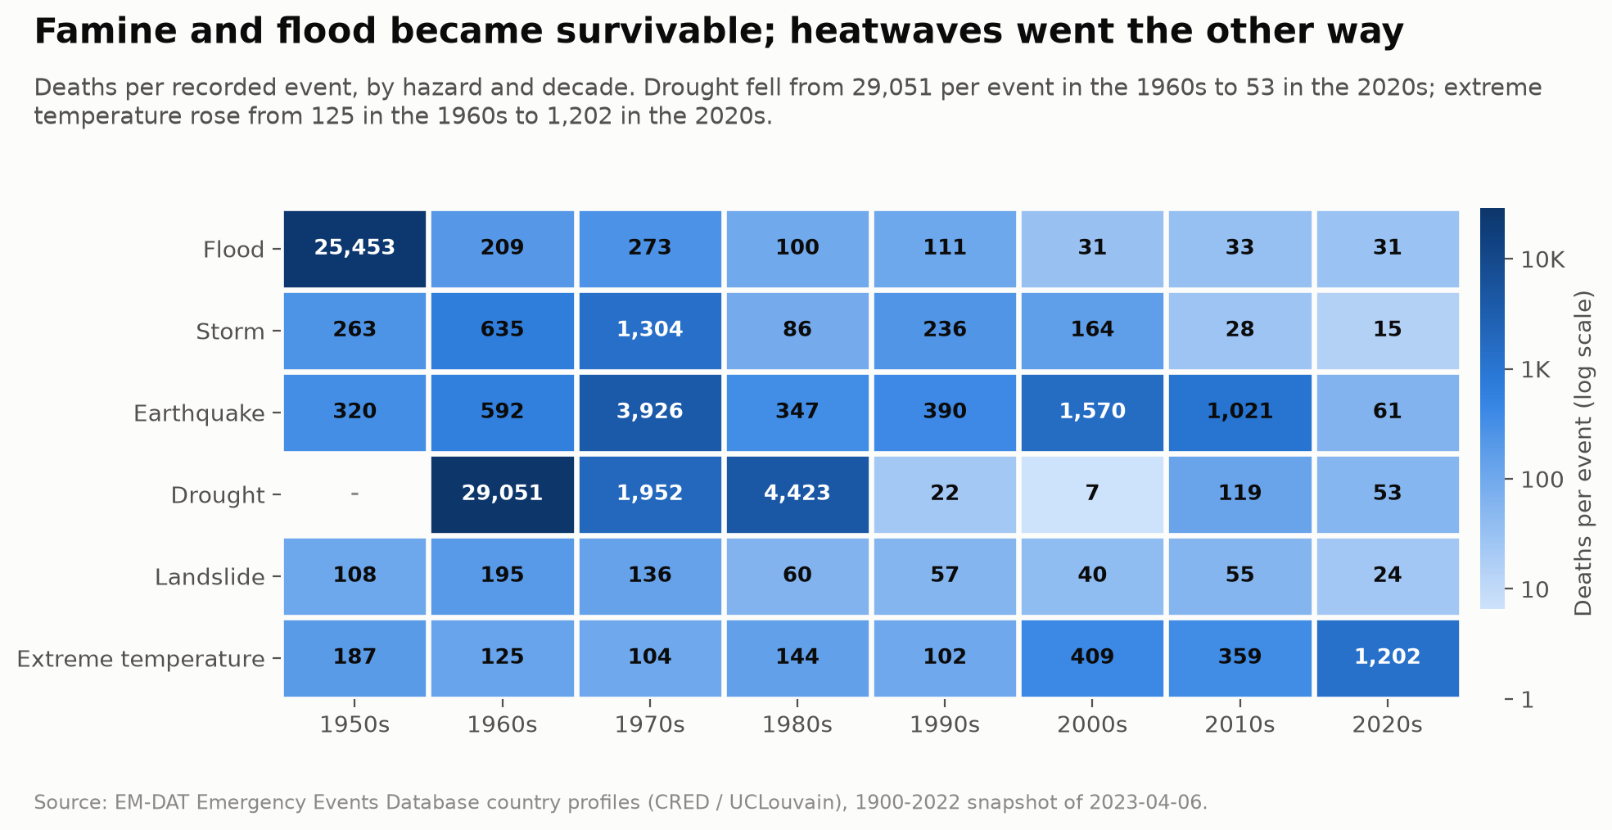
Which hazards became survivable?
Drought 29,051 -> 53. Earthquakes never improved. Extreme heat went the wrong way.
Kalpit
Notes:
4:20-4:35 C1.4 COMPARE.
"Drought fell from twenty-nine thousand deaths per event to fifty-three. Floods and storms collapsed too - all hazards that give warning. Earthquakes, which give none, did not improve at all. And extreme temperature went the wrong way: 125 in the 1960s, 1,202 in the 2020s."

Slide 17
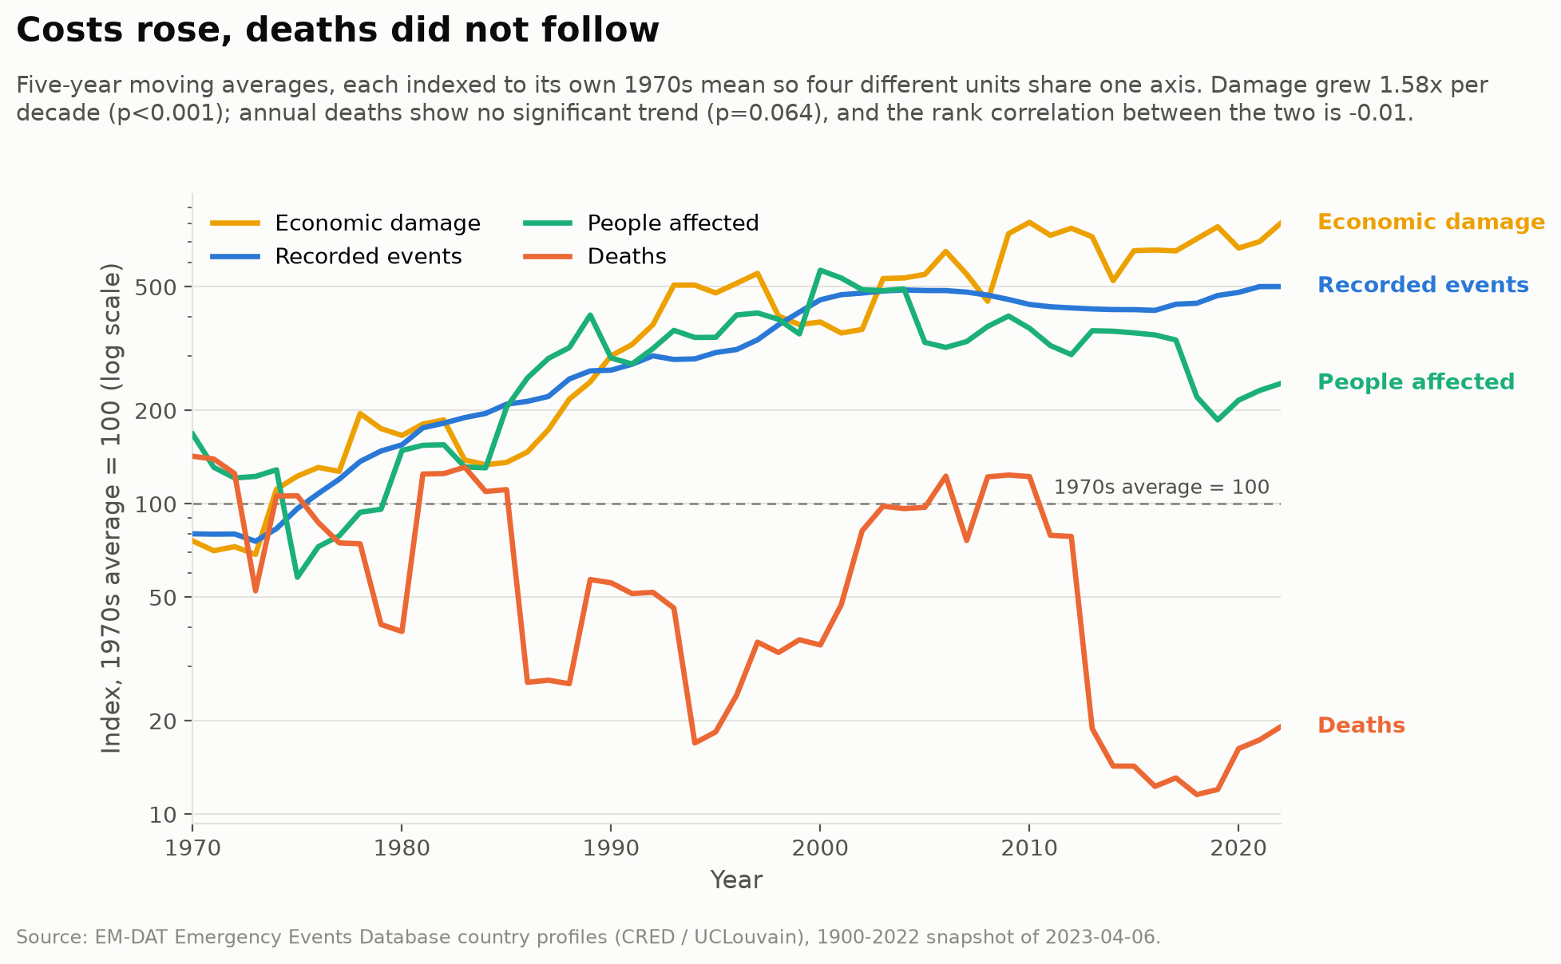
Costs rose. Deaths did not follow.
Rank correlation between annual deaths and annual damage: -0.01.
Kalpit
Notes:
4:35-4:45 C1.5 CORRELATE.
"Since 1970, events, damage and people affected all rise significantly. Annual deaths show no significant trend at all - p is 0.064. Costs and mortality have decoupled."

Slide 18
Exposure up. Vulnerability down. The bill still rising.
Exposure rose
more assets, more people - and much better reporting
Vulnerability fell
deaths per recorded event down 99.4% in a century
But unevenly
2 countries carry half of all deaths; heat is getting worse
And one caveat on our own headline: most of the fall in total deaths is the loss of mega-catastrophes, not a broad decline.
Thank you.
Notes:
4:45-5:00 CLOSE (any member).
"So: exposure up, vulnerability down, and the bill rising. The world got dramatically better at not dying in disasters - unevenly, not at all for earthquakes, and going backwards for heat. Thank you."
HARD STOP at 5:00.

