Slide 1
The Unserious Generation
on the Most Serious Topic
Field Project · Final Presentation · SYBA English Literature
Presenter: Gatha Kalpana Vijay · Guide: Prof. Dr. Umesh Jagdale Sir
Sangamner Nagarpalika Arts, D.J. Malpani Commerce and B.N. Sarda Science College (Autonomous)
October 2026

Slide 2
CONTEXT
The NEET-UG 2026 Protests
01
June 6: Protests begin at Jantar Mantar, New Delhi
Led by the Cockroach Janta Party (CJP) and student groups, demanding accountability.
02
June 28: Sonam Wangchuk joins and begins a hunger strike
Alongside six AISA student activists. Police removed him from the site on July 18.
03
July 20: ‘Sansad Chalo’, the march to Parliament
Violent clashes with security forces. By July 23 the protests spread to Tamil Nadu, Kerala and more.
04
July 25: Education Minister Dharmendra Pradhan resigns
Seven weeks after the first demonstration at Jantar Mantar.
Demands: accountability, the minister’s resignation, and relief for families of students lost to exam-related suicide.

Slide 3
RESEARCH
Research Question & Thesis
Research Question
What made irony and humor an effective register for political resistance in the NEET-UG 2026 protests, rather than undermining the protest's seriousness?
Thesis
Memes, reels, and Gen Z slang functioned as a rhetorical mode of political resistance, not decoration around the protest.
Framework
Multimodal discourse analysis (Hakoköngäs, Halmesvaara & Sakki, 2020), adapted to four dimensions: Device · Target · Audience · Function.
Corpus
13 items from Instagram, Pinterest and BBC News (June 6 – July 25, 2026). 7 analysed in detail.

Slide 4
METHODOLOGY
Corpus: 7 of 13 Items Analysed
7 / 13
Fig. 1 Spider-Man: "With great power…"
Fig. 2 "Education & System"
Fig. 3 Blinkit & Flipkart
Fig. 4 "Baddies are not apolitical"
Fig. 5 Error 404: Accountability Not Found
Fig. 6 Dora: "Kya aapko kahi accountability dikh rahi hai?"
Fig. 7 "My pad got better leak protection…"
items analysed in detail along four dimensions, out of 13 collected (Pinterest 9 · Instagram 3 · BBC 1)

Slide 5
ANALYSIS · FIGURE 1
The Spider-Man Moment
"With great power comes great responsibility. Can’t say the same for the Indian Government."
Device
Intertextuality + irony + parody. Spider-Man’s moral lesson about power is flipped into an accusation.
Target
A government with power over education policy that failed to act responsibly, especially over the leak.
Audience
Gen Z raised on Marvel get it instantly; officials and older generations may not, which marks the gap.
Function
Power without accountability in one shareable line. ‘Just a joke’, so harder to censor and lower-risk to post.
Source: Instagram @p9xrider and @p9x_puneet_saxena

Slide 6
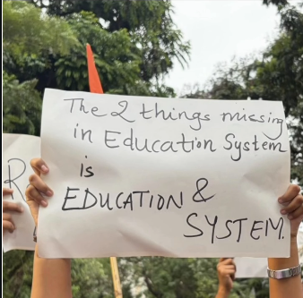
ANALYSIS · FIGURE 2
Missing: Education & System
"The 2 things missing in Education System is EDUCATION & SYSTEM"
Device
Wordplay + structural irony. A riddle set-up whose punchline is the institution's own name.
Target
Total systemic failure: not one leak, but an education system that is hollow at its core.
Audience
In-group gets the "2 things" riddle format instantly; out-group cannot dismiss it, because the joke is literally the accusation.
Function
Compresses a sweeping critique into one self-evident line. The system is indicted by its own name.
Source: Instagram @chief.of.shitposting

Slide 7
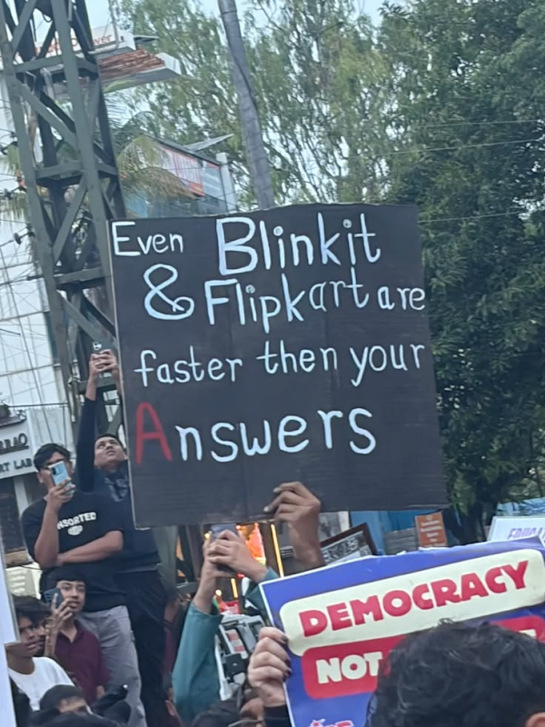
ANALYSIS · FIGURE 3
Faster Than Your Answers
"Even Blinkit & Flipkart are faster then your answers"
Device
Comparative satire + consumer-culture intertextuality (10-minute delivery apps).
Target
Government and NTA silence and delay in answering students after the leak.
Audience
Urban Gen Z who order on quick-commerce apps daily; the comparison needs no explanation.
Function
Measures state accountability against the speed Gen Z expects from everyday life, making official delay look absurd.
Source: Pinterest @yaashnaaaa

Slide 8
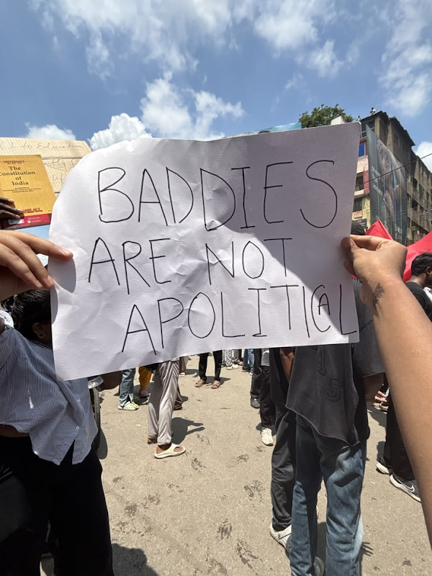
ANALYSIS · FIGURE 4
Baddies Are Not Apolitical
"BADDIES ARE NOT APOLITICAL"
Device
Slang reclamation + subversion of stereotype. "Baddie" = Gen Z slang for a confident, stylish young woman.
Target
The assumption that Gen Z, especially young women, are unserious and apolitical, which institutions rely on.
Audience
In-group self-identifies with the label; elders and media are forced to revise their stereotype.
Function
An identity declaration: the "unserious" label becomes a political stance. The thesis of this project, on a poster.
Source: Pinterest @Lyaaa

Slide 9
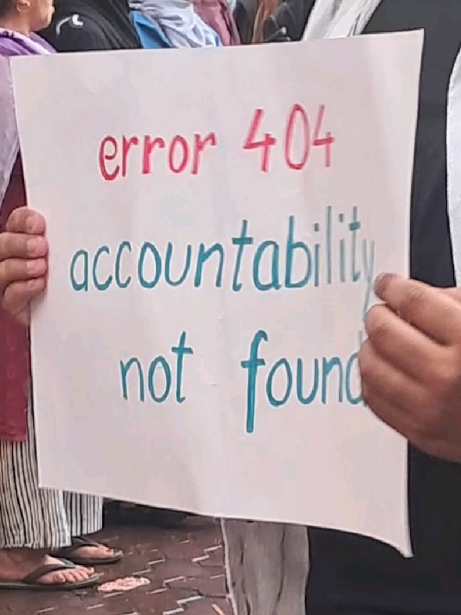
ANALYSIS · FIGURE 5
Accountability Not Found
"error 404 — accountability not found"
Device
Internet/tech intertextuality (the HTTP 404 error page) + deadpan irony; "error 404" written in red.
Target
Absence of accountability: no minister or agency taking responsibility for the leak.
Audience
Digitally native Gen Z read "404" instantly; older viewers may miss the reference, marking the generational gap.
Function
Frames the government as a broken website: the page students need simply does not exist. Visual, compact, shareable.
Source: Pinterest @FAGUN

Slide 10
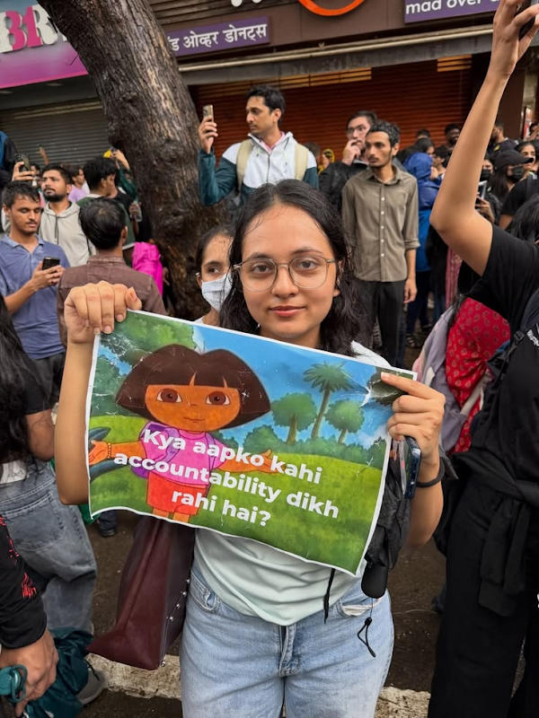
ANALYSIS · FIGURE 6
Dora Asks the Question
"Kya aapko kahi accountability dikh rahi hai?" (Do you see accountability anywhere?)
Device
Parody of Dora the Explorer's Hindi-dubbed catchphrase + childhood nostalgia + Hinglish.
Target
Invisible accountability: the government's evasion after the NEET-UG leak.
Audience
Gen Z raised on Hindi-dubbed Dora; the call-and-response format pulls the viewer into answering.
Function
Turns the audience into participants. The answer, "No!", is the protest, and it treats official evasion like a children's game.
Source: Pinterest @mydearnikes

Slide 11
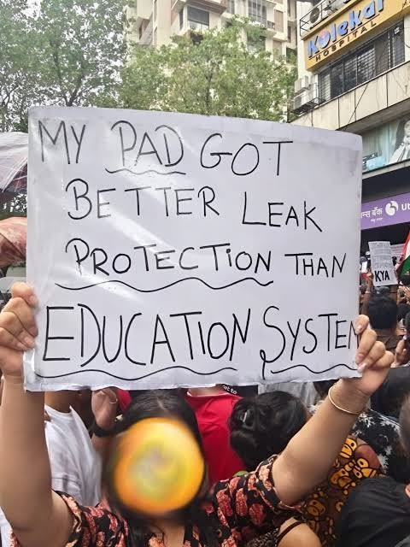
ANALYSIS · FIGURE 7
Better Leak Protection
"My pad got better leak protection than Education System"
Device
Pun on "leak" + parody of sanitary-pad advertising + dark humor that breaks the taboo around menstruation.
Target
The NEET-UG paper leak and the failure of exam security.
Audience
Young women as in-group; the out-group is jolted by a taboo subject made public.
Function
Shock + humor = memorable. An everyday product outperforms a national system, a comparison formal language could never make.
Source: Pinterest @Spring potato

Slide 12
EMERGING PATTERNS
Four Patterns Across the Seven Posters
Borrowed Formats
Comparison as Accusation
Reclaimed Identity
One Shared Target
Marvel, Dora, delivery apps, 404 pages, pad ads. Familiar culture carries the critique.
Blinkit and a sanitary pad outperform the State. The absurdity is the argument.
"Baddies are not apolitical": the "unserious" label becomes political.
Every item, whatever the joke, points back to one demand: accountability.

Slide 13
WHAT HUMOR DID
Humor as Shield, Sword & Community
Shield
Sword
Community
Open to All
“It’s just a joke”: deniable and harder to censor, while staying completely serious.
Says what formal protest language can’t: the State next to a pad, a delivery app, a broken website.
The “you get it” moment is solidarity. Shared laughter turns individual anger collective.
No policy expertise needed to make or share a meme. Anyone can join the protest.

Slide 14
FINDINGS
What the Seven Posters Show
3 / 7
Intertextuality, irony, parody: 3 posters each
Wordplay / pun: 2 · satire, slang, dark humor: 1 each
Most humor is borrowed: Marvel, Dora, Blinkit, 404, ads
Almost every poster has a dual-layered audience
Jokes make critique short, shareable and deniable
No policy expertise needed: anyone can join in
9 of 13 items circulated on Pinterest
posters point straight at missing accountability; the other four hit closely related failures

Slide 15
CONCLUSION
Humor Carried the Protest
01
Irony
Said one thing and meant another, leaving Gen Z to complete the meaning.
02
Parody & Intertextuality
Borrowed what everyone already knew and turned it against the government.
03
Wordplay & Comparison
Made institutional failure look so absurd that it was hard to defend.
04
Slang
Turned “baddie”, a label used to dismiss Gen Z, into a political identity.
Each meme served as a tiny revolution: not decoration around the protest, but a mode of resistance.

Slide 16
RECOMMENDATIONS
Suggestions & Further Research
01
Institutions
Treat memes as political expression, not disrespect. Secure exams and answer students quickly.
02
Media & Older Generations
Engage with Gen Z’s language. Getting the reference is the first step to getting the demand.
03
Educators
Study memes and protest posters as living satire; use multimodal analysis for media literacy.
04
Further Research
Analyse the remaining 6 items, reels, chants and CJP’s content; compare with Gen Z protests elsewhere.
Limitation: 7 of 13 items analysed in detail, so the findings are interpretive, not statistical.

Slide 17
Thank You
The unserious generation speaks seriously,
through the language they know best.
Gatha Kalpana Vijay · SYBA English Literature · October 2026

