Slide 1
Exploratory Data Analysis Project
Dataset - Sales Data for a Pizza Outlet

Slide 2
Problem Statement
KPI’s Requirements: We need to analyze key indicators for our pizza sales data to gain insights into our business performance. Specifically, we want to calculate the following metrics:
Total Revenue: The sum of the total price of all pizza orders.
Average Order Value: The average amount spent per order, calculated by dividing the total revenue by the total number of orders.
Total Pizzas Sold: The sum of the quantities of all pizzas sold.
Total Orders: The total number of orders placed.
Average Pizzas Per Order: The average number of pizzas sold per order, calculated by dividing the total number of pizzas sold by the total number of orders.

Slide 3
Problem Statement
Charts Requirement: We would like to visualize various aspects of our pizza sales data to gain insights and understand key trends. We have identified the following requirements for creating charts:
Daily Trend for Total Orders: Create a bar chart that displays the daily trend of total orders over a specific time period. This chart will help us identify any patterns or fluctuations in order volumes on a daily basis.
Monthly Trend for Total Orders: Create a line chart that illustrates the hourly trend of total orders throughout the day. This chart will allow us to identify peak hours or periods of high order activity.
Percentage of Sales by Pizza Category: Create a pie chart that shows the distribution of sales across different pizza categories. This chart will provide insights into the popularity of various pizza categories and their contribution to overall sales.

Slide 4
Problem Statement
Charts Requirement:
Percentage of Sales by Pizza Size: Generate a pie chart that represents the percentage of sales attributed to different pizza sizes. This chart will help us understand customer preferences for pizza sizes and their impact on sales.
Total Pizzas Sold by Pizza Category: Create a funnel chart that presents the total number of pizzas sold for each pizza category. This chart will allow us to compare the sales performance of different pizza categories.
Top 5 Best Sellers by Revenue, Total Quantity and Total Orders: Create a bar chart highlighting the top 5 best-selling pizzas based on the Revenue, Total Quantity, Total Orders. This chart will help us identify the most popular pizza options.
Bottom 5 Sellers by Revenue, Total Quantity and Total Orders: Create a bar chart highlighting the bottom 5 worst-selling pizzas based on the Revenue, Total Quantity, Total Orders. This chart will help us identify the underperforming or less popular pizza options.

Slide 5
KPI’s
Total Revenue - $817860.05
Average Order Value - 38.31
Total Pizzas sold - 49574
Total Orders - 21350
Average Pizzas Per Order - 2.32

Slide 6
Key Performers
Weekly Highest Orders - Friday- Saturday Evenings
Monthly Highest Orders - July and January
Maximum Sale Category - Classic
Pizza Size Sold the most - Large
Average Pizzas Per Order - 2.32
Best Seller - The Classic Thai Chicken Pizza
Worst Seller - The Barrie Carrie Pizza

Slide 7
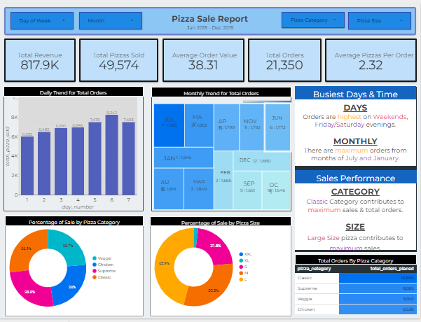
Dashboard

Slide 8
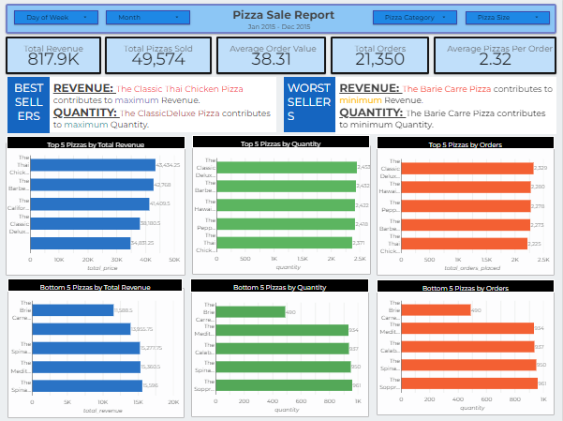
Dashboard

