Slide 1
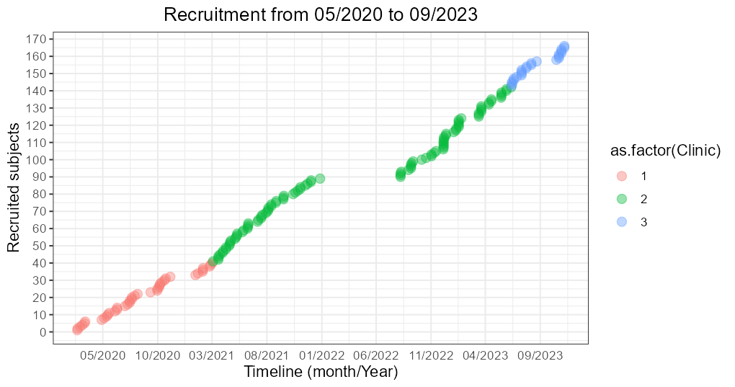
Patient recruitment
1
#Clinic | #cases n=178
Clinic_1 (KH01) | 42
Clinic_2 (KH02) | 112
Clinic_3 (KH03) | 24
Complete cases | 149
Incomplete cases (less blood/damaged /biopsy got cancelled) | 29
Current analysis | 149

Slide 2
Cohort Demographics
2
Cohort
n = 149
Variable | Malignant cases n=91 (61 %) | Benign cases n=58 (39 %) | P value | Test
Age, years mean (min. – max.) | 64 (29 - 93) | 52.8 (20 - 85) | 0.0006 | t.test
Menopause premenopausal postmenopausal | 18 (20%) 73 (80%) | 31 (56%) 24 (44%) | 0.9999
Tissue biopsy Punch Vacuum | 77 (85%) 14 (15%) | 52 (90%) 6 (10%) | 0.7637
Tissue histology NST/IDC DCIS ILC IMPC Fibroadenoma Benign cysts Fibrous Mastopathy Papillomas PASH unknown | 78 (81%) 10 (10%) 5 (5%) 1 (1%) 3 | 22 (44%) 4 (8%) 5 (10%) 4 (4%) 1 (8%) 19

Slide 3
Cohort Demographics
3
Variable | Malignant cases n=91 (61 %) | Benign cases n=58 (39 %) | P value
Molecular subtype Luminal A (HR+, Her2 -, Ki67<14%) Luminal B (HR+, Her2 -, Ki67>14%) Her2/neu (HR -, Her2 +, Ki67+) TNBC | 21 (22%) 32 (33%) 30 (31%) 14 (14%)
CTC before biopsy (intact/questionable) positive negative | 11 (11%) 80 (89%) | 9 (18%) 49 (82%) | 0.4202
CTC before biopsy (intact) positive negative | 4 (4%) 87 (96%) | 3 (6%) 55 (94%) | 0.6727

Slide 4
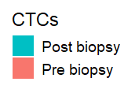
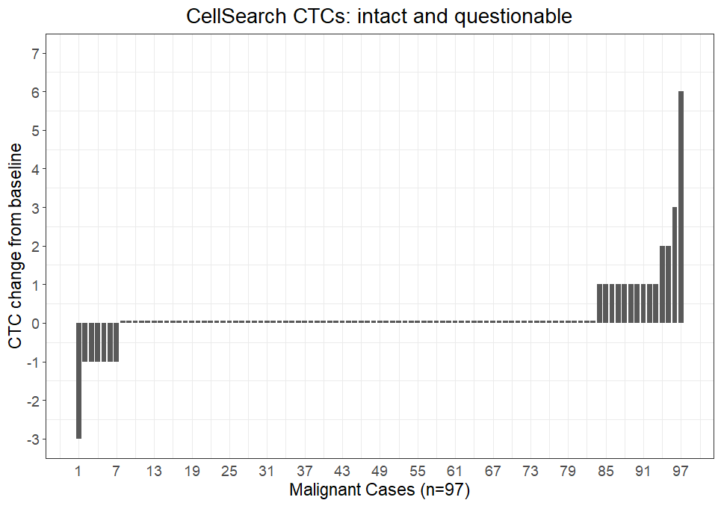
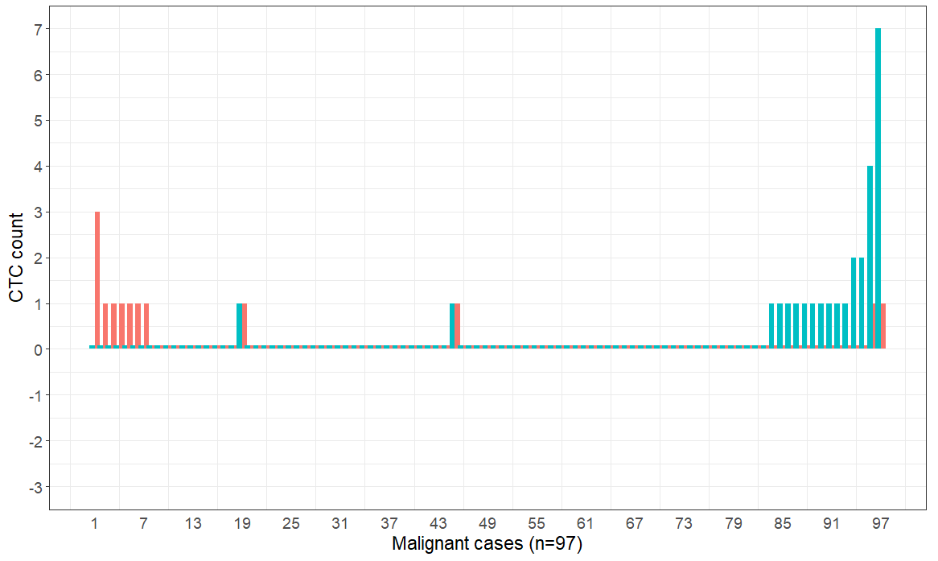
Method_1 CTCs : Malignant cases
4

Slide 5
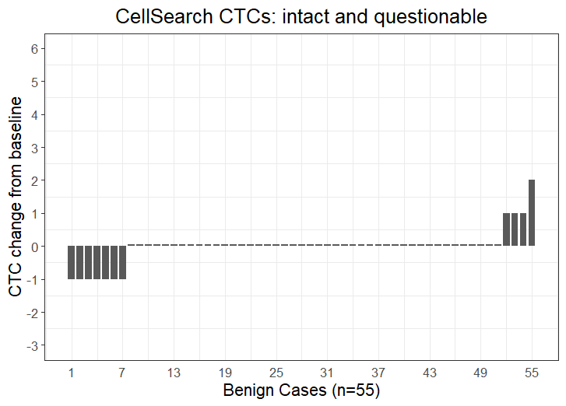
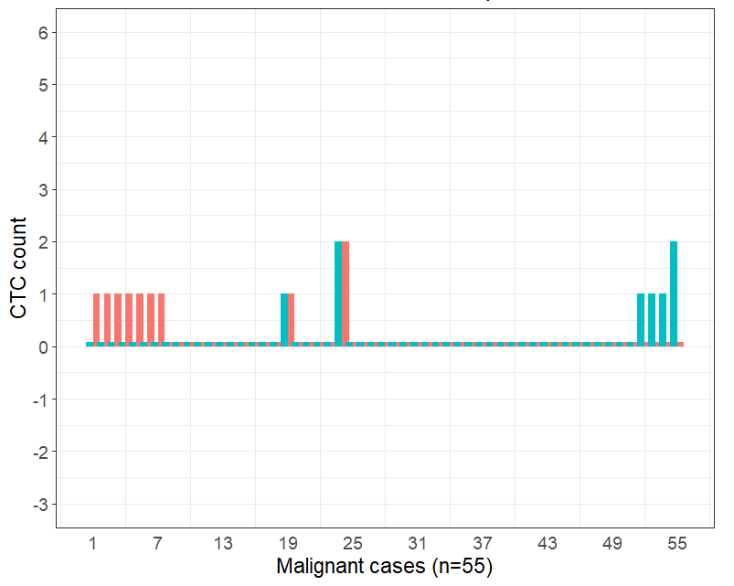
CellSearch CTCs : Benign cases
5

Slide 6
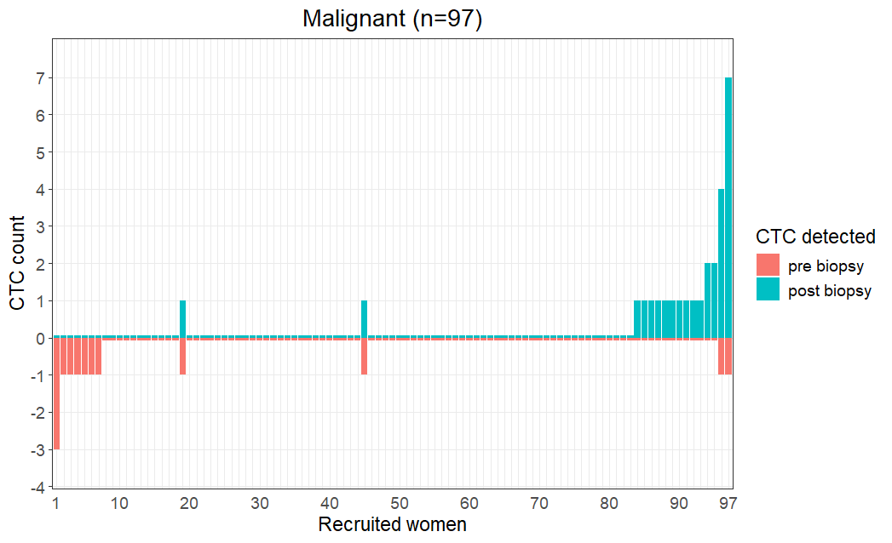
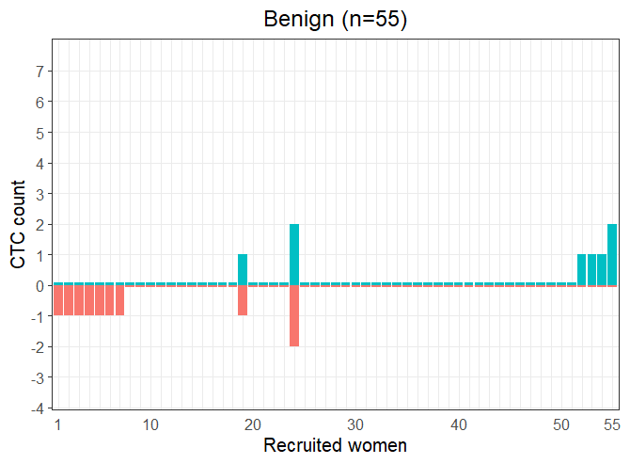
CTC change following biopsy
6
Cases n = 152 | CTC change > 0 | CTC change < = 0
Malignant cases | 14 | 83
Benign cases | 4 | 51
P=0.2592
Biopsy may increase the release of tumor cells into the blood circulation

Slide 7
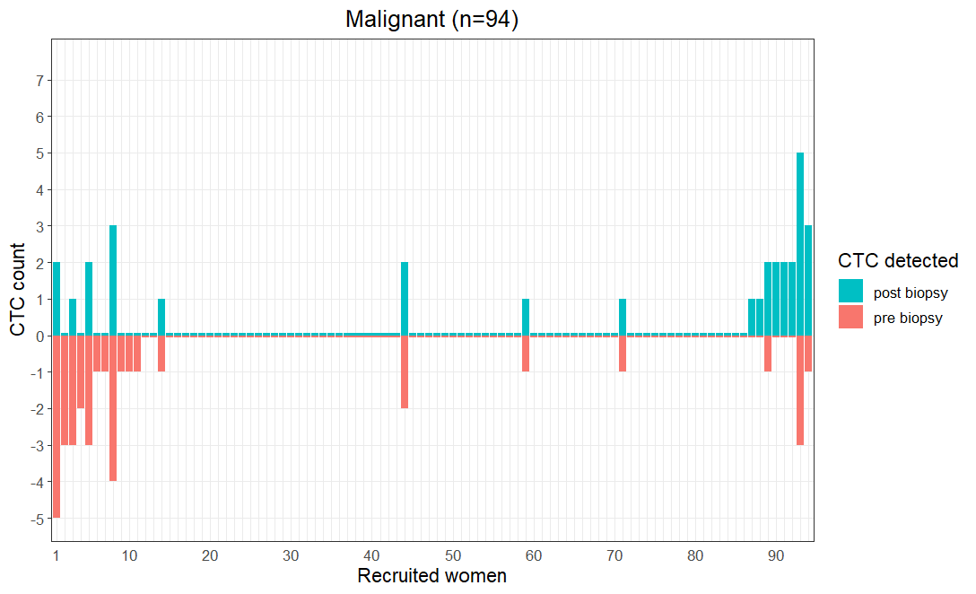
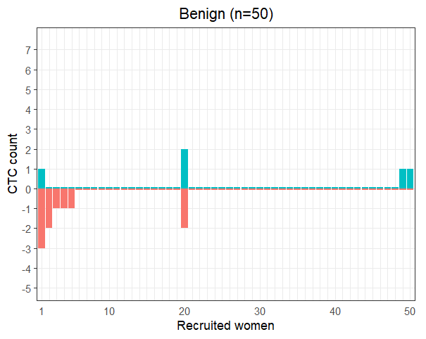
CTC change following biopsy (Parsortix)_not updated
7
Cases n = 144 | CTC change > 0 | CTC change < = 0
Malignant cases | 8 | 86
Benign cases | 2 | 48
P=0.1743

Slide 8
Clinicopathological parameters
8
Breast Cancer positive, n = 97 | CTC change > 0 (n=14) | CTC change =< 0 (n=83) | P-value
T-stage T1 + T2 T3 + T4 | 12 1 | 60 6 | 0.9395
N stage N0 N1 | 8 5 | 44 21 | 0.8763
M status M0 M1 | 9 1 | 26 4 | 0.8691
Grade G1+ G2 G3 | 6 4 | 41 20 | 0.7750
ER positive negative | 8 6 | 58 22 | 0.2655
PR positive negative | 8 6 | 53 27 | 0.5989
HER2 positive negative | 3 11 | 28 46 | 0.2792
Conclusion: CTC increase is not correlated to the clinical parameters

Slide 9


Study limitation: CTC variability (CellSearch results)
9
CTC difference | #Cases n = 53 | Probability (%)
3 | 0 | 0
2 | 0 | 0
1 | 2 | 3.70
0 | 48 | 88.89
-1 | 3 | 7.41
-2 | 0 | 0
-3 | 0 | 0
Before biopsy
Tube 1
Tube 2
CellSearch
Case | #CTC Tube 1 | #CTC Tube 2 | CTC Diff.
1 | neg | neg | = 0
2 | neg | pos | 0
3 | pos | neg | < 0
4 | pos | pos | =/!= 0
Poisson Statistics
CTC change | P value
0 | 0.8889
1 | 0.1131
2 | 0.0066
Cases n = 53 | Malignant n = 27 | Benign n = 26
CTC > 0 | 3 | 3
CTC = 0 | 24 | 23
11% probability to have 1 cell difference

