Slide 1

Evaluation of Optimizers on KMNIST Dataset
A Comparative Analysis of Adam, RMSprop, and AdamW
By
Kartik Kalra
Antra Nayudu
Pushkar Kafley

Slide 2
Introduction
Deep learning models depend on optimization algorithms for effective training.
Optimizers influence convergence speed, accuracy, and generalization.
This study evaluates Adam, RMSprop, and AdamW using the KMNIST dataset.

Slide 3
KMNIST Dataset Overview
Kuzushiji-MNIST (KMNIST) is a dataset of 28x28 grayscale images of Hiragana characters.
It consists of 60,000 training and 10,000 test images across 10 classes.
KMNIST is a challenging dataset due to handwriting variability.

Slide 4
Objective
Compare the performance of Adam, RMSprop, and AdamW optimizers.
1
Analyze training time, accuracy, and convergence behavior.
2
Determine the best optimizer for KMNIST classification.
3

Slide 5
Adam Optimizer (Adaptive Moment Estimation)
Adam combines Momentum and RMSprop.
Adaptive learning rates for each parameter.
Bias correction for first and second moment estimates.
Advantages: Efficient computation, adaptive learning rate, and good for sparse gradients.

Slide 6
RMSprop Optimizer (Root Mean Square Propagation)
Uses a moving average of squared gradients to scale learning rates.
Prevents overly large updates, stabilizing training.
Performs well on non-stationary problems and requires less hyperparameter tuning.

Slide 7
AdamW Optimizer (Adam with Weight Decay)
Introduces weight decay to prevent overfitting.
Weight decay is decoupled from gradient updates for better generalization.
Improves model stability and performance.

Slide 8
Experimental Setup
Model: Feedforward Neural Network (FNN).
Dataset: KMNIST (60,000 training, 10,000 test images).
Batch Size: 32, Epochs: 10.
Hyperparameters Tuned: Learning Rate & Weight Decay.

Slide 9
Results Overview
AdamW achieved the highest validation accuracy.
1
RMSprop was competitive, while Adam tended to overfit.
2
Weight decay played a crucial role in performance.
3

Slide 10
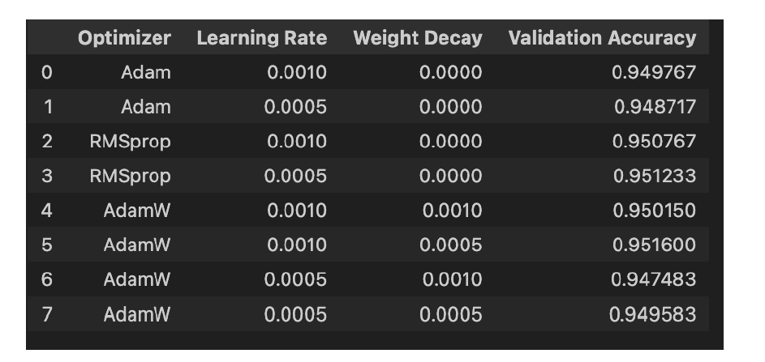
Validation Accuracy Comparison

Slide 11
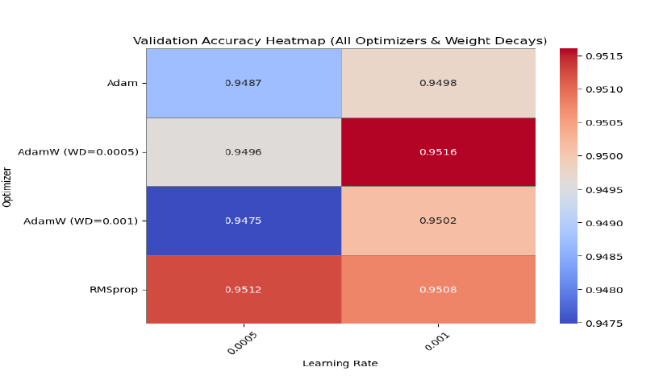
Heatmap of Optimizer Performance
Graph/Chart here (to be added manually)

Slide 12
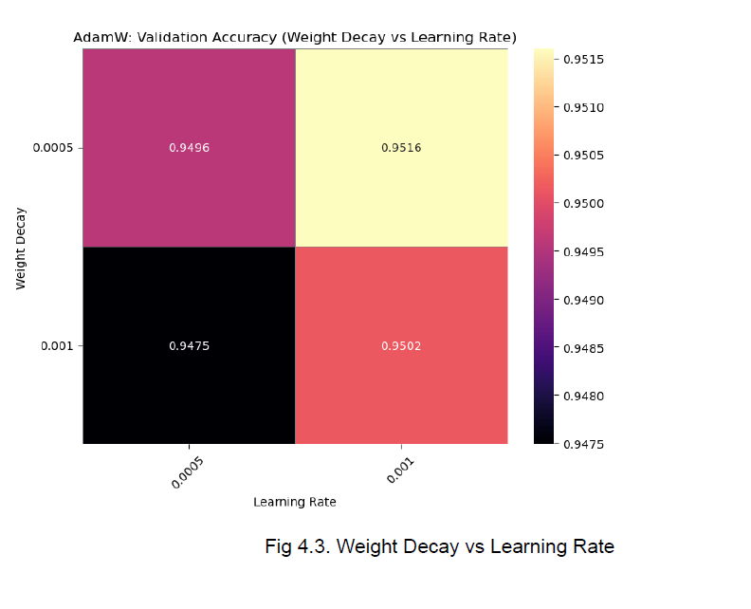
Weight Decay vs Learning Rate

Slide 13
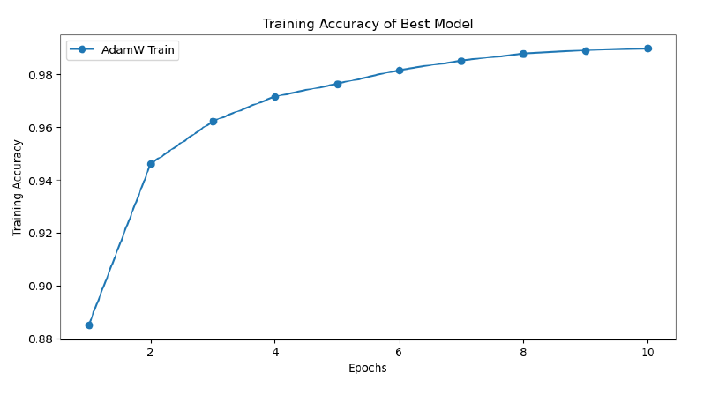
AdamW Training Accuracy

Slide 14
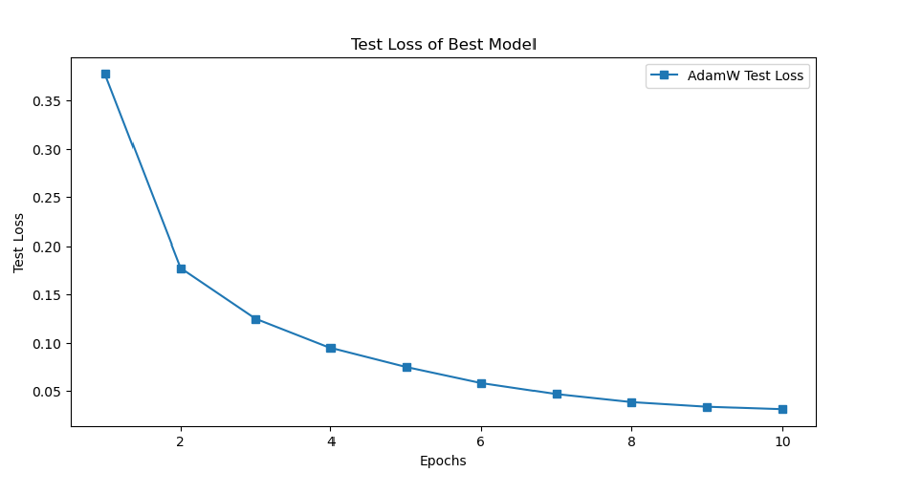
AdamW Test Loss

Slide 15
Key Observations
AdamW with LR=0.001 and WD=0.0005 performed best (Accuracy: 0.9516).
RMSprop was competitive but lacked weight decay.
Weight decay prevents overfitting but excessive decay hurts performance.
Learning rate tuning is crucial for optimization.

Slide 16
Overfitting and Stability
Adam: Fast convergence but overfits smaller datasets.
RMSprop: Lacks momentum and regularization.
AdamW: Balances convergence speed and stability, preventing overfitting.

Slide 17
Convergence Behavior
Adam: Quick but less stable convergence.
RMSprop: Struggles with oscillations.
AdamW: Smooth learning curve and better final accuracy.

Slide 18
Regularization & Generalization
AdamW decouples weight decay, leading to better generalization.
Adam integrates weight decay into updates, reducing effectiveness.
Regularization prevents memorization and enhances model performance.

Slide 19
Conclusion
AdamW (LR: 0.001, WD: 0.0005) performed best.
RMSprop was a strong alternative.
Weight decay prevents overfitting but needs tuning.
Hyperparameter tuning is critical for optimization.

Slide 20
References
Kingma & Ba (2015) - Adam Optimizer.
Hinton et al. (2012) - RMSprop.
Loshchilov & Hutter (2019) - AdamW Optimization.

