Slide 1

Evaluation of Optimizers on KMNIST Dataset
A Comparative Analysis of Adam, RMSprop, and AdamW
By
Kartik Kalra
Antra Nayudu
Pushkar Kafley

Slide 2
Introduction
Deep learning models depend on optimization algorithms for effective training.
Optimizers influence convergence speed, accuracy, and generalization.
This study evaluates Adam, RMSprop, and AdamW using the KMNIST dataset.

Slide 3
KMNIST Dataset Overview
Kuzushiji-MNIST (KMNIST) is a dataset of 28x28 grayscale images of Hiragana characters.
It consists of 60,000 training and 10,000 test images across 10 classes.
KMNIST is a challenging dataset due to handwriting variability.

Slide 4
Objective
Compare the performance of Adam, RMSprop, and AdamW optimizers.
1
Analyze training time, accuracy, and convergence behavior.
2
Determine the best optimizer for KMNIST classification.
3

Slide 5
Adam Optimizer (Adaptive Moment Estimation)
Adam combines Momentum and RMSprop.
Adaptive learning rates for each parameter.
Bias correction for first and second moment estimates.
Advantages: Efficient computation, adaptive learning rate, and good for sparse gradients.

Slide 6
RMSprop Optimizer (Root Mean Square Propagation)
Uses a moving average of squared gradients to scale learning rates.
Prevents overly large updates, stabilizing training.
Performs well on non-stationary problems and requires less hyperparameter tuning.

Slide 7
AdamW Optimizer (Adam with Weight Decay)
Introduces weight decay to prevent overfitting.
Weight decay is decoupled from gradient updates for better generalization.
Improves model stability and performance.

Slide 8
Experimental Setup
Model: Feedforward Neural Network (FNN).
Dataset: KMNIST (60,000 training, 10,000 test images).
Batch Size: 32, Epochs: 10.

Slide 9
Experimental Setup
Adam: Learning rate, beta1 (momentum term), beta2 (second moment term), and epsilon (numerical stability).
AdamW: Learning rate, weight decay (L2 regularization), beta1, beta2, and epsilon.
RMSprop: Learning rate, rho

Slide 10
Results Overview
AdamW achieved the highest validation accuracy.
1
RMSprop was competitive, while Adam tended to overfit.
2
Weight decay played a crucial role in performance.
3

Slide 11
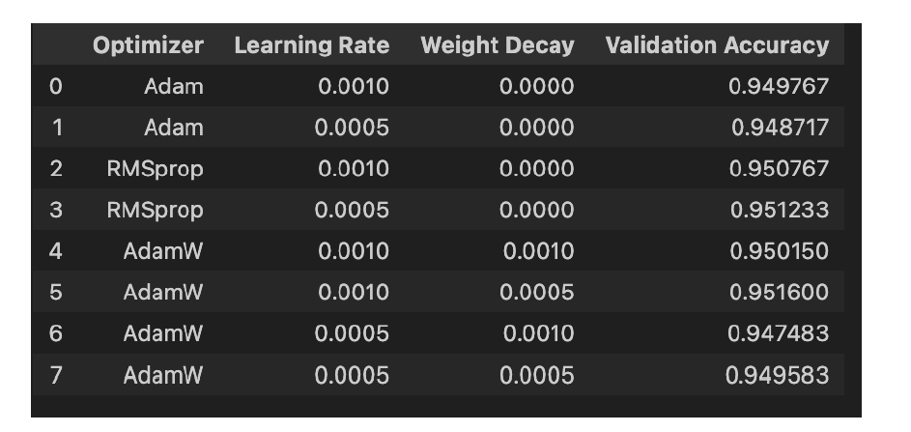
Validation Accuracy Comparison

Slide 12
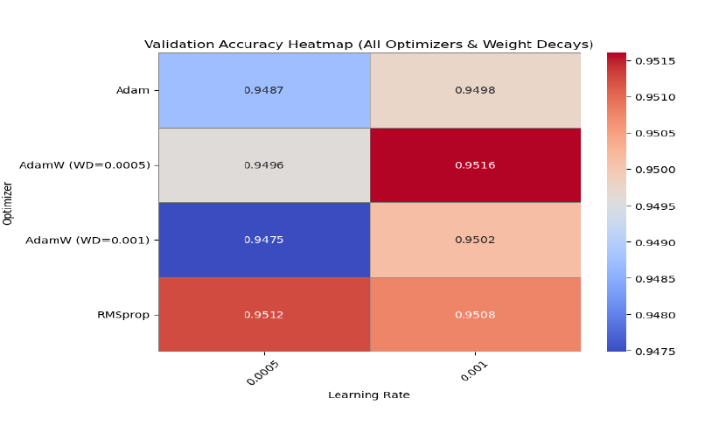
Heatmap of Optimizer Performance
Graph/Chart here (to be added manually)

Slide 13
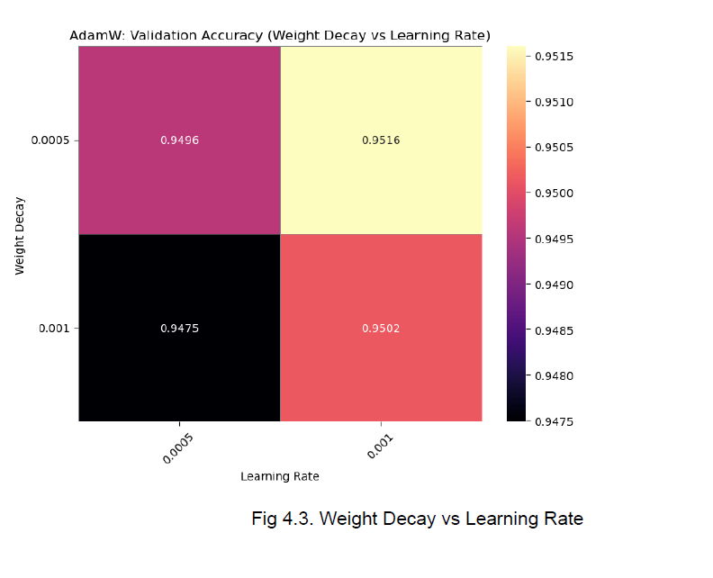
Weight Decay vs Learning Rate

Slide 14
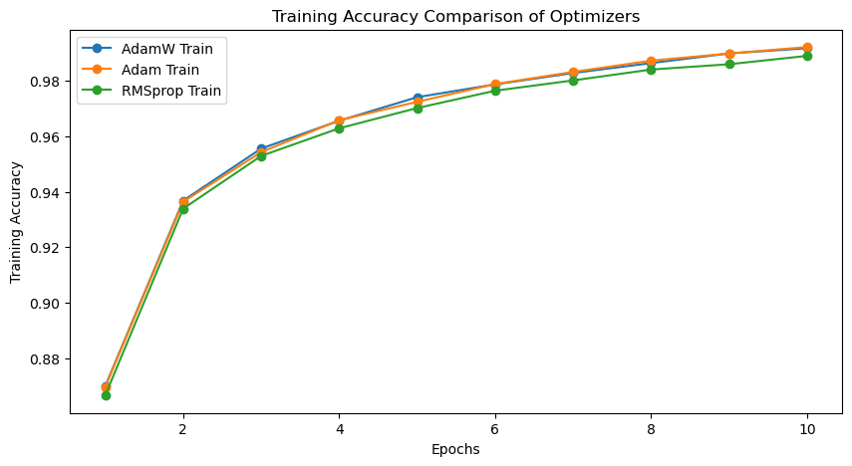
Training Accuracy across all optimizers

Slide 15
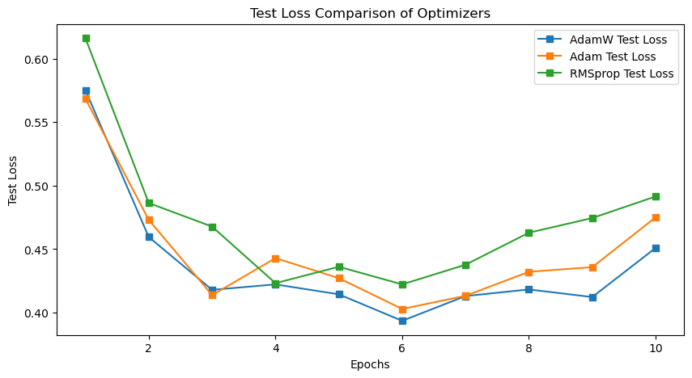
Test Loss across all optimizers

Slide 16
Key Observations
AdamW with LR=0.001 and WD=0.0005 performed best (Accuracy: 0.9516).
RMSprop was competitive but lacked weight decay.
Weight decay prevents overfitting but excessive decay hurts performance.
Learning rate tuning is crucial for optimization.

Slide 17
Overfitting and Stability
Adam: Fast convergence but overfits smaller datasets.
RMSprop: Lacks momentum and regularization.
AdamW: Balances convergence speed and stability, preventing overfitting.

Slide 18
Convergence Behavior
Adam: Quick but less stable convergence.
RMSprop: Struggles with oscillations.
AdamW: Smooth learning curve and better final accuracy.

Slide 19
Regularization & Generalization
AdamW decouples weight decay, leading to better generalization.
Adam integrates weight decay into updates, reducing effectiveness.
Regularization prevents memorization and enhances model performance.

Slide 20
Conclusion
AdamW (LR: 0.001, WD: 0.0005) performed best.
RMSprop was a strong alternative.
Weight decay prevents overfitting but needs tuning.
Hyperparameter tuning is critical for optimization.

Slide 21
References
● D. P. Kingma and J. Ba, “Adam: A Method for Stochastic Optimization,” in Proc. Int. Conf. Learn. Represent., 2015, pp. 1–15.
● G. Hinton, N. Srivastava, and K. Swersky, “Lecture 6a: RMSprop,” Neural Networks for Machine Learning, 2012.
● I. Loshchilov and F. Hutter, "Decoupled Weight Decay Regularization," ICLR 2019.

