Slide 1

Data mining presentation

Slide 2
GROUP B
Sravani Donthireddy
Pratik Jaiswal
Kalyan Soma

Slide 3

Introduction to Data Mining
The process of using computers and automation to search large sets of data for patterns and trends, turning those findings into business insights and predictions.

Slide 4
Business problem
How can we reduce customer churn in the bank's credit card services by identifying customers at risk of leaving and providing them with targeted services to encourage them to stay?
Motivation :
It is crucial for a bank to maintain financial stability, and a continuous flow of credit is essential for its overall performance and well-being.
Banks are vital to the economy of a country, facilitating financial transactions, providing credit and supporting economic growth by channeling funds efficiently.
Credit cards are crucial for banks, generating revenue through interest and fees, and enhancing customer engagement, and expanding financial services.

Slide 5
Past resolutions
Customer Segmentation and Personalization:
Use advanced analytics to segment customers based on their behaviors, preferences, and needs. This allows for targeted communication and offers tailored to specific customer groups.
Fraud Detection:
Implement AI-powered chatbots or virtual assistants to provide instant responses to customer queries, offer assistance, and guide them through various processes. This improves customer satisfaction and reduces frustration.
Chat bots and Virtual Assistance:
Implement advanced fraud detection algorithms that can identify suspicious activities in real-time, preventing unauthorized transactions and ensuring customer trust.

Slide 6
Approach to problem
Problem Statement and Objective: The bank manager is concerned about increasing customer churn in their credit card services. They seek a predictive solution to identify potential churners, allowing proactive customer engagement for improved services and retention. The dataset comprises information on 10,128 customers.

Slide 7
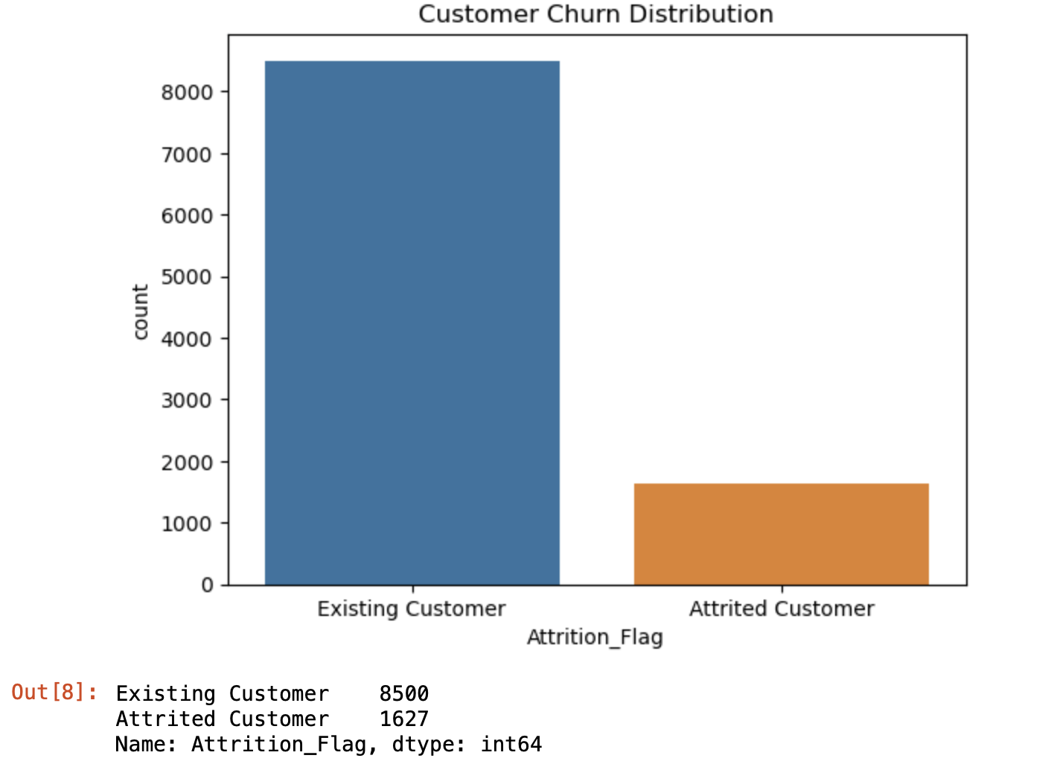
Data Exploration:
The dataset is loaded and explored for its shape and summary statistics.
Descriptive statistics for categorical features are calculated.
Visualizations, including count plots and box plots, are used to understand the distribution of features and their relationship with customer churn.

Slide 8
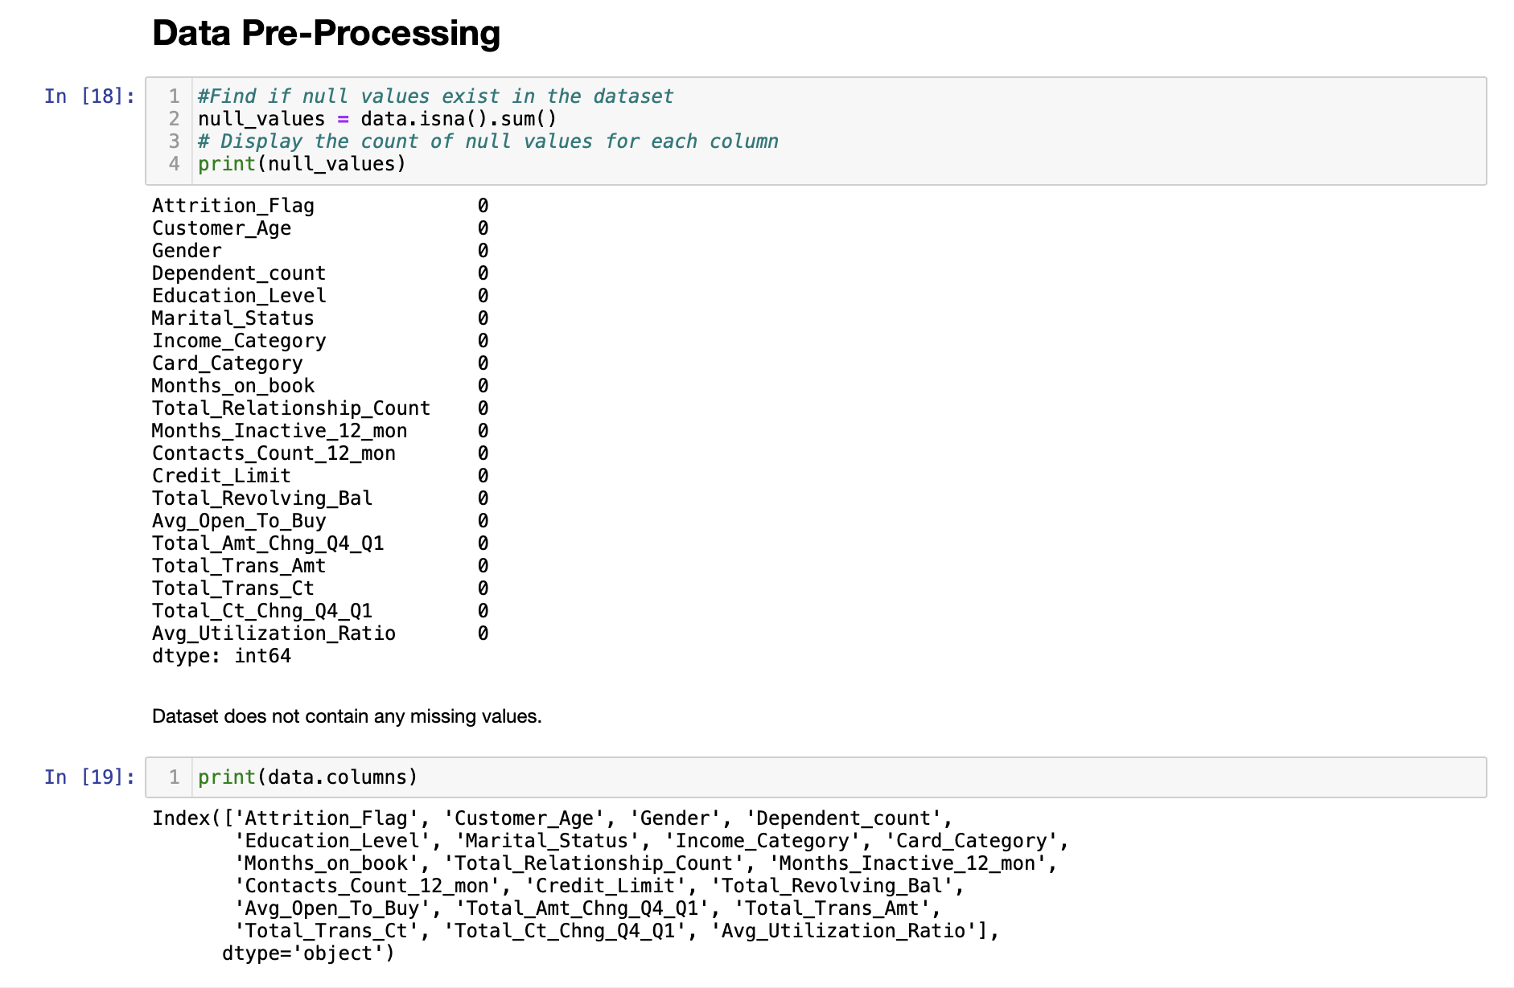
Data Preprocessing:
Columns with unique identifiers and irrelevant information are removed.
Categorical features are mapped to numeric values using dictionaries.
Nominal features are one-hot encoded.
Outliers in numerical features are identified and minimized.

Slide 9
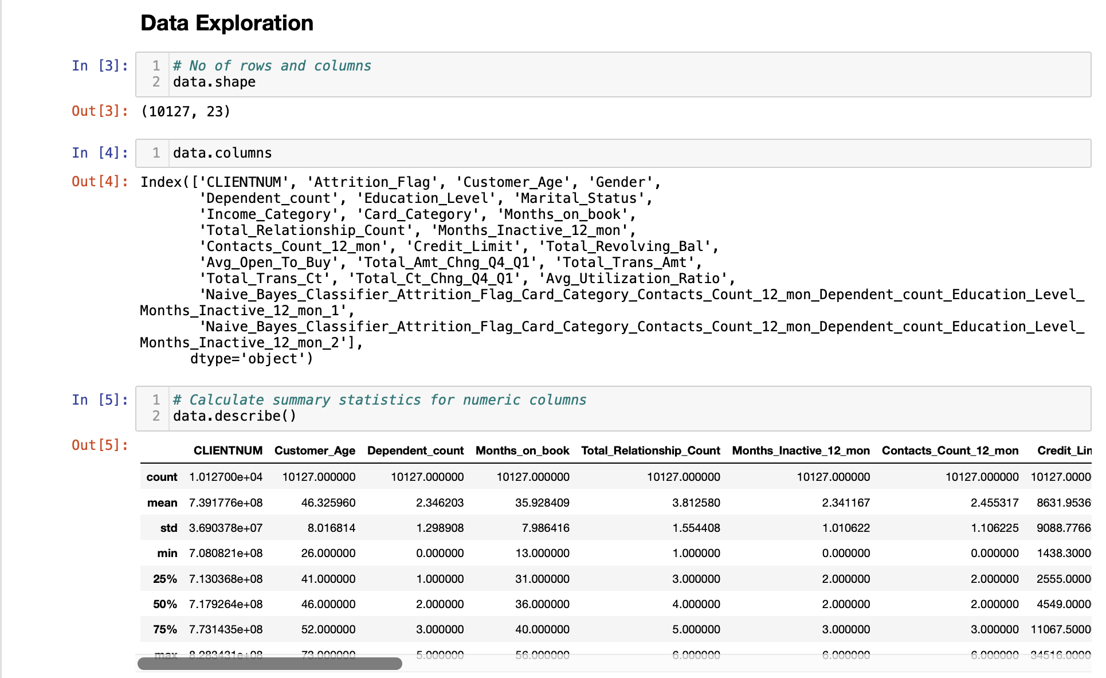
Exploratory Data Analysis (EDA): Used functions such as shape(), describe() to find the summary statistics of dataset and removed additional columns as well.

Slide 10
Model Training and Validation:
Classification models (Logistic Regression, Decision Tree, Random Forest, Gradient Boosting, XGBoost) are trained and evaluated.
Evaluation metrics such as accuracy, confusion matrix, and classification report are printed for each model.
Model Performance: It was evaluated using variety of metrics including Accuracy, Precision, Recall, F1 Score, AUC. The higher the model's Accuracy and Precision is the higher is their performance ratings.
Hyperparameter Tuning:
Grid search is performed for hyperparameter tuning of the XGBoost classifier.
ROC Curve:
The ROC curve and AUC are calculated and visualized for the XGBoost classifier.

Slide 11
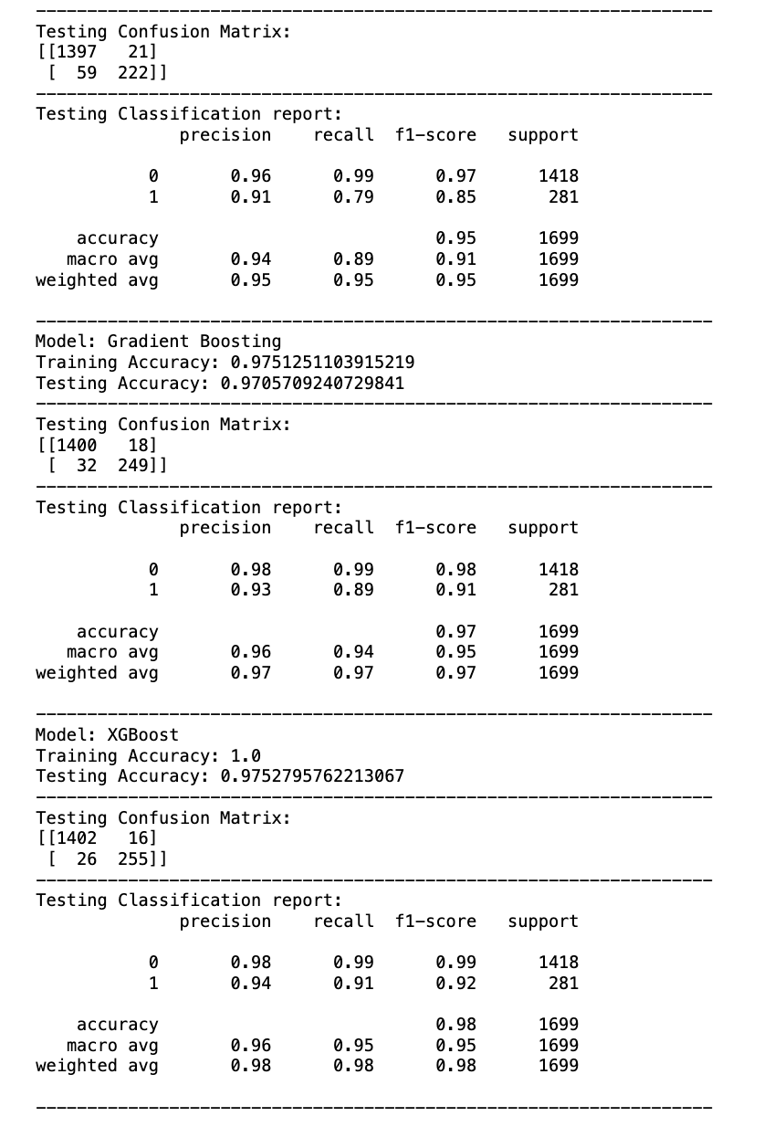
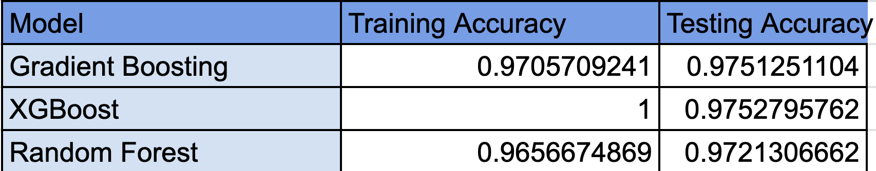
Results & Observations
Shown is the output of the top 3 training models used in solving the problem
Random Forest
Gradient Boosting
XGBoost

Slide 12
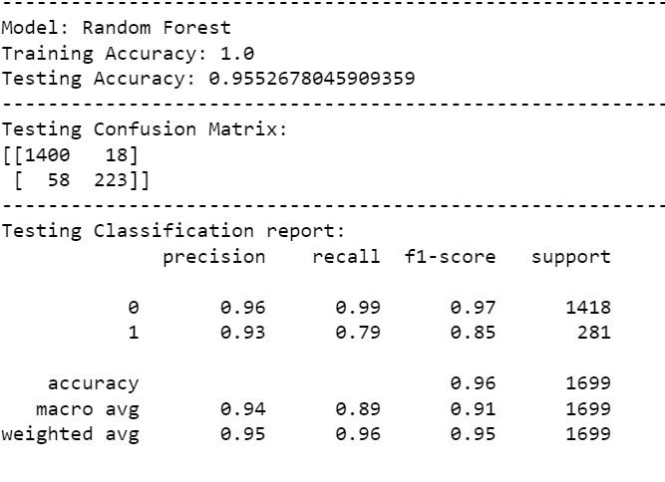
The testing confusion matrix shows how the model performed on each class. The rows of the matrix represent the actual class labels, and the columns represent the predicted class labels. Each cell of the matrix shows the number of cases that were predicted as belonging to a particular class, given that they actually belong to a different class.
In this case, the confusion matrix shows that the model made very few mistakes, with only 18 false negatives and 58 false positives. This means that the model was able to correctly identify most of the cases in each class.
In this case, the confusion matrix shows that the model made very few mistakes, with only 18 false negatives and 58 false positives. This means that the model was able to correctly identify most of the cases in each clas

Slide 13
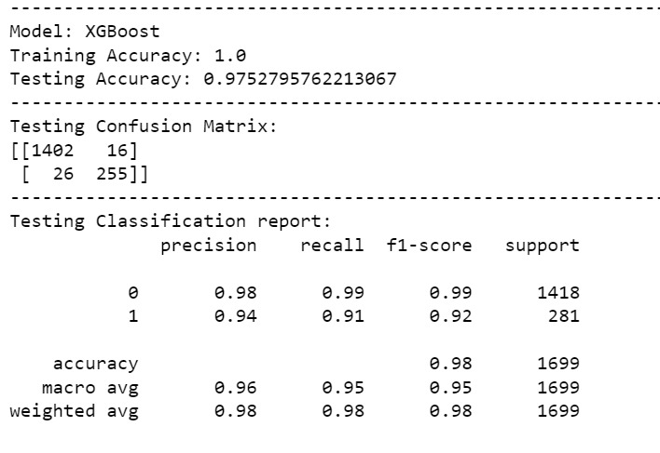
The image shows a testing report for a Tesla Model X using XGBoost, a popular machine learning algorithm. The report shows that the model has a training accuracy of 1.0 and a testing accuracy of 0.975. This means that the model was able to correctly predict the outcome for 97.5% of the test cases. The testing confusion matrix shows that the model made very few mistakes, with only 16 false negatives and 26 false positives. The testing classification report shows that the model has high precision, recall, and F1-score for both classes. Overall, the results suggest that the model is very good at predicting the outcome for Tesla Model X test cases.

Slide 14
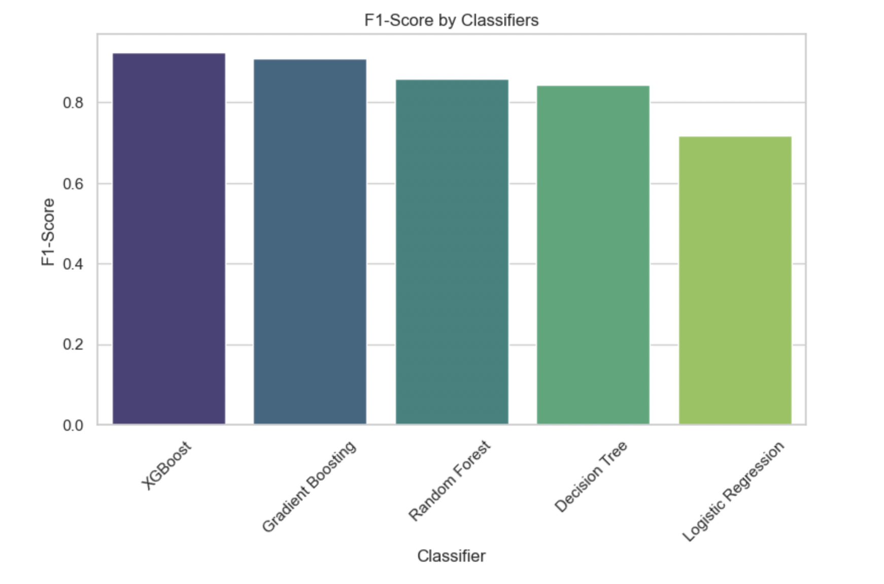
Different Classifiers
This suggests that XGBoost is the best classifier for this particular task, as it has the highest test accuracy score. However, the performance of classifiers can vary depending on the task at hand. It is always best to try out multiple classifiers and see which one performs best for the specific task.

Slide 15
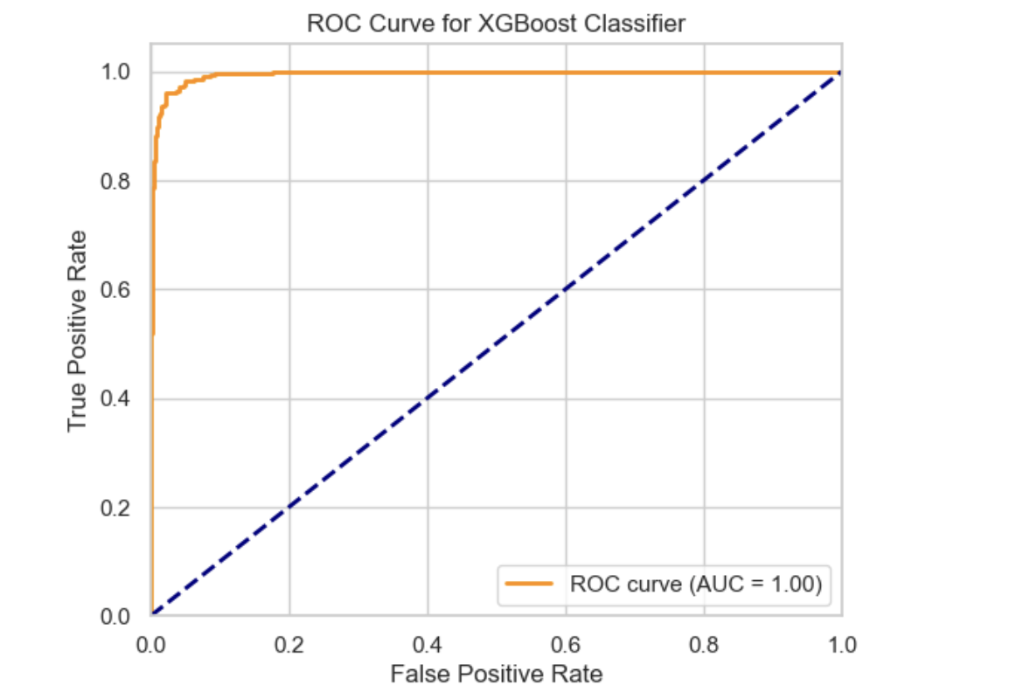
ROC CURVE
The ROC curve in the image has an AUC (area under the curve) of 1.00, which indicates perfect performance. This means that the classifier is able to perfectly distinguish between positive and negative cases, without any false positives or false negatives.

Slide 16
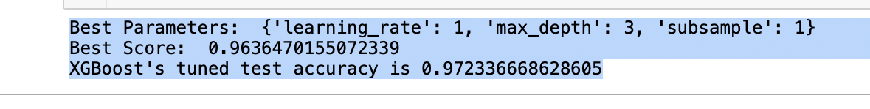
HYPERPARAMETER TUNING
The fact that the model achieved a high test accuracy suggests that it is not overfitting the training data. This is a good sign, and it suggests that the model is likely to generalize well to new data.
Overall, the output shows that the XGBoost model was tuned successfully and that it is performing well.

Slide 17
Conclusion
Our Data Mining project aimed at predicting potential customer churn in the bank's credit card services has delivered promising results. Leveraging the potent XGBoost model, we established an accurate predictive system identifying customers at risk of churning.
The bank's manager can use the information to identify high-risk customers who are predicted to churn and provide personalized incentives such as Lower Interest Rates, Cashback Rewards, Credit Limit Increase, Fee waivers, Personalized promos.
Our project empowers the bank with a proactive tool to reduce churn, leading to enhanced satisfaction and financial stability. This underscores the potential of data-driven strategies in revolutionizing customer retention efforts.

Slide 18

Thank you

