Slide 1
Heart Disease Prediction
Project Presentation
on
Date: March 10 , 2023
Presented by: Dhruvika Sharma , Aniket Kalta
Project Mentor: Mr Something

Slide 2
TABLE OF CONTENTS
Introduction
Problem statement
Objective or Problem formulation
Libraries Used
Design Methodology (Block Diagram or Work flow)
Dataset Explanation
Results – Front end clips, back end design clips, data base etc
Conclusion
References

Slide 3
INTRODUCTION
According to the World Health Organization, every year 12 million deaths occur worldwide due to Heart Disease.
The load of cardiovascular disease is rapidly increasing all over the world from the past few years..
This project aims to predict future Heart Disease by analyzing data of patients which classifies whether they have heart disease or not using machine-learning algorithms.
With accurate predictions, we can solve the unnecessary trouble. Besides, if we can apply our machine learning tool into medical prediction, we will save human resource because we do not need complicated diagnosis process in hospitals.

Slide 4
PROBLEM STATEMENT
Heart disease can be managed effectively with a combination of lifestyle changes, medicine and, in some cases, surgery.
With the right treatment, the symptoms of heart disease can be reduced and the functioning of the heart improved.
The predicted results can be used to prevent and thus reduce cost for surgical treatment and other expensive.
The overall objective of our work will be to predict accurately with few tests and attributes the presence of heart disease.

Slide 5
OBJECTIVE OR PROBLEM FORMULATION
Main Objectives.
The main objective of this research is to develop a heart prediction system.
The system can discover and extract hidden knowledge associated with diseases from a historical heart data set.
Heart disease prediction system aims to exploit data mining techniques on medical data set to assist in the prediction of the heart diseases.
Specific Objectives.
• Provides new approach to concealed patterns in the data.
• Helps avoid human bias ness.
• To implement Naïve Bayes Classifier that classifies the disease as per the input of the user.
• Reduce the cost of medical tests.

Slide 6





LIBRARIES USED
Programming Language -
Python
Libraries Used -
Pandas
Numpy
Sklearn
Joblib
Matplotlib , Seaborn
Front End Libraries -
Tkinter

Slide 7
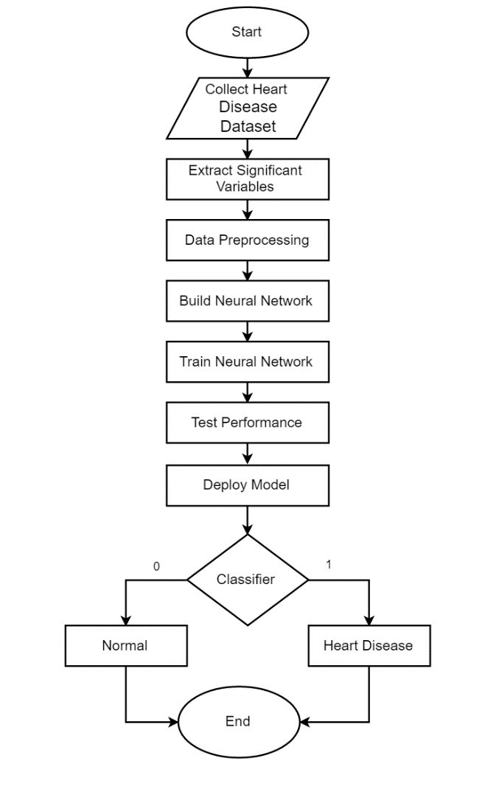
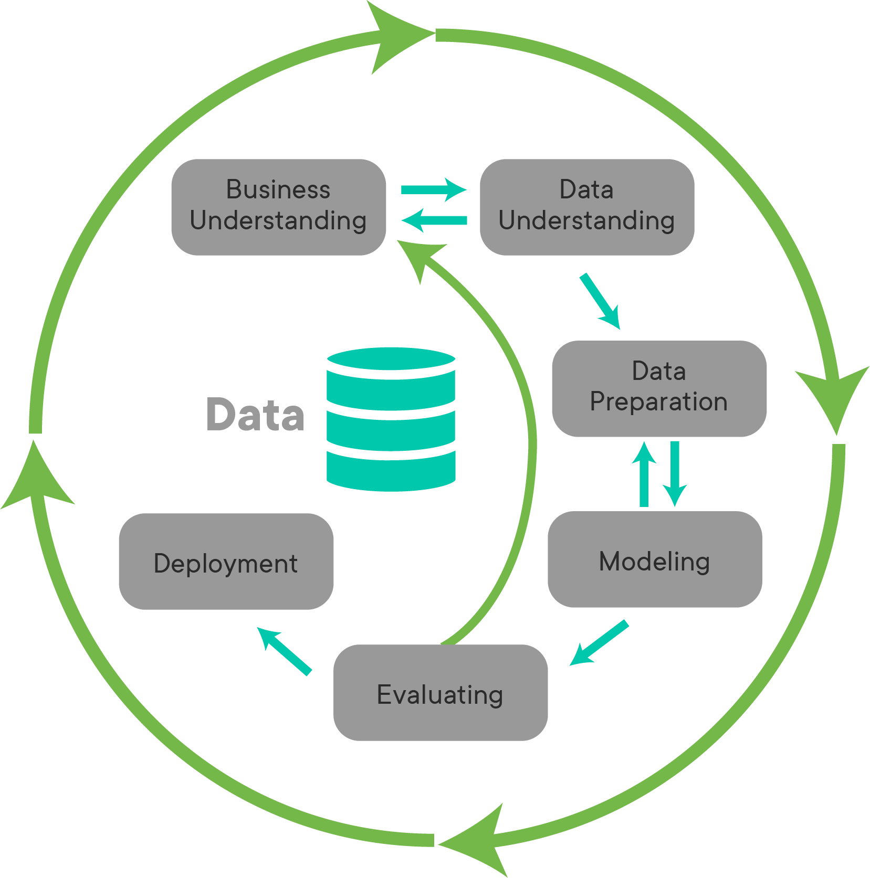
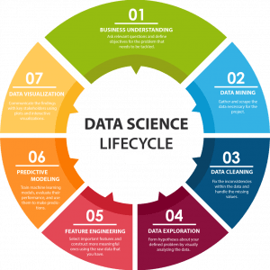
DESIGN METHODOLOGY

Slide 8
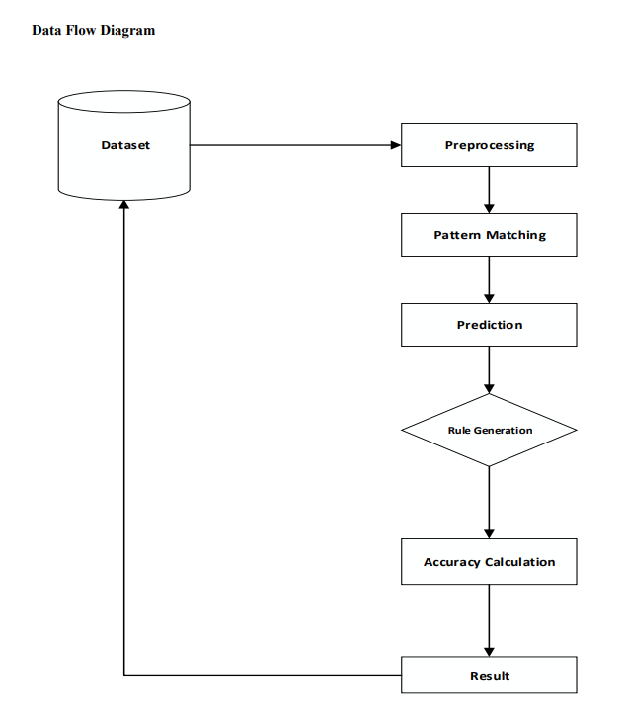
Data Flow Diagram

Slide 9

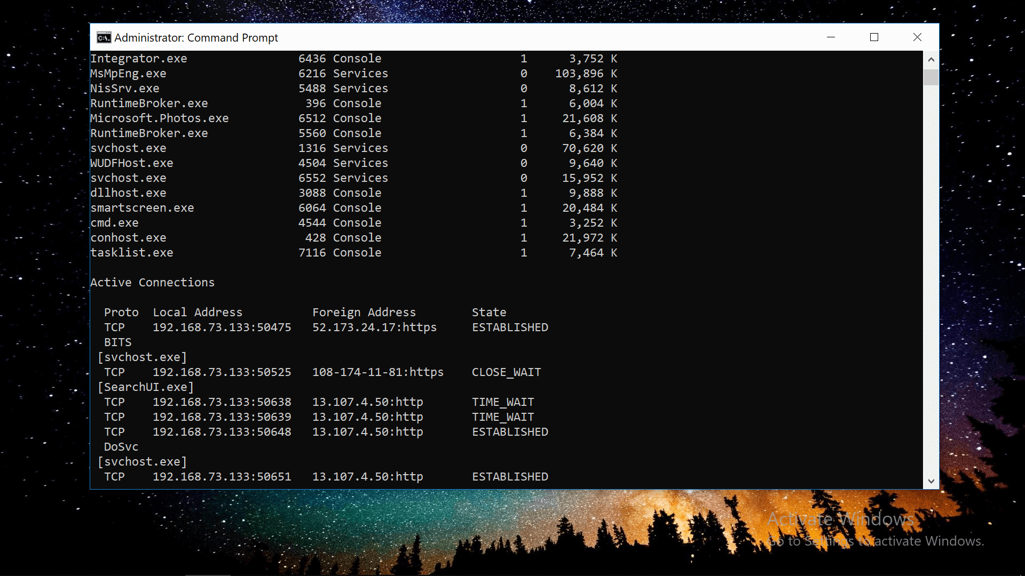


SOFTWARE USED -
Anaconda - Anaconda offers the easiest way to perform Python/R data science and machine learning on a single machine.
Jupyter Notebook - The Jupyter Notebook is the original web application for creating and sharing computational documents .
Command Prompt
Chrome Web Browser

Slide 10
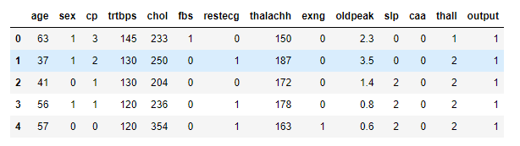
DATASET EXPLANATION
Dataset Features:
- age
- sex
- chest pain type (4 values)
- trestbps: resting blood pressure (in mm Hg on admission to the hospital)
- chol: serum cholestoral in mg/dl
- fbs: (fasting blood sugar > 120 mg/dl) (1 = true; 0 = false)
- restecg: resting electrocardiographic results
— Value 0: normal
— Value 1: having ST-T wave abnormality (T wave inversions and/or ST elevation or depression of > 0.05 mV)

Slide 11
— Value 2: showing probable or definite left ventricular hypertrophy by Estes’ criteria
- thalach: maximum heart rate achieved
- exang: exercise induced angina (1 = yes; 0 = no)
- oldpeak = ST depression induced by exercise relative to rest
- slope: the slope of the peak exercise ST segment
— Value 1: up-sloping
— Value 2: flat
— Value 3: down-sloping
- ca: number of major vessels (0–3) colored by fluoroscope
- thal: 3 = normal; 6 = fixed defect; 7 = reversible defect
- target : 0=low risk of heart attack, 1=high risk of heart attack
.

Slide 12
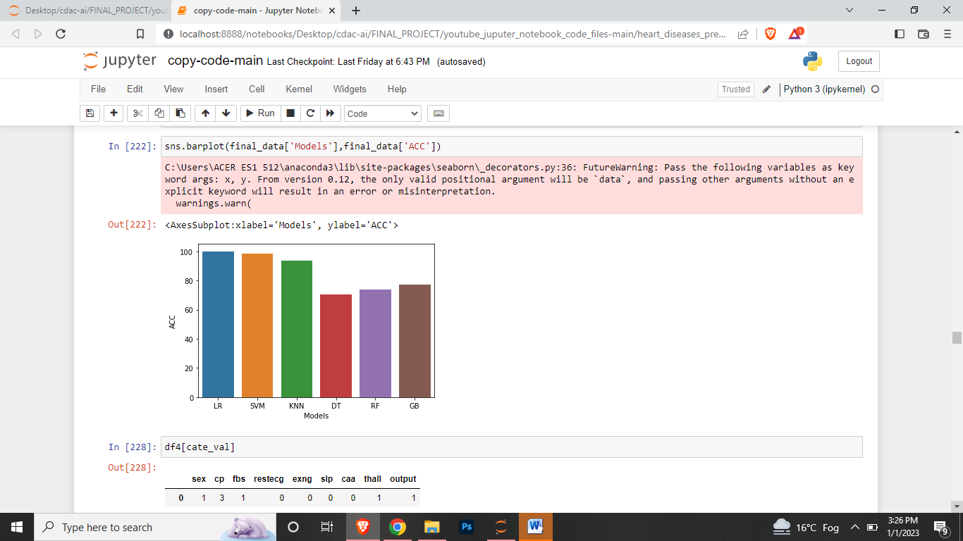
RESULTS
Result 1 -
Model Performance on Heart Diseases
Dataset ( Graphical Representation of all model
accuracy score values ) -
Logistic Regression
Support Vector Machine
K Nearest Neighbors
Decision Tree
Random Forest
Gradient Boosting

Slide 13
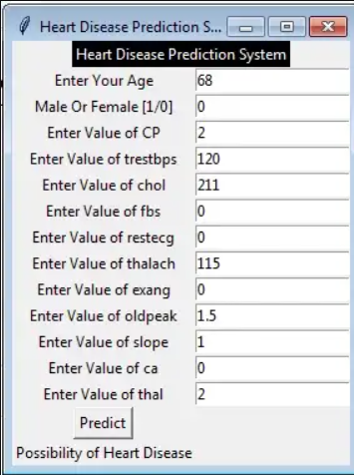
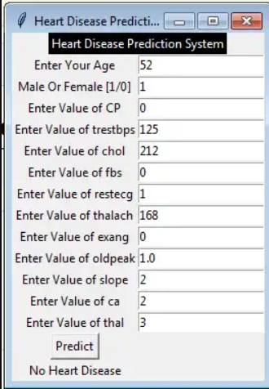
Result 2 -
Output Values of the model ( GUI - FRONT END )

Slide 14
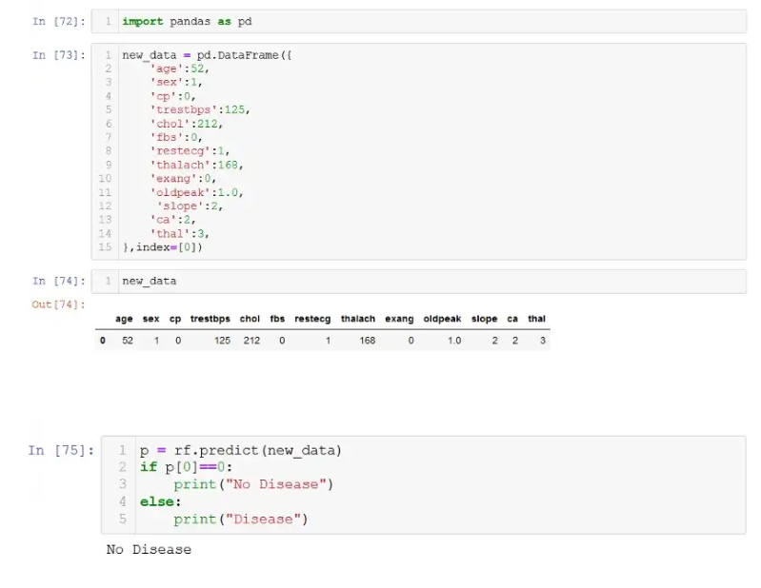
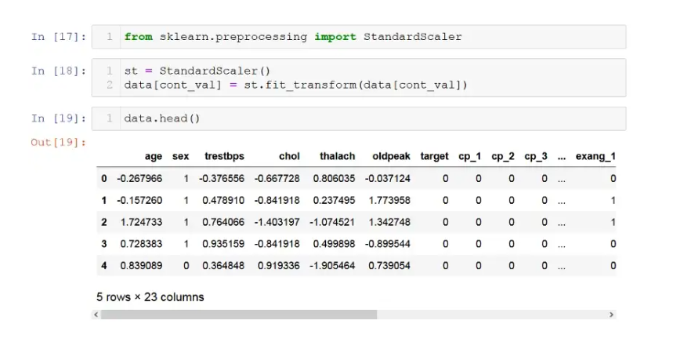
Result 3 -
Output Values of the model ( BACK END )

Slide 15

Heart diseases are one of the major concerns of society and the number of people affected by these diseases is increasing day by day and it is important to find a solution to this problem.
It is difficult to manually determine the odds of getting heart disease based on risk factors.
But with the help of data analytics and machine learning models, we can determine these diseases and have a better chance of treating it.

Slide 16


REFERENCES
Content - Wikipedia - https://www.wikipedia.org/
Google - https://www.google.com
Dataset - https://www.kaggle.com/rashikrahmanpritom/heart-attack-analysis-prediction-dataset
Anaconda Software - https://www.anaconda.com/products/distribution#Downloads
Project Mentor - Himani Mam

